Slide 1
HYBRID ENERGY (BIOFUEL) PRODUCTION IN A HIGH-RATE ANAEROBIC DIGESTION PROCESS AND BIOMASS GASIFICATION PROCESSES
BIO-ENERGY SYSTEM TECHNOLOGY LAB (BEST)
Dr. Haider Al-Rubaye
Senior Process Engineer, Senior Researcher
Department of Chemical and Biochemical Engineering
March 30, 2023
Notes:
Good morning, thanks a lot for attending my presentation and I hope that you had happy Spring break,

Slide 2
BIO-ENERGY SYSTEMS TECHNOLOGY LABORATORY (BEST)
Introduction

Slide 3
BEST Tasks: Energy Pathways for Organic Compounds
Organic Material
Physico-Chemical
Bio-Chemical
Thermo-Chemical
Biodiesel Production
Anaerobic Digestion
Pyrolysis
Gasification
Hydrolysis/ Fermentation
Combustion
Liquefaction
Chopra, S., & Jain, A. (2007). A Review of Fixed Bed Gasification Systems for Biomass . Agricultural Engineering International: the CIGR Ejournal.
Notes:
In the BEST in MS&T we are focusing on the hybrid energy systems and how it can be applied in the industry, the main research trends that we are focusing on are the Physico-Chemical, Biochemical and the Thermochemical, and our research work is a combination of an experimental and theoretical investigation, I’m dealing with the Biochemical line by studying the anaerobic Digestion technique.

Slide 4
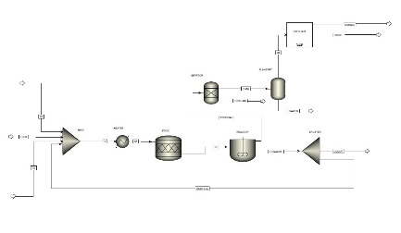
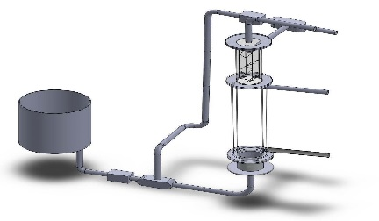
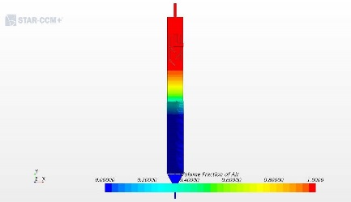
Digester/Gasifier Hybrid Energy System
Hybrid Energy System
Anaerobic Digestion Process, AD
Biomass Gasification Process
Computational Fluid Dynamics
Aspen Plus Modeling simulation
Experimental Setup
Aspen Plus Modeling Simulation
Experimental Setup
Notes:
The hybrid energy system could be defined as a combination of more than one renewable resource together.
The hybrid energy system that we designed consist of two subsystems, the first one is the anaerobic digestion process which assigned to produce biogas and it is connected to a biomass gasification process which is the second subsystem to produce a syngas, for each system there are several research trends, so for the AD there are a lab scale experimental setup which is currently under construction and also there is a computational fluid dynamics to study the hydrodynamics inside the AD reactor which is running but we still processing the results and the last trend will be the aspen plus model simulation which I will present it to you today, and for the biomass gasification process there are also the same trends for it.

Slide 5
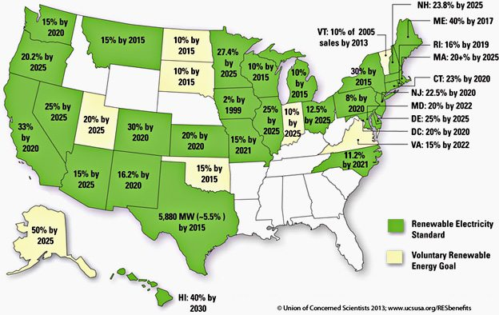
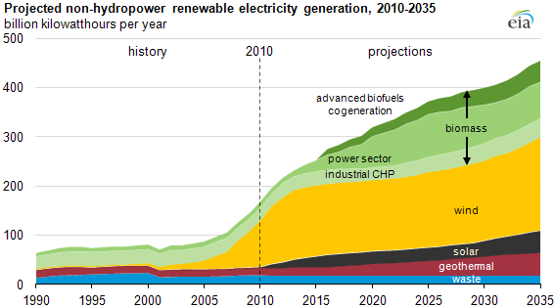
BIO-ENERGY SYSTEMS TECHNOLOGY LABORATORY (BEST)
Renewable Energy in the USA
Energy Outlook
Notes:
So why the united states put efforts in renewable and alternative energy developments.
Most of the states start focusing on the renewable energy sources after being heavily relayed on the fossil energy to operate their power plants
Many reasons behind making the US move towards the renewables
Using fossil fuel to produce power may not be sustainable
Burning fossil fuel may have a negative effects on humans'’ health and environment
Extracting and transporting fossil fuel may lead to accidental spills which cause damaging to environment and communities
Depending on foreign source of fossil fuel can cause a threat to the national security
Fluctuating the electric costs are associated with fossil fuel based power plant
Burning the fossil fuel emits green house gases

Slide 6
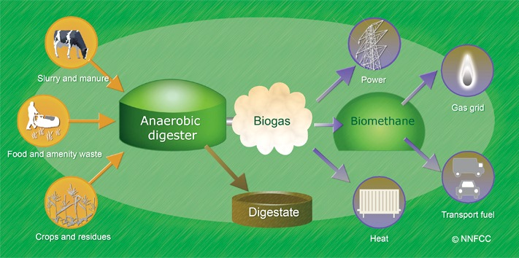
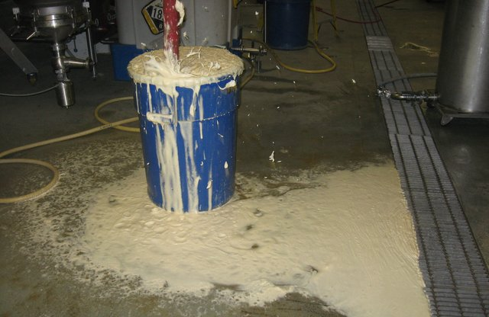
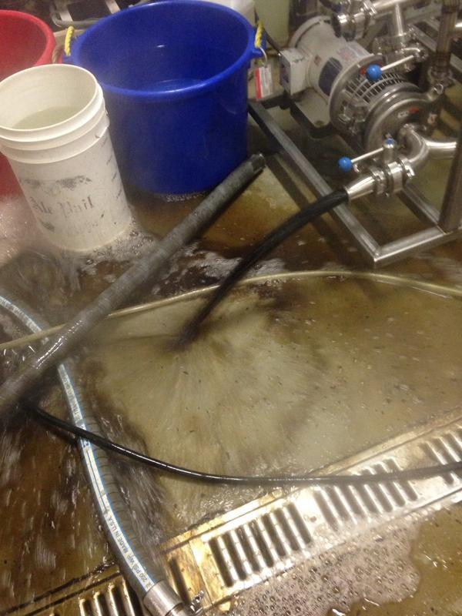
BIO-ENERGY SYSTEMS TECHNOLOGY LABORATORY (BEST)
Anaerobic Digestion (AD)- Process Overview
Industrial Wastewater
Wastewater Discharge
Notes:
One of the renewable energy resources is the anaerobic digestion process
It can be defined as a biological degradation process of the organic matter in the absence of air, this process will generate biogas which is a gaseous mixture composed of methane and carbon dioxide
The biogas generated could be used in generating heat, power, combined heat and power, and it can be used in all equipment designed for natural gas with minim adjustment for the lower BTU content of the biogas
In the US, the AD is commonly used for wastewater treatment. The reasons for using it are
Renewable energy generated from wastes
Greenhouse gas emission reduction
It will help reduce the waste pollution to the environment
It will become a potential revenue stream created from wastes

Slide 7
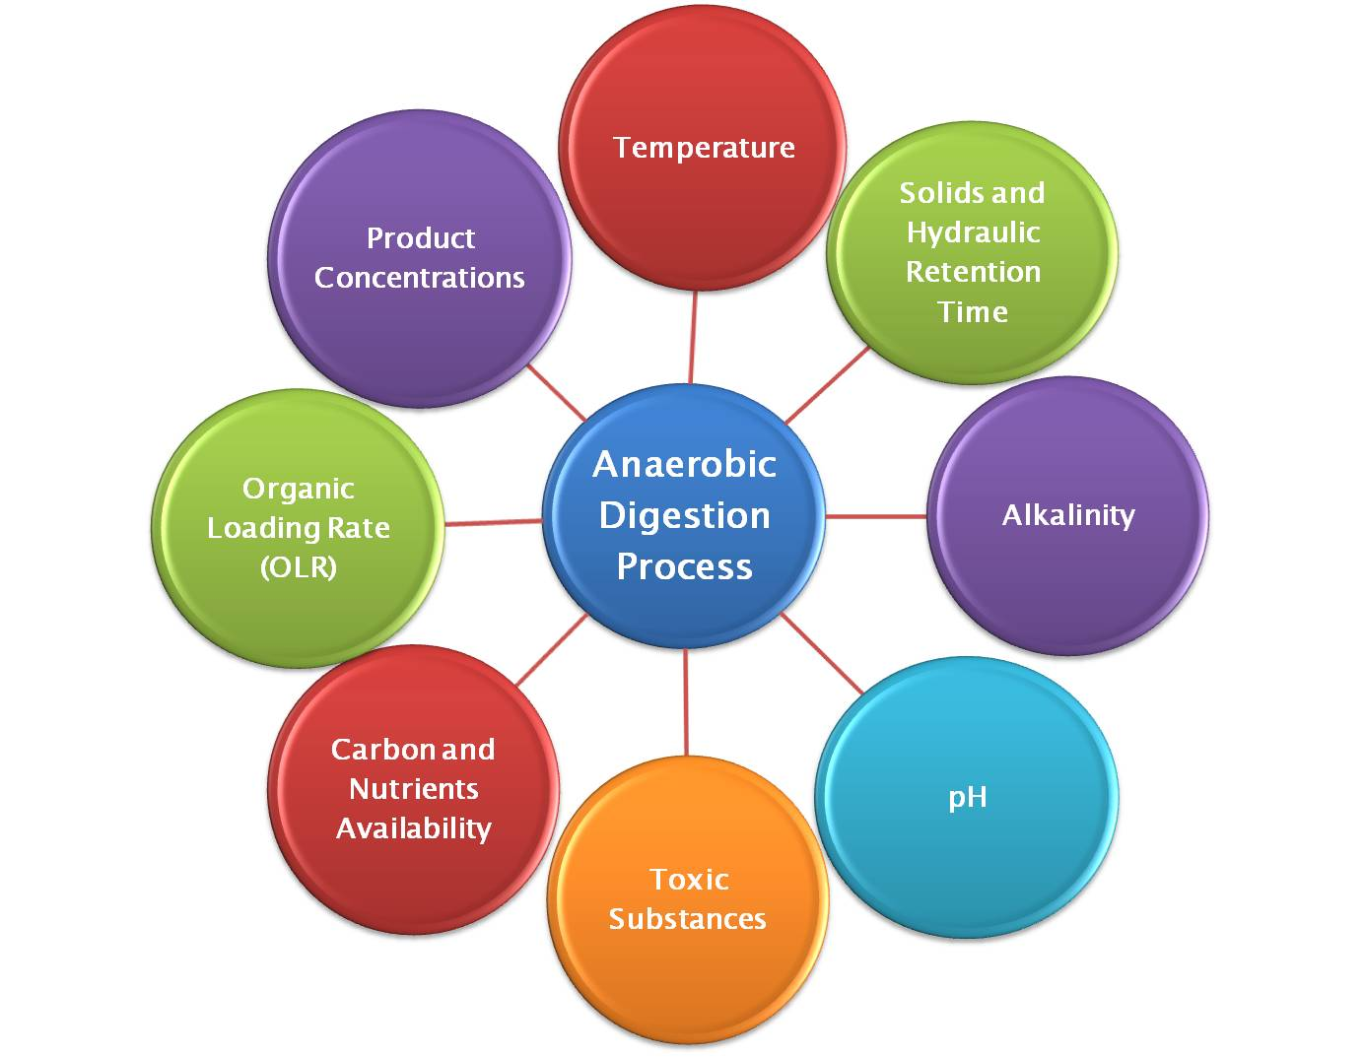
BIO-ENERGY SYSTEMS TECHNOLOGY LABORATORY (BEST)
AD Process Steps
Factors
Carbohydrates
Sugar
Carbo-n acids
Alcohol
Proteins
Amino-Acids
Acetic Acid, CO_{2,} H₂
CH₄, CO₂
Hydrolysis
Acidogenesis
Acetogenesis
Methanogenesis
H₂, CO_{2,} NH₃
Fats
Fatty-Acids
The AD process consists of four steps, Hydrolysis, Acidogenesis, Acetogenesis, and Methanogenesis
Specific microorganisms will be responsible for each step
The factors affecting the AD process are: hydraulic retention time (HRT), solid retention time (SRT), pH, Alkalinity, temperature, carbon; nitrogen ratio, and substrate concentration
Notes:
The AD consists of four steps and for each step there is a specific type of microorganism responsible for each step
The first step is hydrolysis, which is converting the undissolved organics like (complex polymers like fats, cellulose, or protein) into smaller molecules (LCFA, glucose, aminoacids) by using extracellular enzymes. This step is considered as a limiting the step for the undegradable materials. The second step is the acidogenesis, which is basically converts the monomers from the first stage on to volatile fatty acids. The third step is the acetogenesis, where all the VFAs into hydrogen, carboan dioxide and acetic acid. The fourth step is the methanogenesis where all the intermediates from the previous step got converted into methane, carbon dioxide. Two types of bacteria used here, the acetoclastic methanogens and the hydrogenotrophic methanogens

Slide 8
RESEARCH
MOTIVATION

Slide 9
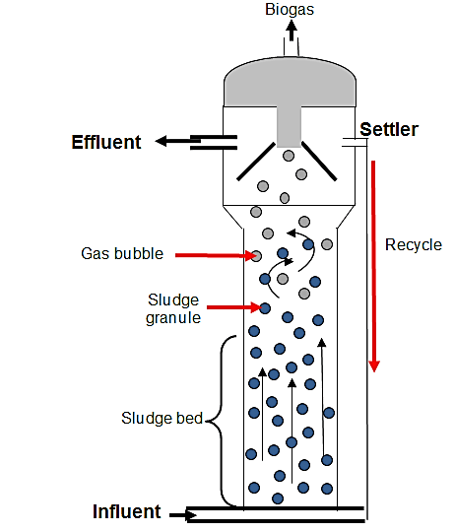
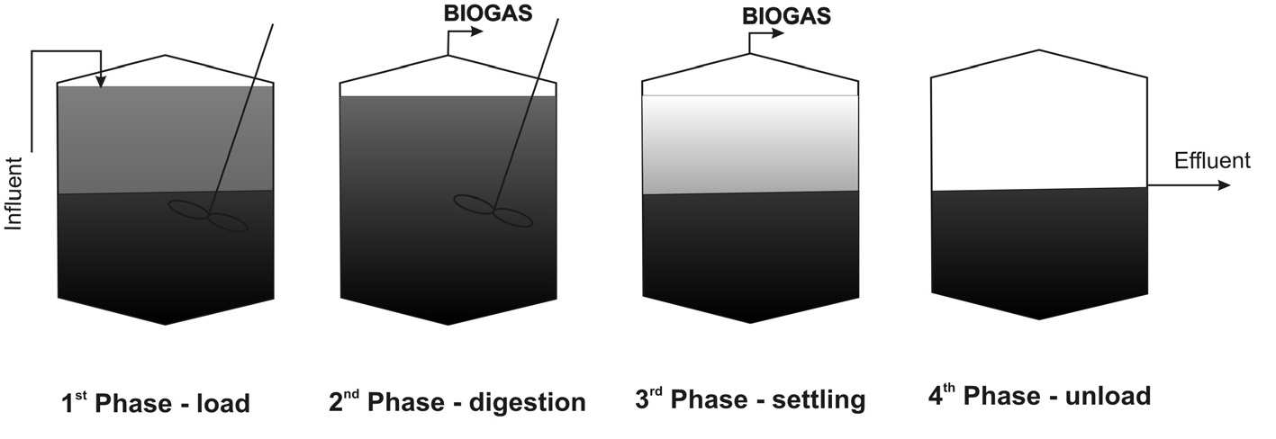
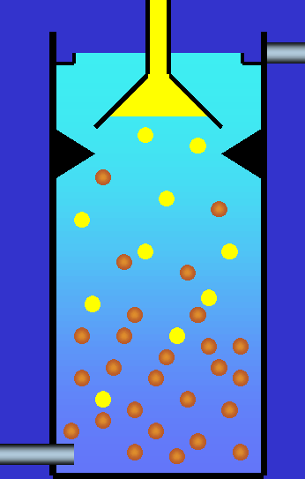
Research Investigation Motivation
BIO-ENERGY SYSTEMS TECHNOLOGY LABORATORY (BEST)
There are two main types of AD
Conventional AD reactor
High rate AD reactor (flow through reactor)
Conventional Digester
Up-flow anaerobic sludge blanket (UASB), OLD
Expanded granular sludge bed (EGSB), LATEST

Slide 10
Research Investigation Motivation
BIO-ENERGY SYSTEMS TECHNOLOGY LABORATORY (BEST)
Most of the literature discussed about the conventional digesters
The acclimatization time to start producing biogas is relatively long
The footprint required to build an anaerobic digestion plant is significant
The difficulty in conducting sensitivity analysis/ investigate the effect of operating parameters on process performance in short time
The significant budget required to build a pilot plant setup
Improve the biogas production (quality/quantity) in the AD process was not done

Slide 11

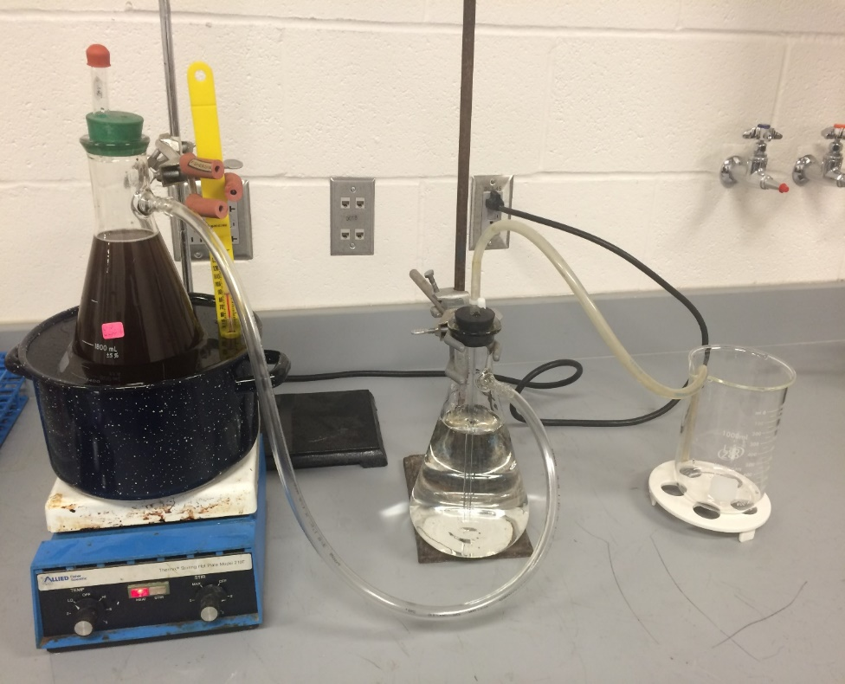
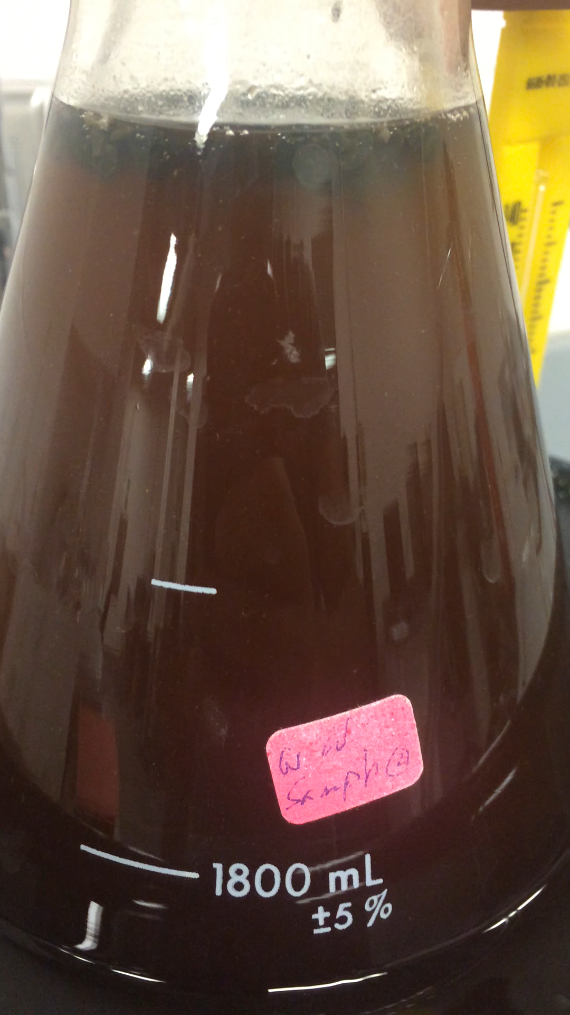
BIO-ENERGY SYSTEMS TECHNOLOGY LABORATORY (BEST)
Batch Test
Objective: To investigate the sludge particles activity with the substrate feedstock
Notes:
When we got the biomass granules particles from enhuaser busch, I started a bench scale batch reactor to see the activity of the biomass I got with the wastewater we collected from the brewery company, I ran this test at mesophilic temperature range and did that before we proceed building the EGSB reactor

Slide 12
BIO-ENERGY SYSTEMS TECHNOLOGY LABORATORY (BEST)
Piping and Instrumentation Diagram (P&ID)

Slide 14
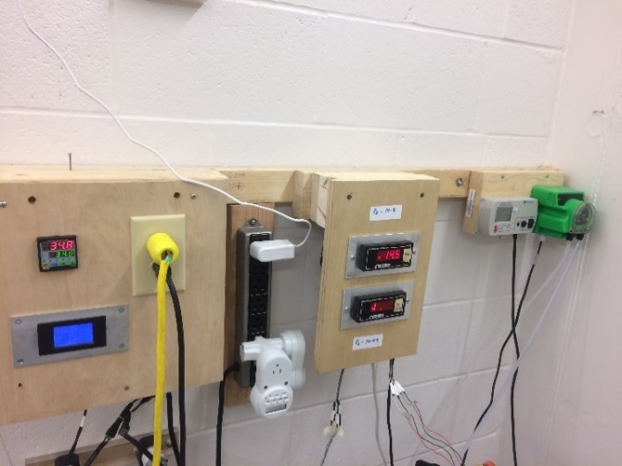
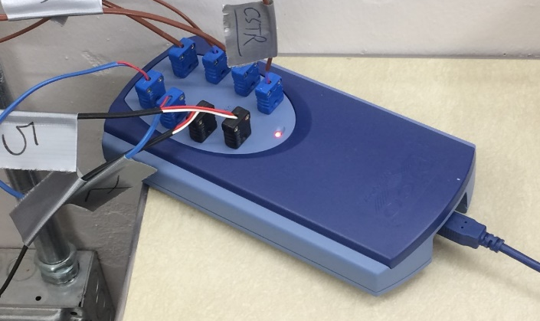
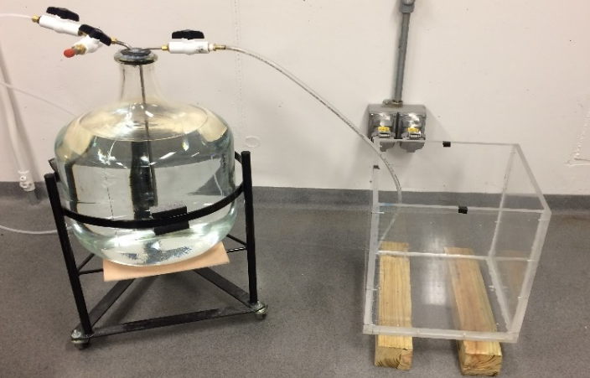
BIO-ENERGY SYSTEMS TECHNOLOGY LABORATORY (BEST)
Components
Two-Stage AD Process

Slide 16
Publications
BIO-ENERGY SYSTEMS TECHNOLOGY LABORATORY (BEST)
Author Publications
Hybrid Energy Systems, Encyclopedia of Chemical Technology, Taylor and Francis, 2016 Joseph D. Smith, K. Buchheit, H. Zhang, H. Golpour, Haider Al-Rubaye
Process Simulation of Two-Stage Anaerobic Digestion for Methane Production, Published in Biofuels by Taylor and Francis,18 Apr 2017 Haider Al-Rubaye, Shruti Karambelkar, Manohar M. Shivashankaraiah & Joseph D. Smith
The Impact of Hydraulic Retention Time and Operating Temperature on Biofuel Production and Process Wastewater Treatment, Submitted to the Journal of Chemical Engineering & Processing: Process intensification, 2018 Haider Al-Rubaye, Manohar M S, Shruti S K, Jia Yu, Mahyar Ghorbanian, Joseph D Smith
The Pre-acidification gas impact on upgrading the biogas produced in expanded granular sludge bed reactor, Submitted to the Journal of Biofuels, 2020 Haider Al-Rubaye, Manohar M S, Jia Yu, Mahyar Ghorbanian, Joseph D Smith
Experimental investigation of tar recycling in biomass gasifiers: a study on feasibility
Jia Yu, Haider Al-Rubaye, Hassan Al-Abedi, Joseph D. Smith
In Processing:
Recycling Effect in Expanded Granular Sludge Bed Reactor Manohar M. S., Haider Al-Rubaye, Shruti S. K., Joseph D. Smith
Implementation Of Six Sigma in a Methane Generation Process Manohar M. S., Haider Al-Rubaye, Shruti S. K., Joseph D. Smith
Gasification in Pilot Scale Biomass Gasifier of Different Sizes: Process Variations, Process Controls, and Operating Procedures Jia Yu, Haider Al-Rubaye, Joseph D. Smith

Slide 17
Conferences Participation
BIO-ENERGY SYSTEMS TECHNOLOGY LABORATORY (BEST)
AIChE Spring Meeting and 12th Global Congress on Process Safety, April 10-14, 2016, Houston, TX, USA, “FUEL GAS PRODUCTION FROM GREY WATER USING A HYBRID DIGESTION-BIOMASS GASIFICATION ENERGY SYSTEM” Haider Al-Rubaye, Joseph D. Smith
Midwest Energy Policy Conference and Laufer Energy Symposium, October, 04, 2016, St. Louis, MO, USA, “ PROCESS MODELING SIMULATION OF FUEL GAS PRODUCTION FROM GREY WATER USING ANAEROBIC DIGESTION (AD) SYSTEM” Haider Al-Rubaye, Joseph D. Smith
AIChE Annual Meeting, November 13-18, 2016, San Francisco, CA, USA, “EXPERIMENTAL INVESTIGATION ON EXPANDED GRANULAR SLUDGE BED REACTOR TO MAXIMIZE THE METHANE GAS PRODUCTION IN THE BIOGAS” Haider Al-Rubaye, Joseph D. Smith
AIChE Spring Meeting and 13th Global Congress on Process Safety, March 26-30, 2017, San Antonio, TX, USA, “LIFE CYCLE ANALYSIS OF HYDROGEN GAS USED FOR BIOGAS UPGRADING PROCESS IN EXPANDED GRANULAR SLUDGE BED REACTOR” Shruti Karambelkar, Haider Al-Rubaye, Manohar Manchenahalli, Joseph D. Smith
International Conference on Environmental Impacts of the Oil and Gas Industries, Kurdistan Region of Iraq (EIOGI 2017), “PROCESS WASTE WATER TREATMENT IN A HIGH RATE ANAEROBIC DIGESTION REACTOR (EGSB) UNDER VARIOUS HYDRAULIC RETENTION TIMES (HRTS)” Haider Al-Rubaye, Joseph Smith
AIChE Annual Meeting, October 29 - November 3, 2017, Minneapolis, MN, USA, “IMPLEMENTATION OF SIX SIGMA IN A METHANE GENERATION PROCESS” Manohar Manchenahalli, Haider Al-Rubaye, Shruti Karambelkar, Joseph D. Smith
AIChE Annual Meeting, October 29 - November 3, 2017, Minneapolis, MN, USA, “HYDRAULIC RETENTION TIME AND TEMPERATURE IMPACTS ON BIOGAS PRODUCTION IN EXPANDED GRANULAR SLUDGE BED REACTOR” Haider Al-Rubaye, Manohar Manchenahalli, Shruti Karambelkar, Joseph D. Smith
AIChE Annual Meeting, October 29 - November 3, 2017, Minneapolis, MN, USA, “EXPERIMENTAL INVESTIGATION OF TAR RECYCLING IN BIOMASS GASIFICATION” Jia Yu, Haider Al-Rubaye, Joseph Smith
AIChE Spring Meeting and 14th Global Congress on Process Safety, April 22-26, 2018, Orlando, FL, USA, “ BIOGAS PRODUCTION AND HYDROGEN GAS INJECTION EFFECT IN EXPANDED GRANULAR SLUDGE BED REACTOR UNDER THERMOPHILIC TEMPERATURE RANGE” Haider Al-Rubaye, Manohar Manchenahalli, Joseph D. Smith
AIChE Annual Meeting, October 28 - November 2, 2018, Pittsburgh, PA, USA, “PROCESS SIMULATION AND EXPERIMENTAL INVESTIGATION OF BIOFUEL PRODUCTION IN A HIGH RATE ANAEROBIC DIGESTION PROCESS” Haider Al-Rubaye, Joseph D. Smith

Slide 18

BIO-ENERGY SYSTEMS TECHNOLOGY LABORATORY (BEST)

Slide 19
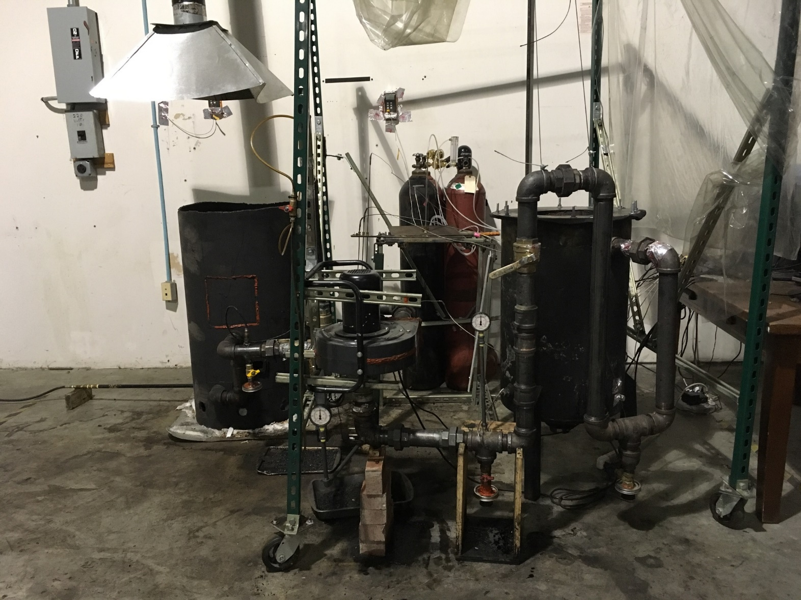
Biomass Gasification Process
BIO-ENERGY SYSTEMS TECHNOLOGY LABORATORY (BEST)
Working on liquid tar recycling into a down-draft biomass gasifier
Investigating various feedstock on syngas production
Modifying and installing a bio-tar trap to help get rid of the tar before letting the syngas burn in the enclosed flare
Study the effect of different reactor sizes on the syngas production

Slide 20
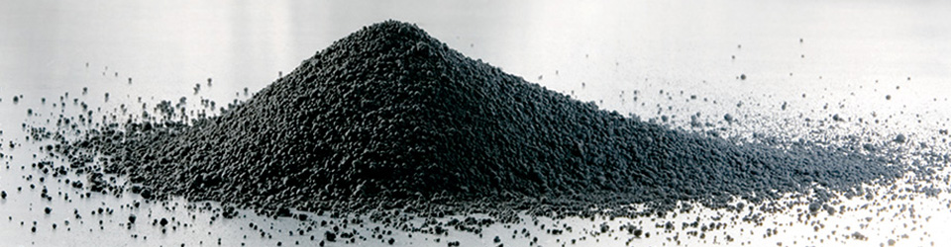
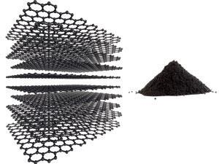
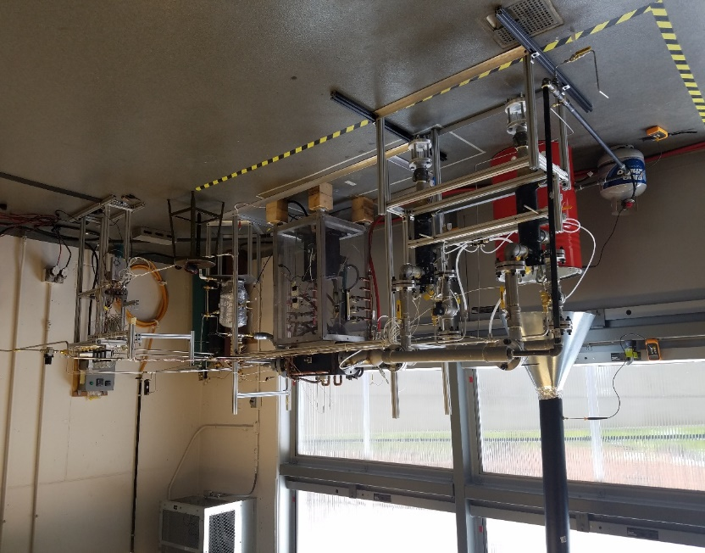

Carbon Black/ Graphene production
BIO-ENERGY SYSTEMS TECHNOLOGY LABORATORY (BEST)

Slide 21
BIO-ENERGY SYSTEMS TECHNOLOGY LABORATORY (BEST)
Acknowledgement

Slide 22

BIO-ENERGY SYSTEMS TECHNOLOGY LABORATORY (BEST)

