Slide 1
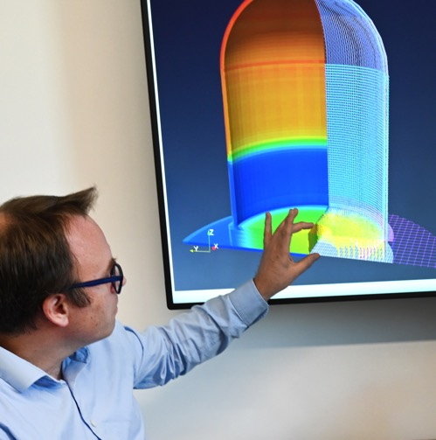
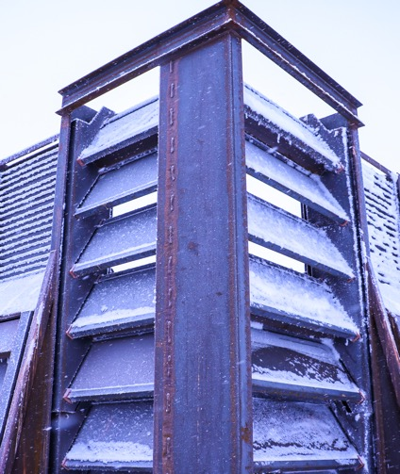
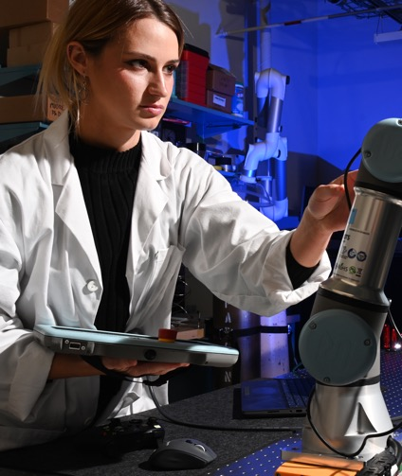
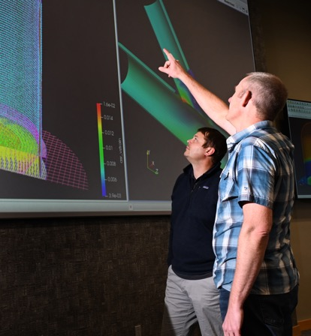
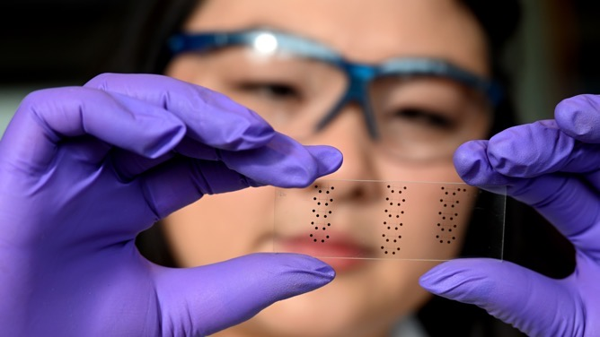
March 30, 2023
John C. Wagner, PhD
Director, Idaho National Laboratory
John.Wagner@inl.gov
U.S. Energy Security & Nuclear Energy
2023 Laufer Energy Symposium - St. Louis, Missouri
Notes:
Top left: Ben spencer and Grizzly modeling and simulation
Top center: N&HS ballistics demo for armor technology to protect transformers, licenses to Michigan-based Waltonen Engineering
Top right: Kamrynn Schiller and a robotic mockup for hot cell use
Bottom left: Kiyo Fujimoto, materials science and engineering from Boise State University, researching 3D printing of sensors at CAES. 2020 Students, Post Doctoral and Early Career (SPEC) Professionals Subcommittee of the President’s Council of Advisors on Science and Technology (PCAST) appointment
45 minute Keynote Presentation

Slide 2

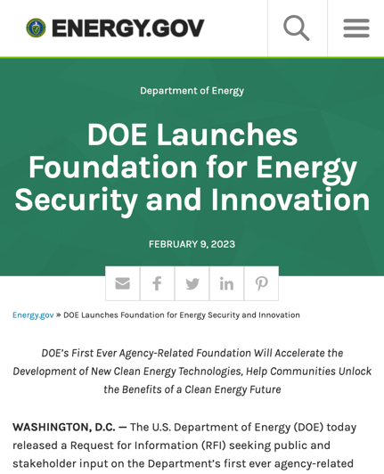
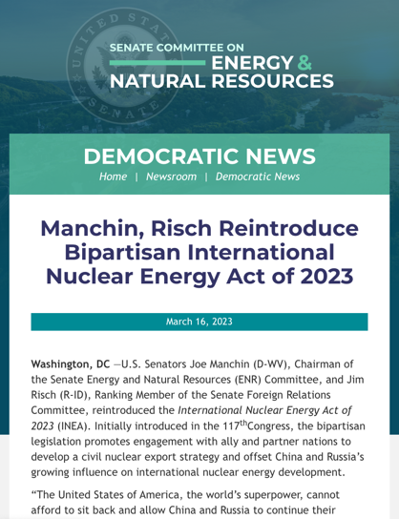
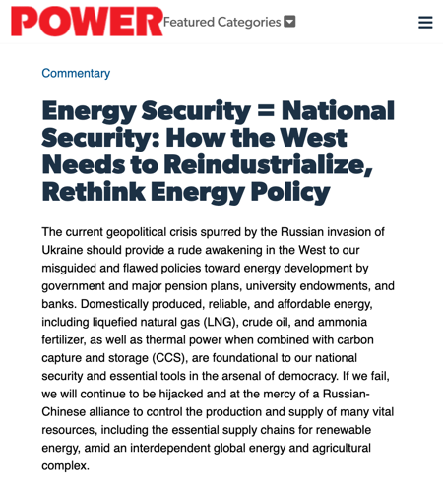
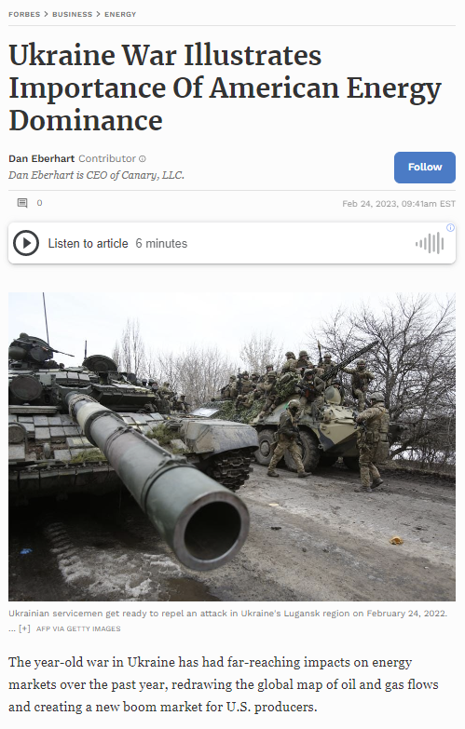

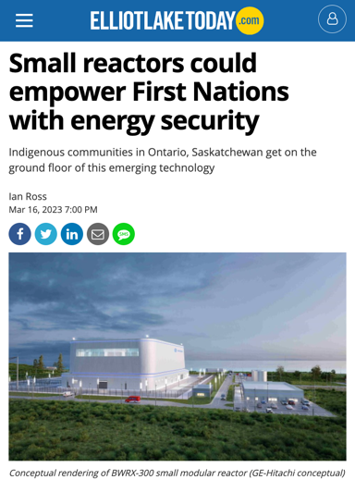
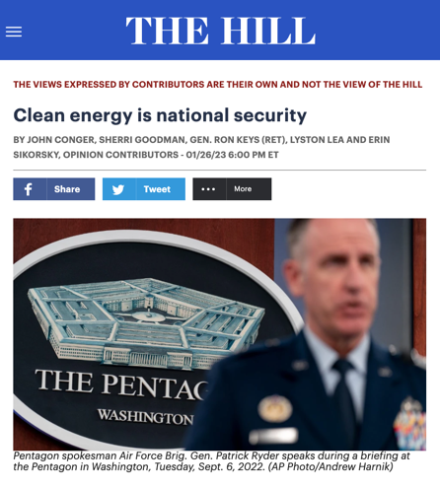



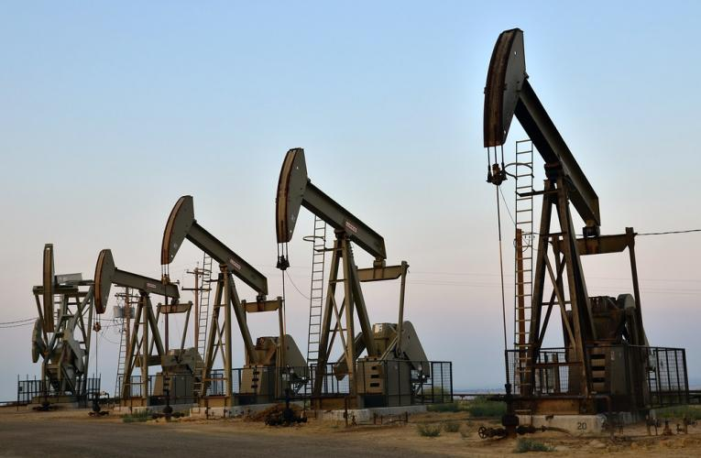
Energy security is national security – now more than ever
Notes:
https://cole.house.gov/media-center/weekly-columns/energy-security-is-national-security
https://www.powermag.com/energy-security-national-security-how-the-west-needs-to-reindustrialize-rethink-energy-policy/https://thehill.com/opinion/national-security/3832066-clean-energy-is-national-security/
https://www.elliotlaketoday.com/local-news/small-reactors-could-empower-first-nations-with-energy-security-6711969
https://www.energy.gov/articles/doe-launches-foundation-energy-security-and-innovation

Slide 3
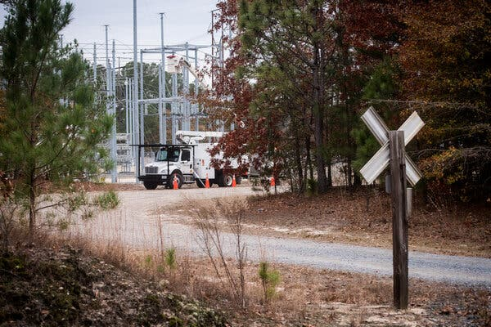
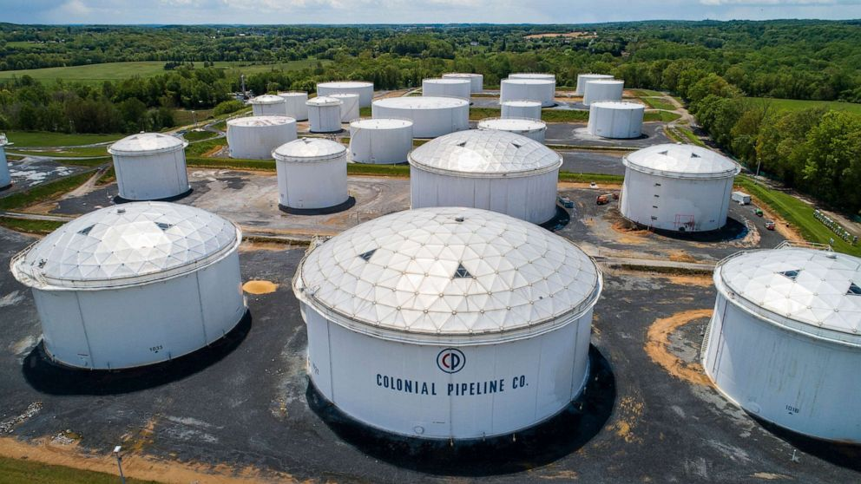
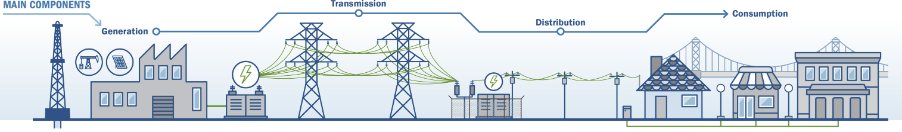
The U.S. energy grid is increasingly vulnerable to cyber and physical threats
Critical infrastructure relies on industrial control systems vulnerable to cyber attack
Cyber threats have physical consequences
Direct physical attacks on the grid by domestic violent extremist increased by 77% in 2022
An aging grid is overly dependent on legacy technologies
Increasing frequency of severe weather events
Gunfire damaged two substations in Moore County, N.C., in December, causing 45,000 people to lose power.
Kate Medley for The New York Times
A cyberattack forced the shutdown of 5,500 miles of Colonial Pipeline's interstate system.
Jim Lo Scalzo/EPA via Shutterstock
Notes:
Image from CISA: https://www.cisa.gov/sites/default/files/publications/Sector%20Spotlight%20Cyber-Physical%20Security%20Considerations%20Electricity%20Sub-Sector%20508%20compliant.pdf
Although in recent years the grid has been augmented with automation and some emerging tech, It is still mostly dependent on legacy technologies. In fact, 70 percent of transmission lines are at least 30 years old and approaching the end of their lifecycle, and 60 percent of the circuit breakers are more than 35 years old, compared to useful lives of 20 years. Aging grids drive $51B in annual utility distribution spending | Utility Dive
The problem is that substations make easy soft targets and there are more than 55,000 connected to the grid in the US. The threat is not only from white supremacists, but eco-terrorists have also physically attacked plants in the past. Vandalism is also an issue. And global terrorist and nation state adversaries could pose a threat to stations and substations. The cost to protect all these stations from physical threats is significant and requires strong law enforcement coordination.
https://www.forbes.com/sites/chuckbrooks/2023/02/15/3-alarming-threats-to-the-us-energy-grid--cyber-physical-and-existential-events/?sh=56a89430101a

Slide 4
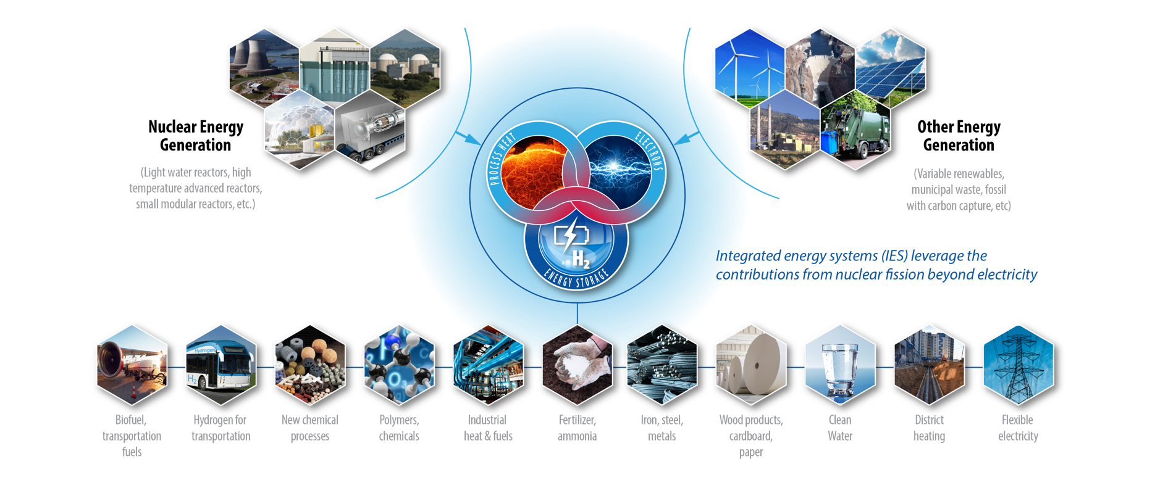
Transforming our energy system provides an opportunity for a secure and resilient clean energy future
Notes:
23-50240-R1
Integrated Energy Systems (IES) strategy requires fundamental research and continued scale-up

Slide 5
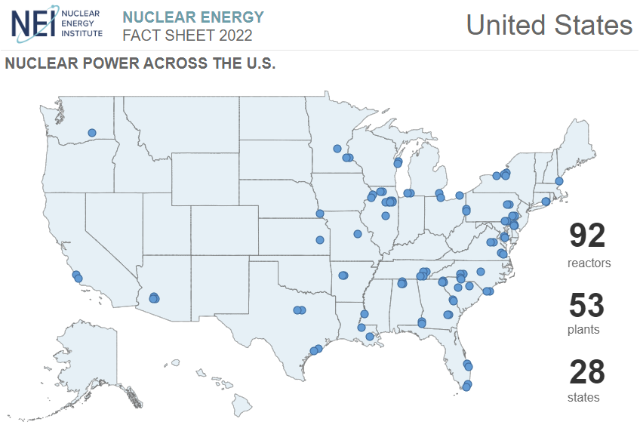
U.S. nuclear industry recognizes the demand for new nuclear power projects
Utilities are prepared to invest in nuclear energy because it is a proven non-carbon-emitting solution
New reactor designs are simpler, more versatile, and more economical at scale
Utilities are evaluating reusing retired coal plant sites to leverage existing infrastructure and workforce
Emissions avoided by adding 100 gigawatts of nuclear power is equivalent to taking more than 100 million cars off the road.
Utilities recently identify the need to add 100 gigawatts of nuclear power by 2050, more than doubling current capacity.
Today, 92 reactors provide nearly 20% of the electricity produced for our power grid and more than half of our carbon-free electricity – more than solar, wind, hydro, and geothermal combined.
Notes:
https://www.eia.gov/energyexplained/nuclear/us-nuclear-industry.php
In March 2023, Chief Nuclear Officers at Nuclear Energy Institute member utilities identify the need to add 100 gigawatts of nuclear power by 2050, more than doubling current capacity.

Slide 6

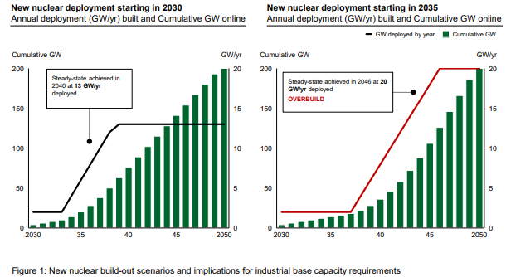
U.S. domestic nuclear capacity has the potential to scale from ~100 GW in 2023 to ~300 GW by 2050
“Power system decarbonization modeling, regardless of level of renewables deployment, suggests that the U.S. will need ~550–770 GW of additional clean, firm capacity to reach net-zero.”
Notes:
U.S. domestic nuclear capacity has the potential to scale from ~100 GW in 2023 to ~300 GW by 2050—driven by deployment of advanced nuclear technologies. Power system decarbonization modeling, regardless of level of renewables deployment, suggests that the U.S. will need ~550–770 GW of additional clean, firm capacity to reach net-zero; nuclear power is one of the few proven options that could deliver this at scale, while creating high-paying jobs with concentrated economic benefits for communities most impacted by the energy transition.
Office of Nuclear Energy: Katy Huff, Mike Goff, Alice Caponiti, Andy Griffith, Sal Golub, John Krohn, Janelle Eddins, Cheryl Herman, Kim Petry, Jason Tokey, Melissa Bates, Billy Valderrama, Erica Bickford, Jason Marcinkoski, Alison Hahn
National Reactor Innovation Center: Ashley Finan
Gateway for Accelerated Innovation in Nuclear: Chris Lohse
From the introduction: Advanced Nuclear As a carbon-free, firm power generating resource, nuclear can play a critical role in complementing the buildout of variable renewables and providing a significant portion of the additional clean, firm capacity required in all decarbonization scenarios. System modeling indicates achieving net-zero in the U.S. by 2050 requires adding on the order of 550–770 GW of additional clean, firm power. These same models indicate advanced nuclear is likely to be the economic option for at least 200 GW of this capacity addition assuming expected overnight capital cost reductions, comparing favorably with other clean, firm options (e.g., renewables paired with long duration energy storage, fossil with carbon capture, geothermal). Deploying ~200 GW of nuclear capacity in the U.S. could require ~$700B in capital formation by 2050, with $35-40B required by 2030. Challenges with transmission expansion, interconnection, land-use intensity, and other factors limiting renewables buildout are likely to make nuclear an even more attractive option. New deployment of advanced reactors at scale, however, will depend heavily on taking action toward building a committed orderbook of 5-10 projects by 2030; and achieving predictable construction timelines and cost profiles, by incorporating lessons learned from Units 3 and 4 at the Alvin W. Vogtle Electric Generating Plant, two Westinghouse AP1000 pressurized water reactors.

Slide 7
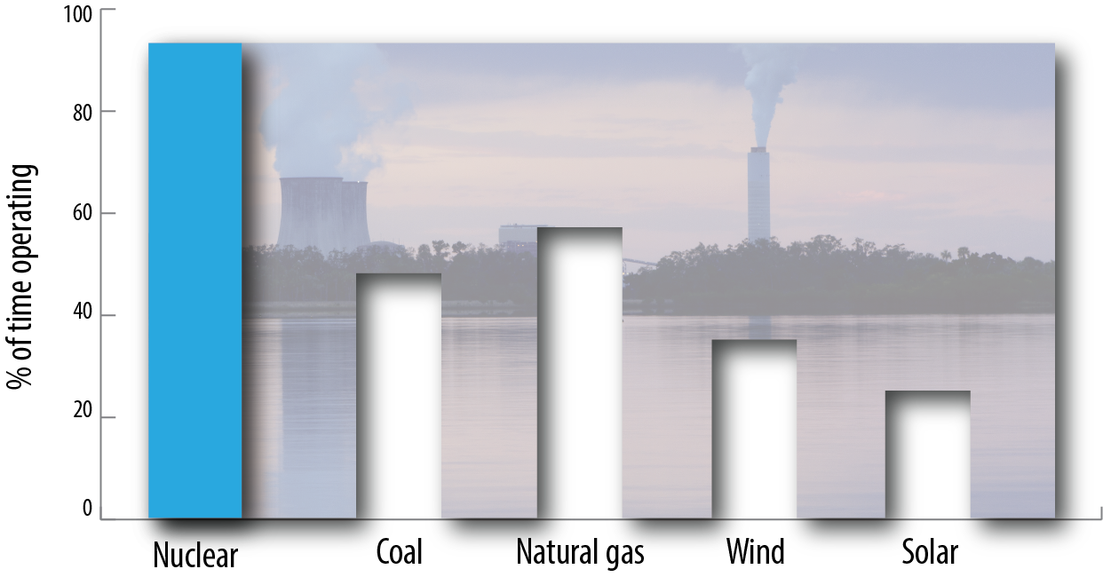
Nuclear is the most productive source of electricity — producing power more than 93% of the time in 2020
Nuclear energy is Reliable
~2X
as much as coal or
natural gas plants
~3X
as much as
wind power
~4X
as much as
Solar plants
Notes:
22-50518

Slide 8
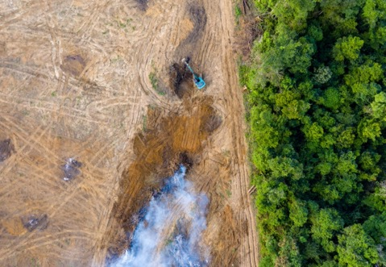
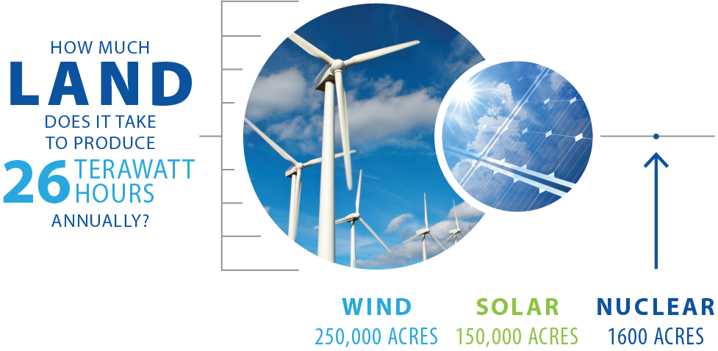
Nuclear energy has one of the smallest footprints
Nuclear energy can scale to meet the immense need for zero-carbon energy while also avoiding deforestation or industrialization of deserts and other fragile ecosystems.
Today’s nuclear plants require just 1.3% of the land area needed for solar photovoltaic farms with the same output and just 0.3% of the land area required for wind farms.
Notes:
22-50518

Slide 9

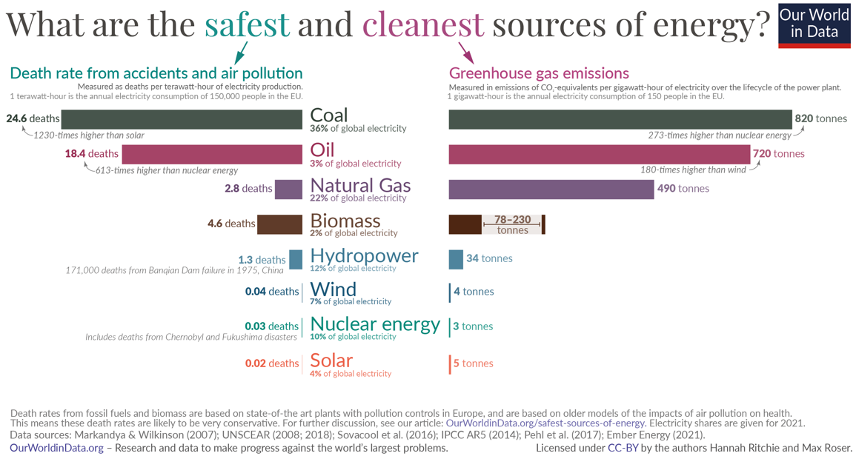
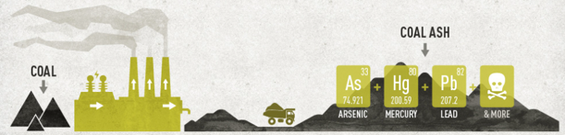
Nuclear is safe and clean
In the United States clean, 24/7 nuclear power has produced 83,000 metric tons of spent fuel since the 1950s—and all of it could fit on a single football field at a depth of less than 10 yards.
While about 110 million metric tons of coal ash are produced by the coal industry annually - more every single day than all the spent fuel since the beginning of the commercial
nuclear industry.
Notes:
https://www.energy.gov/ne/downloads/infographic-5-fast-facts-about-spent-nuclear-fuel
Center for Sustainable Systems, University of Michigan. 2021. "Nuclear Energy Factsheet." Pub. No. CSS11-15. https://css.umich.edu/publications/factsheets/energy/nuclear-energy-factsheet; U.S. Department of Energy (DOE) (2020) “5 Fast Facts about Spent Nuclear Fuel.”
https://world-nuclear.org/information-library/nuclear-fuel-cycle/nuclear-wastes/radioactive-wastes-myths-and-realities.aspx and https://www.bts.gov/product/freight-facts-and-figures
https://www.epa.gov/coalash/frequent-questions-about-2015-coal-ash-disposal-rule#2
https://earthjustice.org/features/the-coal-ash-problem

Slide 10
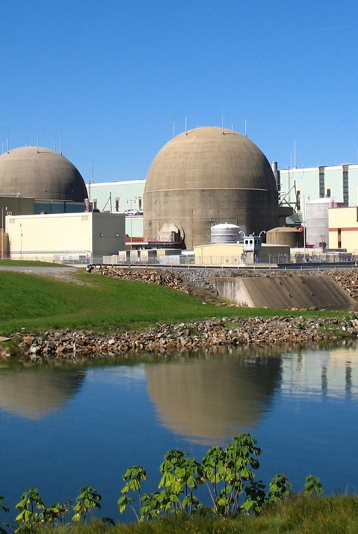
Energy security considerations are driving international actions to deploy new nuclear energy
The U.S. can limit dependence on carbon-emitting energy sources through strategic investments in nuclear energy at home and abroad.
There are around 30 countries considering nuclear power programs and 20 others that have expressed interest. Reactor exports allow the U.S. to form 100-year strategic relationships.
U.S. leadership lets us develop a culture of security- and safeguards-by-design, which enables newcomer countries to more easily access advanced nuclear technologies and sustains the safeguards, security and normative safety expectations enshrined in the international nonproliferation regime.
Notes:
(source: World Nuclear Association)

Slide 11
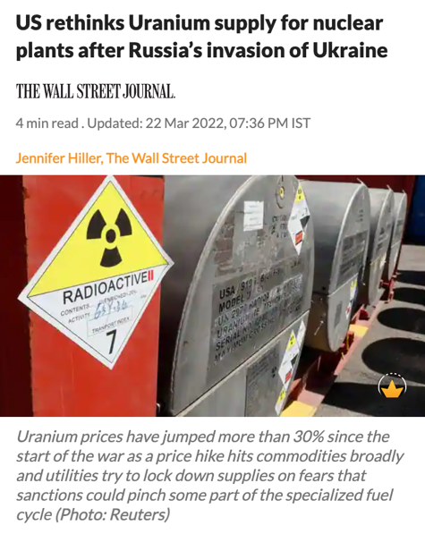
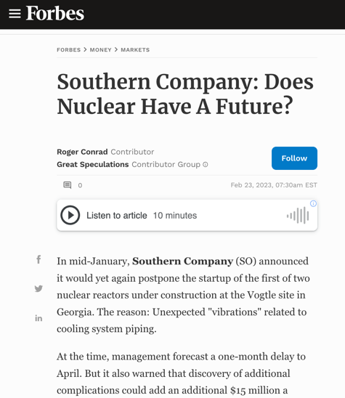
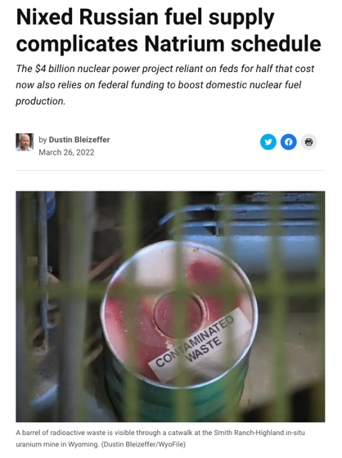
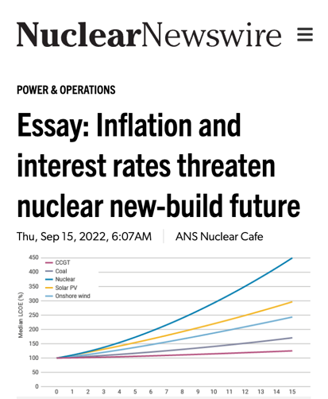
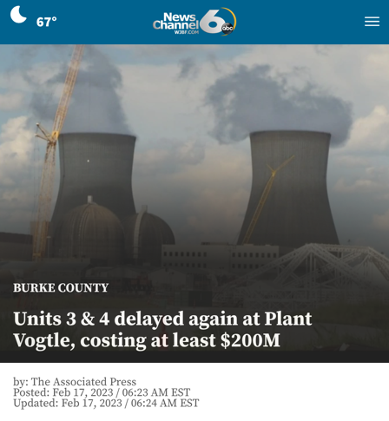
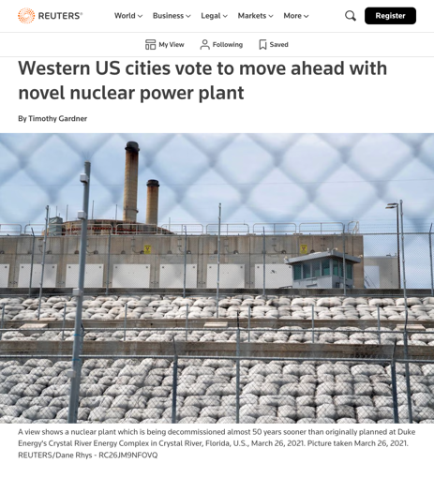
Significant reactor deployment faces technical, geopolitical, policy, and economic challenges
Notes:
https://www.forbes.com/sites/greatspeculations/2023/02/23/southern-company-does-nuclear-have-a-future/?sh=2e3fd0a0dd3b
https://www.reuters.com/business/energy/western-us-cities-vote-move-ahead-with-novel-nuclear-power-plant-2023-02-28/
https://apnews.com/article/georgia-power-co-southern-climate-and-environment-business-3b1d6c65353c6a65b1ccfddede753ab7
https://www.ans.org/news/article-4313/essay-inflation-and-interest-rates-threaten-nuclear-newbuild-future/

Slide 12

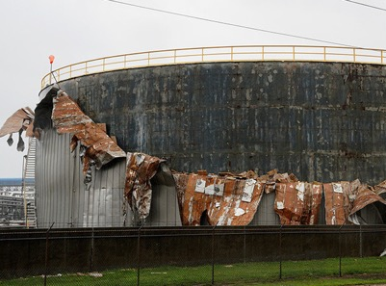
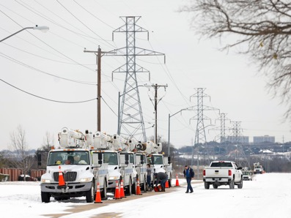


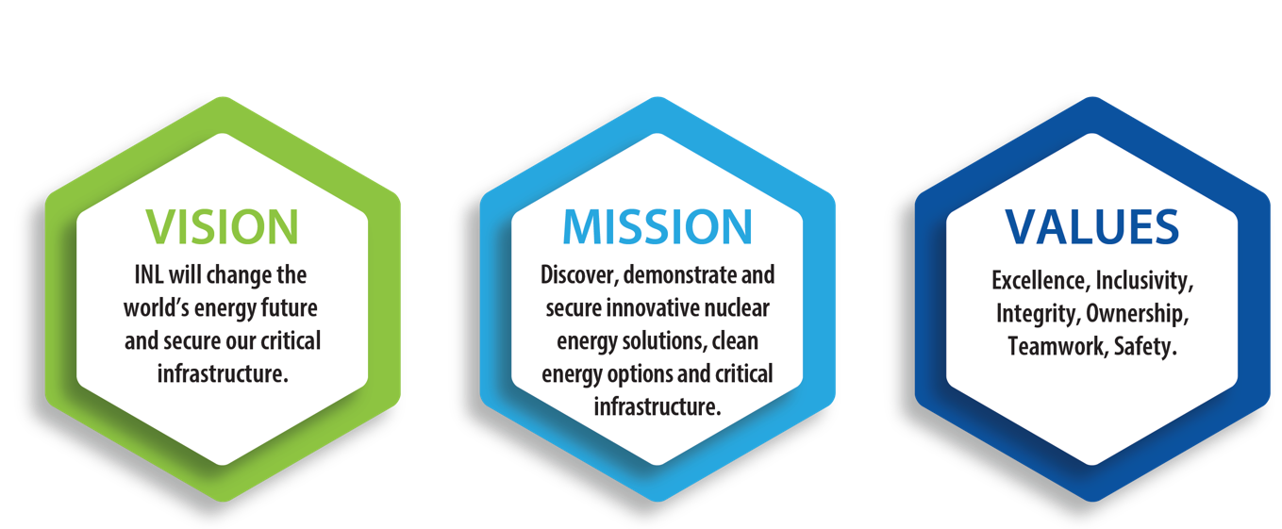
Addressing the world’s most pressing challenges through research, development, and demonstration
Notes:
Images:
Climate change increasing wildfires in Idaho: Helicopters battle the 64,000-acre Beaver Creek Fire in August 2013 north of Hailey. Dozens of giant fires over the last 25 years have become more catastrophic because of warming caused by climate change. https://www.idahostatesman.com/news/local/environment/fires/article244911292.html; https://www.eastidahonews.com/2021/05/nothing-looks-good-preparing-for-summer-wildfire-season/
Hurricane Harvey damage to oil refineries in Texas 2017: https://www.rt.com/business/401149-us-refineries-shut-harvey-storm/
Texas power outage: https://www.businessinsider.com/texas-blackouts-millions-lost-power-in-storm-went-wrong-2021-2
Gas shortages during Colonial Pipeline Hack: https://www.axios.com/gas-shortage-colonial-pipeline-21c0f5cd-a453-4fff-9fa4-b2061391ceed.html
Russian-Ukrainian conflict

Slide 13
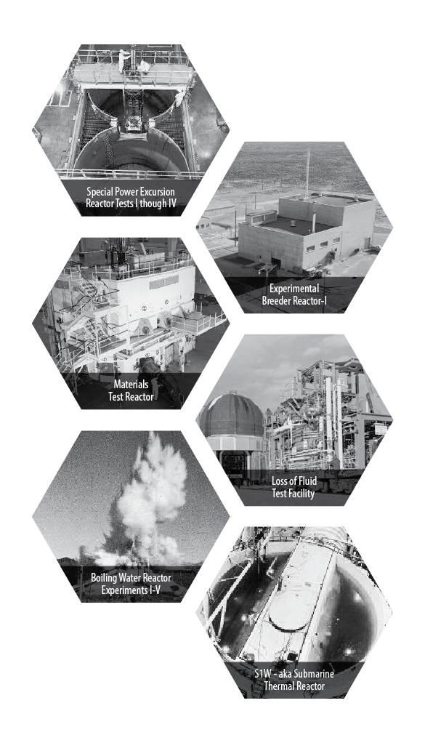
Our Heritage: The National Reactor
Testing Station drove nuclear innovation in the U.S. and around the world
1st
Nuclear power plant
U.S. city to be powered by nuclear energy
Submarine reactor tested; training of nearly 40,000 reactor operators until mid-1990s
Mobile nuclear power plant for the army
Demonstration of self-sustaining fuel cycle
Basis for LWR reactor safety
Aircraft and aerospace reactor testing
Materials testing reactors
Notes:
At 52 reactors in the Idaho desert, today’s nuclear energy industry was born. In fact, we know that every single nuclear reactor operating around the world can trace some part of its DNA to research conducted at INL.
That legacy continues today with INL’s work with industry to develop and deploy advanced nuclear technologies, as well as our work to extend the lives of America’s high-performing reactor fleet.

Slide 14

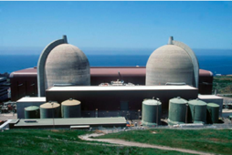

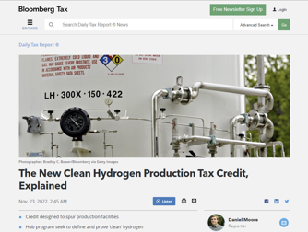
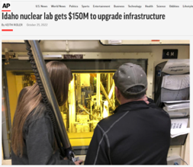
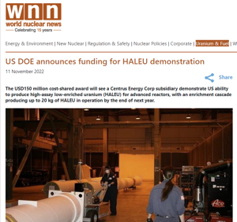
Recent legislation and budget show strong bipartisan support for our mission
Inflation Reduction Act: game changing investments for nuclear, hydrogen, clean energy innovation
Levels the playing field:
  Production Tax Credit for operating commercial nuclear plants
  Production Tax Credit and Investment Tax Credit for new carbon-free generation
Production Tax Credit for carbon-free hydrogen production
$700M for HALEU
Lab infrastructure: $150M for Department of Energy’s Office of Nuclear Energy infrastructure
Office of Nuclear Energy Appropriations
$1.655B
$1.8B
$1.493B
$1.507B
FY23
$1.205B
$1.326B
FY21
FY22
$1.026B
FY19
FY20
$833M
$986M
FY17
FY18
FY15
FY16
Notes:
22-50753-R3

Slide 15
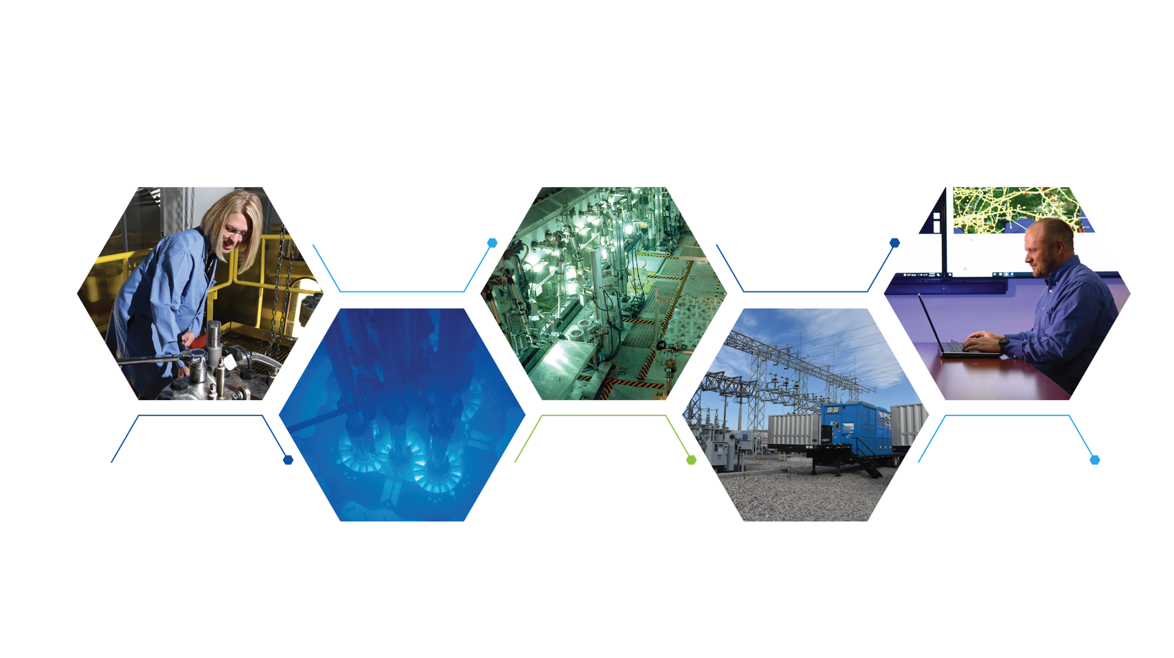
Creating a secure and resilient clean energy future
Energy & Environment
Science & Technology
Advanced
Test Reactor Complex
Nuclear Science
& Technology
Materials and
Fuels Complex
National & Homeland
Security Science
& Technology
Notes:
INL is working every day to create a secure, clean, resilient energy future.
That work is accomplished through five directorates
Nuclear Science & Technology directorate. Before becoming laboratory director in December of 2020, I headed up NS&T.
Primary components of our nuclear energy R&D are two vital complexes on our desert Site: The Advanced Test Reactor and Materials and Fuels Complex.
But the modern INL is much more than just nuclear energy R&D.
Our Energy and Environment, Science & Technology (EES&T) directorate works with industry to develop longer-lived electric vehicle batteries.
Finally, our National & Homeland Security Science & Technology directorate works tirelessly to protect our nation’s most critical assets from both manmade and natural threats.

Slide 16
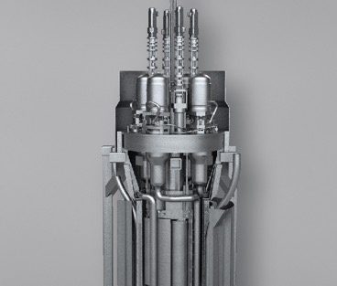
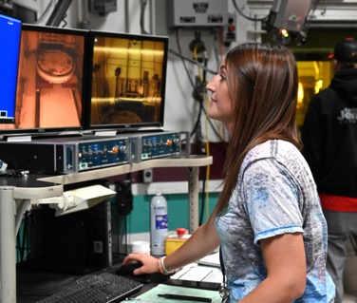
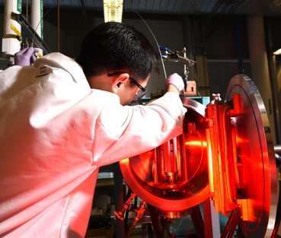
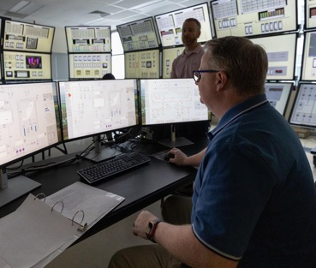
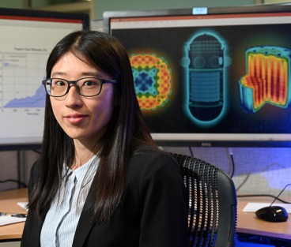

Sustaining the existing commercial reactor fleet and expanding deployment of future reactors
Regulatory
and safety
research
Advanced
modeling and simulation
Advanced
reactor technologies
Fuel cycle
and separations
Nuclear fuels and materials
Notes:
Sustaining U.S. technological leadership through innovative RD&D ensures that the U.S. is positioned to lead the decarbonization of global energy networks through advanced reactor development and deployment.
Achieving battery-like functionality for nuclear systems.
Fission battery initiative to drive technology developments for next generation nuclear reactors enabling distributed use of nuclear energy
Image: Fission battery attributes- economic, standardized, installed, unattended, reliable.
NMDQi: Accelerating discovery, development, and qualification of new nuclear materials and fuels.
Images: NMDQI; INL has nine electromechanical load frames, four servo-electric frames, 11 servo-hydraulic frames, 21 different creep frames and two custom-built stress-relaxation systems for testing new materials like Alloy 617.
Digital engineering principles are predicted to save up to 25% of costs in complex vertical construction and are already realizing multiple years in reduced schedules at the Department of Defense.
Image: INL’s transformational digital engineering research is used to design digital twins (top figure: MAGNET) and model of the design (bottom figure: MBSE).
At INL, digital engineering is centered around 5 key areas:
Transformation from document-centric design to model-based design,
Integration of data across the lifecycle in a digital thread,
Development of operational digital twins,
Establishment of next generation cloud, edge, and HPC computing,
And finally, workforce transformation to a digital-first environment
To realize this vision the laboratory has partnered with several universities:
North Carolina State University
Virginia Commonwealth University
Naval Postgraduate School
Agreements to deploy these technologies to industry are currently in development with:
TerraPower
General Electric Hitachi
and many ARDP award winners through NRIC
NRIC works closely with the INL-led Gateway for Accelerated Innovation in Nuclear (GAIN) to build on the success of GAIN’s industry engagement through regularly available funding awards to industry.

Slide 17
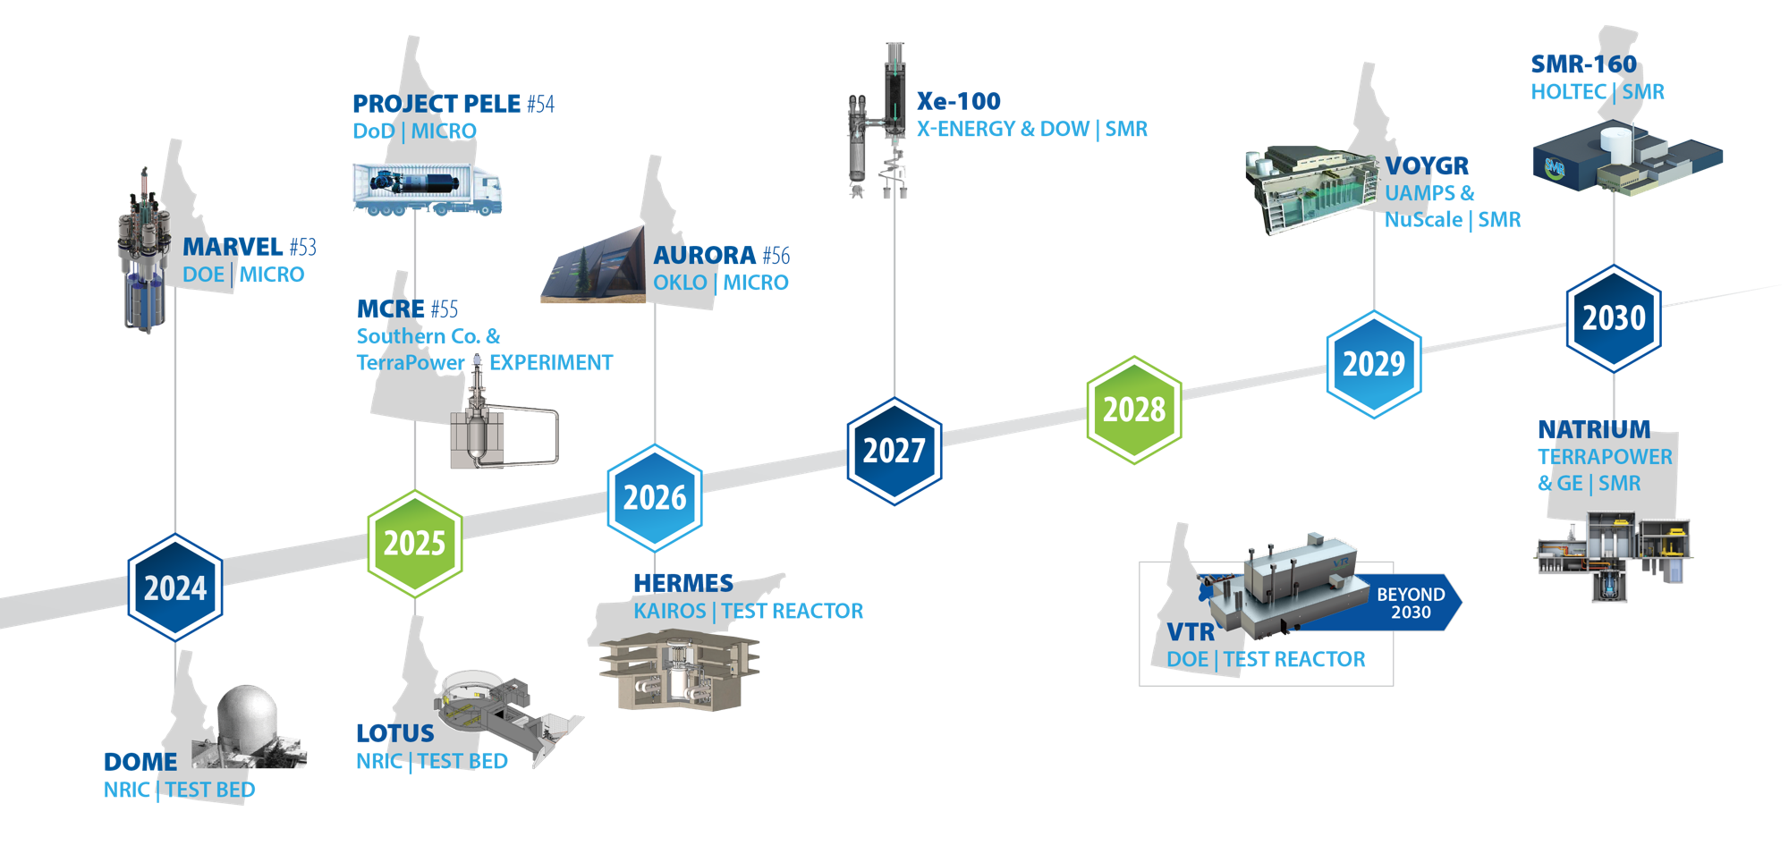
Accelerating advanced reactor demonstration & deployment
Notes:
22-GA50114-R48*
Criteria for timeline inclusion: Reactors that can meet any 3 of the following 4 criteria should be included on the timeline
• The company is part of a cost sharing government award with a reactor as the direct outcome of that cost share project
• There is an identified and concurred on site (note necessarily a site permit or agreement, but a clearly identified site that both the company and the site location acknowledge as the site)
• There is an NRC regulatory engagement plan or similarly robust level of pre-licensing engagement with the NRC (minimum is the formal submission of something)
• INL engagement of some sort or an agreement with another National Lab
Notes:
Inclusion in the timeline is limited to reactors to be sited in the United States
Timeline dates are those publicly identified by the individual companies
MARVEL – 100 kWth, 20kWe
Pele – 5 MWth, 1 MWe
Aurora – 4 MWth, 1.5 Mwe (but Oklo may be re-branding to their larger version)
MCRE – 150 kWth (not generating energy)Xe-100 – each module 80 Mwe (can be scaled to a ‘four-pack’ up to 320 MWe)
VOYGR – each module 77 Mwe (up to 12 modules, so up to 924 MWe)
SMR-160 – 525 MWth, 160 MWe
Natrium – 840 MWth, 345 Mwe (variable output (up to 500 Mwe short-term with molten salt storage)

Slide 18
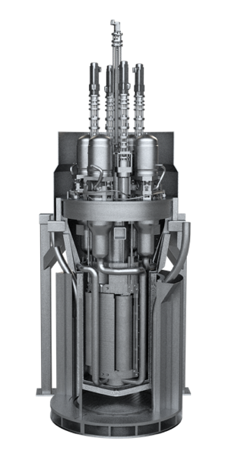
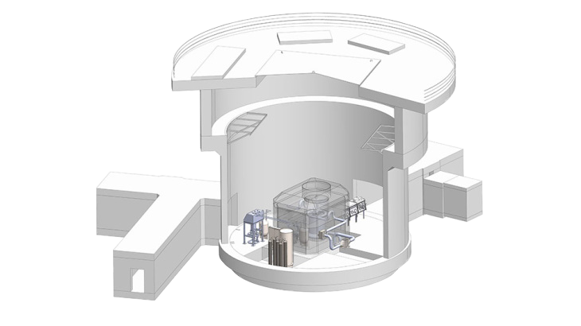
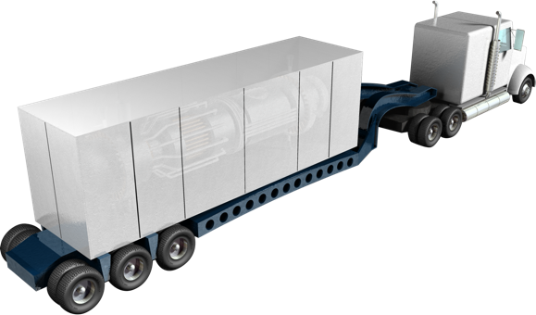
Over the next three years, we will demonstrate the first new reactors on the INL site in over 40 years
Microreactor Application Research, Validation and EvaLuation Project
(MARVEL)
Department of Defense Strategic Capabilities
Office Project Pele
Molten Chloride
Reactor Experiment (MCRE)
Notes:
MARVEL is a 100 KW microreactor that will be installed in INL’s Transient Reactor Test Facility.
It will help researchers and industry partners understand how microreactors can be integrated with end-user applications to provide electricity and heat on demand.
It will be used to test technologies to enable remote and autonomous microreactor operation. It will also provide important information to support rapid reactor development, environmental assessment and licensing.
Project Pele Overview:
A 2016 Defense Science Board (DSB) study¹ found the Department of Defense (DoD) has a need for a mobile, reliable, sustainable, and resilient power source which does not require a long logistics tail
Authorized in FY19+FY21 NDAA², FY20+FY21 appropriations³, and Executive Order (E.O.) 13972⁴
Incorporates Advanced Tristructural Isotropic (TRISO) encapsulated nuclear fuel for compact, safe operations
SCO/DOE/NASA have re-established a national TRISO production capability
Two-year reactor design competition kicked off in March 2020
April 2022 - Final engineering design evaluations complete
April 13th, 2022 the DoD Strategic Capabilities Office (SCO) released a Record of Decision for Project Pele
Decision: SCO will construct an inherently safe by design nuclear microreactor capable of being transported by the DoD and able to deliver 1-5 MegaWatts of electrical power for a minimum of three years of full power operation.
The reactor will be assembled and initially operated at Idaho National Laboratory (INL)
Pele is a microreactor being developed for the Department of Defense as a portable energy source that could power remote military installations.
It will help reduce dependence on long supply lines of diesel, which is a significant source of danger to service personnel.
Pele also will help the armed forces lower carbon emissions.
INL Scope:
Provide fuel salt synthesis and storage, and development of MCRE
Integrate reactor into an NRIC-LOTUS test bed for operation and testing

Slide 19
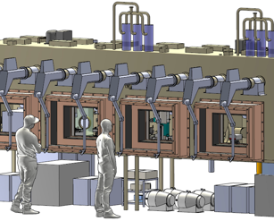
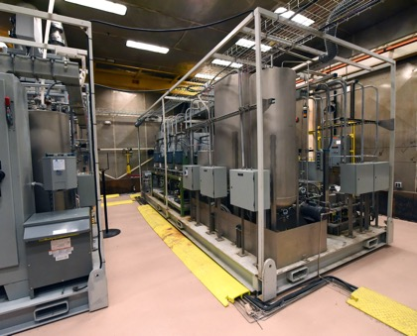


Leading advanced reactor fuel cycle development through RD&D test beds
Molten Salt Thermophysical
Examination Capability (MSTEC)
Moran –
uranium-based spent fuel test bed
Beartooth –
special nuclear material test bed
Veolia's GeoMelt Engineering Scale Melt Unit
Notes:
Images
MSTEC
Beartooth-Remote IAEA Inspections by Mobile Robotics & Digitally Enhanced Mixed Reality Methods using the SPOT robot in Beartooth
Geomelt- Veolia's GeoMelt Engineering Scale Melt Unit. The picture shows the in-process molten surface of the top of the melt through the viewing window. The vitrification process using GeoMelt removes the reactivity of the sodium components and incorporates everything into a glass form for safe and compliant disposal. BEA has partnered with Veolia for application of their technology to reactive (sodium) materials and wastes for the successful treatment and disposal of thousands of pounds of sodium and the elimination of several liabilities.
Stewarding RD&D test bed facilities is critical for INL to engage and train the next generation of fuel cycle, nonproliferation, and waste management experts.
All new fuel cycle test beds are designed with the ability to demonstrate innovative safeguards and security concepts applicable to advanced reactors and their fuel cycles in support of national security objectives.
Developing RD&D Test Beds
Advanced test beds allow INL to lead advanced reactor development (including SMRs, microreactors, liquid-fuel reactors, and TRISO fuel development)
Test Beds
Beartooth (completed 2023) will expand nonproliferation research capabilities allowing researchers to process HALEU, plutonium, thorium, uranium-233 and their minor actinides and fission products. Complemented with digital twin research, undperinned by AI, machine learning and deep learning.
MSTEC developed through NRIC to support industry developers. Will provide users with characterization equipment, infrastructure and technical staff with data needed to design, demonstrate, license, and operate molten salt reactors.
Modern Waste Management Capabilities: INL developing embedded waste management test bed capabilities at MFC to address challenges with legacy and newly generated waste streams.
Geomelt
Pyrolysis
Drum Assay

Slide 20






Transforming the energy paradigm through innovation and demonstration
Critical materials recovery
Secure vehicle charging
Nuclear H₂
High-efficiency
thermal
energy use
Integrated energy systems solutions
Sustainable fuels through waste recycling

Slide 21

Integrating systems for the nation’s net-zero future
Vehicles
Power Plant Operations
Hydrogen
Power Emulation
Power Systems
Wireless
Charging
Human Systems Simulation Lab
(out of picture)
High Temperature
Electrolysis
Digital, Real-Time Grid Simulation
Energy Storage
Battery Testing
(out of picture)
Fast
Charging
Thermal Energy Distribution System
Includes Thermal Energy Storage
MAGNET
Microreactor Agile Nonnuclear
Experimental Testbed
Distributed Energy
& Microgrid
Notes:
Energy Systems Integration Lab: INL has invested in new facilities and equipment to support further growth in this research area. Dynamic Energy Transport and Integration Laboratory (DETAIL) (DETAIL includes the High Temperature Electrolysis, TEDS, and MAGNET facilities) will emulate thermal energy generation from a nuclear source using controllable heaters and the Microreactor Agile Nonnuclear Test (MAGNET) facility and will transport that heat both to thermal energy storage and coupled energy users via the Thermal Energy Distribution System (TEDS). DETAIL will provide an opportunity to demonstrate systems integration components and will demonstrate integrated system operation and dynamic control. Preliminary design activities are also underway for the integration of high-grade heat exchangers in the MARVEL primary coolant system.
DETAIL, combines systems that represent energy generation sources, distribution systems, energy storage, and energy users to demonstrate how novel integrated energy systems might be operated within a microgrid under both nominal and off-nominal conditions. This allows researchers to show how a nuclear reactor would physically connect with renewable energy, energy storage, industrial plants, and within a microgrid, and also to demonstrate control systems for this new type of multi-input, multi-output energy system that can support multiple energy use sectors. DETAIL integrates real-world energy storage, electric vehicles, solar power and more using physical hardware, grid emulators, and modelling and simulation tools to form a working model of tomorrow’s electric grid.
The facility provides representation of energy input that might be provided by a nuclear microreactor, which is represented via a 250 kW electrical heater. This system will be coupled via heat exchanger to the thermal energy distribution system (TEDS) that will demonstrate how that thermal energy can be stored and conditioned using a thermal energy storage system, such that heat can be delivered at the right time and at the right quality needed by a range of energy users. TEDS is currently being integrated with a platform to demonstrate up to 250 kW of solid oxide electrolysis cells that will break down steam to produce hydrogen and oxygen. INL is working with a number of vendors to demonstrate different cell technologies to assess long duration performance, cyclic performance, and overall hydrogen production efficiency.
The Energy Systems Lab has also established connections to the INL Human System Simulation Laboratory, which represents a nuclear plant control room
Facility is also integrated with a microgrid that allows us to characterize energy system performance in the context of real power systems in the grid, using digital real time simulators (DRTS) to represent grid components and interactions..

Slide 22



High Temperature Electrolysis (HTE) with nuclear power sets the stage
“
The
”
GAP
25 kW High
Temp Electrolysis
Stacks V&V
100-500kWe
Modular High
Temp Electrolysis Pilot
Plant Demonstration
2-10 MWe Modular
HTE Units
Integrated proof of
operation system
Hydrogen supply for user technology demonstrations
Accelerates high temp H2 production pathway to commercialization
Wide Commercial
Deployment:
Hydrogen production at
nuclear power plants
Industry-embedded hydrogen production and use
Notes:
”The GAP” – Filled by INL Energy Technology Proving Center (ETPC) (Technology Readiness Level 6-7) Decrease rick for H2 EARTH SHOT Goal: Accelerate Hybrid Nuclear/Renewable – THE Systems Deployment Implement the INL “Net Zero in 10 Years Plan”
-Hydrogen hubs are the biggest opportunity we’ve seen to launch IES and AR’s.
-We can provide H2 Hub with analysis and risk reduction solutions, but this will result in modest growth
Limited to small-scale demonstration and deployment capabiites (ie: Bloom 25kw system)
Slide 1 INL vision
DOE vision earthshot
IES Shot
Boxes
Bench scale – Dong's work
100 kw
10 mw (blank) -
Commercial
THEN BLUF

Slide 23







Hydrogen creates new opportunities for the existing commercial fleet and for future advanced reactors
Constellation: Nine-Mile Point Plant
H₂ production beginning in 2023
Nel Hydrogen proton exchange membrane module
Energy Harbor:
Davis-Besse Plant
H₂ production beginning in 2024
2 MW_{eDC} Cummins proton exchange membrane module
Xcel Energy: Prairie Island Plant
H₂ production beginning in 2024
Bloom Energy
high-temperature electrolysis modules
Pinnacle Northwest Hydrogen
Project award in discussion
20 MW_{eDC} proton exchange membrane electrolysis
H₂ storage for gas turbine combustion test
Combustion in
Saguaro NCGG plant
Notes:
Four demonstration projects have been awarded with joint NE-EERE funding . These projects are helping nuclear plant owners/operators and electrolysis technology suppliers reduce the technical and economic risks of scaling up hydrogen production to full-scale commercial systems.
INL and NREL are supporting these project with systems verification and testing procedures relative to nuclear plants operations and dynamic integration with the grid,
Last month, there was a ground-breaking ceremony at the Constellation 9-Mile Point Plant. A 2 MWe Nel is being put in place. Some representatives from the NE and EERE headquarters offices were there.
At the Energy Harbor Davis-Besse Plant, an all-new electrical switch gear has been put into place and will be connected during the next outage. This will allow the testing of the Cummins Low-Temperature PEM Electrolyzer, and then provides the capability to expand up to over 50 MWe being directly connected to the plant.
The engineering has been competed for the Xcel Project and a commercial contract has been signed with Bloom Energy. This will be the very first high temperature electrolysis demonstration at a nuclear plant. Steam and electricity will be provided directly from the plant for this demonstration.
The project with Pinnacle Northwest Hydrogen (backed by Arizona Public Service) is sill be arranged between PNH and DOE.

Slide 24






Solving urgent national security challenges
Secure
and Resilient
Grid
First
Responder Training
National
Defense
Support
Industrial
Control Systems
Security
Wireless Security
Nuclear
Safety and Security

Slide 25



Ensuring the security and resiliency of critical infrastructure
Cyber-informed science and engineering to protect infrastructure
Partnering with industry to protect the power grid
CyberStrike training to protect utilities
Notes:
INL is the leader in innovate enduring control systems cybersecurity: To secure U.S. manufacturing and critical infrastructure requires economically viable and pervasive cybersecurity solutions. The connectivity of INL research laboratories with CITRC, CAES, and partner university campuses (including Boise State University, University of Idaho, and Idaho State University) creates an exceptional collaborative research environment.
Armor technology designed to protect the power grid, developed at INL and licensed by Michigan-based Waltonen Engineering. Designed to protect against the types of deliberate attacks on substations seen recently in North Carolina. Currently, the U.S. imports about 85% of its high-voltage transformers from other countries. These large, custom-built devices cost $2.5 million to $10 million dollars each. With limited supplies, expensive raw materials and fabrication times of more than a year, the loss of a single piece of equipment could prevent reliable power from being delivered, creating a risk to national security, economic stability and public health.
National Cyber-Informed Engineering Strategy released by the Department of Energy in June 2022 was developed by INL and influenced by INL work in this area. It encourages the adoption of a “securityby-design” mindset within the Energy Sector Industrial Base, which refers to building cybersecurity into our energy systems at the earliest possible stages rather than trying to secure these critical systems after deployment.
CyberStrike To reduce the consequences of cyberenabled sabotage, the U.S. Department of Energy’s Office of Cybersecurity, Energy Security and Emergency Response (CESER), in collaboration Idaho National Laboratory (INL), developed the CyberStrike training program. This program works to enhance the ability of energy sector owners and operators to prepare for a cyber incident impacting operational technology.

Slide 26



Slide 28





INL regional engagement on nuclear energy
Expand Market for Nuclear Energy through Regional-to-Global Strategy
Advise States Regarding Energy Goals, Including Coal-to-Nuclear Transitions
Assist States Regarding Road Mapping, Siting, and Demonstrations
REGIONAL
NATIONAL
GLOBAL IMPACT
Notes:
22-50615-R5

Slide 29










Beyond the nuclear echo chamber: communicating
INL’s mission to a broad spectrum of audiences
Notes:
Left to right:
Zach announcing governor’s Cyber Taskforce with Gov. Little
John at Breakthrough Energy Summit
Chris Inglis visit
Todd at Up and Atom Breakfast
Jess ANS plenary
Geri Richmond visit
J’Tia Hart at IAEA Ministerial
John at Frontiers Project event in Jackson, WY
Juan Hometown Hero award
Australian Ambassador visit

