Slide 1

Advanced Thermal Conversion
Sustainable Power, Heat, RNG, H2, Aviation, Diesel, Biochar & Graphene
2023 Laufer Energy Symposium
March 30-April 1, St. Louis MO

Slide 2

Overview
“De-Carbonizing the planet by generating carbon-negative clean energy, sustainable transportation fuels, graphene and valuable carbon capital opportunities while eliminating harmful methane release from environmentally devastating waste is one of the single largest growth opportunities in human history.
We accomplish this while solving many of mankind’s biggest energy, environmental, economic and social problems. SynTech has the team and the technology needed to solve these problems and lead the way in decarbonizing the planet, reversing global warming and combatting climate change."–Wayne McFarland, CEO
SynTech’s BioMax® advanced thermal
conversion technology delivers
CARBON NEGATIVE CLEAN ENERGY from
biomass and other problematic wastes
Multiple revenue streams from
Power, Heat, Fuel, Biochar & Graphene,
Project Development, Manufacturing, Waste Remediation and Carbon Capital Opportunities

Slide 3
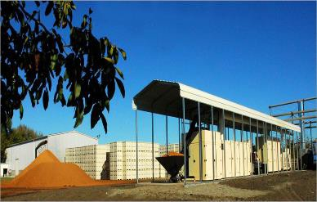
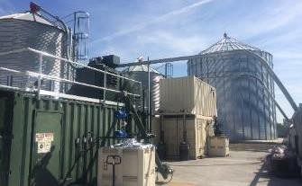
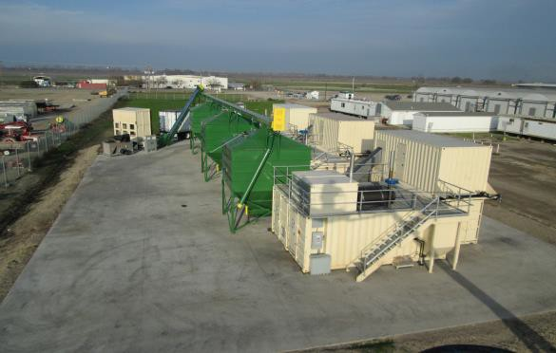
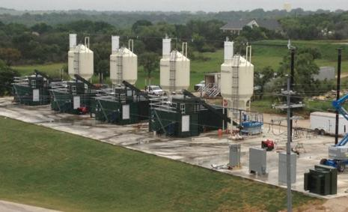
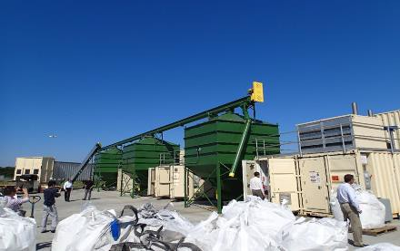



BioMax®—History and Development
Over 120,000 hours of operation at commercial scale (equivalent to 13 years)
Organic Walnut Producer, CA Mushroom Farm, CA
Pecan Producer, TX
Then—1st Commercial Unit
Now—Gen 1 and Gen 2 Array
3 Gen 1 Array
4 Gen 2 Array
2008
BioMax® 50
Continuous Operation
Dec 2012
BioMax® Gen 1
Runs 24x7
Jan 2015
BioMax® Gen 2 Runs 24x7
Jan 2015
(3) BioMax®
Gen 1 Units
September 2017
(4) BioMax®
Gen 2 Units
50kW
Gross
125kWe Gross
155kWe Gross
375kWe Gross
620kWe Gross
https://www.youtube.com/watch?v=X2iwiHY6Q0k
For additional information on Technology, please see Appendix A “Technology Details”

Slide 4
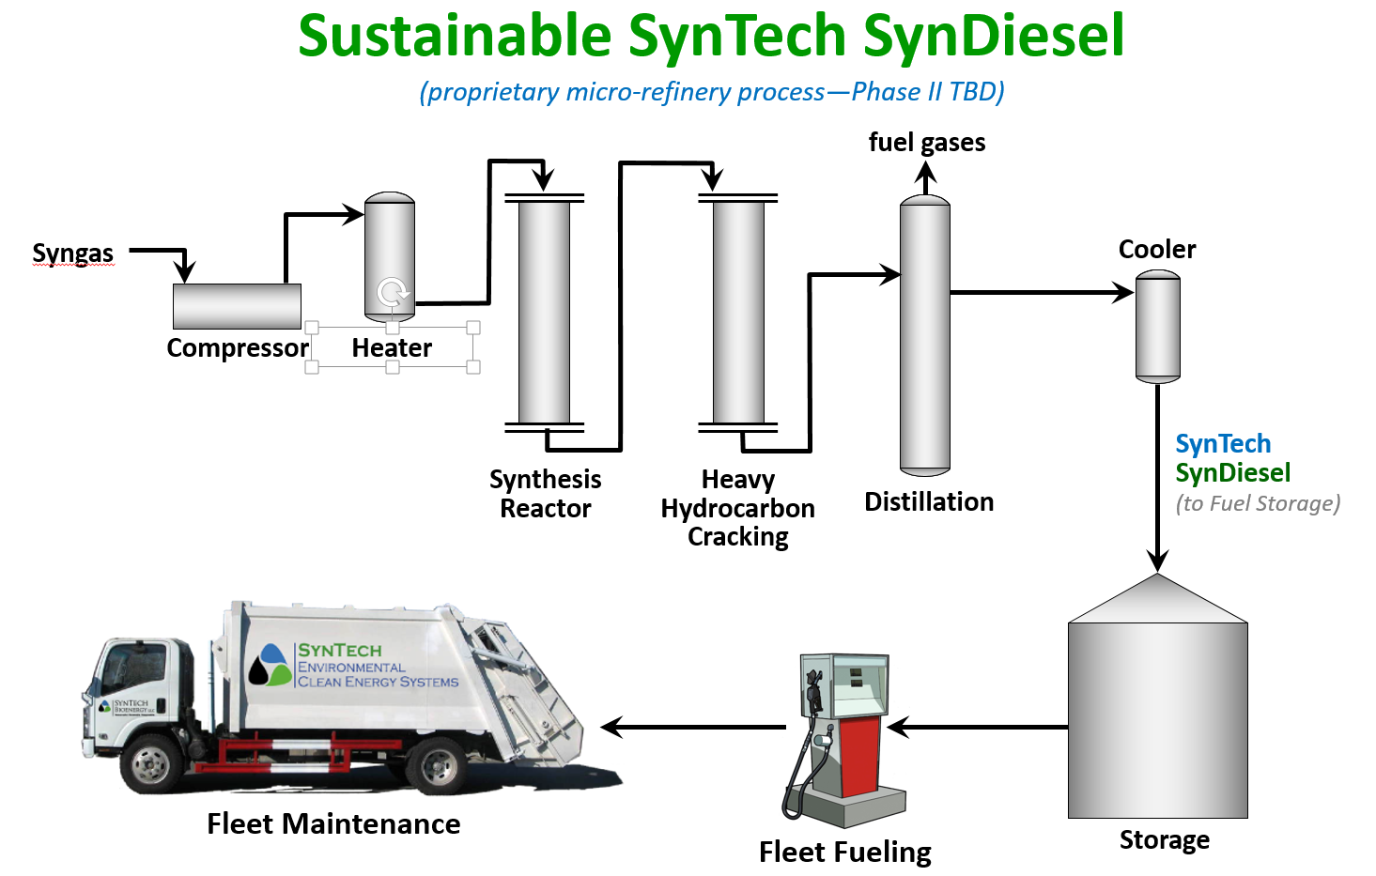
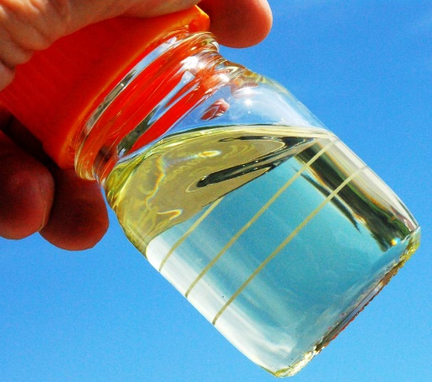
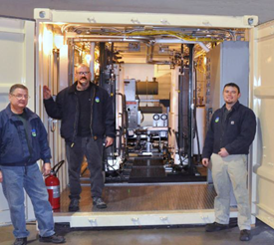
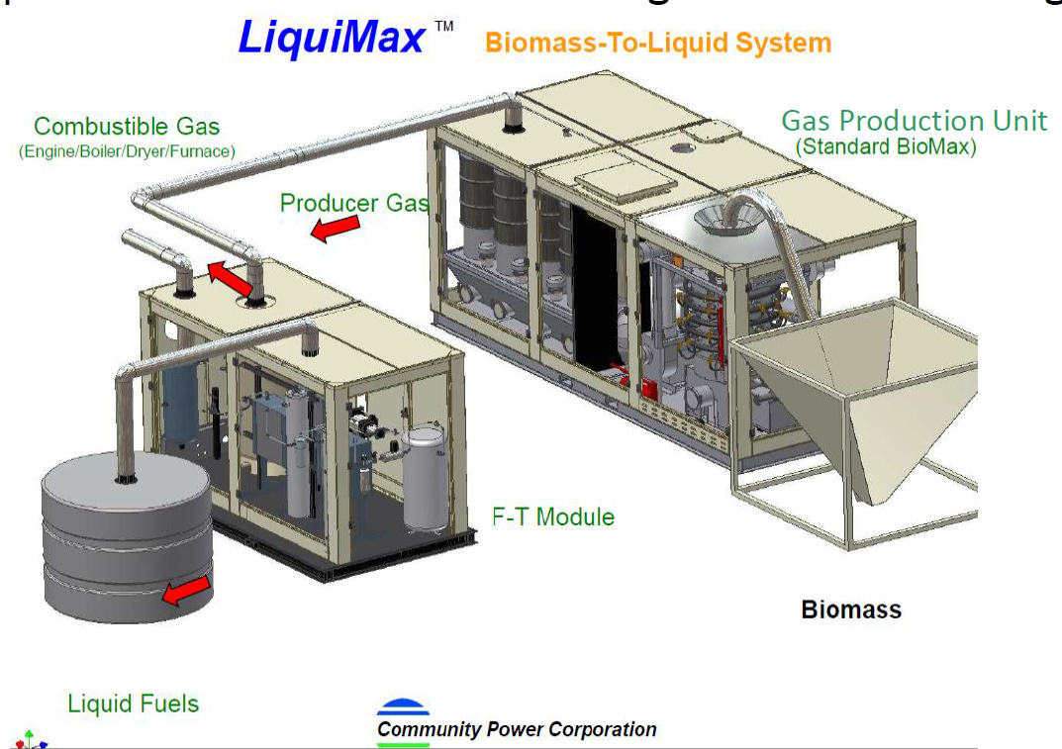
LiquiMax® Advanced Sustainable Aviation Fuel, RNG & H2
Small Scale Micro-refinery
  Biomass to liquid fuels
  Landfill and wellhead flare gases to liquid fuels
  Pipeline natural gas and digester gases to liquid fuels
Producing
  Renewable Natural Gas
  Sustainable Aviation Fuels (civilian & military)
  Hydrogen
  Renewable Diesel Fuel
Ready to use—”drop-in”—fuels
  Meet all published fuels standards (including US Military spec)
  Does not require blending
  Does not require engine modification

Slide 5
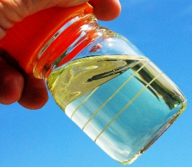
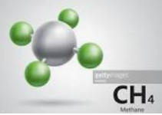
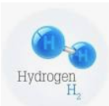
LiquiMax® Advance Sustainable Fuel Products
LiquiMax® (Drop-In Liquid Fuels)
  Proprietary Fischer-Tropsche Gas to Liquids technology and process
  Drop-in renewable liquid fuels including Diesel, Jet A, JP8, wax, etc.
  Developed for US Department of Defense
  Commercial ready, globally protected
RNGMax® (Renewable Natural Gas)
  Modified LiquiMax® format
  Produces pipeline quality renewable natural gas (RNG)
H2Max® (Hydrogen)
  Modified LiquiMax® format
  Produces 42%+ pure Hydrogen

Slide 6
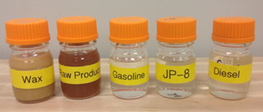
LiquiMax®—Proprietary FT Process & Conversion Efficiencies
Small Scale Micro-refinery Scalability
  Modular process allows unlimited scalability
  Scalability achieved by increasing number of deployed reactors
Drop-in Fuel Capacity
  3.2 gallons per 1,000 scfm
Feedstock conversion efficiencies
  42 gallons per ton bone dry feedstock

Slide 7
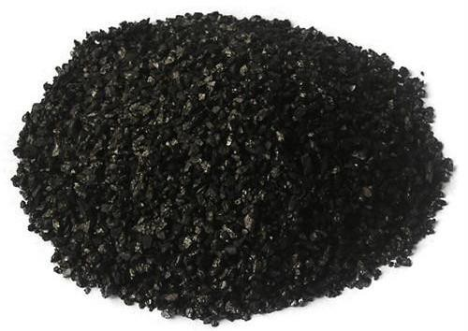
BioMax® Biochar—High Quality Byproduct Enhances Project Economics
Biochar is the only byproduct created by the BioMax® process.
Biochar is an excellent carbon “sequestration” media
SynTech’s Biochar has been Certified Organic by USDA and IBI
Highest quality biochar meeting “activated carbon standards”
Selling price of $200 - $5,000 / ton creates significant project returns
Biochar has many market applications including
Organic fertilizer and soil amendment
Enhancement for anaerobic digesters and composting processes
Activated carbon for air/water filtration, desalination, fracking fluid clean-up
Raw material for refined production of carbon black, graphite and graphene
Each 75 pounds of feedstock yields +/- 1 pound of market ready graphene
Notes:
tp

Slide 8
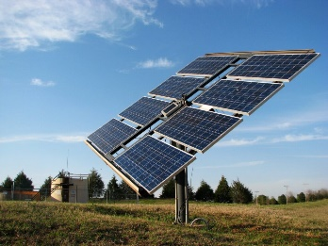
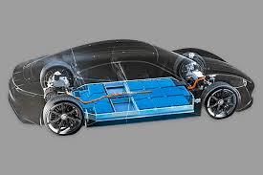
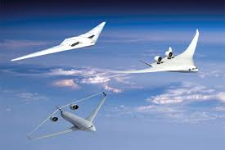
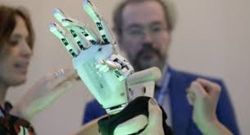
BioMax® Graphene—leading the way forward in material sciences
Graphene is pure carbon and highly conductive with exceptional thermal properties Extraordinarily light (A sheet of graphene of one square meter of weighs only 0.77 milligrams)
200 times stronger than steel with a density like to that of carbon fiber
One of the most sought-after elements on the planet.
Graphene—has a extremely high market value per ton
—is produced from high-quality SynTech Biochar®
—has many market applications including
Solar & Photo Voltaic Composites
Electric Vehicle & other advanced energy storage
Aerospace & Defense composites & applications
BioMed & Medical technologies & appliances

Slide 9
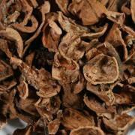
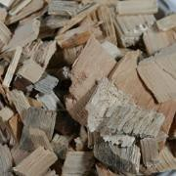
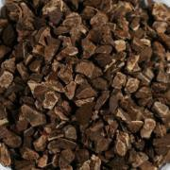
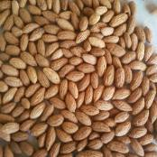
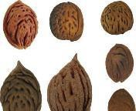

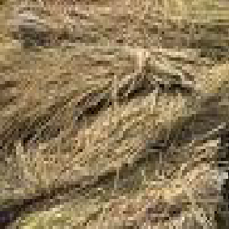
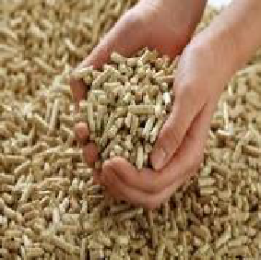

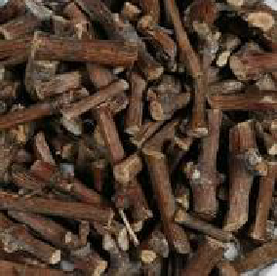
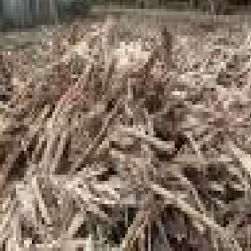
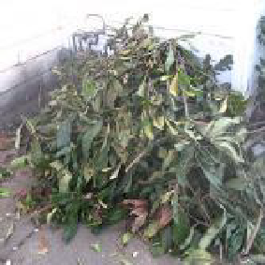
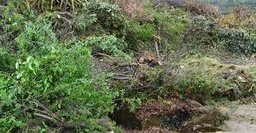
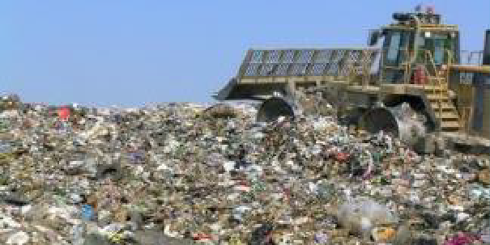
BioMax®—Feedstock Flexibility
Abundant localized feedstock supplies
Ready to Use
Many biomass feedstocks require no pre-processing beyond simple sorting, including:
Nut Shells
Wood Chips
Fruit Pits
Coconut Shells
Jojoba Pulp
Olive Pits
Processed Biomass
Additional biomass feedstock is abundantly available with sorting, drying and densification, including:
Bamboo
Wood Pellets
Green Waste
Grape Vine
Sugar Cane
Slash/Trimmings
Future Feedstocks
Global demand for small scale remediation of site-produced, problematic waste streams provide growing markets for new products, including:
Institutional Solid Waste from:
Processed Municipal Solid Waste
Hospitals & Medical Centers
College & University Campuses
Resorts & Hospitality Centers
Defense and Correction Facilities
Sport Stadiums & big box stores
Big Box Retailer & Grocers
Curbside MSW
Can be blended to remediate Bio-solids
Processed into Refuse Derived Fuel Pellets
Remediates two horrific waste problems

Slide 10
BioMax®—Environmental Benefits/Annual Carbon Displacement analysis
 | Single BioMax Gen2 Unit | BioMax Gen3 System (4 reactors and 1 Dresser-Rand engine) | 3MW BioMax Gen3 System
Biochar Carbon Sequestration | 57.8 ~ 232.3 (typically 115) short tonnes CO2 per year | 231.2 ~ 928.8 (typically 460) short tonnes CO2 per year | 1,192 ~ 4,791 (typically 2,372) short tonnes CO2 per year
Fossil Fuel Displacement | 1,121 tonnes CO2 from coal or 660 tonnes CO2 from natural gas | 4,484 tonnes CO2 from coal or 2,640 tonnes CO2 from natural gas | 23,120 tonnes CO2 from coal or 2,640 tonnes CO2 from natural gas
Methane and CO2 Emission Avoidance | 7,255 tons CO2 E/year | 29,020 tons CO2 E/year | 149,600 tons CO2 E/year
Total Carbon Negative Impact | Up to 8,608 tonnes CO2 E/year | Up to 34,432 tonnes CO2 E/year | Up to 177,500 tonnes CO2 E/year

Slide 11
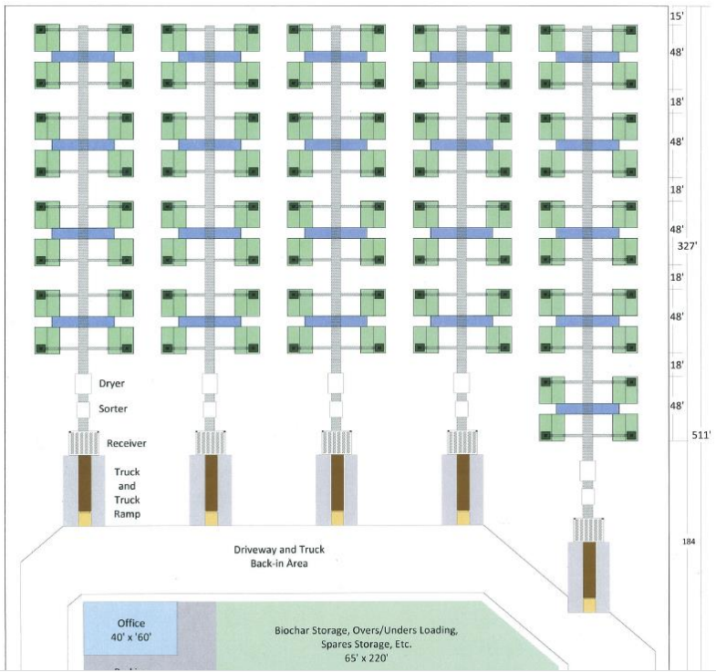
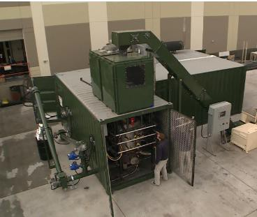
BioMax®—Scalability without technology or scale-up risk
BioMax®—can be scaled from 155kWe to 25MWe+
—with absolutely no new technology risk and
—with absolutely no scale-up risk
Pecan Producer, TX
A BioMax® Gen3 Array (15MWe+ gross output)
A twin BioMax® Gen2 array (330kWe gross output)
A single BioMax® Gen2 (165kWe gross output)
For additional information on Technology, please see Appendix A “Technology Details”

Slide 12
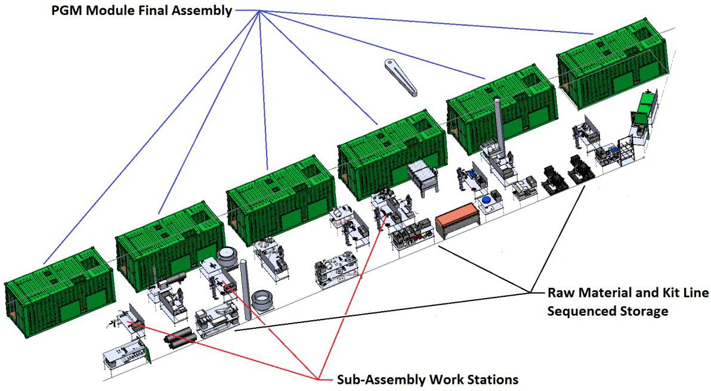
BioMax® Manufacturing Principles and Processes
Highly Efficient World Class Lean Manufacturing Principles & Processes
Complete Vertical Integration—owned IP
Exceptional supply chain management
Design for Manufacturability
Continuous Improvement
Finished Product Control
Factory Assembled & Tested before delivery
PROPRI_{I}ETARY AND CONFI_{I}DENTI_{I}AL_{. P}P_{R}R_{O}O_{P}P_{E}E_{R}R_{T}T_{Y}Y_{O}O_{F}F _{S}S_{Y}Y_{N}N_{T}T_{E}E_{C}C_{H}H_{B}B_{I}I_{O}O_{E}E_{N}N_{E}E_{R}R_{G}G_{Y}Y_{, L}L_{L}L_{C}C..

Slide 13
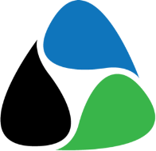
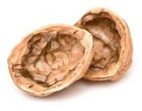




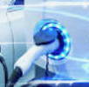


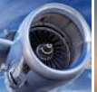















Market Reach & Industry Opportunities
Nut Processors
Colleges & Universities
Energy Traders
Forestry
Hospitals & Medical Centers
Electric Vehicle Operators
Biomass Producers
Defense Installations
SAF Consumers
Agriculture
Correctional Facilities
Public Utilities
Landfill Operators
Resorts, Hospitality & Sports Stadiums
Municipalities
Wastewater Treatment Facilities
Shipboard Applications
Impact Investors
Digester Operators
Distributed Infrastructure
Foundations & Family Offices
Animal Bio-solids Producers
Micro, Smart & Off-Grid Applications
Villages and Communities

Slide 14
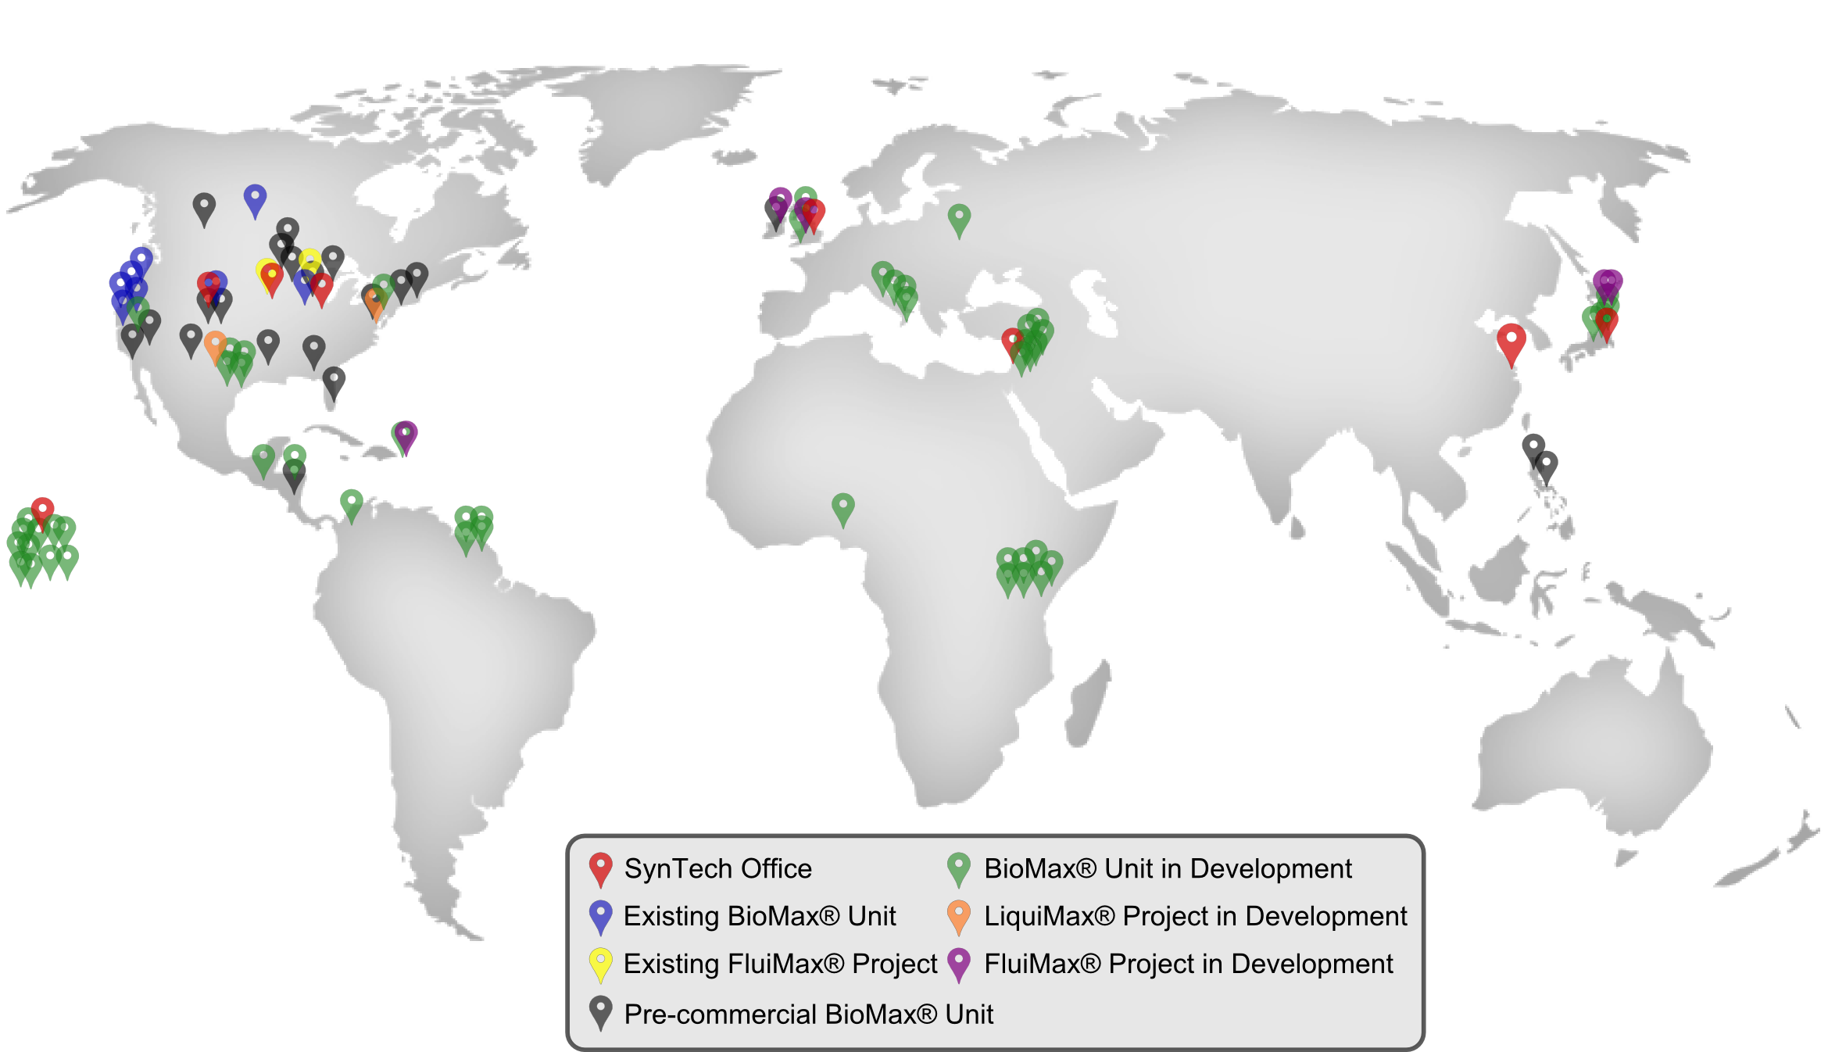
Historic & Planned Global Reach

Slide 15


Thank You!
For Further Information, Please Contact:
Wayne McFarland, CEO
SynTech PCo, LLC
wmcf@syntechbioenergy.com Office: 815-513-3363
Mobile: 815-302-3002
www.syntechpco.com

