Slide 1
2023 Laufer Energy Symposium Unconventional Fuels
Vivek M Rao, PhD
Fusion and Fission Energy and Science Directorate, ORNL
March 30, 2023

Slide 2
Motivation
“ hybrids producing thermal energy, hydrogen, or other renewable fuels can specifically target hard to decarbonize applications in the industrial and transportation sectors, which can provide significant additional GHG reductions required to achieve a net-zero economy by 2050”
Office of Energy Efficiency and Renewable Energy
“In the U.S., there are approximately 40,000 commercial vessels and 360 commercial seaports handling every type of cargo, from people to phosphorus. There are an additional 10.5 million motorized recreational boats”
“Global emissions from all vessels account for about 3% of total GHG emissions each year; if the maritime industry was its own country, it would rank sixth on the list of largest GHG emitters globally.”
Hybrid energy systems, why?
Office of Energy Efficiency and Renewable Energy
“ competitively selected projects apply modeling, simulation, and data analysis to industrial processes and products to lower production costs and shorten the time to market. The aim is to advance future technology investments by optimizing designs, predicting performance, and reducing the number of testing cycles during development “
Office of Advanced Manufacturing
And Industrial Decarbonization
Why decarbonize the maritime industry?
How to leverage super computing resources?

Slide 3
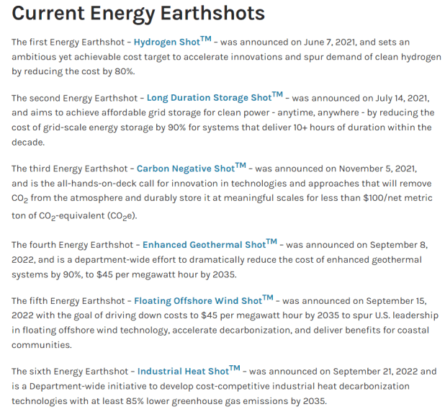
Initiatives by USDOE
https://www.energy.gov/policy/energy-earthshots-initiative

Slide 4
Key Challenges in Fuel-to-Energy
Nuclear Processes
Thermal Transport Processes
Biofuel Processes
Solar Power Systems
Sustainable Transportation
Nuclear fission
Nuclear fusion
Beams
Plasmas
Multiphase interactions
Flow regime dynamism
Flow stratification
Reacting flows, phase change
Material behavior
Air-fuel pre-heat
Oxidation
Radiation
Refractory wear
Emissions enthalpy
Optical configuration, accumulation of heat
Removal and storage of heat (concentrated solar power)
Power block design
BETO
HFTO
VTO
Waste Heat Recovery
Sensible heat recovery
Balance-of-plant
Sequestered heat
Reduced Order Models, Experiments, V&V, Benchmarks, Materials Response, Life-Cycle, Techno-Economic Feasibility, Commercialization

Slide 5
Computational Design Workflows for Modular Power
Concentrated Solar Power
Offshore Wind Power
Sustainable Transportation
Energy sectors which can benefit from technology development in modular nuclear power
Multiphysics Modeling and Simulation
Flow Regimes
Transport Phenomena
Fluid-Structure Interactions
Thermal Hydraulics
Inertial flows
Powerful CAE Design Tools
High-Performance Computing Resources
Probabilistic Risk Assessment and Process Safety
Advanced Manufacturing Techniques
f(T,P)
Process scaleup
Tech
to
Market
f(P, T)_{wall}
Lessons Learned from Nuclear Technology

Slide 6
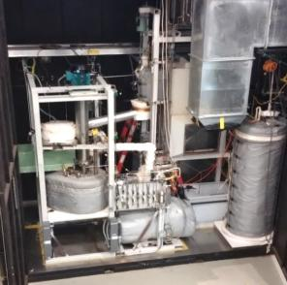
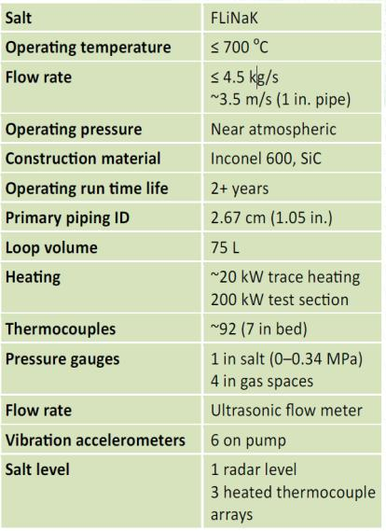
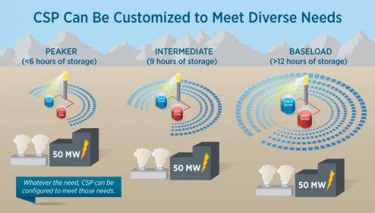
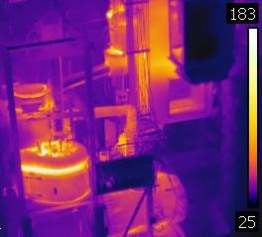
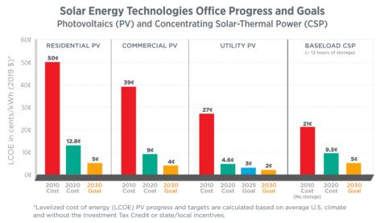
Unique Capabilities at ORNL: Molten Salt (Fluoride) Test Loop
Yoder G. Liquid Salt Test Loop Fact Sheet. 2016.
https://www.energy.gov/eere/articles/concentrating-solar-power-could-provide-flexibility-and-reliability-us-electric-grid

Slide 7
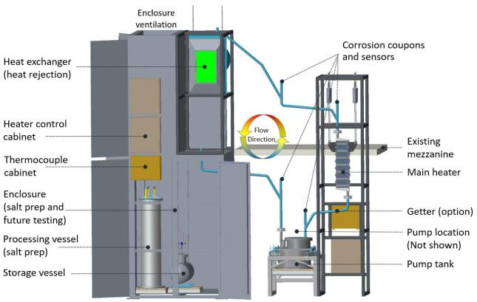
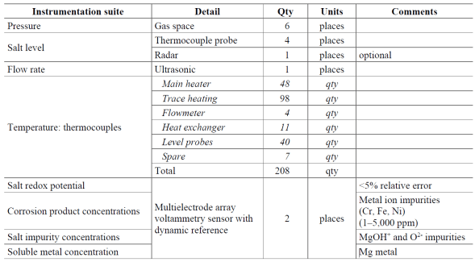
Unique Capabilities at ORNL: Molten Salt (Chloride) Test Loop
ORNL/TM-2019/1370. Facility to Alleviate Salt Technology Risks (FASTR): Preliminary Design Report with Failure Modes and Effects Analysis. Robb K, Mulligan P, Yoder G, Smith K and Massengale J. 2019.

Slide 8
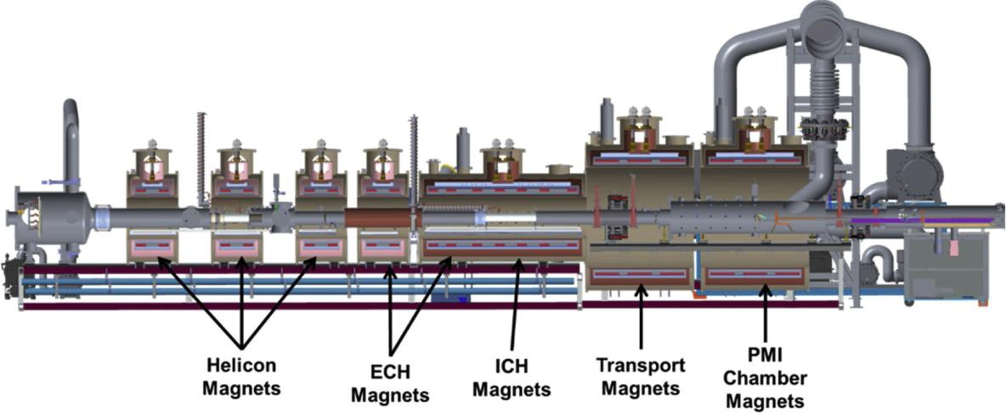
Unique Capabilities at ORNL: Fusion Science
Material Plasma Exposure eXperiment (MPEX)
Original artwork reproduced with permission, from “Juergen Rapp, Arnold Lumsdaine, Clyde Beers, Theodore Biewer, Timothy Bigelow, Ted Boyd, Juan Caneses, John Caughman, Robert Duckworth, Richard Goulding, William Hicks, Cornwall Lau, Pawel Piotrowicz, David West, Dennis Youchison, The Material Plasma Exposure eXperiment: Mission and conceptual design, Fusion Engineering and Design, Volume 156, 2020, 111586, ISSN 0920-3796”.

Slide 9
Thermal Efficiency Improvements 1. Direct-Contact Heat Exchanger for Low-Temperature Waste Heat Recovery

Slide 10
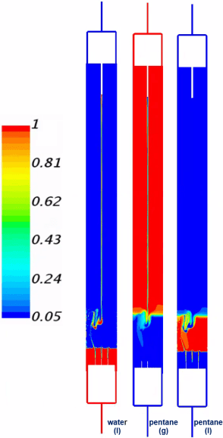
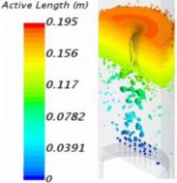
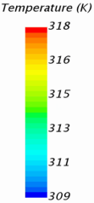
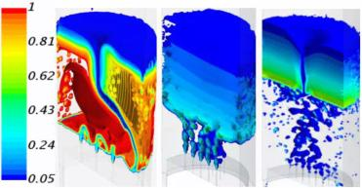
Immiscible Water-Refrigerant Mixture
Volume
Fraction
Volume
Fraction
Of Pentane_{(l)}
7-nozzle 19-nozzle 36-nozzle

Slide 11
Multiphysics Model Development

Slide 12
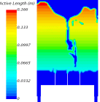
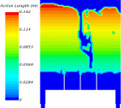
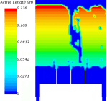
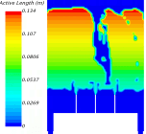
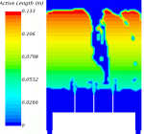
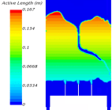
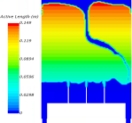
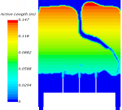
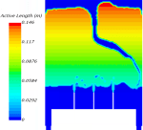
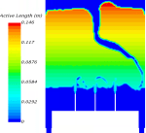
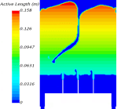
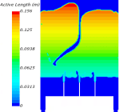
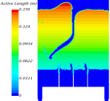
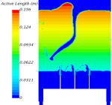
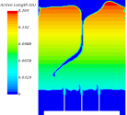
Multiphysics Model Validation
${ α}_{threshold}$ = 0.05 ${ α}_{threshold}$ = 0.10 $α_{threshold}$ = 0.15 $α_{threshold}$ = 0.20
$α_{threshold}$ = 0.014
1.3x COARSE
7-nozzle Sparger:
Sensitivity
of predicted
active heights
to global mesh
refinement
BASE MESH
$α_{threshold}$ = 0.014
BASE MESH
1.3x FINE
$α_{threshold}$ = 0.025
Measured value ~ 16.75 cm

Slide 13
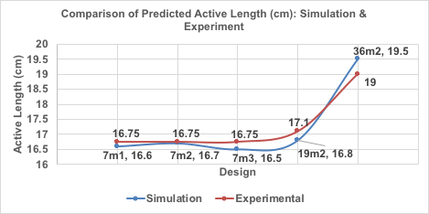
Prediction of Steady Operation
Water
Jet
Pentane_{(l)}

Slide 14
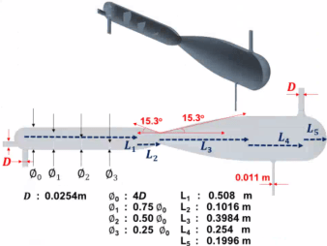
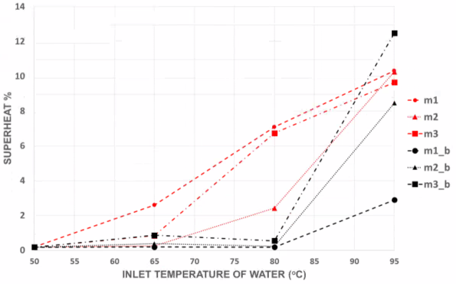
Validated Model to New Design
Notes:
Best-case energy savings: 251M BTU per year for simulated design
Practical design would save 25.1 BBTU per year, or roughly the consumption of 500 tonnes of kerosene

Slide 15
Thermal Efficiency Improvements 2. Additively Manufactured Ceramics for High-Temperature Gas-to-Gas Operations

Slide 16
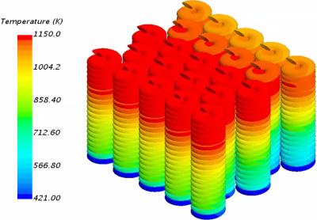
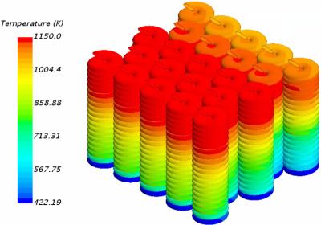
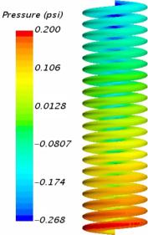
High-Temperature Composite Heat Exchangers
Shell-Side
Mass Inflow 0.265 kg/s
Inlet Temperature 1150.0 K
Tube-Side
Mass Inflow 0.2735 kg/s (total)
Inlet Temperature 421 K
Simulated rate of heat transfer to tube-side (cold fluid): 2.2 kW
Fluid Profile
Ceramic Coils
ΔP (1 tube) < 0.3 psi
55M cells
(tube array)

Slide 17
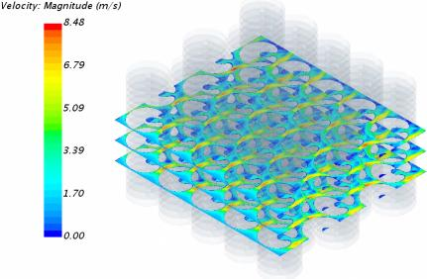
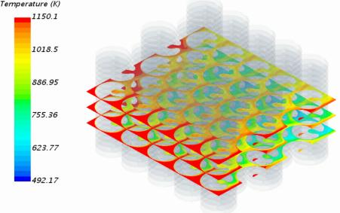
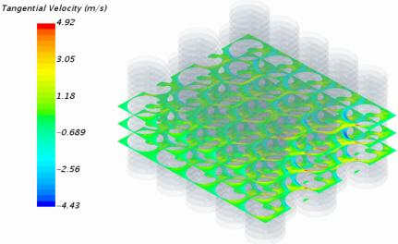
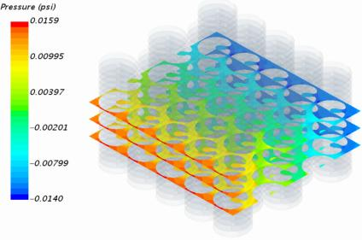
High-Temperature Composite Heat Exchangers
Consistency in flow – plume length, span-wise temperature, pressure
No stagnation of flow near “walls”
ΔP ~ 0.03 psi

Slide 18
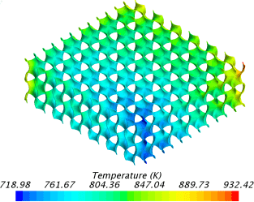
High-Temperature Composite Heat Exchangers
 | Simulated Rate of Heat Transfer, Q (W) |  | Q/V (kW/m³) |  | Q/ΔP (kW/psi)
 | Spiral Array | Gyroid Plate | Spiral Array | Gyroid Plate | Spiral Array | Gyroid Plate
SUNY Anode | 29.75 | 3378 | 7.65 | 4263 | 1.65 | 3246
SUNY Cathode | 2200 | 50944 | 343 | 64290 | 0.31 | 77
Brayton Energy | 24.10 | 914 | 6.2 | 1153 | 1.04 | 1974
CSM Fuel-Side | 21158 | 9500 | 3295 | 11989 | 7.78 | 272
CSM Air-Side | 22600 | 10149 | 3520 | 12808 | 18.06 | 400

Slide 19
Thermal Map: Power Density and Pressure Drop

Slide 20
Thermal Map: Specific Power Density and Wall Thickness
2379 W/π
15520 W/in.
3pi, 0.075”
2pi, 0.05”
2644 W/π
4920 W/in.
2pi, 0.075”

Slide 21
Thermomechanical Summary
CFD-informed FEA Predictions
 |  | P_{in} (psig) | ΔP (psid) | Rate of Heat Transfer (W) | Mass of Solid Walls (kg) | Volume of Solid Wall (m³) | Tin (ºC) | Tout (ºC) | Principal Stress (Pa) | Max. Displac-ement (µm)
2pi 0.05” | Hot | 0.032 | 0.053 | 4850 | 1.55 | 5.34e-4 | 619 | 553 | < 25 MPa | 437
 | Cold | 0.019 | 0.032 |  |  |  | 267 | 343
2pi 0.075” | Hot | 0.043 | 0.076 | 4973 | 1.80 | 6.21e-4 | 619 | 548 | < 25 MPa | 543
 | Cold | 0.033 | 0.041 |  |  |  | 267 | 342
3pi 0.050” | Hot | 0.011 | 0.126 | 7229 | 1.83 | 6.315e-4 | 619 | 517 | < 25 MPa | 244
 | Cold | 0.055 | 0.064 |  |  |  | 267 | 370
3pi 0.075” | Hot | 0.178 | 0.284 | 11961 | 2.18 | 7.506e-4 | 619 | 453 | < 25 MPa | 168
 | Cold | 0.304 | 0.138 |  |  |  | 267 | 354

Slide 22
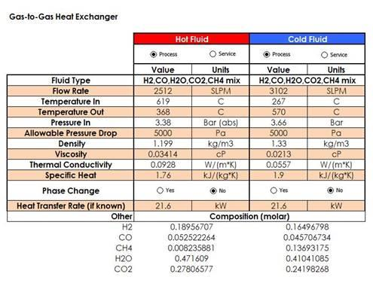
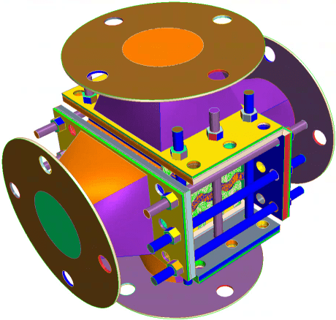
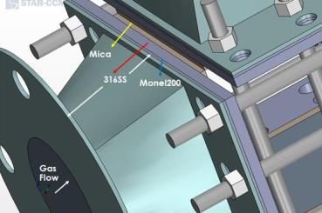
Developing the Gyroid
(Colorado School of Mines)
NECTAR Design
Cold
Flow
$$\vec{g}$$
Shell-Side (Hot Fluid)
Flow Rate 0.04502 kg/s
Inlet Temperature 619 C (892.16 K)
Tube-Side (Cold Fluid)
Mass Inflow 0.034668 kg/s (total)
Inlet Temperature 267 C (540.16 K)
Hot
Flow

Slide 23
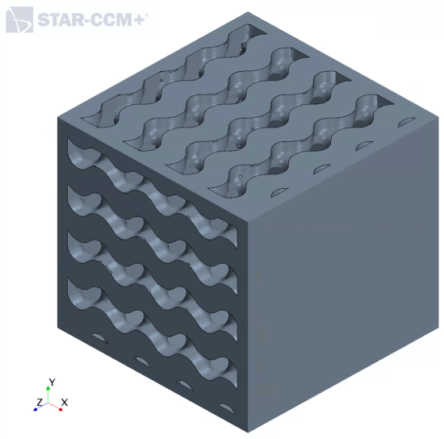
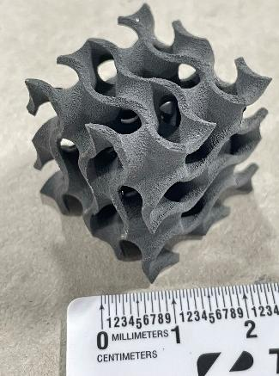
CAD to Realization
Cold
Flow
OUT
Closed to
Both Fluids
Printed at ORNL Manufacturing
Demonstration Facility
Hot
Flow
OUT
Cold
Flow
IN
Closed to
Both Fluids
Hot
Flow
IN

Slide 24
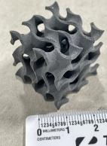
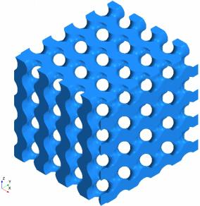
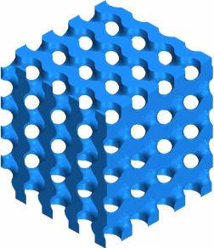
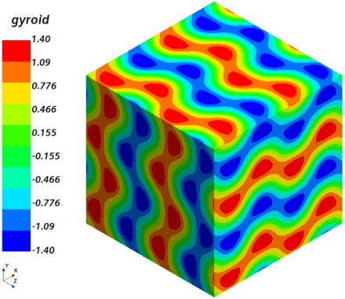
Gas to Gas HX: Flow Volumes
OUT
OUT
IN
IN
COLD
FLUID
HOT
FLUID

Slide 25
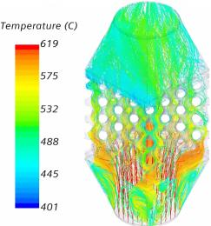
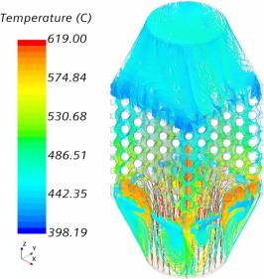
High-Temperature Composite Heat Exchangers
2pi, 0.05”
4pi, 0.05”
3pi, 0.05”
4pi, 0.1”
2pi, 0.1”

Slide 26
High-Temperature Composite Heat Exchangers
2pi, 0.1”
3pi, 0.05”
2pi, 0.1”
3pi, 0.05”
4pi, 0.05”
4pi, 0.05”
2pi, 0.05”
2pi, 0.05”
4pi, 0.1”
4pi, 0.1”
3pi, 0.05”
3pi, 0.05”
4pi, 0.1”
2pi, 0.1”
4pi, 0.1”
2pi, 0.1”
2pi, 0.05”
2pi, 0.05”
4pi, 0.05”
4pi, 0.05”

Slide 27
Ongoing Research
Heat exchangers w/ invertible Leidenfrost dynamics (ARPA-e CREATE)
Micro-HTGR in PCC conditions (NEUP)
Cymatic fluid dynamics
Pumped storage hydro power (WPTO HydroWIRES)
Tandem wind-tidal-wave energy capture ORBs for offshore marine power (WPTO Marine Energy Seedlings)

Slide 28
Support from Wayne and Gayle Laufer Endowment

Slide 29
Nuclear Energy | SMR | Lower Plenum
Concept Thermal Design
Westinghouse Nuclear – Small Modular Reactor (WSMR)
Based on the AP-1000 design (1100 MWe)
Advanced passive safety features
Cool operation w/o human intervention or AC power for 7 days
Design life: 60 years
Integral pressurizer unit
Integral annular steam-generator unit
Total site area ~ 15 acres
Rail, truck, or barge shippable
Underground containment
Containment cooling via evaporation, condensation, gravity
Reactor core thermal output: 800 MW
Active fuel length: 8 ft (~2.4 m)
Less than 5% enriched UO2 fuel
17x17 robust fuel assemblies (RFAs)
89 fuel assemblies
37 internal CRDMs
100,000 gpm coolant flow rate
8 reactor coolant pumps (RCPs)
3.5 m ∅ reactor pressure vessel (RPV)
24.1 m height RPV
Secondary side heat to 225 MWe
Image Courtesy: Westinghouse. ©2020 Westinghouse Electric Company LLC. All rights reserved.

Slide 30
Nuclear Energy | SMR | Lower Plenum
$$ratio=\frac{k_{les}}{\left(k_{les}+k_{sgs}\right)}$$

Slide 31
Nuclear Energy | SMR | Lower Plenum
1.
2.
3.
4.
Coefficient of Variation | Spalart-Allmaras | k-epsilon | k-omega | RST
z = -0.508 m | 0.166 | 0.424 | 0.378 | 0.326
z = -0.762 m | 0.473 | 0.568 | 0.504 | 0.654
z = -1.016 m | 0.389 | 0.321 | 0.331 | 0.321
z = -1.27 m | 0.340 | 0.397 | 0.333 | 0.252

Slide 32
Nuclear Energy | SMR | Lower Plenum
TKE (J/kg)
RST
LES
Cut-off Frequency
LES successful in capturing sub-range of spatial frequencies corresponding to inertial forces in turbulent flow

Slide 33
Nuclear Energy | SMR | Pressurizer Design
Operating Pressure | 2250 psia
Inlet Velocity | 11.92 m/s
Steam Volume | 19.435 m³
Steam-Water Volumetric Ratio | ~1.5:1
Gravity | [0, 0, -9.81] m/s²
10,278,437 hexahedral cells
Image Courtesy: Westinghouse. ©2020 Westinghouse Electric Company LLC. All rights reserved.

Slide 34
Nuclear Energy | SMR | Prediction of Steam Quality
Design Data
9,188 tubes
60% steam quality – secondary side
Simulation Data
Primary Side Flow:
12 m/s into upper tube sheet
@ 605 K, 15.5 MPa;
Secondary Side Flow:
5.5 MPa
T_sat = 543.3 K
VOF Boiling (Rohsenow) model RST model used to simulate turbulent flow
Tube Side: 198.5M cells
Shell Side: 93.5M cells
30º sector of steam generator

Slide 35
Nuclear Energy | SMR | Predicting Flow Under Pressurizer

Slide 36
Nuclear Energy | SMR | Prediction of Steam Quality
Profiles on Shell-Side Symmetry Plane
100 kg/s, 500 K @ Inlet
Profiles on Tube-Side Walls
9⁰ Sector
Outlet averaged quality: ~87%

Slide 37
Nuclear Energy | SMR | Prediction of Steam Quality
Profiles on Shell-Side Symmetry Plane
500 kg/s, 500 K @ Inlet
Profiles on Tube-Side Walls
9⁰ Sector
Outlet averaged quality: ~67%

Slide 38
Acknowledgements
Wayne and Gayle Laufer Endowment
Missouri University of Science & Technology
Nuclear Energy and Fuel Cycle Division, ORNL
Fusion Energy Division, ORNL
Compute and Data Environment for Sciences (CADES), ORNL
USDOE Funding (NE, EERE, WPTO, ARPA-e)

Slide 39
Thank you!
https://dilbert.com/strip/1989-09-24

