Slide 1
Techno-Economic Analysis
of an SOFC Hybrid Carbon Conversion Concept
Kyle L. Buchheit, Ph.D.^{1,2}, Alex Noring ^{1,2}, Arun Iyengar ^{1,2}, and Gregory Hackett ¹
¹NETL; ²NETL Support Contractor
2023 Laufer Energy Symposium
March 30 – April 1, 2023

Slide 2
TEA of an SOFC Hybrid Carbon Conversion Concept
Analysis Summary Statements
Objective
Understand the potential of coupling solid oxide fuel cell (SOFC) technology in hybrid carbon conversion (HCC) configurations from a cost and performance perspective.
Outcome
Techno-economic analysis (TEA) of an SOFC system paired with compressed air energy storage (CAES).
Identify primary cost and performance drivers for the hybridized system.
Identify specific process configurations and operating modes that make the hybridized system cost competitive with traditional NG fossil generation plants.
Approach
In partnership with Idaho National Laboratory, NETL recently completed an internal screening of multiple HCC concepts that included renewable, nuclear, and energy storage technologies with SOFC.
NETL has chosen to assess an SOFC+CAES hybrid system for further analysis.
Assess several operating configurations of a 250 MWe SOFC system paired with an 80 MWe CAES-powered turbine.
Analyze process sensitivities to cavern size, turbine operating temp, and charge/discharge timing.
Authors
Kyle Buchheit, Alex Noring, Arun Iyengar, and Gregory Hackett

Slide 3
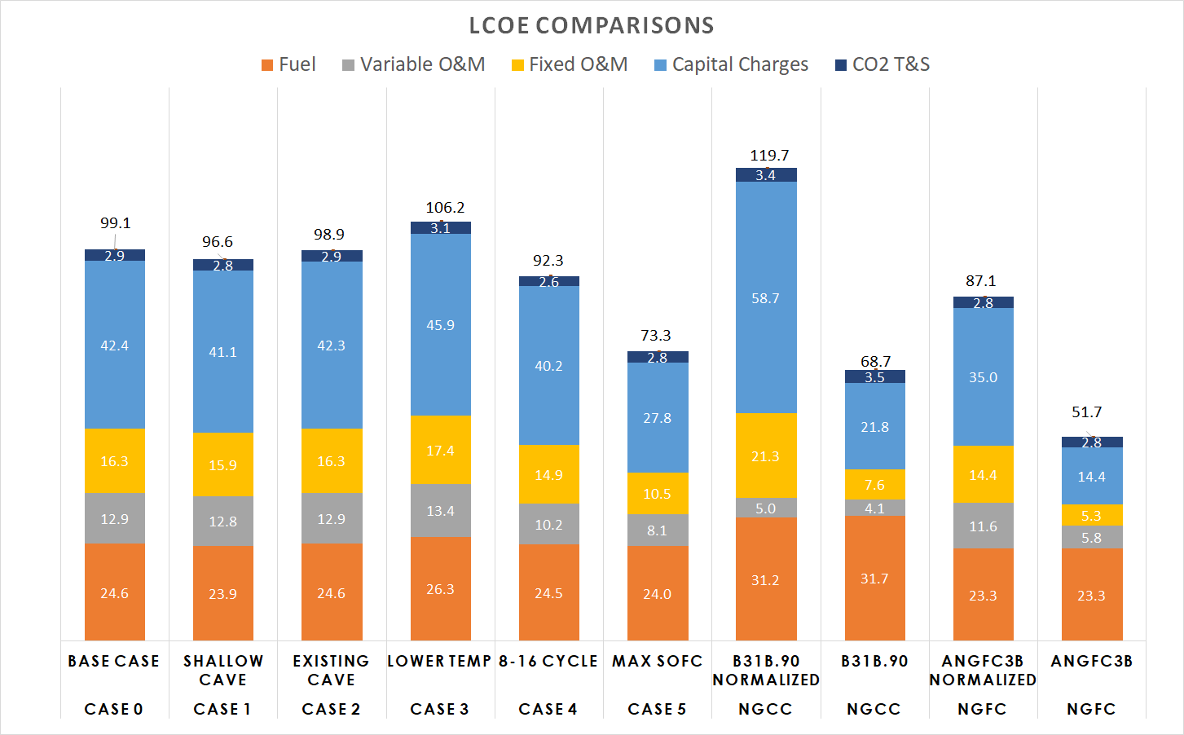
TEA of an SOFC Hybrid Carbon Conversion Concept
Highlights
The added flexibility of the hybrid system comes at an increased cost.
A power ratio of ≈3.1 SOFC to CAES thermally integrates the system, eliminating the need for external heat.
The charge and discharge times affect the cavern sizing and compressor power requirements.
When normalized for power output and capacity factors, the hybridized system is cost competitive with Natural Gas Combined Cycle (NGCC) and Natural Gas Fuel Cell (NGFC) plants.
Identified several items related to process configuration and operating conditions for future analysis.

Slide 4
Remaining Agenda
Design Basis Overview.
Operating Parameters/Assumptions.
Base Case.
Analysis Case Review.
Results Summary.
Performance Results.
Economic Results.
Conclusions.
Future Work.
Questions/Comments.

Slide 5
Design Basis
Important Operating Principles/Assumptions
Site and fuel conditions are consistent with NETL Fossil Energy Baseline¹.
SOFC system is based on atmospheric operation with carbon capture (ANGFC3B) from the TEA of NGFC Configurations².
Operation Dynamics:
The SOFC system runs continuously to avoid thermal cycling.
Charging Mode – SOFC output is ramped down to system net zero electricity output; heat used to drive steam cycle.
Discharging Mode – SOFC output is ramped to full output; heat used to pre-heat air.
Efficiency Metrics:
Efficiencies
Round-Trip Efficiency | $$\frac{Full Cycle Net Plant Power}{Full Cycle Thermal Input (HHV)}$$
Apparent Charging Efficiency | $$\frac{Round−Trip Efficiency}{Discharge Efficiency}$$
1 - NETL Fossil Energy Baseline Report Link
2 - TEA of NGFC Plant Configurations

Slide 6
Design Basis
Base Case Configuration
Standard Operation
Material Stream
Charging
Work Stream
Discharging
Heat Stream
79.3 MW
H
2
O
CO₂
CO₂ Purification
Turbine
Air
Air Separation
900
°
C
Expanded
Unit
Exhaust
250 MW
Cooler
239°C
66.2 MW
O₂
HX
190
°
C
91 MW
94
°
C
180
°
C
Natural Gas
Anode
H₂O,CO₂,H₂,CO
Combustion
H₂O, CO₂
Thermal
Manager
HX
HX
Chamber
100
°
C
Cathode
Air
Solid Oxide
Fuel Cell*
Compressed
Air Storage
* Less than 100% fuel utilization
Depleted Air
Steam Cycle
50
°
C
114
°
C
94.7 MW
45.3 MW
HX
Compressor
Air
70 bar
~910,000 lb/h air
800
°
C
104.4 MW

Slide 7
Design Basis
SOFC + CAES System Model Assumptions
SOFC Assumptions
SOFC Fuel Utilization | 85%
Current Density (mA/cm²) | 400
Natural Gas Reformation | 100% Internal
Cathode Recycle | 50%
Oxygen: Carbon Ratio in Anode | 2.1
SOFC Delta T (°C) | 100
SOFC Max T (°C) | 750
SOFC Pressure | Atmospheric
CAES Assumptions
Salt Cavern Storage
Maximum Cavern Pressure (Bar) | 70
Minimum Cavern Pressure (Bar) | 40
Isothermal Cavern Temperature (°C) | 50
Turbine Inlet Temperature (°C) | 900
Inlet Air Pressure (Bar) | 1
Charge/Discharge Cycle | 12 Hour
SOFC output during discharge meets thermal requirements of CAES.
Net zero power generation during charging.
Reduced SOFC output + steam cycle heat utilization.

Slide 8
Design Basis
Case Overview
 | Case 0 | Case 1 | Case 2 | Case 3 | Case 4 | Case 5
SOFC Scale | 250 MW | 250 MW | 250 MW | 250 MW | 250 MW | 250 MW
CAES Scale | 80 MW | 75 MW | 80 MW | <80 MW | 80 MW | 80 MW
Cavern Min Pressure | 40 bar | 20 bar | 40 bar | 40 bar | 40 bar | 40 bar
Cavern Max Pressure | 70 bar | 35 bar | 70 bar | 70 bar | 70 bar | 70 bar
Cavern Type | Average | Shallow | Existing | Average | Average | Average
Turbine Inlet Temperature | 900 °C | 900 °C | 900 °C | 600 °C | 900 °C | 900°C
Charge-Discharge Cycle | 12-12 | 12-12 | 12-12 | 12-12 | 8-16 | 12-12+SOFC
Case 1 – Lower CAES power due to shallow cavern and lower pressure.
Case 2 – Performance is identical to Case 0, CAES cavern economics impact.
Case 3 – Lower turbine inlet temperature.
Case 4 – 8 hour charge and 16 hour discharge.
Case 5 – SOFC operates at constant output.

Slide 9
Results Summary
Performance Comparison
Plant Performance | Case 0 | Case 1 | Case 3 | Case 4 | Case 5
Discharge Net Auxiliary Load | 17,924 | 17,943 | 17,902 | 17,924 | 17,924 | kWe
Charge Net Auxiliary Load | 111,303 | 89,781 | 151,040 | 222,453 | 125,250 | kWe
Discharge Net Plant Power | 311,457 | 307,338 | 310,879 | 311,457 | 311,457 | kWe
Full Cycle Net Plant Power | 3,741,074 | 3,690,444 | 3,735,333 | 4,988,099 | 6,175,584 | kWe-h
Full Cycle Thermal Input | 6,102,580 | 5,864,676 | 6,516,137 | 8,123,530 | 9,849,890 | kWt-h
Net Plant Efficiency (HHV) | 61.30% | 62.93% | 57.32% | 61.40% | 62.70 | %
Round-Trip Efficiency | 61.07% | 62.75% | 56.97% | 61.08% | 70.71 | %
Apparent Charging Efficiency | 80.39% | 83.75% | 75.11% | 80.40% | 93.08 | %
Carbon Dioxide Capture Rate | 98.1 | 98.1 | 98.1 | 98.1 | 98.1 | %
Compressed Air Flowrate | 21,864,060 | 23,554,686 | 29,720,334 | 29,152,080 | 21,864,060 | lb/day
Natural Gas Feed Flowrate | 923,448 | 887,448 | 986,028 | 1,229,260 | 1,490,496 | lb/day
Condenser Duty | 2,700 | 2,220 | 3,660 | 3,600 | 4,440 | MMBtu/day
Raw Water Withdrawal | 10,177 | 9,054 | 12,388 | 13,122 | 15,859 | gpd
Raw Water Consumption | 7,033 | 6,196 | 8,692 | 9,033 | 10,913 | gpd

Slide 10
Results Summary
Economic Calculation Methodology
Estimate total plant costs for each subsystem (i.e., 70 bar/40 bar, charge/discharge).
Identify main cost component contributor.
Combine largest cost contributors for overall system.
Integrate individual sub-accounts based on maximum values from each individual subsystem.
Resulting sub-accounts are often higher cost than simple subsystem maximum.
Overall operating factor of 85% is assumed in addition to cycle times.
Net values based on total cycle over a day/year as opposed to per hour/ assumed steady operation basis.

Slide 11
Results Summary
Economic Comparison
Cost of Electricity (2018$/MWh) | Case 0 Base Case | Case 1 Shallow Cavern | Case 2 Existing Cavern | Case 3 Lower Turbine Inlet Temp | Case 4 8-16 Cycle | Case 5 Constant SOFC | NGFC Normalized | NGFC ANGFC3B
Variable COE | 37.5 | 36.7 | 37.5 | 39.7 | 34.7 | 32.1 | 35.0 | 29.2
Fuel | 24.6 | 23.9 | 24.6 | 26.3 | 24.5 | 24.0 | 23.3 | 23.3
Variable O&M | 12.9 | 12.8 | 12.9 | 13.4 | 10.2 | 8.1 | 11.6 | 5.8
Fixed O&M | 16.3 | 15.9 | 16.3 | 17.4 | 14.9 | 10.5 | 14.4 | 5.3
Capital Charges | 42.4 | 41.1 | 42.3 | 45.9 | 40.2 | 27.8 | 35.0 | 14.4
Total First Year COE (excl. T&S) | 96.2 | 93.7 | 96.0 | 103.1 | 89.8 | 70.5 | 84.4 | 48.9
CO₂ T&S | 2.9 | 2.8 | 2.9 | 3.1 | 2.6 | 2.8 | 2.8 | 2.8
First Year COE (with T&S) | 99.1 | 96.6 | 98.9 | 106.2 | 92.3 | 73.3 | 87.1 | 51.7
*Normalized refers to adjusting peak power output to 310 MW_{e} net and 42.5% Capacity Factor to more closely match the hybrid system outputs

Slide 12
Results Summary
Economic Comparison

Slide 13
Conclusions
To meet the heat requirements of the CAES system, a power ratio of ≈3.1 SOFC to CAES eliminates the need for external heat sources.
During charging, the heat generated can drive a steam cycle.
Lower pressure operation is favorable due to lower auxiliary compressor requirements. However, higher volumes of air are required.
Once hybridized, cavern type and cost have minimal impact on the Levelized Cost of Electricity (LCOE).
Lower turbine temperatures required the most compressed air (even compared to 8-16 cycle), which increase the cost of equipment.
Longer duration power output lowers LCOE by having an effectively higher availability factor.
When normalized for power output and capacity factors, the hybridized system is cost competitive with NGCC and NGFC plants.

Slide 14
Future Work
Flexible Operation
Base operation may not need to be consecutive (i.e., 12-hour charge then 12-hour discharge).
Real world demand, market prices, etc., could be used.
Costing
Purchasing cheaper electricity from the grid could lower costs during charging.
Depending on the availability and market price for electricity, swapping to a reversible SOC to produce hydrogen in addition to storing pressurized air.
Equipment
Specialized equipment, air turbines, compressors, etc., may have different base costs or cost scaling, which may close or widen the differences in LCOE.
Pressurized SOFC system could offer benefits by storing exhaust air.

Slide 15
Co-author Contacts
Kyle Buchheit
Kyle.Buchheit@NETL.DOE.GOV
Alex Noring
Alexander.Noring@NETL.DOE.GOV
Arun Iyengar
Arun.Iyengar@NETL.DOE.GOV
Gregory Hackett
Gregory.Hackett@NETL.DOE.GOV

Slide 16
Disclaimer
This presentation was prepared as an account of work sponsored by an agency of the United States Government. Neither the United States Government nor any agency thereof, nor any of their employees, makes any warranty, express or implied, or assumes any legal liability or responsibility for the accuracy, completeness, or usefulness of any information, apparatus, product, or process disclosed, or represents that its use would not infringe privately owned rights. Reference therein to any specific commercial product, process, or service by trade name, trademark, manufacturer, or otherwise does not necessarily constitute or imply its endorsement, recommendation, or favoring by the United States Government or any agency thereof. The views and opinions of authors expressed therein do not necessarily state or reflect those of the United States Government or any agency thereof.

Slide 17
Questions/ Comments
Gregory Hackett
Gregory.Hackett@netl.doe.gov
Notes:
Photo: 3-D printing of NETL logo in the Multiphase Flow Analysis Laboratory at NETL Morgantown

