Slide 1
LAUFER ENERGY SYMPOSIUM
March 30, 2023
Jeremy Hartvigsen
Senior Research Engineer, INL
Hydrogen
Enabling Unconventional Fuels

Slide 2
Overview
INL Overview
  Demonstration projects
  Nuclear plant demonstrations
Hydrogen
    Theoretical demand
    Properties
    Use Cases
  Integrated Energy Systems
    Hydrogen for low-carbon fuels
    Hydrogen co-located with nuclear power plants
  Hydrogen production
    High Temperature Electrolysis (HTE)

Slide 3

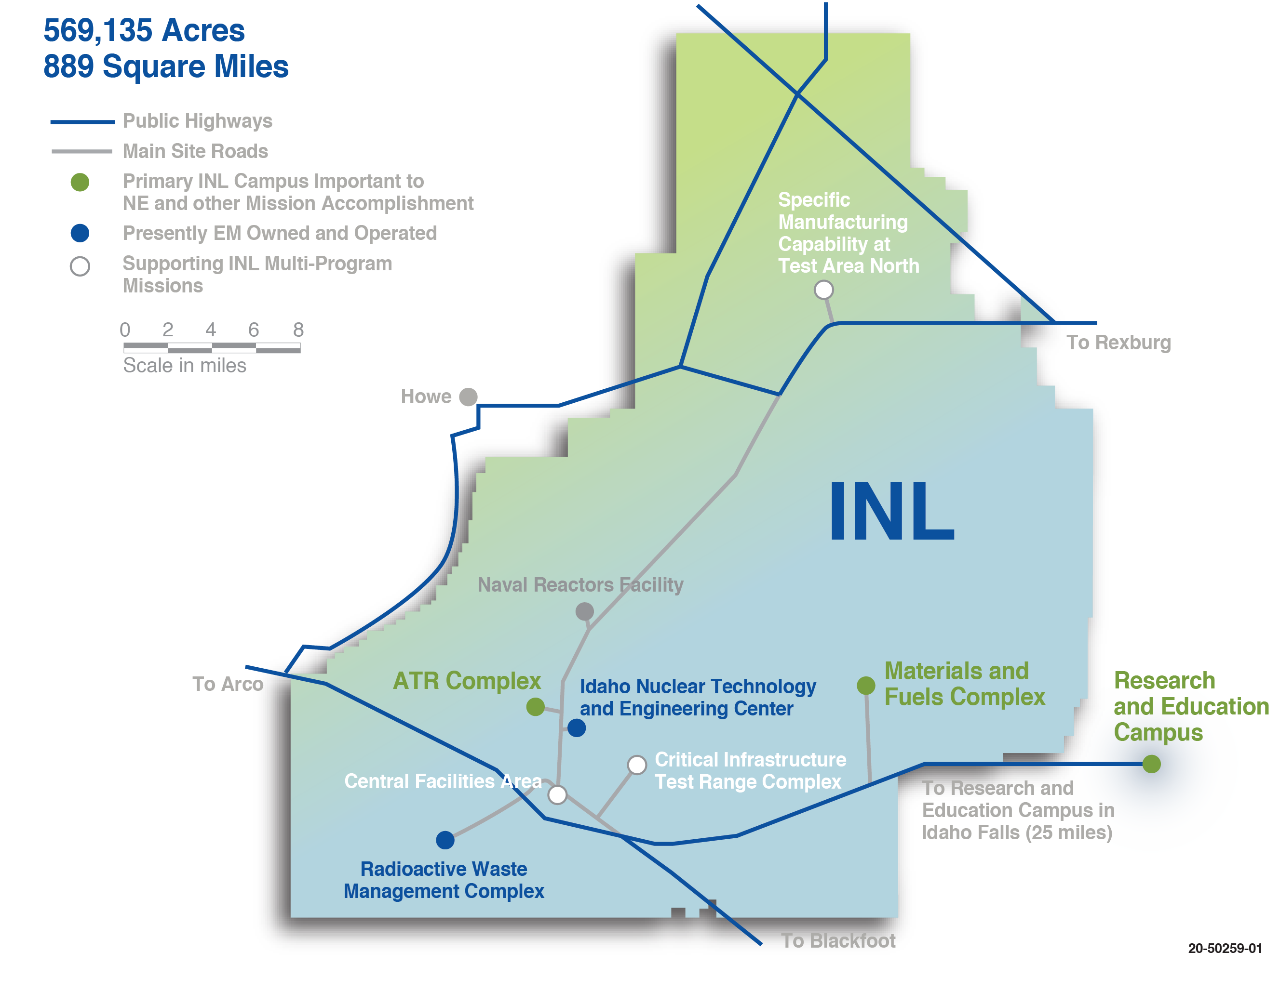





INL Addresses Energy and Security Challenges at Scale
298
DOE owned
buildings & trailers
4,888 Staff &
Subcontractors
27
Contractor leased
buildings & trailers
3.2B
$
RPV
25
Nuclear Facilities
Haz Cat I Adv. Test Reactor
Haz Cat II
Haz Cat III
3.3M
SQ FT
Gross
3 Fire Stations
1 Landfill
1 Museum
44
Radiological
Facilities
4
Operating
Reactors
7
Substations with interfaces
to 2 power providers
40
17.5
Miles primary roads /
125 total
Miles railroad for shipping
nuclear fuel
112
Miles high-voltage
transmission lines
Notes:
The nation’s nuclear laboratory leveraging multiprogram capabilities

Slide 4
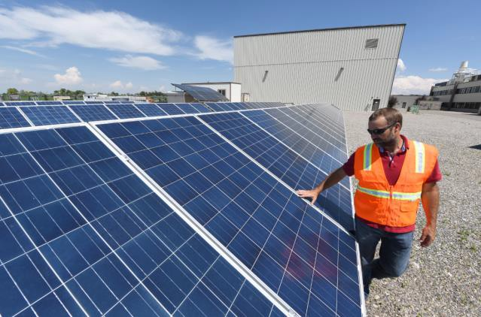
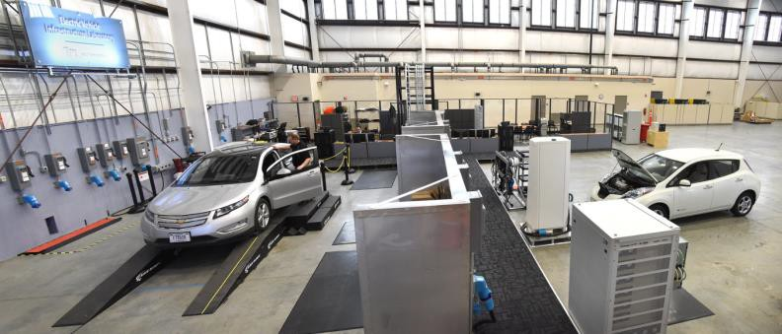
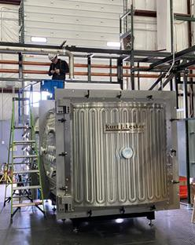
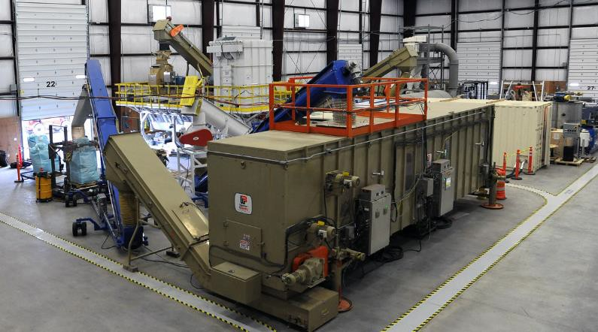
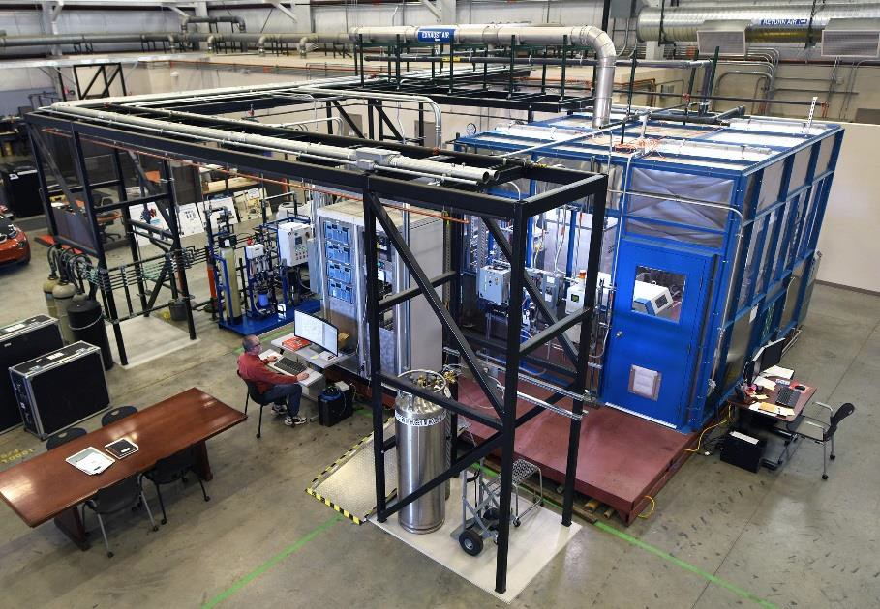
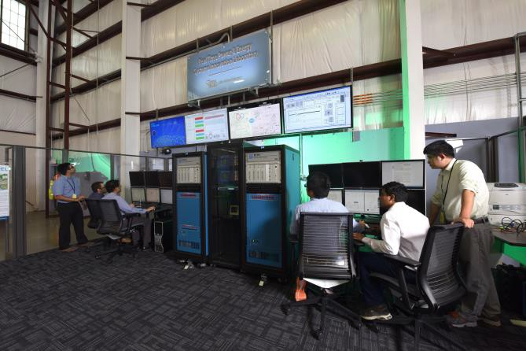
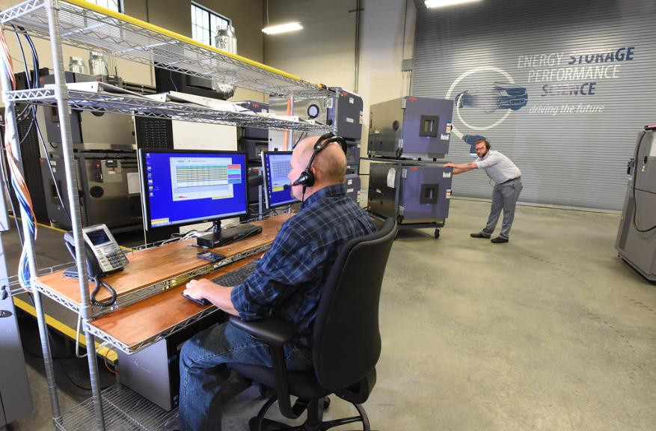
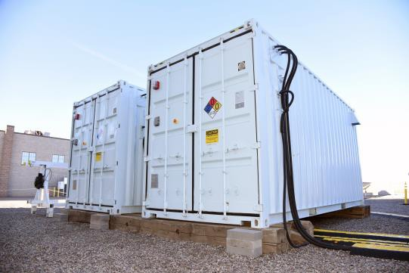
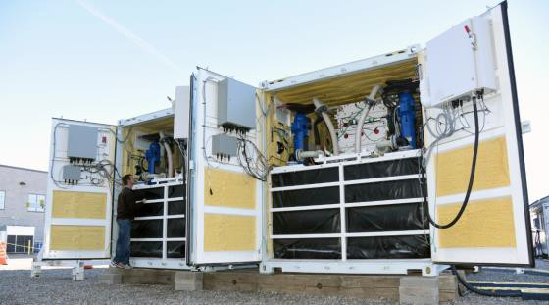

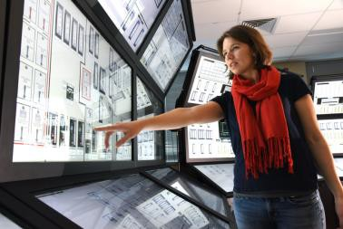
Associated IES Research Capabilities
Electric Vehicle Infrastructure
Solar PV Power Generation
Microreactor
Biomass User Facility
High Temp. Electrolysis
Flow Battery
Human Factors & Controls Environment
Battery Storage Lab
4

Slide 5
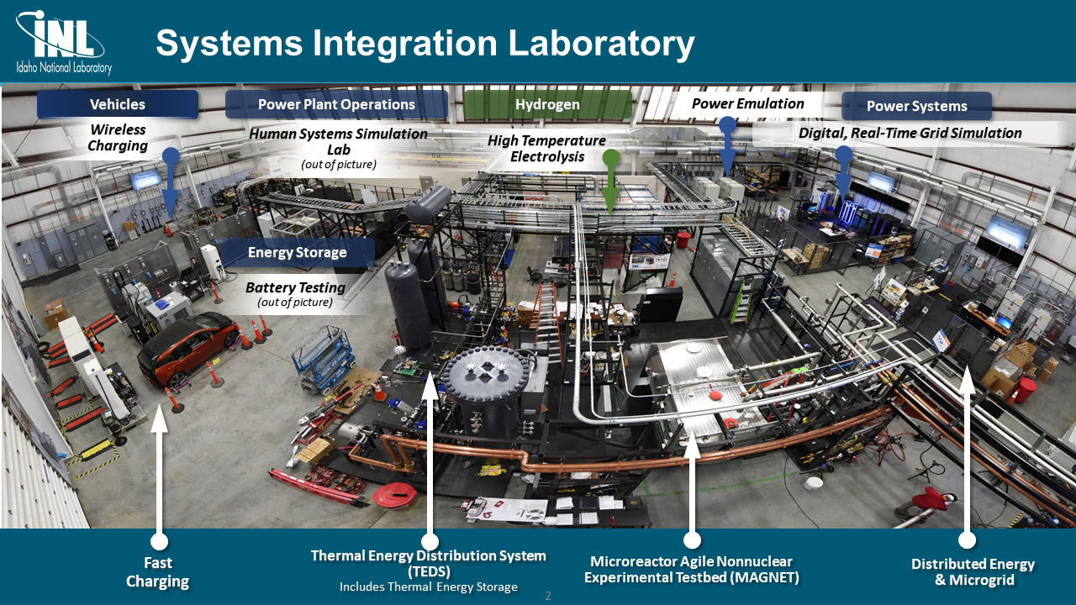

Slide 6

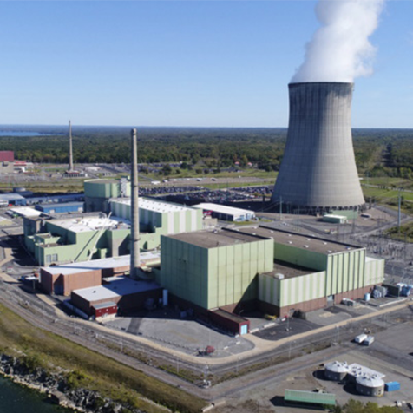
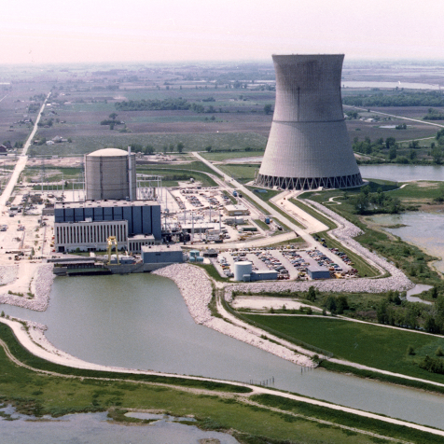
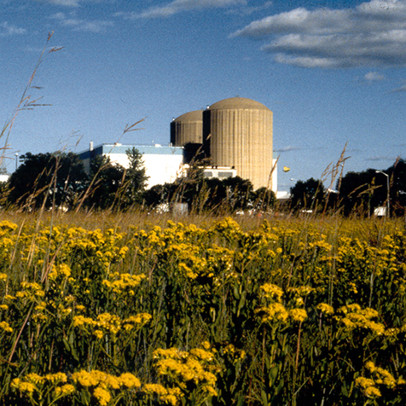
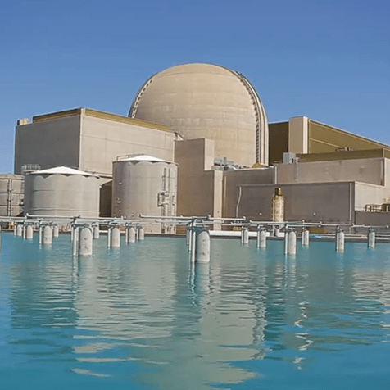
H2 Production at Existing Nuclear Plants
Nine-Mile Point | Davis-Besse | Prairie Island | Palo Verde
Constellation | Energy Harbor | Xcel Energy | Arizona Public Service
PEM | PEM | SOEC | LTE
NEL | To Be Awarded | Bloom Energy | To Be Awarded
Feb 2023 | 2023 | 2024 | 2024

Slide 8
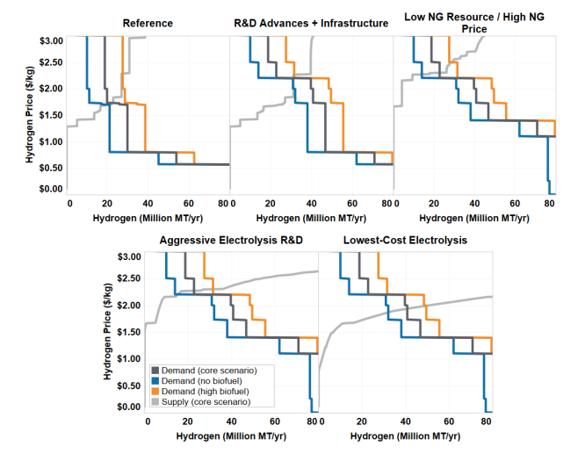


Hydrogen Supply and Demand curves
Forecasts for 2050 from 2020
Forecasts for 2030 from 2023
2020 Outlook for 2050
Very little synfuel or FCV modeled
Only 30% decarbonization by 2050
Hydrogen Shot Target $1/kg by 2030
Source: NREL The Technical and Economic Potential of the H2@Scale Concept within the United States 2020
Rapid Change in the level of support=Rapid Change in the potential Supply & Demand

Slide 9

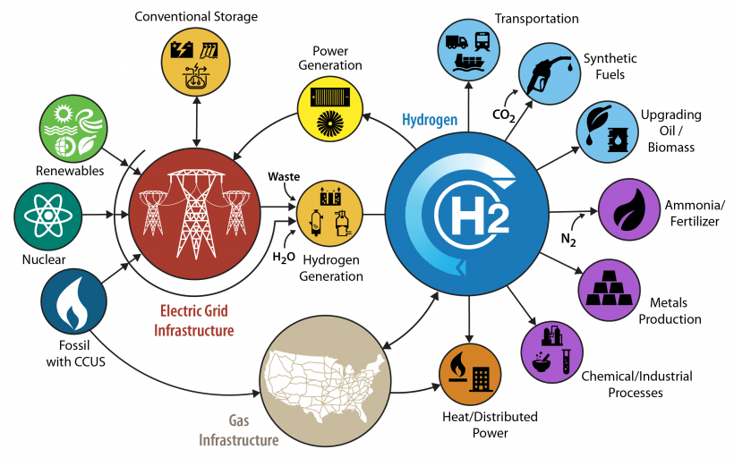
Hydrogen in Integrated Energy
Hydrogen Cost Drivers
Energy or Molecules
Storage
Production
Transport

Slide 10


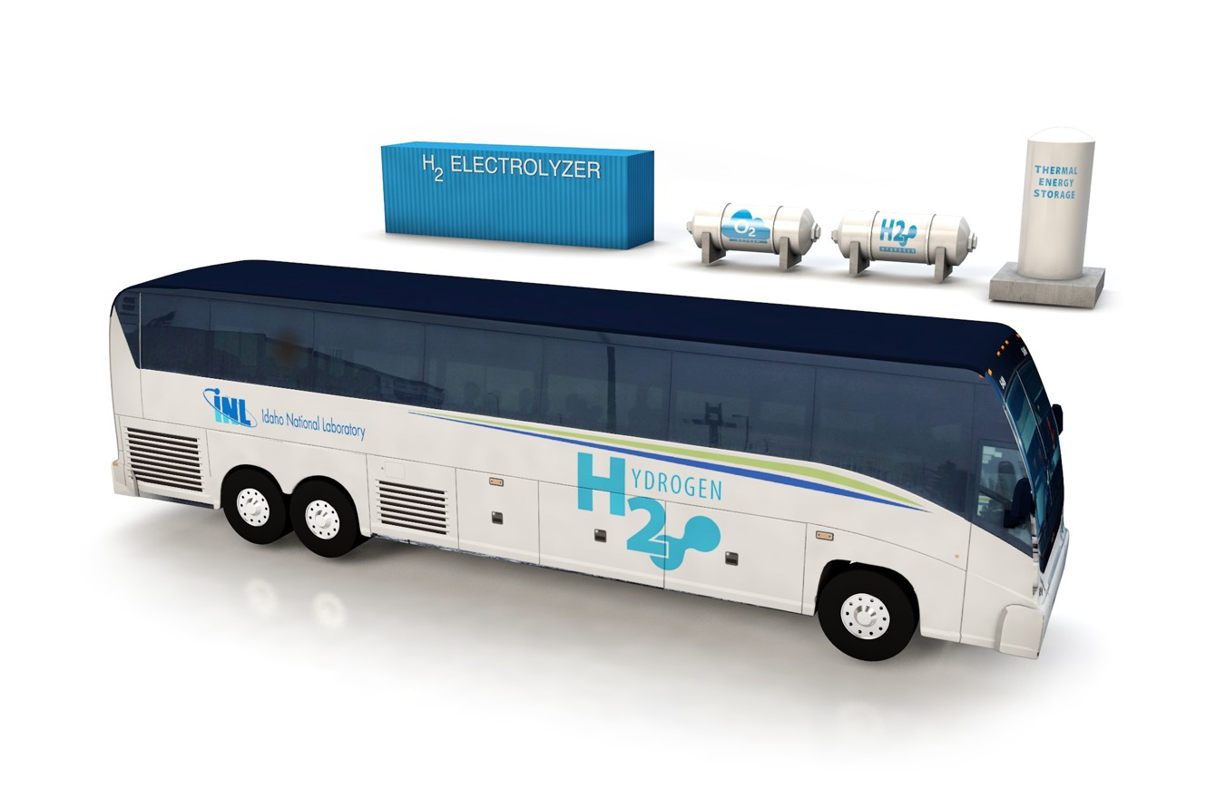
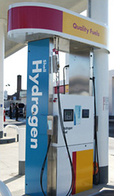
Hydrogen Value Chain
Chemicals
Metals Refining
High Temperature Process heat
Grid Storage
Heavy-duty Vehicles
High-uptime operations
Room-conditioning
Light-duty Vehicles
Molecules
Chemical Value
High Temperature
Capacity Costs
Weight Sensitive
Refilling Speed
Operating Costs
Infrastructure Costs
Network Effects

Slide 11
Hydrogen Properties
Hydrogen Safety Perceptions
Stoichiometric explosions in chemistry
  Rarely reached conditions due to buoyancy, diffusion, and low MIE
Low-density gas
  Gravimetric energy density
    With tank
    Without tanks
  Volumetric energy density is low
Wide flammability limits
  4-74% in air
Low Minimum Ignition Energy
  H₂: .011 mJ CH₄: .3 mJ
Leakage
  High diffusivity
Non-Toxic
Source: DOE website https://www.energy.gov/eere/fuelcells/hydrogen-storage

Slide 14
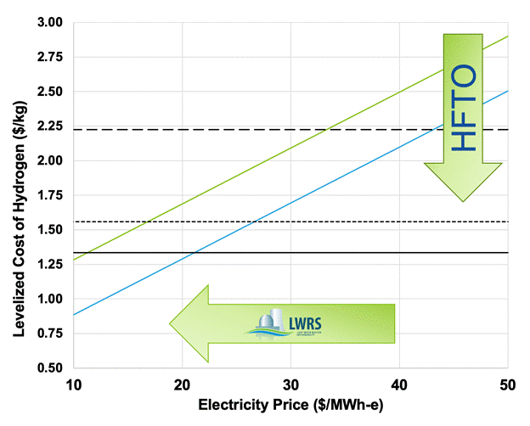
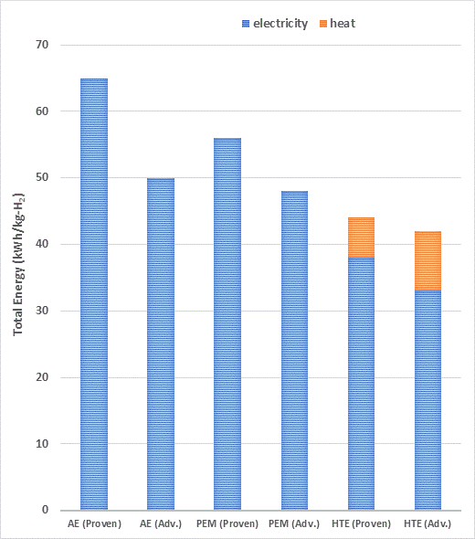
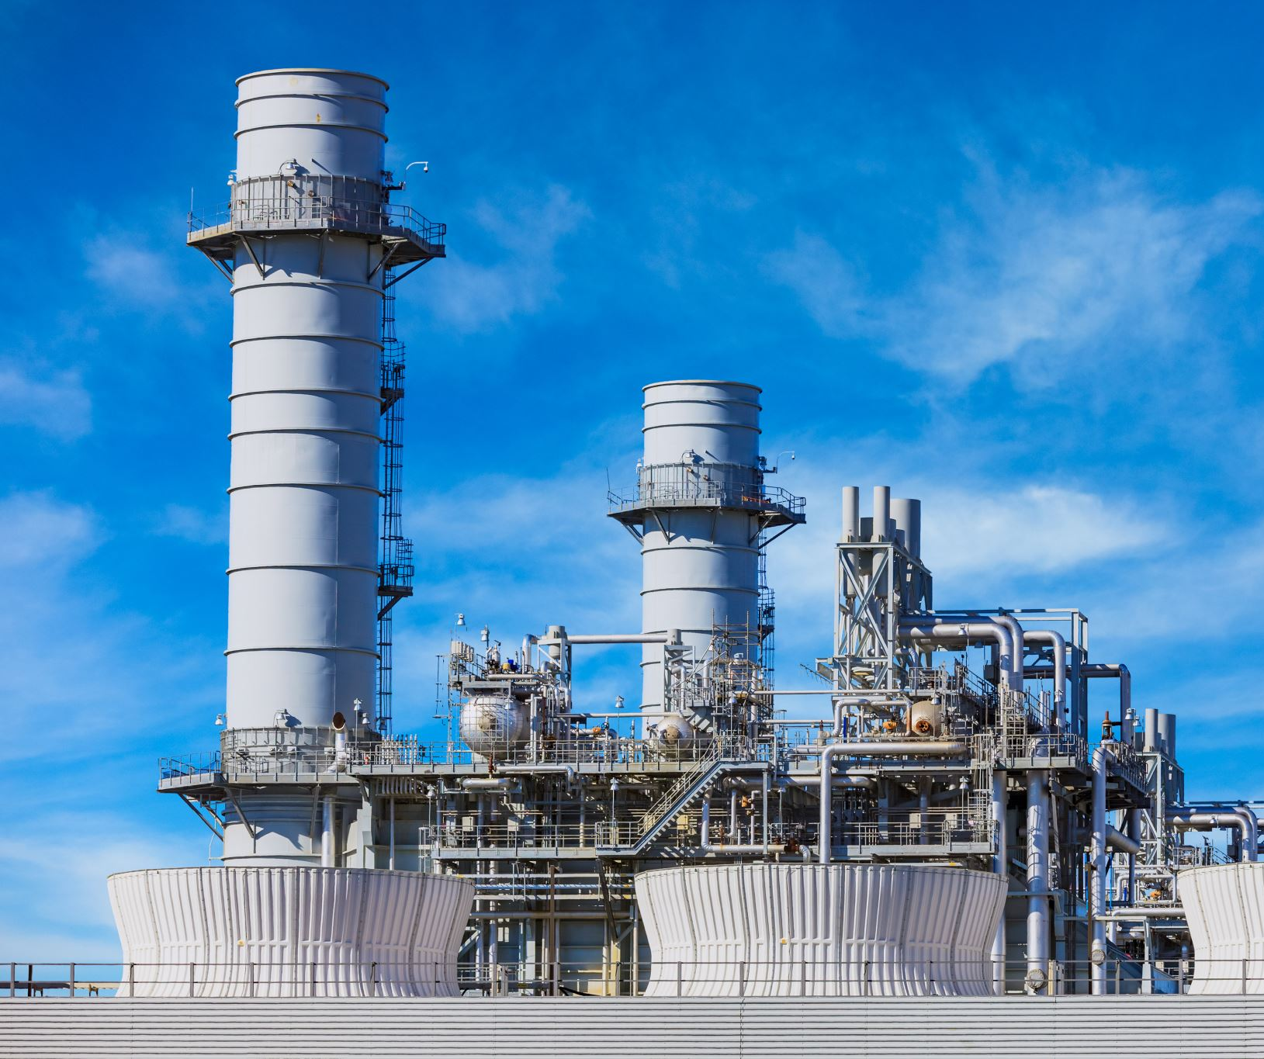


Hydrogen Production
NG – Blue Hydrogen
$Low, $Reference, $High
Fossil Fuel Reforming
  Grey Hydrogen
  Blue Hydrogen
Biomass
Electrolysis
H2NEW: $2026 $2030
CO₂ intensity:
Grey: 9-14kg CO₂/kg H₂
Blue: 0.5-7.9 kg CO₂/kg H₂
Biomass: Variable, :<2 kg CO₂/kg H₂
“Green” Electrolysis:<2 kg CO₂/kg H₂

Slide 15
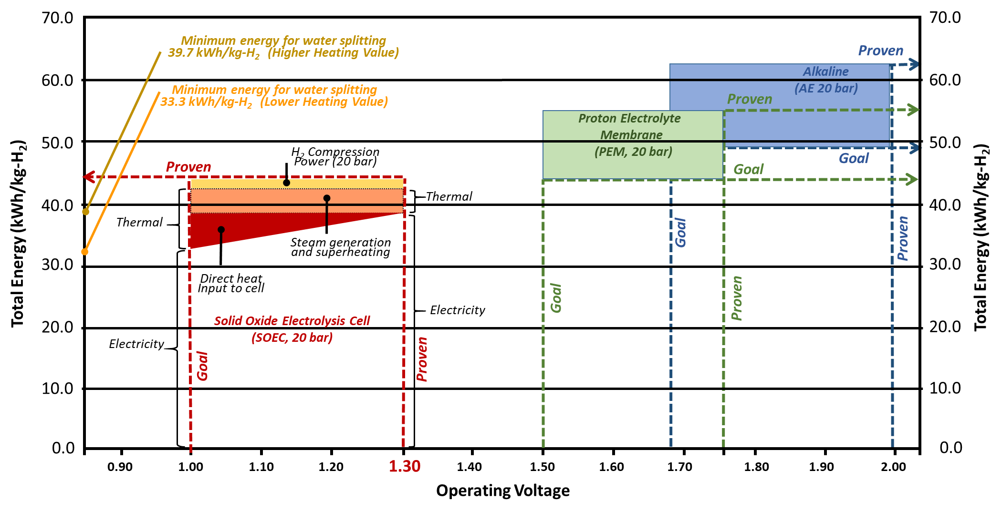
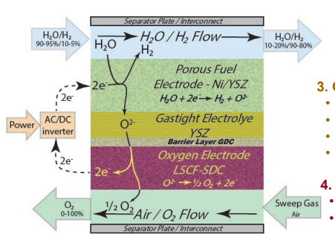
Solid Oxide Electrolysis
SOEC Electrolytic Hydrogen
Low energy use (42 kWh/kg)
Low electricity use (35-37 kWh/kg)
Instantaneous Demand Response (DR)
No precious metal catalyst
Commercially maturity is emerging
  Over 2 GW of factory capacity on-line or announced
Standby load of 5-10% required for heat
SOEC
Operates at 700-800 °C
Utilizes steam as a feedstock
Does not require thermal input

Slide 16
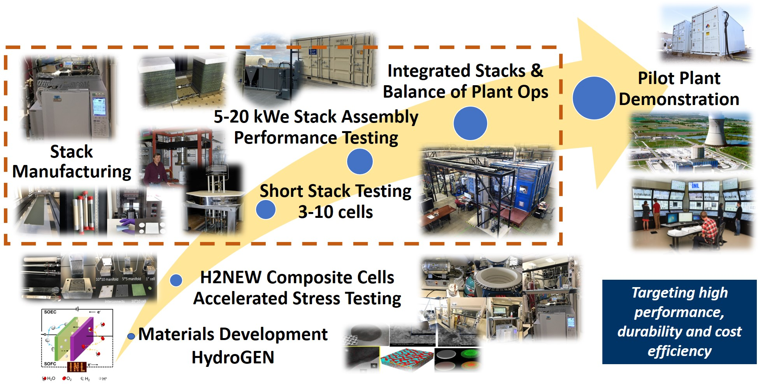
Hydrogen Project Portfolio

Slide 17
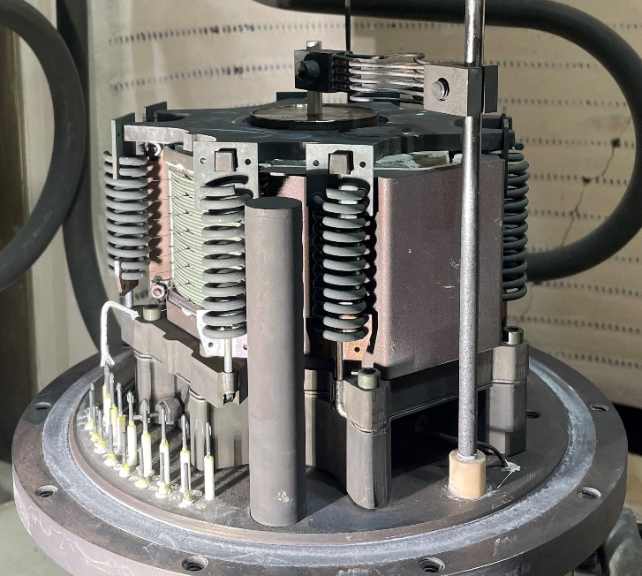
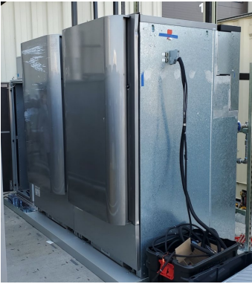
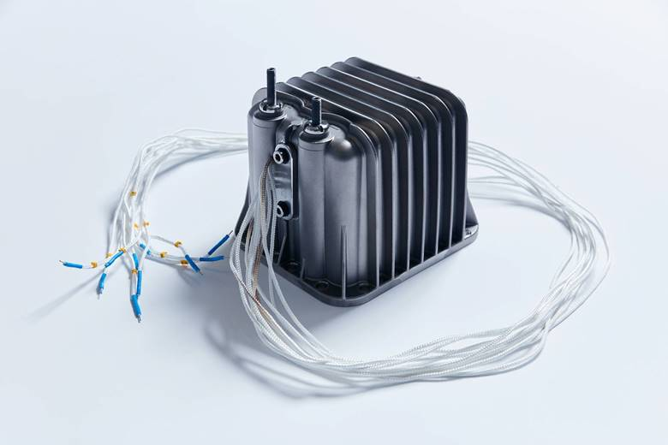
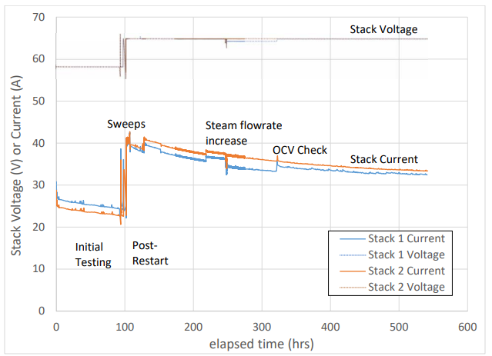
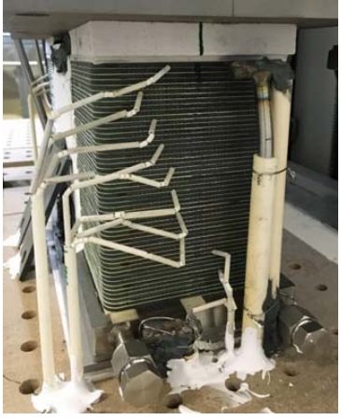
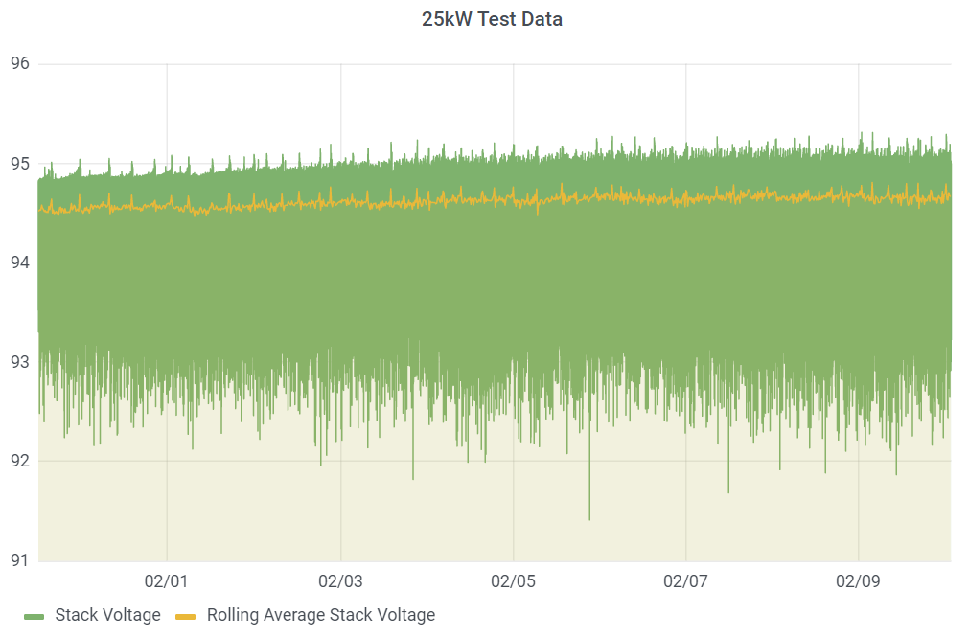
SOEC Testing
Fuel Cell Energy
Bloom
Haldor-Topsoe
1st generation of stack family
.5%/1000 hour stack voltage degradation
Estimated capital cost contribution of $.38/kg
Oxeon
100 kW system
37.7 kWh/kg
More Stacks And Systems On The Way

Slide 18
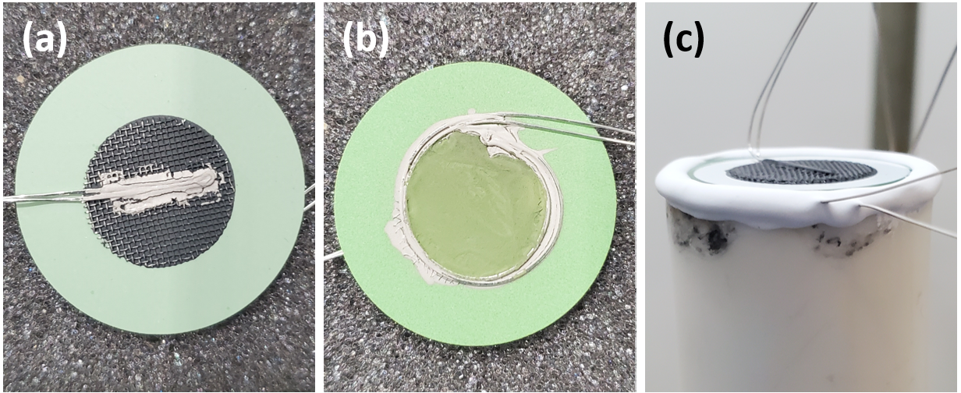
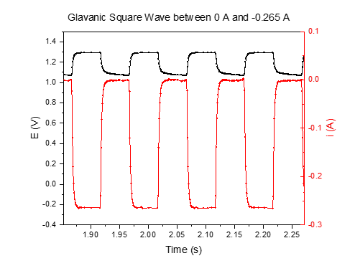
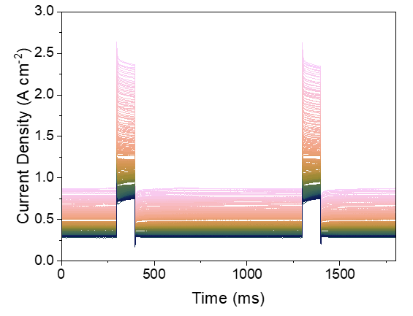
H2New Testing
Objective:
  Improve system lifetime
    20 khrs to 60+ khrs
  Single largest LCOH cost reduction other than electricity
Accelerated Stress Testing
  Pulse Width Modulation Cycling
    Accelerated stress
      Breaks linear current/voltage relationships
    Demonstrates power cycling

Slide 19



Energy Efficiency and Renewable Energy
Office of Nuclear Energy

