Slide 1

The Challenges of Wind and Solar and How
Bioenergy with Carbon Capture
Can Help
Richard L. Axelbaum
Jens Professor of Environmental Engineering Science
Department of Energy, Environmental and
Chemical Engineering
Washington University in St. Louis

Slide 2
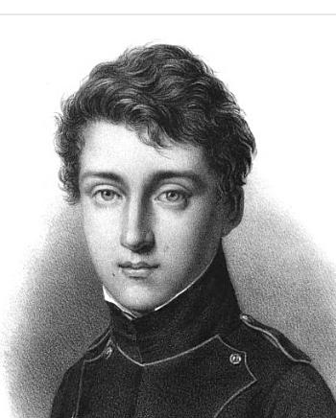
Carnot, the father of Thermodynamics and his Prediction in France, 1824
From: REFLECTIONS ON THE MOTIVE POWER OF HEAT AND ON MACHINES FITTED TO DEVELOP THAT POWER
Nature in providing us with combustibles on all sides has given us the power to produce at all times and in all places heat and the impelling power which is the result of it. To develop this power to appropriate it to our uses is the object of heat engines. The study of these engines is of the greatest interest their importance is enormous their use is continually increasing and they seem destined to produce a great revolution in the civilized world.
It appears that it must some day serve as a universal motor and be substituted for animal power, waterfalls and air currents. Over the first of these motors it has the advantage of economy over the two others the inestimable advantage that it can be used at all times and places without interruption.
Notes:
Carnot died during a cholera epidemic in 1832, at the age of only 36.

Slide 3
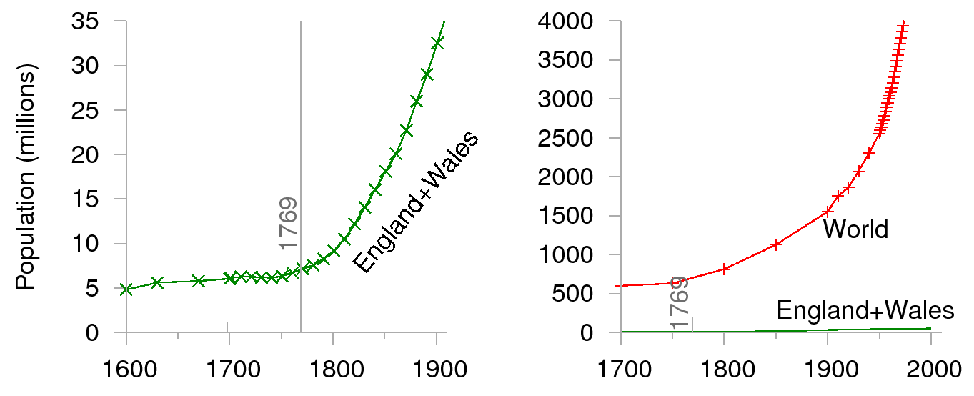

Growth in Population after the
Industrial Revolution
Sustainable Energy, D. MacKay

Slide 4
So where do we stand in the
21st Century?

Slide 5
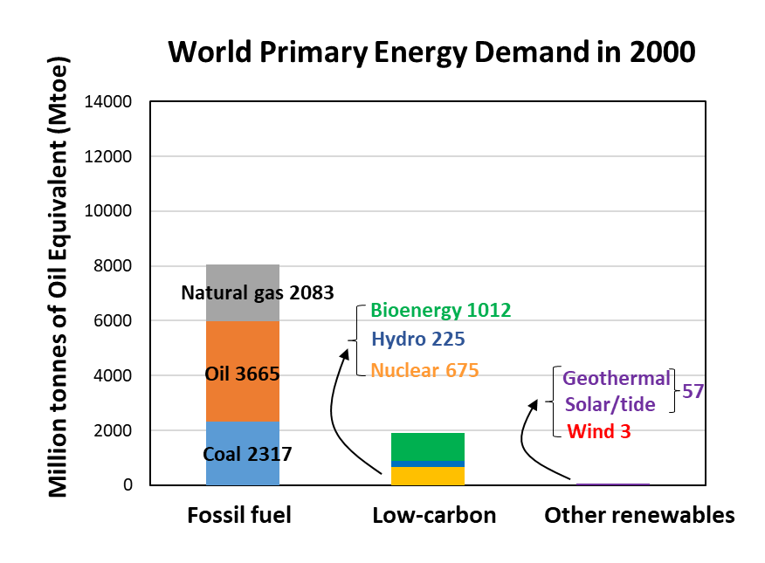
Source: IEA World Energy Outlook 2019

Slide 6
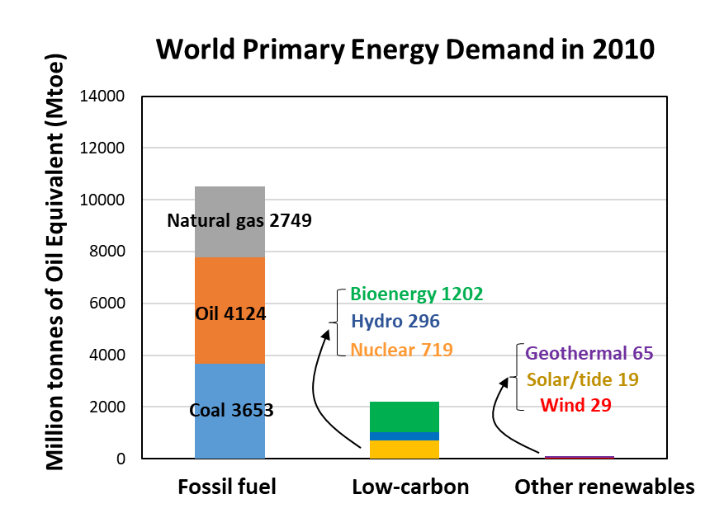
Source: IEA World Energy Outlook 2019； IEA Renewables Information 2012

Slide 7
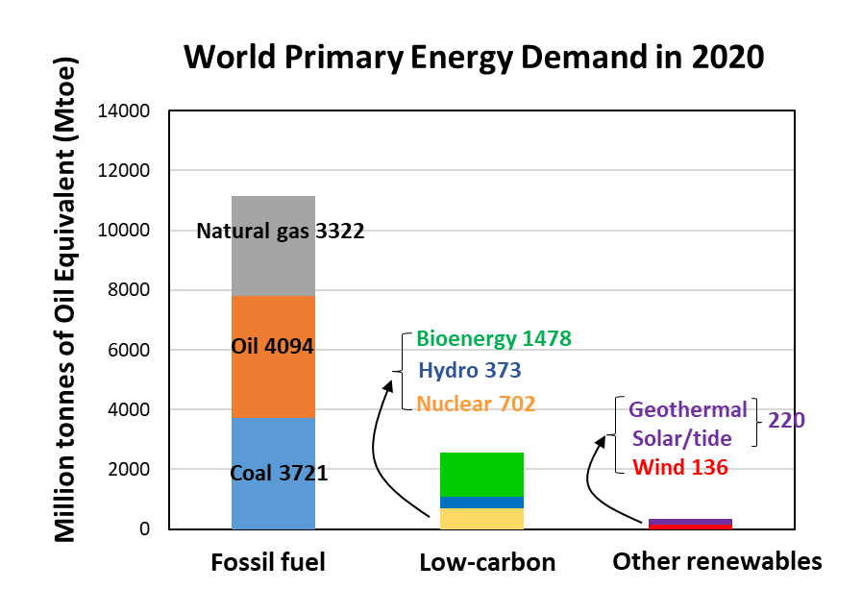
Source: IEA World Energy Outlook 2021

Slide 8
Why, after all the effort and investment,
has there been so little penetration
of wind and solar?
The energy densities of wind and solar are very low compared with “combustibles” (fossil fuels and biomass)
Wind and solar are intermittent, weather-dependent sources of energy
Let’s see what this implies with respect to land use of wind and solar relative to coal.

Slide 9
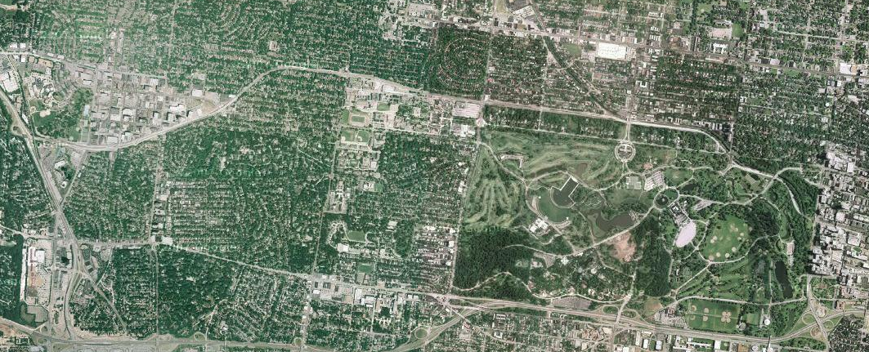

Land Area Needed for 5 MW continuous:
Average Conditions: Power from coal
Notes:
Coal power plant = 5 MW
Average coal seam according to the EIA for major coal beds is 35ft thickness
A 100 acre area will last 216 years with a year disturbance of 0.5 acres.
Average solar radiation of 6.5 kWh/m^2/day takes up a total land area of 261 acres with 40 MW capacity for continuous 5 MW of power with 4 days worth of battery storage.
Average wind speeds from the NREL of 7.5 m/s takes up a total land area of 2,405 aces with 16 MW of capacity for continuous 5 MW of power with 4 days of battery storage. (This includes land allowances between each turbine for 5 rotor diameters between each turbine in the direction of the wind and 3 rotor diameters between each perpendicular to the direction of the prevailing wind)

Slide 10
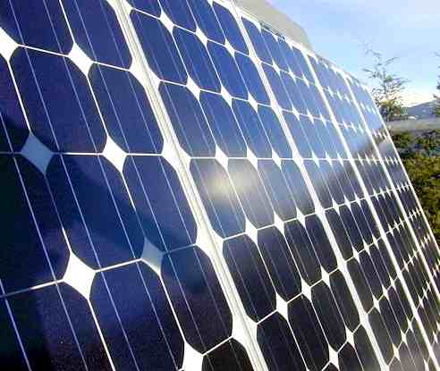
Land Area Needed for 5 MW continuous:
Average Conditions: Power from solar
*Based on results from NREL’s HOMER
Notes:
Coal power plant = 5 MW
Average coal seam according to the EIA for major coal beds is 35ft thickness
A 100 acre area will last 216 years with a year disturbance of 0.5 acres.
Average solar radiation of 6.5 kWh/m^2/day takes up a total land area of 261 acres with 40 MW capacity for continuous 5 MW of power with 4 days worth of battery storage.
Average wind speeds from the NREL of 7.5 m/s takes up a total land area of 2,405 aces with 16 MW of capacity for continuous 5 MW of power with 4 days of battery storage. (This includes land allowances between each turbine for 5 rotor diameters between each turbine in the direction of the wind and 3 rotor diameters between each perpendicular to the direction of the prevailing wind)

Slide 11
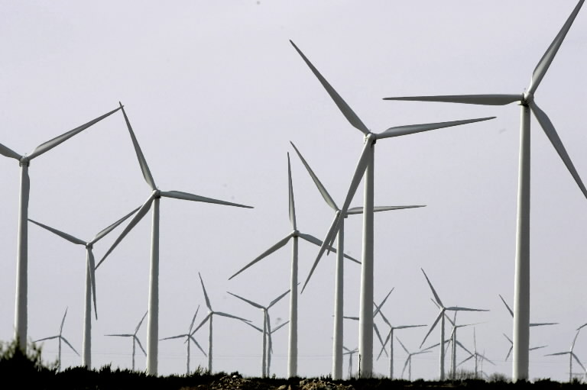
Land Area Needed for 5 MW continuous:
Average Conditions: Power from wind
*Based on results from NREL’s HOMER
Notes:
Coal power plant = 5 MW
Average coal seam according to the EIA for major coal beds is 35ft thickness
A 100 acre area will last 216 years with a year disturbance of 0.5 acres.
Average solar radiation of 6.5 kWh/m^2/day takes up a total land area of 261 acres with 40 MW capacity for continuous 5 MW of power with 4 days worth of battery storage.
Average wind speeds from the NREL of 7.5 m/s takes up a total land area of 2,405 aces with 16 MW of capacity for continuous 5 MW of power with 4 days of battery storage. (This includes land allowances between each turbine for 5 rotor diameters between each turbine in the direction of the wind and 3 rotor diameters between each perpendicular to the direction of the prevailing wind)

Slide 12
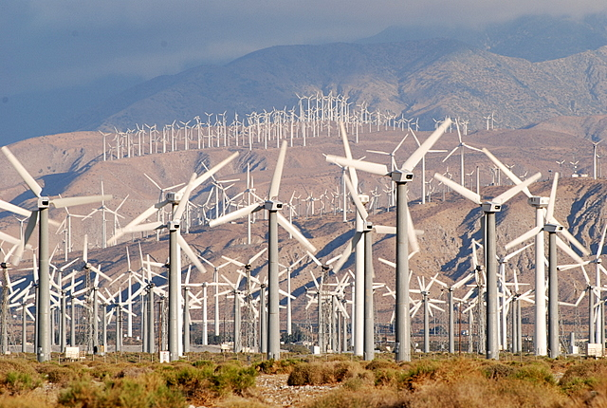
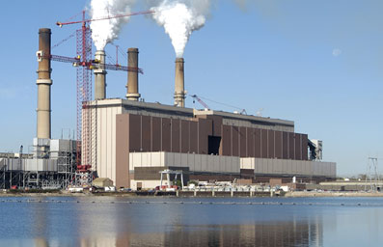
Palm Springs Wind Facility
About 200 small wind turbines
Source: http://www.usmessageboard.com/threads/
Gibson plant
Output 3.1GW continuous: The equivalent of over 5000 of the largest wind turbines (many more (2-3X) if addressing intermittency)

Slide 14
And the elephant in the room is that wind and solar are not reliable
Weather is consistently unreliable!

Slide 15
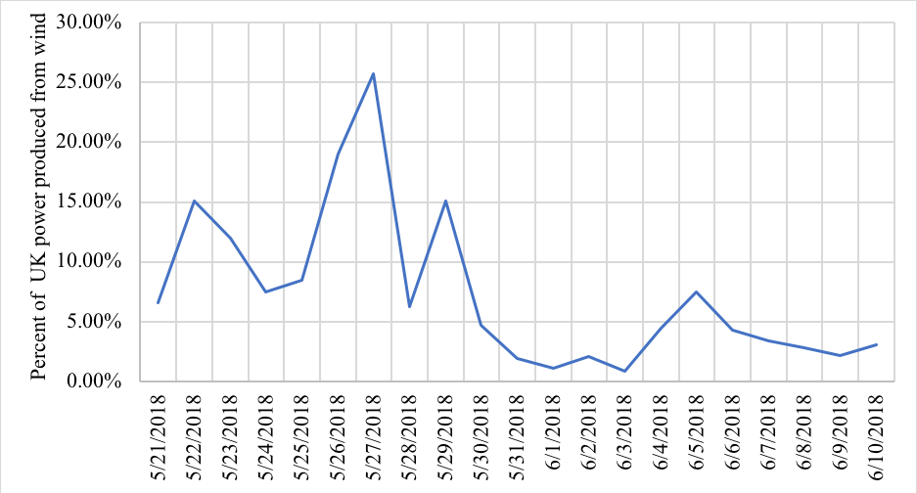
For example, the UK has excellent wind
Percent of UK power produced from wind from May 21, 2018 to June 10, 2018

Slide 16
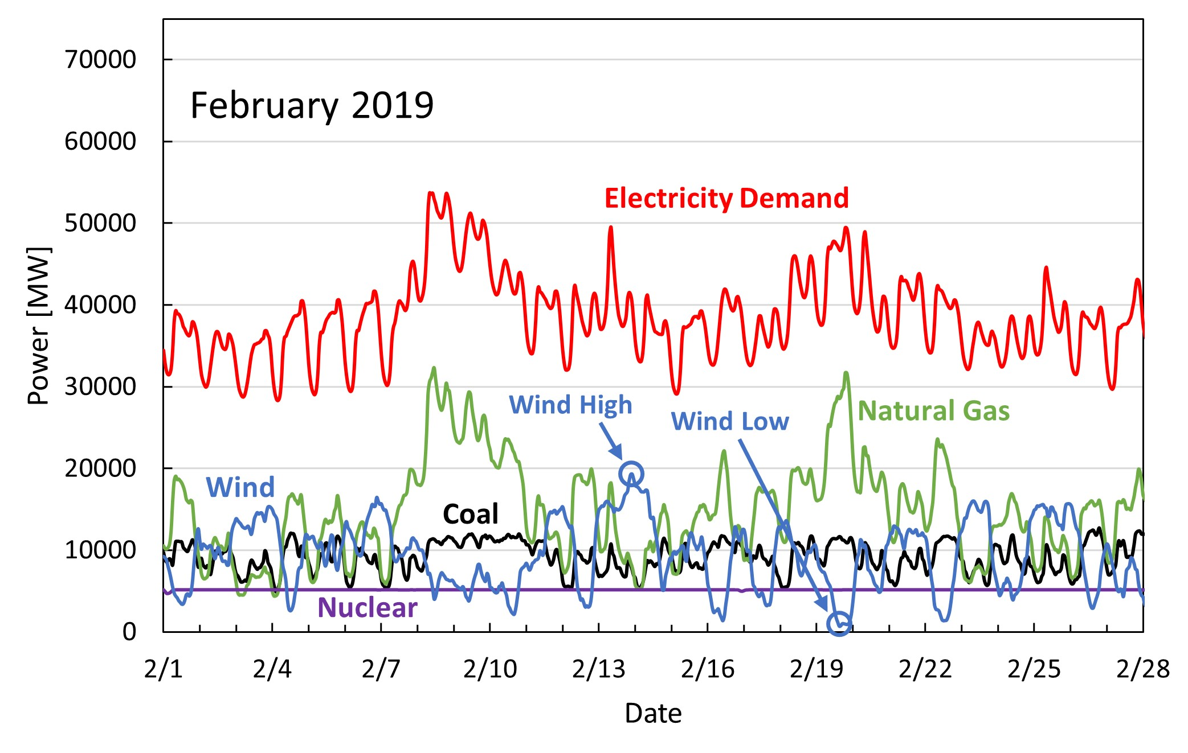
Texas, February 2019
Typical Texas winter
Source: ERCOT

Slide 17
The future needs of the Grid
With the growth in wind and solar, future dispatchable plants are going to need to be highly-flexible, low-carbon plants.

Slide 18
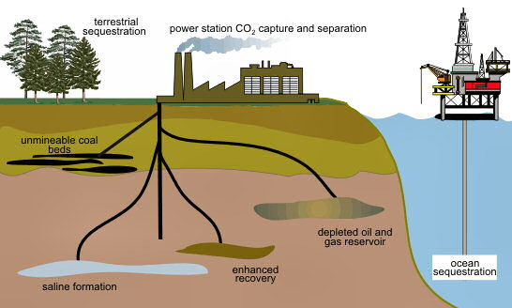
Carbon Capture and Storage (CCS)
Image from: http://www.martinfrost.ws/

Slide 19
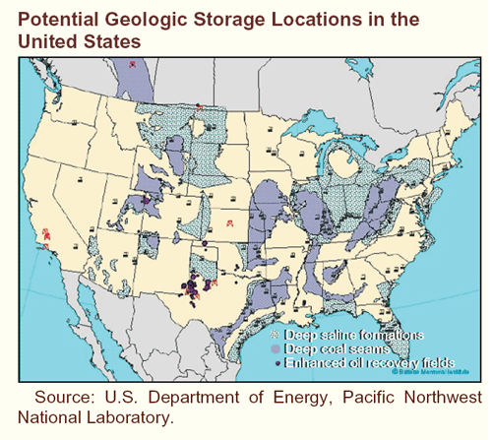
U.S. CO₂ Storage Sites
~ 5-6 Gt of CO₂ emitted per year 1,800-20,000 Gt sequestration potential
(* DOE CO2 Atlas, **2010 Dooley et al., 2006) (Carbon Dioxide Information Analysis Center http://cdiac.ornl.gov)

Slide 20
Staged Pressurized Oxy-Combustion with Biomass (BE-SPOC)
Dispatchable flexible, efficient, low-cost, renewable, carbon-negative electricity

Slide 21
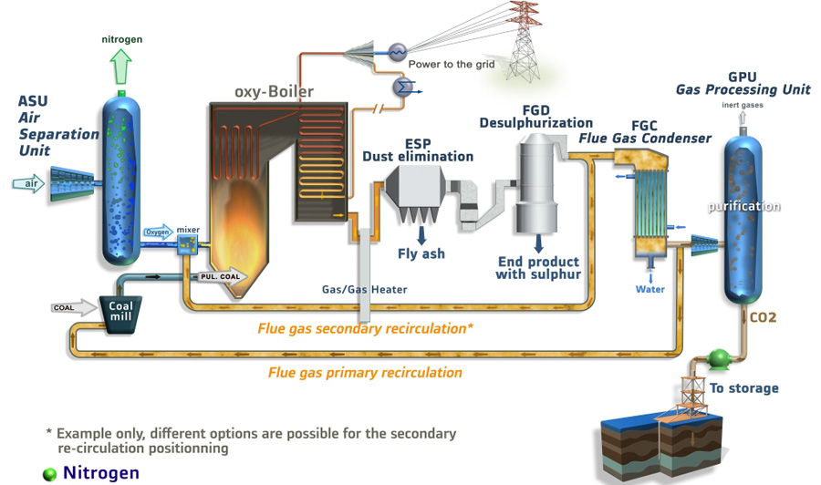
First Generation Capture Technologies are Expensive e.g., Oxy-Combustion
Large flue gas recycle ~ 70%
Image: ALSTOM
Efficiency reduced from 40% to 30% due to carbon capture
Total Cost of Electricity increase by approx. 70% for carbon capture

Slide 22
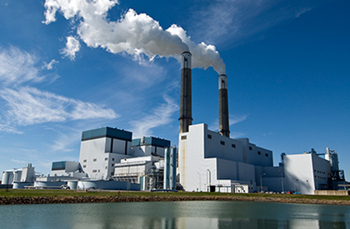
The next-generation of BECCS technologies:
Staged Pressurized Oxy-Combustion (SPOC)
The requirement of high-pressure CO₂ for sequestration, coupled with the fact that we have O₂, enables pressurized combustion as a tool to increase efficiency and reduce costs.

Slide 23
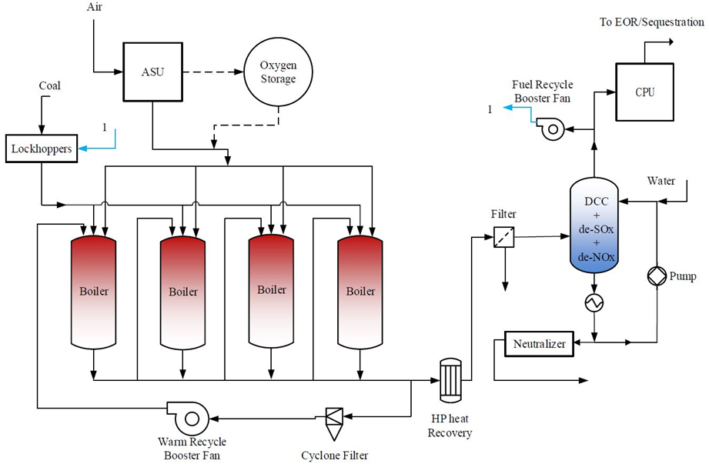
Staged Pressurized Oxy-Combustion (SPOC)
For a 550 MW_{e} power plant with > 90% CO₂ capture
Coal/biomass
O₂

Slide 24
Benefits of Liquid Oxygen Storage…
Smoothing out the Duck Curve

Slide 25
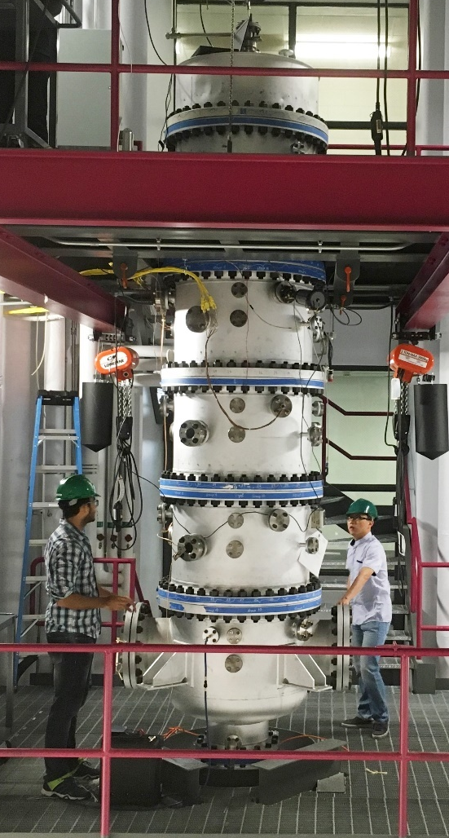
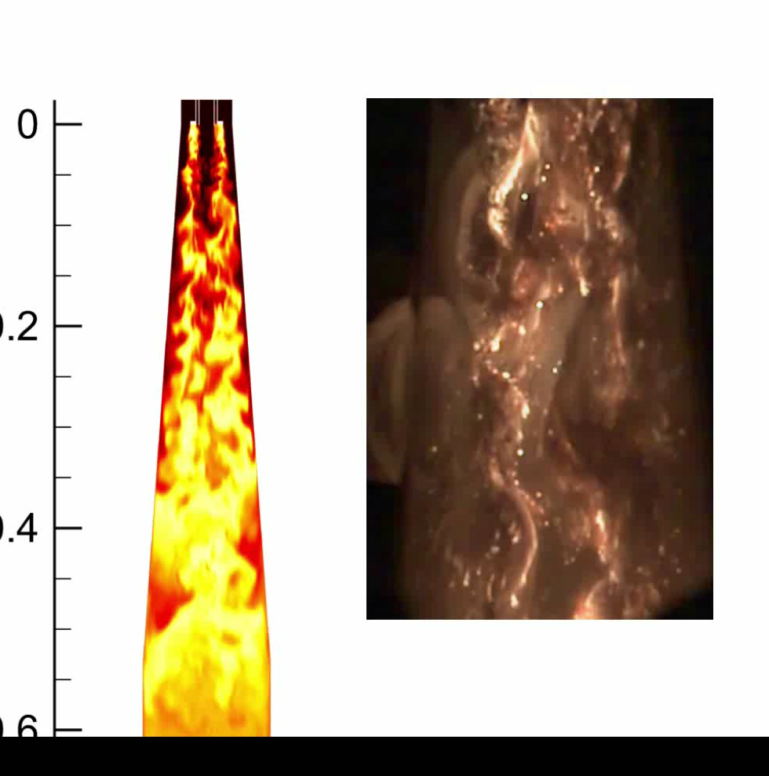
125 kW, 15 bar Pressurized Oxy-Combustion Facility
5+ years operation.
Stable flames from 8 to 125 kW.
No significant challenges have been observed to-date.
LES simulation
High-speed video

Slide 26
BE-SPOC for Efficient Carbon-Negative Electricity
  SPOC efficiencies with biomass are well above BECCS cases with capture
  No efficiency penalty with biomass – latent heat from biomass moisture is recovered; higher O content in biomass results in lower O2 requirement from ASU.

Slide 27
BE-SPOC for Low-cost Carbon-Negative Electricity
  LCOE for carbon-neutral SPOC (25% bio) less than that of SC PC w/ Post-Combustion Capture.
  LCOE for SPOC with 25% biomass significantly less than BECCS with 20% biomass.

Slide 29







Acknowledgments
  Washington University
  Duarte Magalhaes
  Mao Cheng
  Zachariah Wargel
  Anand Sankaranarayanan
  George Pires
  Zhiwei Yang
  Piyush Verma
  Adewale Adeosun
  Bhupesh Dhungel
  Akshay Gopan
  Dishant Khatri
  Ben Kumfer
  Xuebin Wang (Visiting scholar)
  Haixia Zhang (Visiting scholar)
  Qian Huang (Visiting scholar)
  Andrew Maxson
  Scott Hume
  George Booras
  Jeff Phillip
  David Thimsen
  Russel Wheeler
  Raghbir Panesar
  Craig Holloway
  Carl Galloway,
  Andrew Wang
  Krish Krishnamurthy
  Juan Li
  Andrew Chiodo
  Xiaolong Li
  Zhonghua Zhan
  Vyacheslav Akkerman
  Lei Li

