Slide 1

Building Envelope = Net Zero Energy
Matt Belcher, CEO
Verdatek Solutions LLC
Enhanced Building Systems LLC

Slide 2
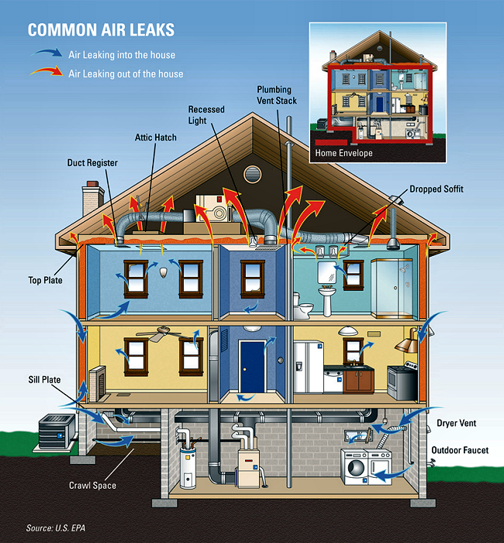
Overview
Defining the Building Envelope
Applied Building Science to Envelope Performance (Leakage, Air transfer)
Energy Code Requirements
  Air Barrier
Compliance Paths
ASHRAE 90.1 as Referenced by IECC
Testing/Compliance
Existing Buildings

Slide 3
Defining the Building Envelope

Slide 4
Building Envelope
The building envelope is what separates the inside from the outside
It is defined as any building element assembly that encloses conditioned space or provides a boundary between conditioned space and exempt or non-conditioned space
The building envelope includes: below grade (basement) walls, exterior walls, windows, doors, floors, ceilings, roofs, etc.
Notes:
(5 minutes) Note: This slide is animated.
►►►►Present the four building envelope functions. Then ask participants to prioritize the four functions in order of importance. Use the next slides to elaborate on the priority of moisture management

Slide 5
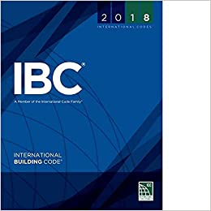

Building Envelope
The building envelope must serve four functions:
  Keep bulk moisture out.
  Handle moisture as vapor.
  Contain air movement.
  Contain heat.
Notes:
(5 minutes) Note: This slide is animated.
►►►►Present the four building envelope functions. Then ask participants to prioritize the four functions in order of importance. Use the next slides to elaborate on the priority of moisture management

Slide 6
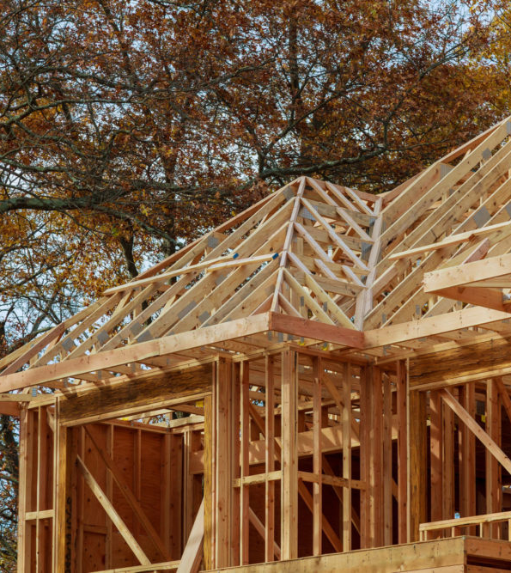
The Energy Code is Everywhere
Unlike most other codes, the energy code directly impacts the work of many disparate building trades and systems, including:
  Framing/Envelope
  Plumbing
  HVAC
  Electric
  Moisture management
  Concrete
  Caulking

Slide 7

Energy Code Background

Slide 8
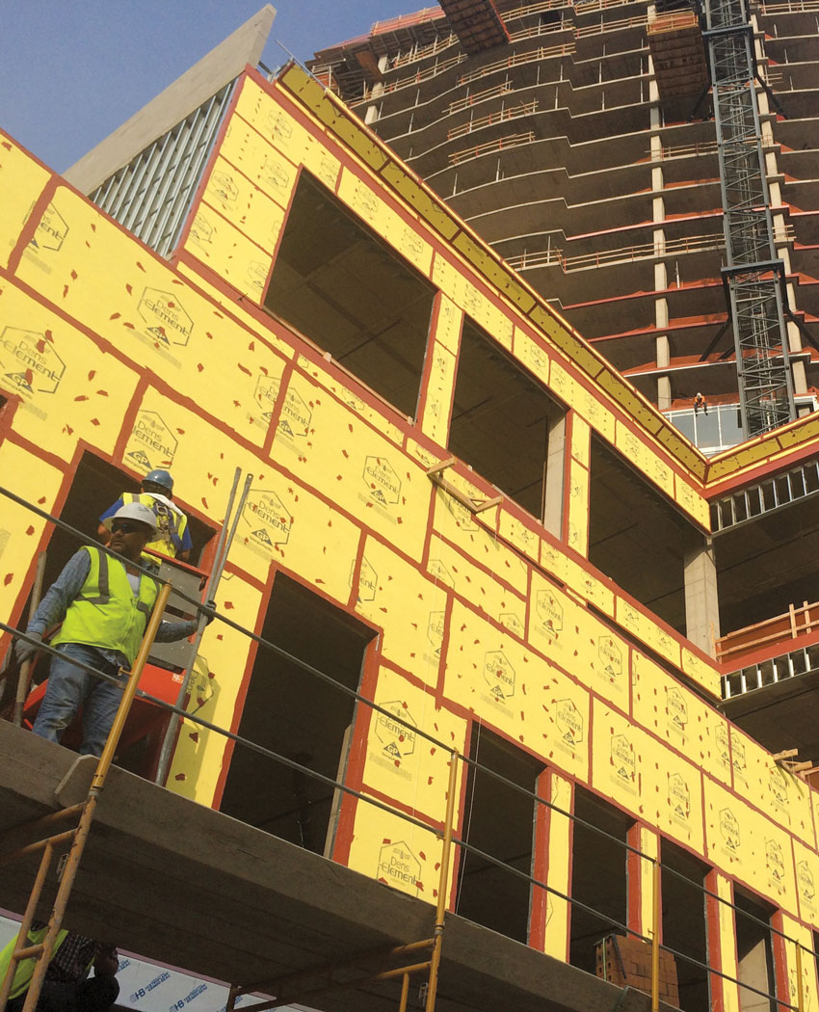
Building Envelope
All of the elements of the envelope and the assembly methods determine how well the building envelope performs.
The building envelope must be an unbroken boundary surrounding the structure.
All elements must be in close alignment with each other.
Photo courtesy of U.S. Gypsum
Notes:
(continued) Note: This slide is animated.
►►Explain the information about the building envelope. Also use the next slides to present related information.

Slide 9
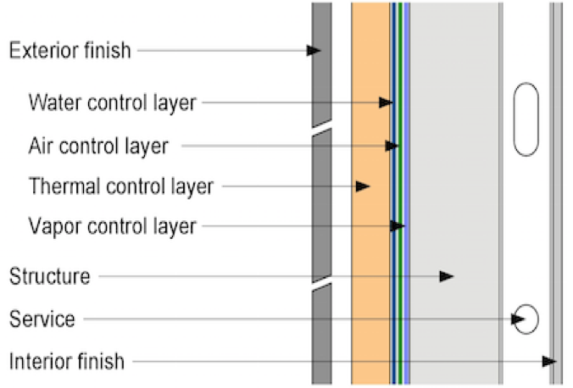
Building Envelope: Control Layers
Image: Green Building Solutions

Slide 10
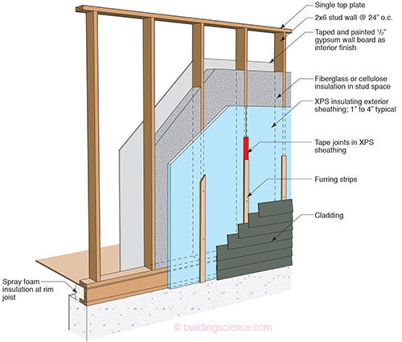
Continuous Insulation - Typical Framing
Typical wall with continuous insulation on the exterior
Be sure to seal all seams in continuous insulation
Stud cavity can accommodate various types of insulation
Single Top Plate
2x6 stud wall @ 24” o.c.
Taped and painted ½“ gypsum wall board as interior finish
Fiberglass or cellulose insulation in stud space
XPS insulating exterior sheathing: 1” to 4” typical
Tape joints in XPS sheathing
Furring Strips
Spray foam insulation at rim joist
Cladding
Image: buildingscience.com

Slide 11


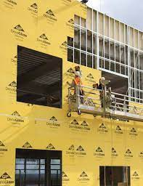
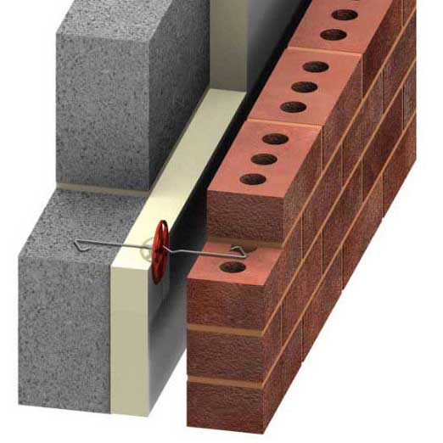
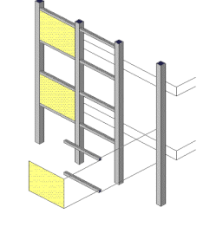
Building Envelope: Many Wall Types
Images: mrfixitbali.com; google.com; Building Design+Construction; metalconstructionnews.com; buildgp.com
Insulated Panel
Mass Timber
Steel Stud/Exterior Sheathing
Cavity Wall
Stick-Built Curtain Wall
Notes:
Many more wall types in commercial construction than typical residential construction – these are just a few. Different wall types have functionalities and considerations for control layers

Slide 12
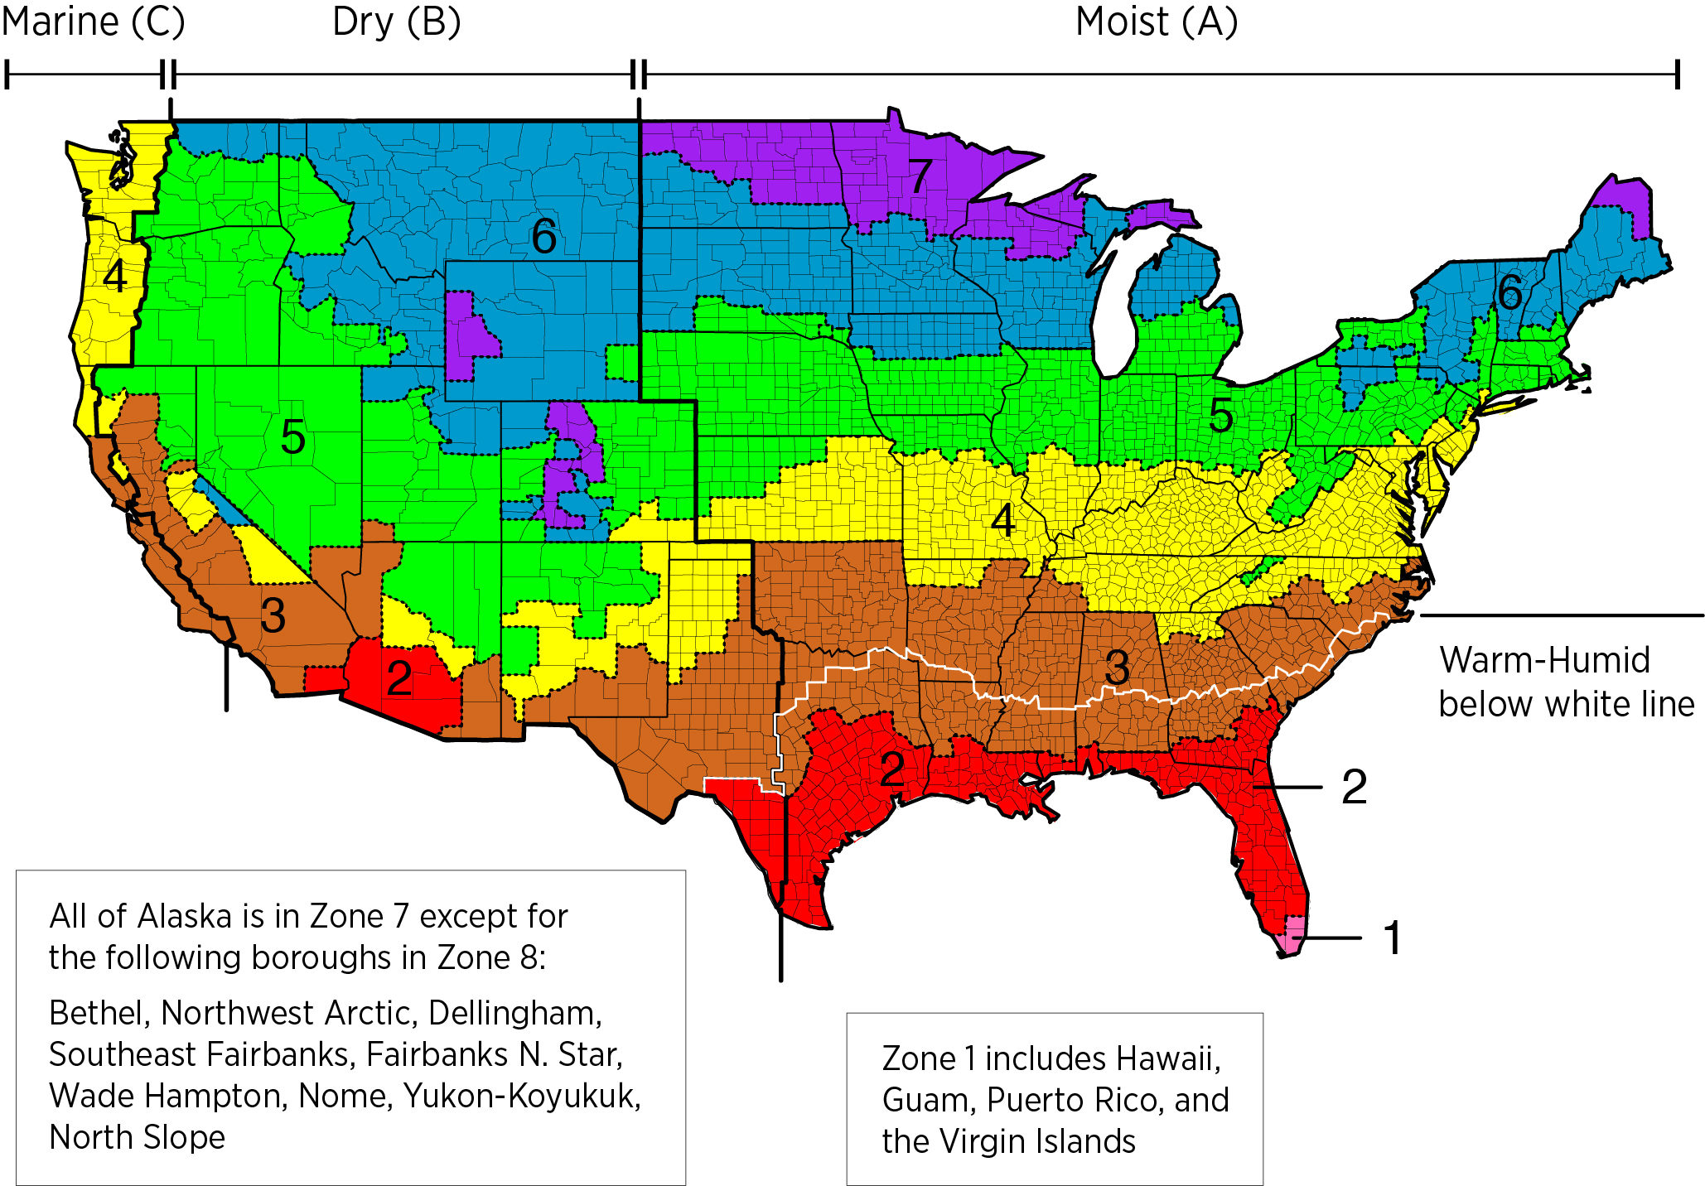
2018 IECC Climate Zones
Image: Building America Solution Center
Notes:
In Nebraska, we are located in a “Cold” Climate Zone (CZ5). But, we still We heat only slightly more than half the year and cool the remainder the year. Remembering basic physics; buildings in this CZ requires addressing heat and water travel in both directions through the building envelope!
Oh, we are also in Tornado alley so durability really matters too!

Slide 13
(Not so) Advanced Science in
Building Science
Heat Hot → Cold
Moisture Wet → Dry

Slide 14
Building Envelope Code Requirements

Slide 15

General Requirements
Section C402.1
Building thermal envelope to comply with the following:
Specific insulation requirements of Section C402.2
Thermal requirements of either:
  R-value-based method of Section C402.1.3
  U-, C-, and F-factor-based method of Section C402.1.4 OR
  Component performance alternative of Section C402.1.5
Fenestration in building envelope assemblies
Air Leakage of building envelope assemblies

Slide 16
Performance Testing

Slide 17
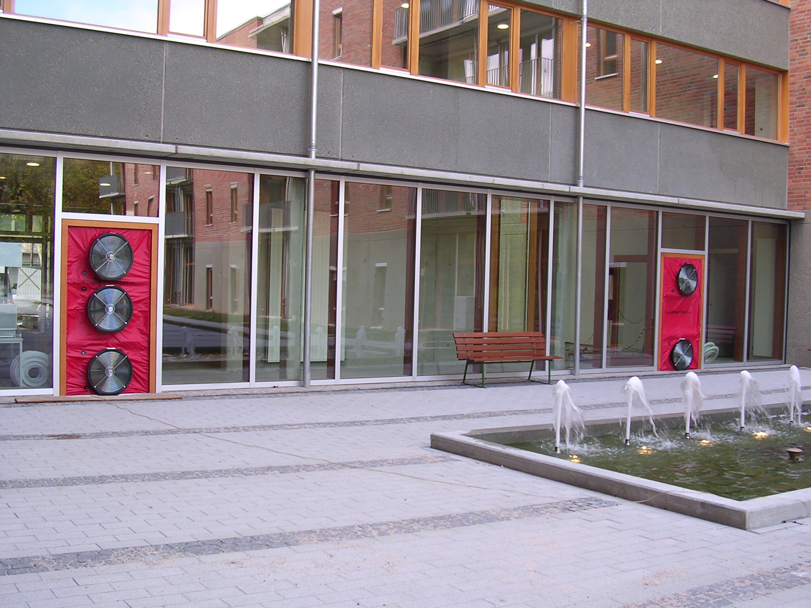
Air Leakage & Continuous Air Barrier Testing
Section C402.5
Continuous Air Barrier Required
Two Compliance Options
  1. ASTM E 779 (blower door test)
  2. Compliant assemblies
    C402.5.1 through C402.5.8
Image: energyconservatory.com

Slide 18
Commissioning: Building Envelope Data Points
Building Orientation
Materials
Construction Assemblies
Roofs
Exterior Wall
Exterior Floors
Doors
Fenestration
Below Grade Walls and/or Slabs

Slide 19
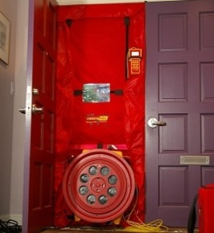
Ventilation and Air Sealing
Both natural and mechanical ventilation provide fresh air that can dilute and remove indoor pollutant levels
Per the IMC/IRC, mechanical ventilation is required when homes are <5 ACH 50
  Need to do a blower door test to determine leakage rate
  Liability concerns when not performed
A blower door test measures a building’s existing air leakage
Can not design a code compliant system without knowing air leakage
Courtesy of AC Tool Supply, Inc.
Notes:
(5 minutes)
Explain natural ventilation’s impact on pollutants.
Describe the blower door test. Also use the next two slides to present related information.

Slide 20
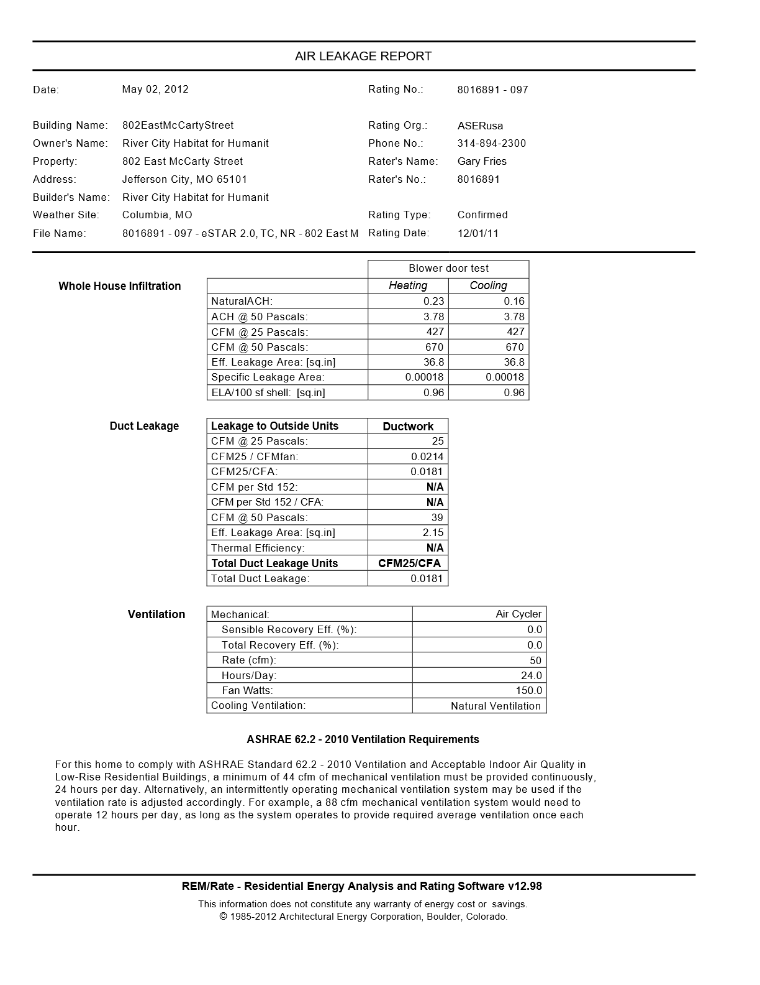
Air Leakage Report
Date: | May 02, 2012 |  | Rating No.: | 81158891-901
Building Name: | 123 Main Street |  | Rating Org.: | Raters USA
Owners Name: | Jane Smith |  | Phone: | 555-555-5555
Property Address: | 123 Main Street Omaha, NE 68007 |  | Rater’s Name: | John Williams
Builder’s Name: | ABC Construction |  | Rater’s No: | 1234567
Weather Site: | Omaha, NE |  | Rating Type: | Confirmed
File Name: | 101682391-097 eSTAR |  | Rating Date: | 12/01/20

Slide 21
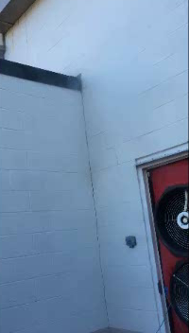

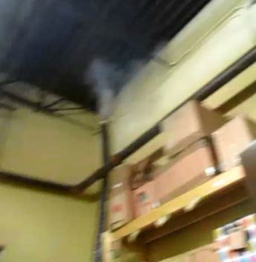
Building envelope
Case Study Findings
  Inline Retail
    Envelope Transitions
Notes:
Flat roofed strip mall

Slide 22

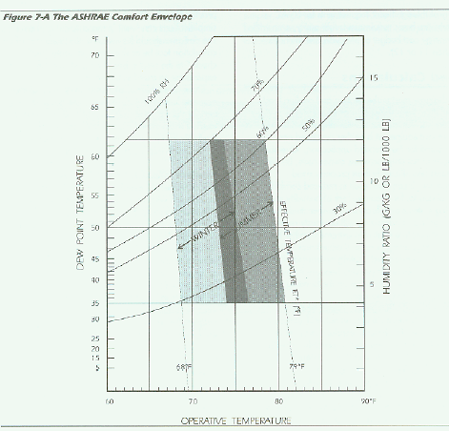
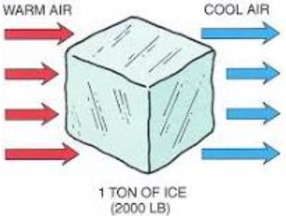
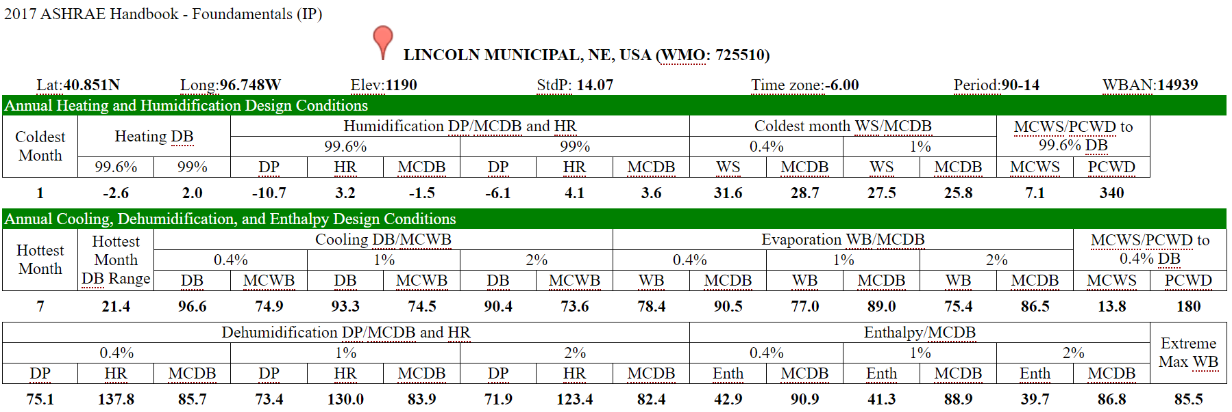
Load Calculations are Mandatory
Must calculate heating and cooling system design loads
Must base calculations on generally accepted engineering standards and handbooks – ASHRAE / ACCA 183
Other approved computation procedures
Outdoor design conditions
  Specified by ASHRAE
  (e.g., Lincoln, NE 2°F winter, 93°F summer)
Interior design conditions
  Specified the IECC
  ≤ 72°F for heating load
  ≥ 75°F for cooling load
1 ton = 12,000 Btu/hr

Slide 23
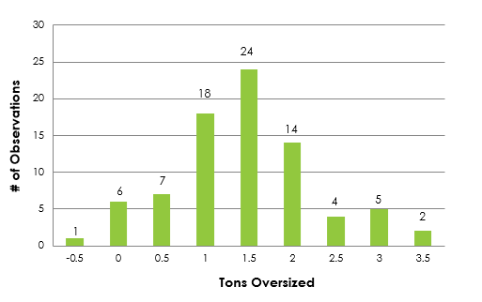
Installed AC Units
MO Equipment Sizing Study
Tons Oversized
Notes:
Avg – 1.5 tons oversized

Slide 24

HVAC Design and Loads - Residential
Properly designed HVAC systems rely on scientific criteria and a systematic method to match the loads required for health and comfort:
  ACCA Manual J – Residential Load Calculation
  ACCA Manual S – Residential Equipment Selection
  ACCA Manual D – Residential Duct Systems
Reports should be submitted with permit application

Slide 25
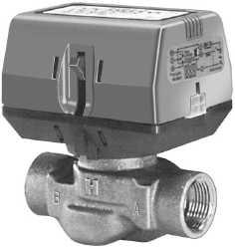
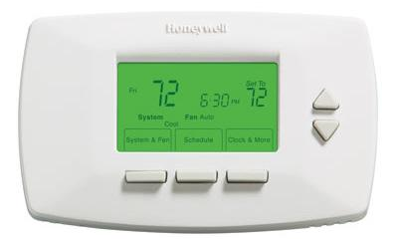
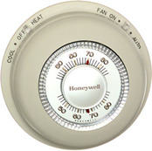
HVAC 101 - Controls
Control Devices
Thermostats
  Manual
  Programmable
DDC Systems
Automatic Valves and Dampers
Outdoor Sensors
Optimum Start
Variable Speed Drives
Notes:
Slide Intent: Give overview of the controls that are required for HVAC equipment.
Talking Points:
Code is very big on automatic, programmable controls for commercial buildings.
Systems can be set to optimum start, which allows the systems to be set back when there is no occupancy in the building, and then optimally start the equipment early enough to meet the desired temperature set point for occupied times.
DDC is direct digital control. DDC allows for increased capability with computers operating the equipment. A DDC system takes readings form sensors and adjusts operations of equipment.
Variable speed drives are a great technology – the ability to slow equipment down and match the load. They save energy by running the equipment at a lower speed when possible.
Photo Captions:
Images various HVAC control devices.
Top- automatic valve
Middle- programmable thermostat
Bottom- non-programmable thermostat

Slide 26
Building Controls are Complicated
Since 2004, about 30% of all new requirements have been related to building controls
Control requirements can be difficult to implement, and verification is beyond the expertise of most building code officials
Assumption is that they are implemented and working correctly
Source: https://www.pnnl.gov/main/publications/external/technical_reports/PNNL-26348.pdf

Slide 27
HERS / Energy Rating Index – What does it mean?
HERS Index (lower is better)
Rated home with Index of 100 = Reference home exactly meeting 2004/06 IECC
Net Zero Energy Home = HERS Index of O
[Rated Home’s Htg + Clg + WtrH + L.A.]
[Refer. Home’s Htg + Clg + WtrH + L.A.]
Index = 100 x PE_{fraction} x
40
30
30
50
= 75
70
20
30
80
PE_{fraction} is ratio of renewables to purchased energy
(If a home produces 2/3 of its annual energy, the PE_{fraction} is 0.33) In this example, 0.33 x 75 = 25

Slide 28
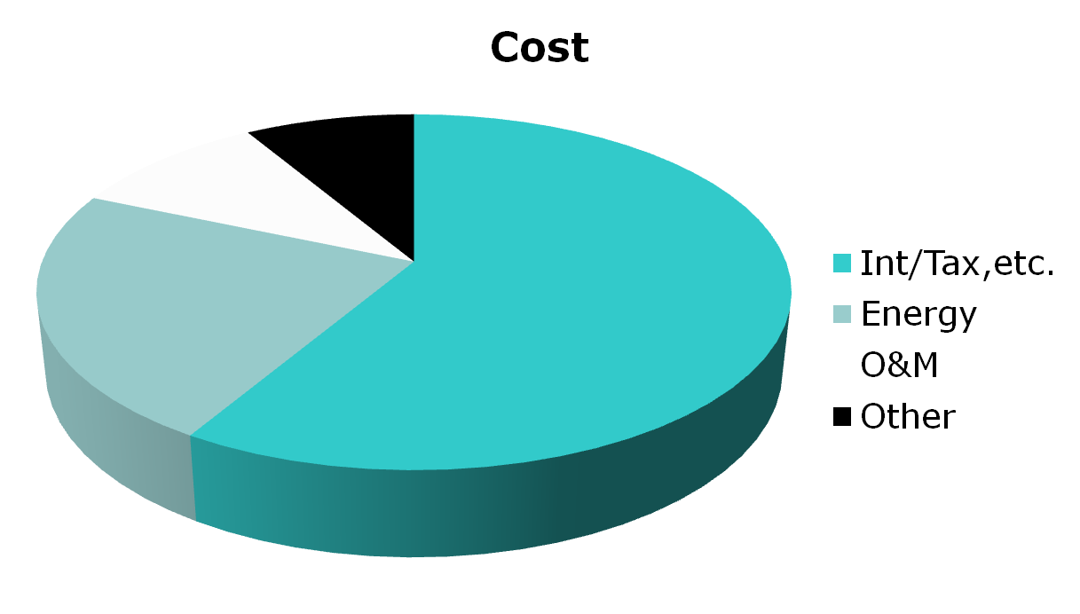
Equity!
Monthly Payment
Notes:
On a Monthly payment basis; After the mortgage costs by far the next highest expense for the homeowner is the operational and maintenance costs. High performance building/retrofits focus on this “slice of the pie” in the Monthly payment. By cutting it in half or more (sometimes much more). The economics show that this is a much better investment.

Slide 29

Residential Green and Energy Efficient Addendum!
Resources for realtors and appraisers on properly valuing energy efficiency/green features
  Educational materials
  List of designated appraisers
  Trainings
For more information: http://www.appraisalinstitute.org/education/green_energy_addendum.aspx
Form 820.04

Slide 30
Lender Specification
“This Home/Building is being built/renovated/updated to standards above prevailing code. It is designed and constructed with unique features and materials and with high efficient equipment and in accordance with high efficiency standards. The Lender shall choose an Appraiser educated and knowledgeable in this type of valuation of these specialized Homes. It is understood that unless said Appraiser can provide verification of education and knowledge, they will not be permitted to conduct the appraisal for this project.”
Notes:
This specification is used to give to Lenders instructing them that appraisers they select to do the construction loan or mortgage appraisal MUST have training to properly valuate these HP buildings. Appraiser Associations such as the Appraisal Institute have adopted this language for their use.
The same analogy is used for Agriculture transactions. If a Farm is sold; an Ag appraiser must do the valuation. They need to understand the value of the crops/livestock, land, buildings, etc. to properly value that Farm. These HP buildings have their own intrinsic value.

Slide 31

Looking Ahead:
IECC changes to The National Energy Standard as of 2024.
Uses 2021 IECC as a baseline.
Introduces Carbon Impact into the conversation.
On a trajectory for Net Zero Energy as of 2030.

Slide 32
Thank You!
Questions: Contact Matt Belcher at matt@verda-solutions.com
Matt Belcher, CEO
Verdatek Solutions LLC
Enhanced Building Systems LLC

