Slide 1
Redox flow batteries for grid-scale
energy storage
Vijay K. Ramani
Roma B. and Raymond H. Wittcoff Distinguished University Professor
Washington University in St. Louis

Slide 2
Overview
Requirements of large-scale energy storage systems
The electrode-decoupled redox flow battery (ED-RFB)
Development of highly selective separators
Formulation of the electrolytes
Performance of a model electrode-decoupled RFB
Conclusion

Slide 3
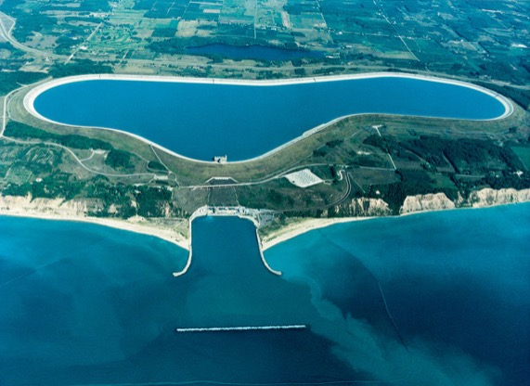
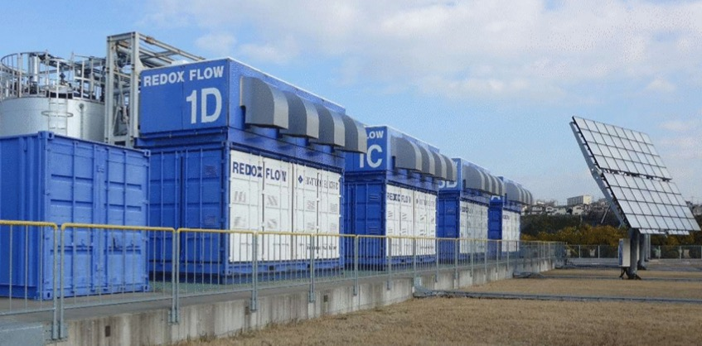
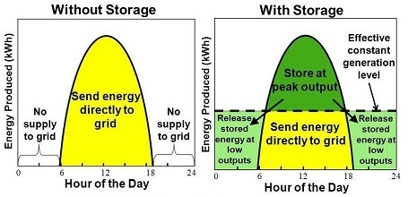
The energy storage ideal
The ideal energy storage system is -
Cheap (< $50/KWh DOE target)
Widely deployable
Available 24/7
Dischargeable at multiple time scales and current rates
http://www.newkirk-electric.com/projects/power-generation/ludington-hydroelectric-pumped-storage-dam/8
https://energyhub.theiet.org/users/57714-anthony-price/posts/18914-energy-storage-opportunities-and-trends
https://depts.washington.edu/maple/

Slide 4
What is a flow battery?
Load or power source
e⁻
e⁻
ions
Separator
Au plated
current collector
Au plated
current collector
ions
V³⁺+ e⁻ ↔ V²⁺
(-0.26V vs. SHE)
Electrolyte
VO₂⁺+ 2H⁺ + e⁻ ↔ VO²⁺ + H₂O (+1V vs. SHE)

Slide 5
Advantages of a RFB
Conventional batteries
Conventional battery design line
System cost ($/KWh)
Energy (KWh)
Redox flow battery
design space
Redox flow batteries
Power (KW)
Operational duration =
Energy/Power (h)
Energy and power are decoupled => greater design flexibility => lower scale-up costs

Slide 6
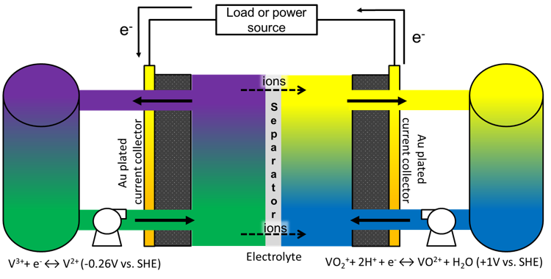
A brief history of Redox flow batteries
1955 – A.M Posner – An Fe-Sn and Br-Sn “redox fuel cell”
1975-77 – NASA – Fe-Ti RFBs
1977-89 – NASA – Fe-Cr RFBs
1984 – Maria Skyllas-Kazacos – Practical demonstration of a VRFB
1999 onwards – Plurion / Frank Walsh (U. Southampton) – Zn-Ce RFB
Several other inorganic and organic based RFB chemistries have been proposed and are in various stages of commercialization
The most famous - The all-V redox flow battery

Slide 7
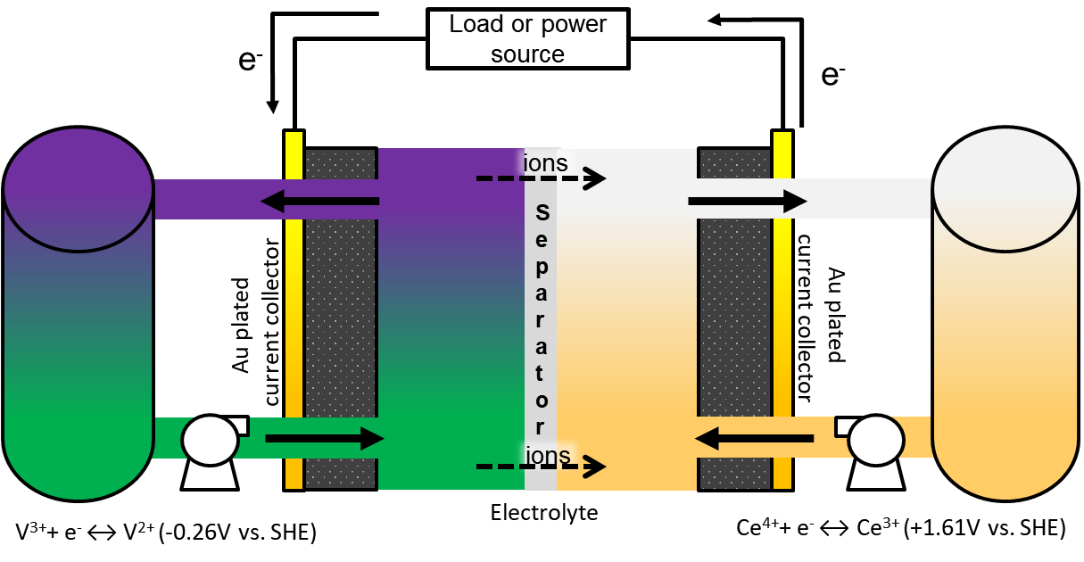
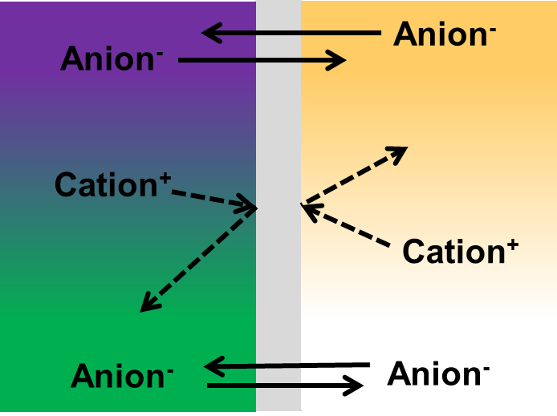
An electrode-decoupled (ED-)RFB
Design flexibility – greater variety of actives
Tunable cell voltage
Can lead to capacity fade due to mixing
Some designs require phase change (deposition/dissolution) of one or more actives
Our system is all-soluble, electrode-decoupled and long lasting

Slide 8
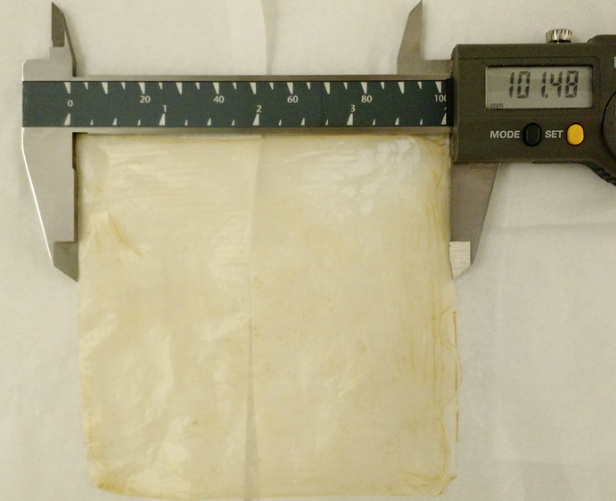
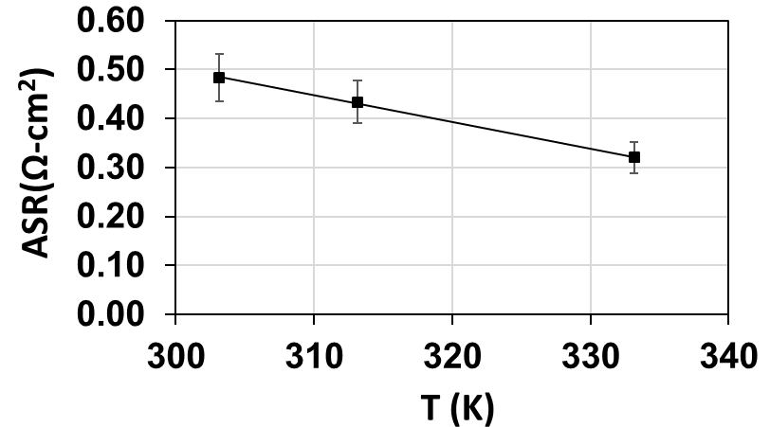
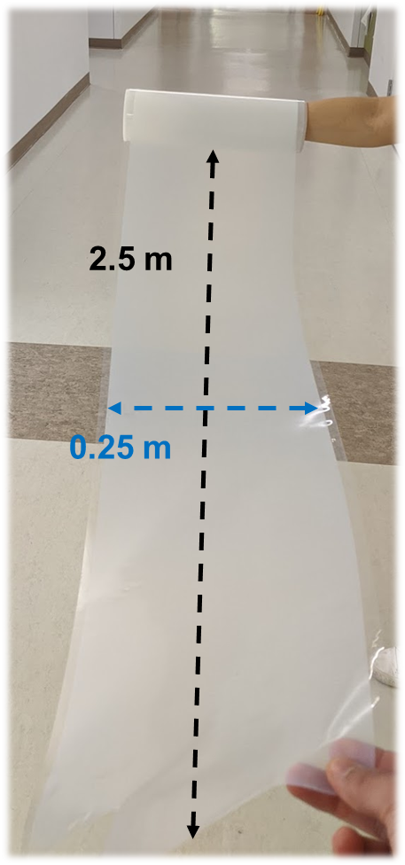
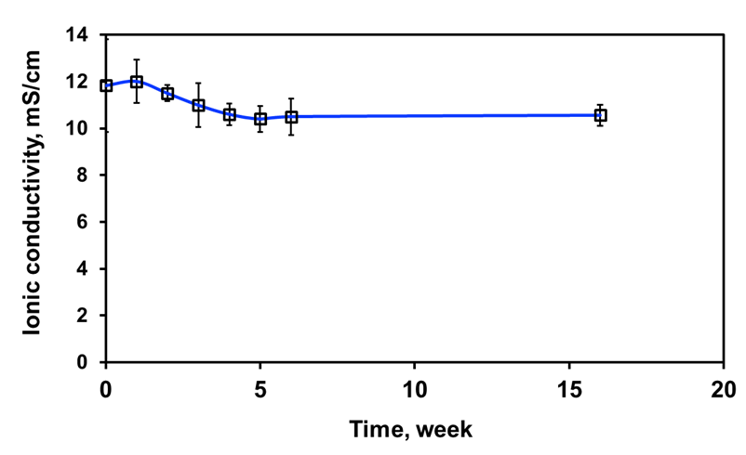
Highly permselective membrane
developed
$$ASR_{IP}=R_{membrane,IP}WT$$
Highly selective
Made at 100cm² and beyond
Low Area specific resistance (ASR)
Extremely stable in ED-RFB actives

Slide 9
Part 2-
Survey of potential aqueous
electrolytes

Slide 10
Selection of RFB couples
Cr³⁺/Cr²⁺
V³⁺/V²⁺
I₃⁻/I⁻
V⁵⁺/V⁴⁺
Ce⁴⁺/Ce³⁺
TiO²⁺/Ti³⁺
Zn²⁺/Zn
Vi⁴⁺/Vi³⁺
H⁺/H₂
Fc²⁺/Fc⁺
Fe³⁺/Fe²⁺
Br/Br⁻
-0.42V
-0.26V
0.00V
0.53V
1.00V
1.61V
0.19V
-0.76V
-0.36V
0.39V
0.77V
1.08V
Selection criteria:
No H₂ evolution
>=1V cell
No plating processes on either electrode
Preferably benign (non-toxic, no side reactions)

Slide 11
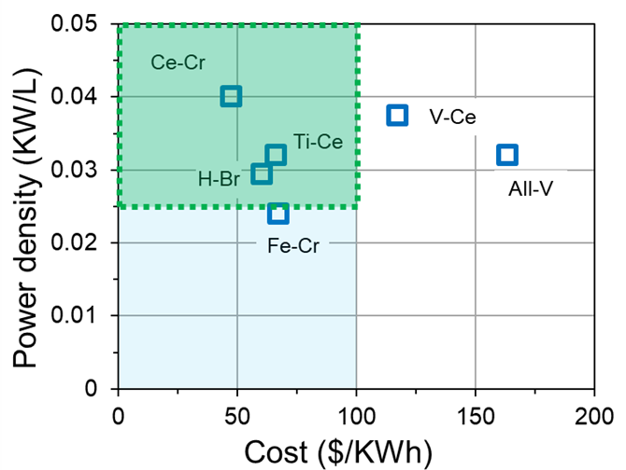
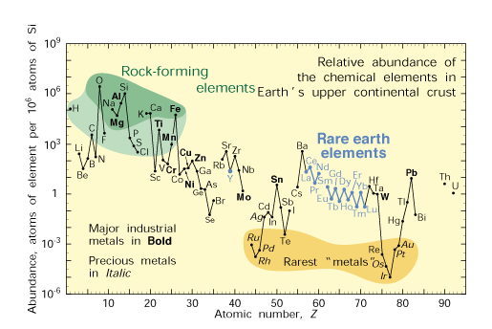
Economic criterion for ED-RFB actives selection
Ti
Ce
Estimated for a 80% efficient 2GW/10GWh system
Actives cost only – balance of plant should add up to <$100/KWh
All-V and V-Ce are out of the price range!
Novel systems needed – Ti-Ce is promising, earth-abundant and potentially problem free
https://pubs.usgs.gov/fs/2002/fs087-02/

Slide 12
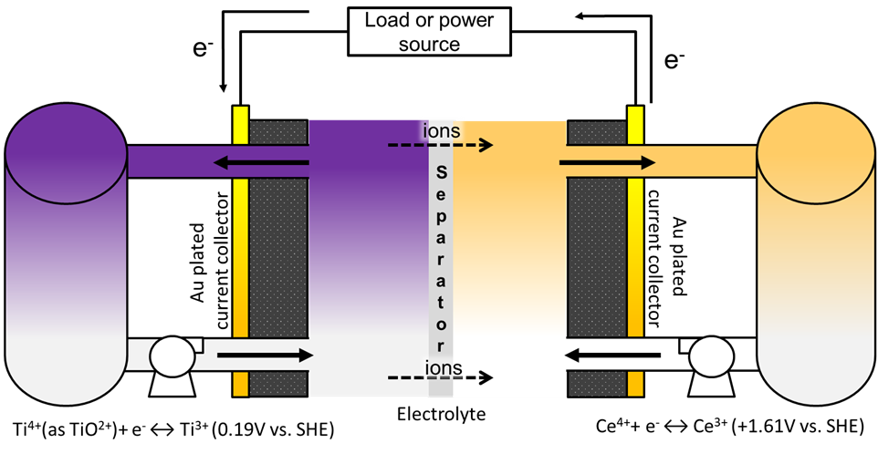
Schematic of a typical Ti-Ce ED-RFB
Electrode-decoupled using an AEM separator – quaternized cardo-polyether ketone (QPEKC) functionalized with trimethylamine (TMA)

Slide 13
Part 3-
The Ti-Ce electrode-decoupled
redox flow battery

Slide 14
Schematic of a typical Ti-Ce ED-RFB
Electrode-decoupled using an AEM separator – quaternized cardo-polyether ketone (QPEKC) functionalized with trimethylamine (TMA)

Slide 15
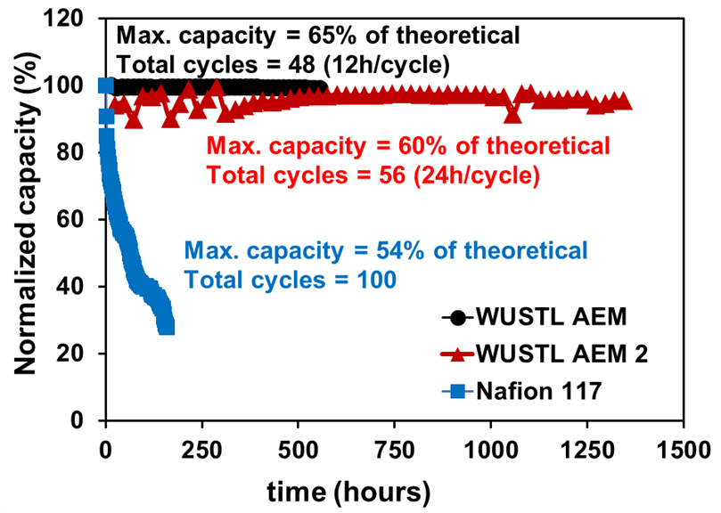
Performance of a Ti-Ce ED-RFB
Use of AEM improves RFB performance compared to Nafion 117

Slide 16
Conclusions
The potential of suitably structured AEMs to deliver ED-RFBs with elemental actives is demonstrated.
Ti-Ce shown to be a very cost competitive (better than Fe-Cr) ED-RFB without the problems of the Fe-Cr system.
Choice of counter-ion/supporting electrolyte plays a key role in cell performance and cost.
The road to low cost, long-term energy storage in ED-RFB runs through low cost, fairly dense electrolytes

Slide 17
Acknowledgements
This study was funded by the Advanced Research Projects Agency – Energy (ARPA-E) of the U.S Department of Energy through grant number DE-AR0000768.
The cost model described here was developed by Borealis Technology Solutions LLC (Mr. Thomas Gregory) using inputs provided by WUSTL under a consulting contract.

