Slide 1
/thepursuitofenergy
@alexepstein
/improvetheplanet
For this and other shareable resources, email resources@alexepstein.com

Slide 2
I love
Fossil Fuels
Practicing what I preach
For this and other shareable resources, email resources@alexepstein.com

Slide 3
The key to clear thinking and effective persuasion
For this and other shareable resources, email resources@alexepstein.com

Slide 4
When evaluating what to do about any product or technology, we must carefully weigh the benefits and side-effects of every option
Irrefutable thinking method:
carefully weigh benefits and side-effects.
No one disputes this, but almost no one follows it
For this and other shareable resources, email resources@alexepstein.com

Slide 5
……………
Factor in fossil fuels’ benefits
Factor in fossil fuels’ “climate mastery benefits”
Factor in fossil fuels’ negative and positive climate side-effects with precision
3 irrefutable principles for weighing fossil fuels’ benefits and side-effects
No one disputes these, but almost no one follows them
For this and other shareable resources, email resources@alexepstein.com

Slide 6
My contention:
My contention: if you apply these irrefutable principles to the facts about fossil fuels and their climate side-effects, it’s obvious the world should use more fossil fuels and that rapidly eliminating fossil fuels is mass suffering and death
For this and other shareable resources, email resources@alexepstein.com

Slide 7
……………
5
facts about fossil fuels’ benefits, including climate mastery benefits
10
undeniable
Facts
5
facts about fossil fuels’ climate side-effects
For this and other shareable resources, email resources@alexepstein.com

Slide 8
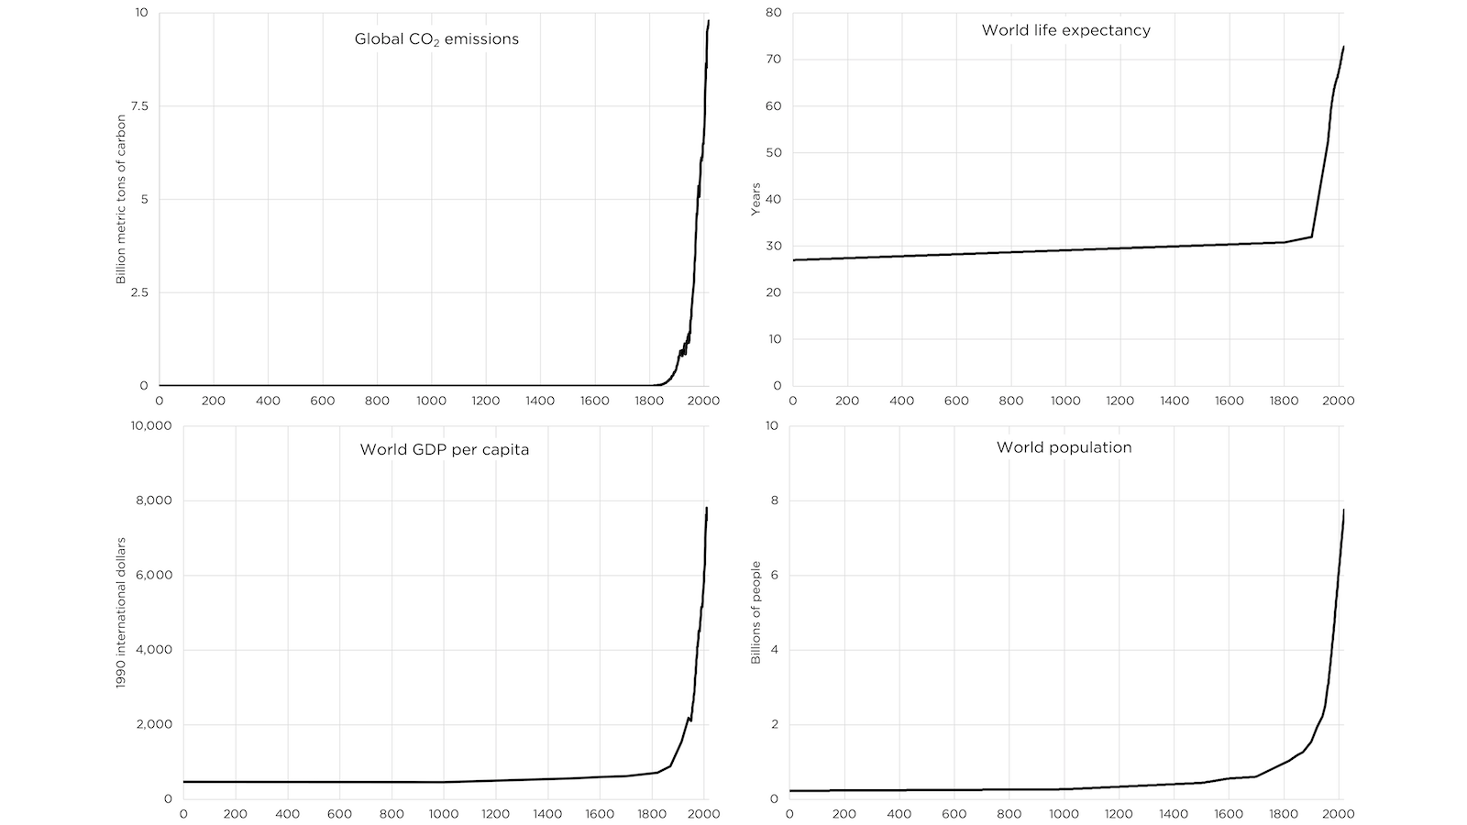
……………
Cost-effective energy is essential to human flourishing.
Undeniable
fact 1
Fossil fuels’ benefits going forward
Cost-effectiveness: affordability, reliability, versatility, scalability.
Human flourishing: humans have the ability to live long, healthy, fulfilling lives.
The more cost-effective energy is, the more we can use machines to be productive and prosperous.
Availability of food, clothing, shelter, medical care all depend on it.
Innovation and progress depend on it.
Environmental health and safety depend on it.
For this and other shareable resources, email resources@alexepstein.com

Slide 9
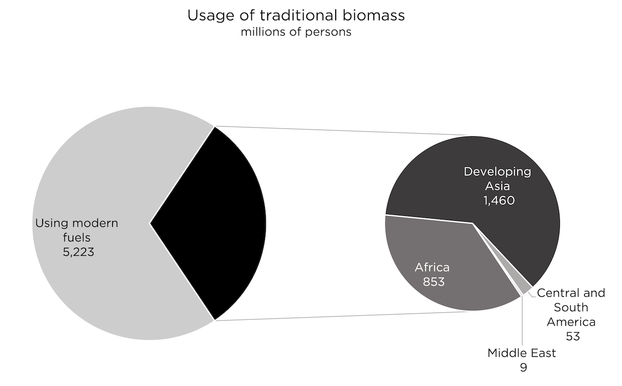
……………
Billions of people lack cost-effective energy.
Undeniable
fact 2
Fossil fuels’ benefits going forward
3 billion use less electricity than a typical American refrigerator.
6 billion use an amount of energy we would consider unacceptable.
1/3 of the world uses wood and animal dung for heating and cooking.
For this and other shareable resources, email resources@alexepstein.com

Slide 10
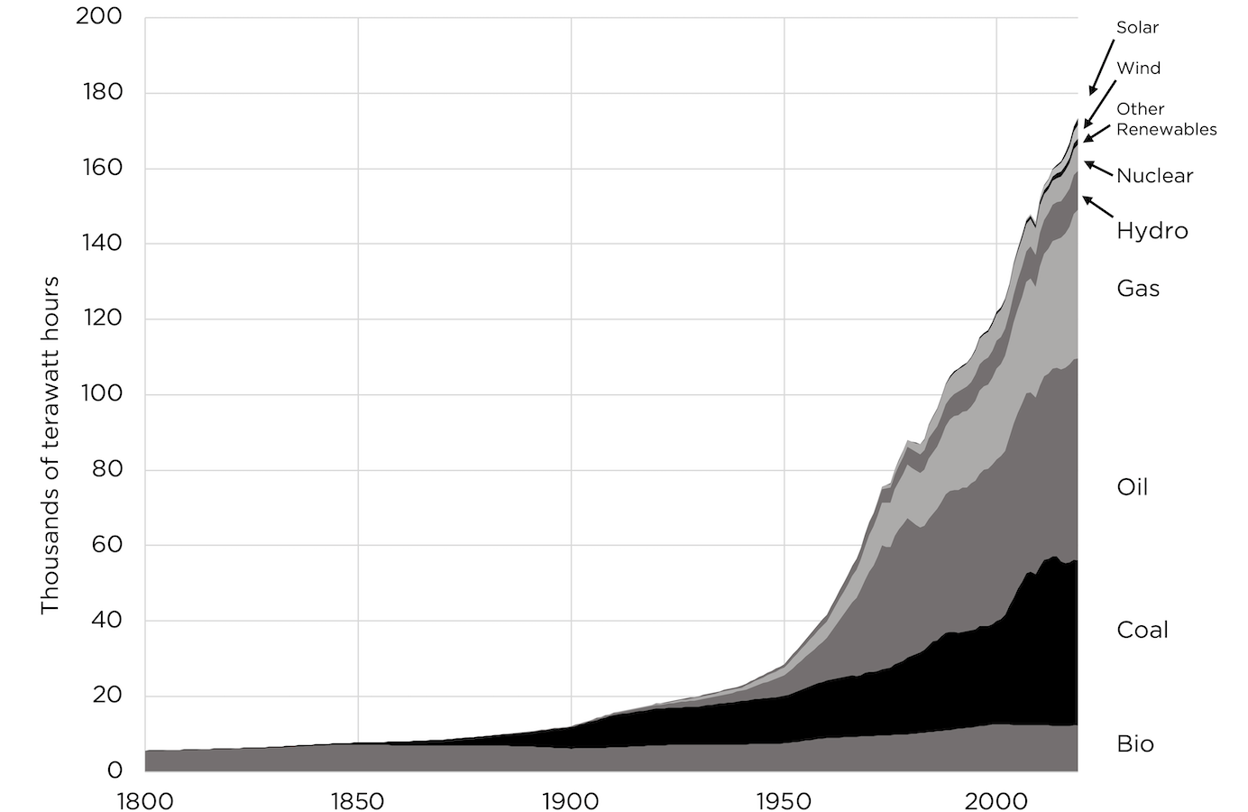
……………
Fossil fuels are a uniquely cost-effective source of energy.
Undeniable
fact 3
Fossil fuels’ benefits going forward
Low-cost, reliable, versatile energy for billions of people in thousands of places.
Fossil Fuels provide 80% of the world’s energy, despite 100+ years of aggressive competition.
Fossil fuel use is still growing, mostly in the countries most concerned with cost-effective energy—e.g., China, 200+ new coal plants commissioned.
Recent price increases are due to political restrictions not resource, technological, or economic fundamentals.
Why so cost-effective? Crucial question that’s rarely asked.
For this and other shareable resources, email resources@alexepstein.com

Slide 11
……………
Fossil fuels’ natural attributes, harnessed by generations of ingenuity and refinement
Undeniable
fact 3
1
Natural storage
Fossil fuels’ benefits going forward
2
Natural concentration
3
Natural abundance
For this and other shareable resources, email resources@alexepstein.com

Slide 12
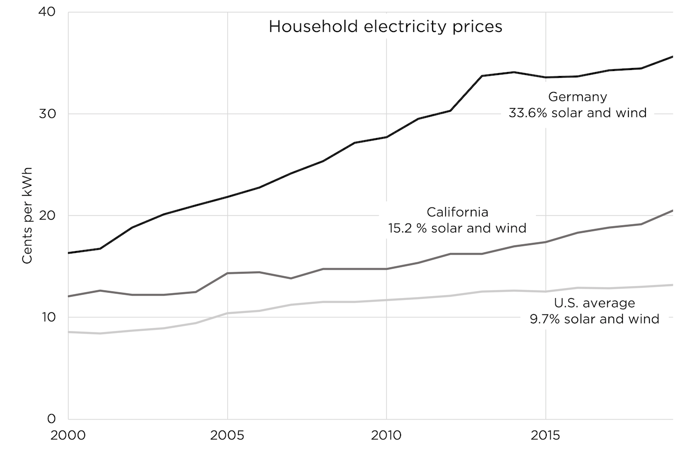
……………
Unreliable solar and wind energy are failing to replace fossil fuels
Undeniable
fact 4
Fossil fuels’ benefits going forward
Solar + wind are used in significant quantities only with strong government preferences.
Solar + wind use correlates strongly with higher prices.
Solar + wind only provides electricity, which is 1/5 of world energy.
For this and other shareable resources, email resources@alexepstein.com

Slide 13
……………
Key principle
The cost of energy is determined by the cost of the total process for producing it
It’s hard to create low-cost, processes for all the energy needs of billions of people around the world—especially for heavy-duty transportation energy
Mining
Processing
Manufacturing
Transportation
Operation
Maintenance
Disposal
For this and other shareable resources, email resources@alexepstein.com

Slide 14
……………
The truth about solar and wind: unreliability 1) requires dependence on “reliables,” 2) creates huge system costs
For this and other shareable resources, email resources@alexepstein.com

Slide 15
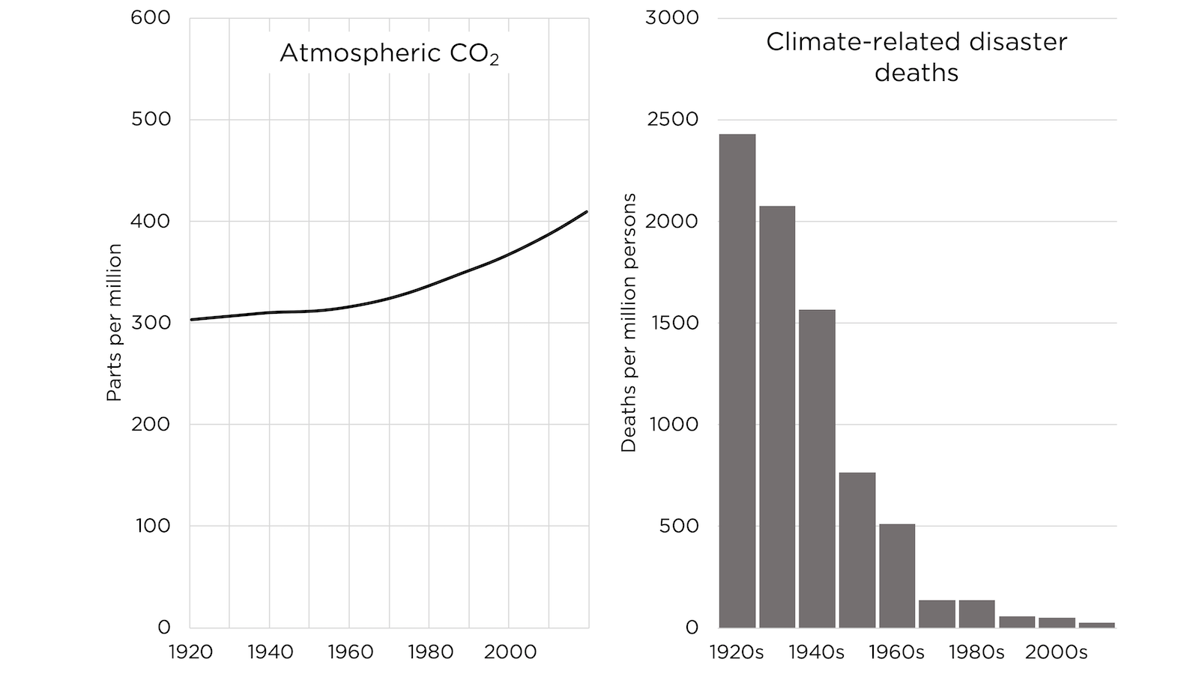
……………
Fossil fuels give us an incredible ability to master climate danger, whether natural (massive) or manmade
Undeniable
fact 5
Fossil fuels’ benefits going forward
Climate-related disaster deaths—extreme temperatures, storms, floods, wildfires, drought—down 98% over the last century.
Made possible by fossil fueled climate mastery.
E.g., 100 million people live below sea level (high tide).
For this and other shareable resources, email resources@alexepstein.com

Slide 16
……………
The benefits of continuing fossil fuel use: conclusion
If we are free to use fossil fuels, then billions more people can have the energy they need to be productive and prosperous—and be safe from climate.
If and to the extent we try to eliminate fossil fuel use, virtually all the world’s 8 billion people will plunge into poverty and premature death.
The deadly global energy crisis has been caused by just 1% implementation of the anti-fossil-fuel agenda.
Conclusion
Fossil fuels’ benefits going forward
For this and other shareable resources, email resources@alexepstein.com

Slide 17
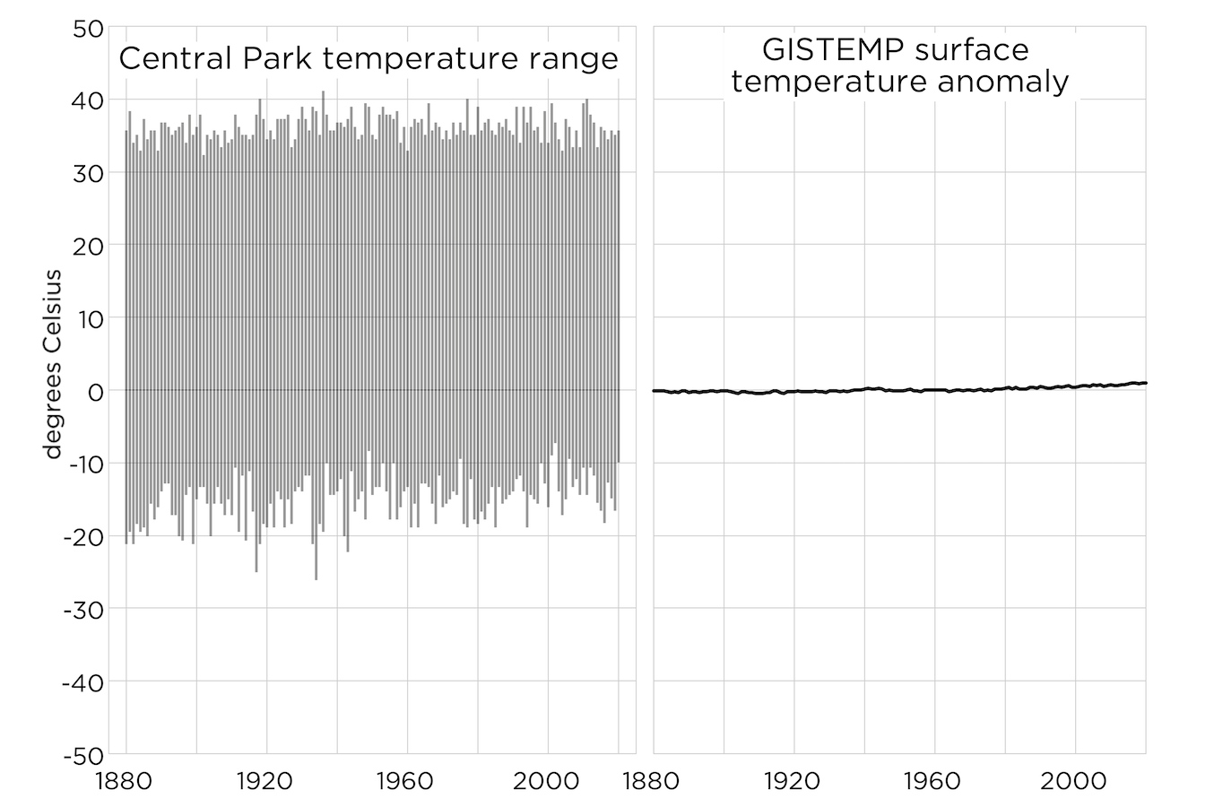
……………
Our CO2 emissions of the last 170 years of fossil fuel use have correlated with 1°C warming and significant greening
Undeniable
fact 1
Full effects of CO2 going forward (- and +) with precision
For this and other shareable resources, email resources@alexepstein.com

Slide 18
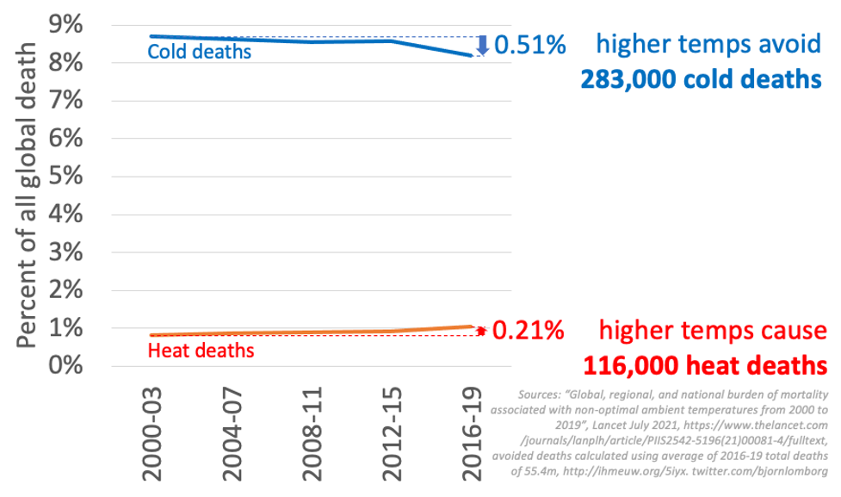
……………
We still have far more cold-related deaths than heat-related deaths.
Undeniable
fact 2
Full effects of CO2 going forward (- and +) with precision
For this and other shareable resources, email resources@alexepstein.com

Slide 19
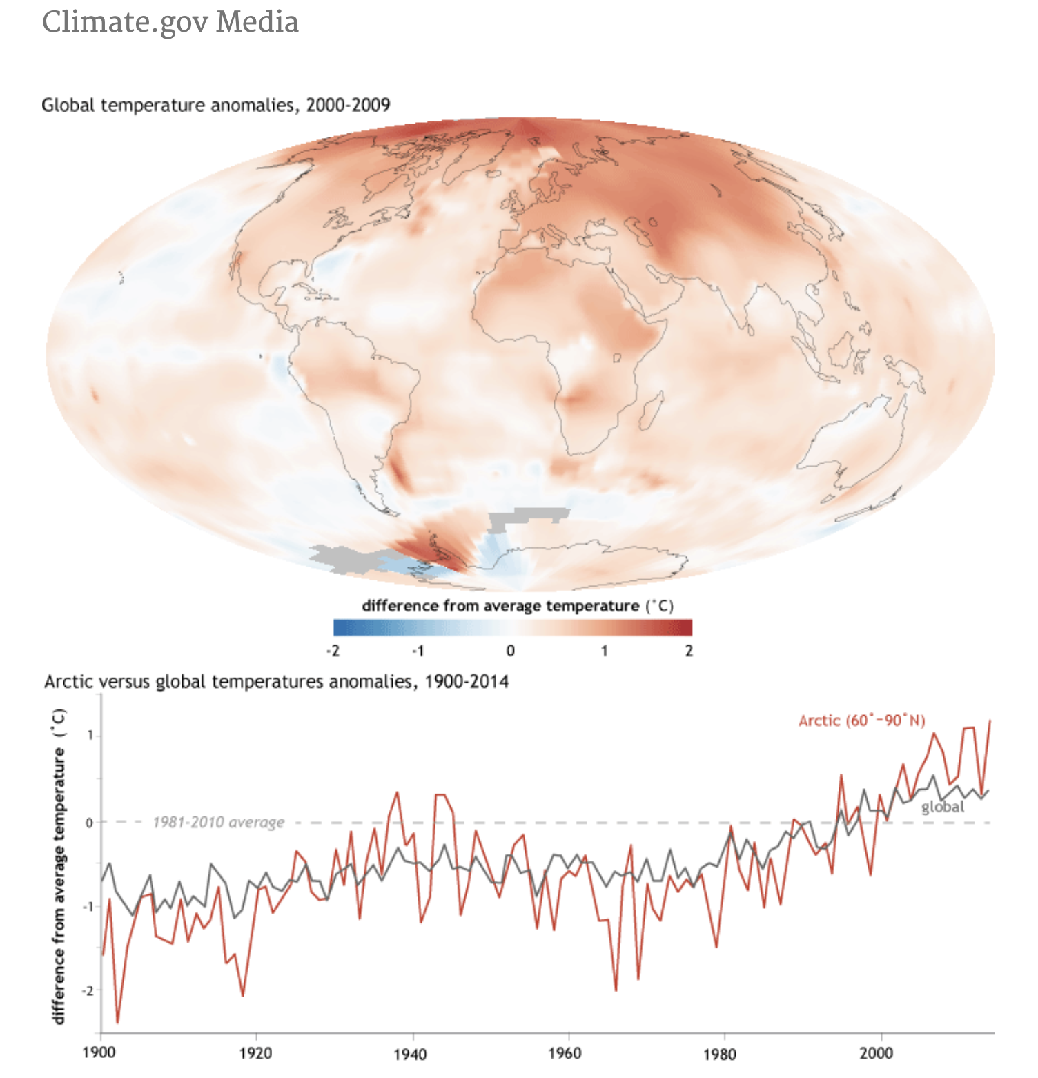
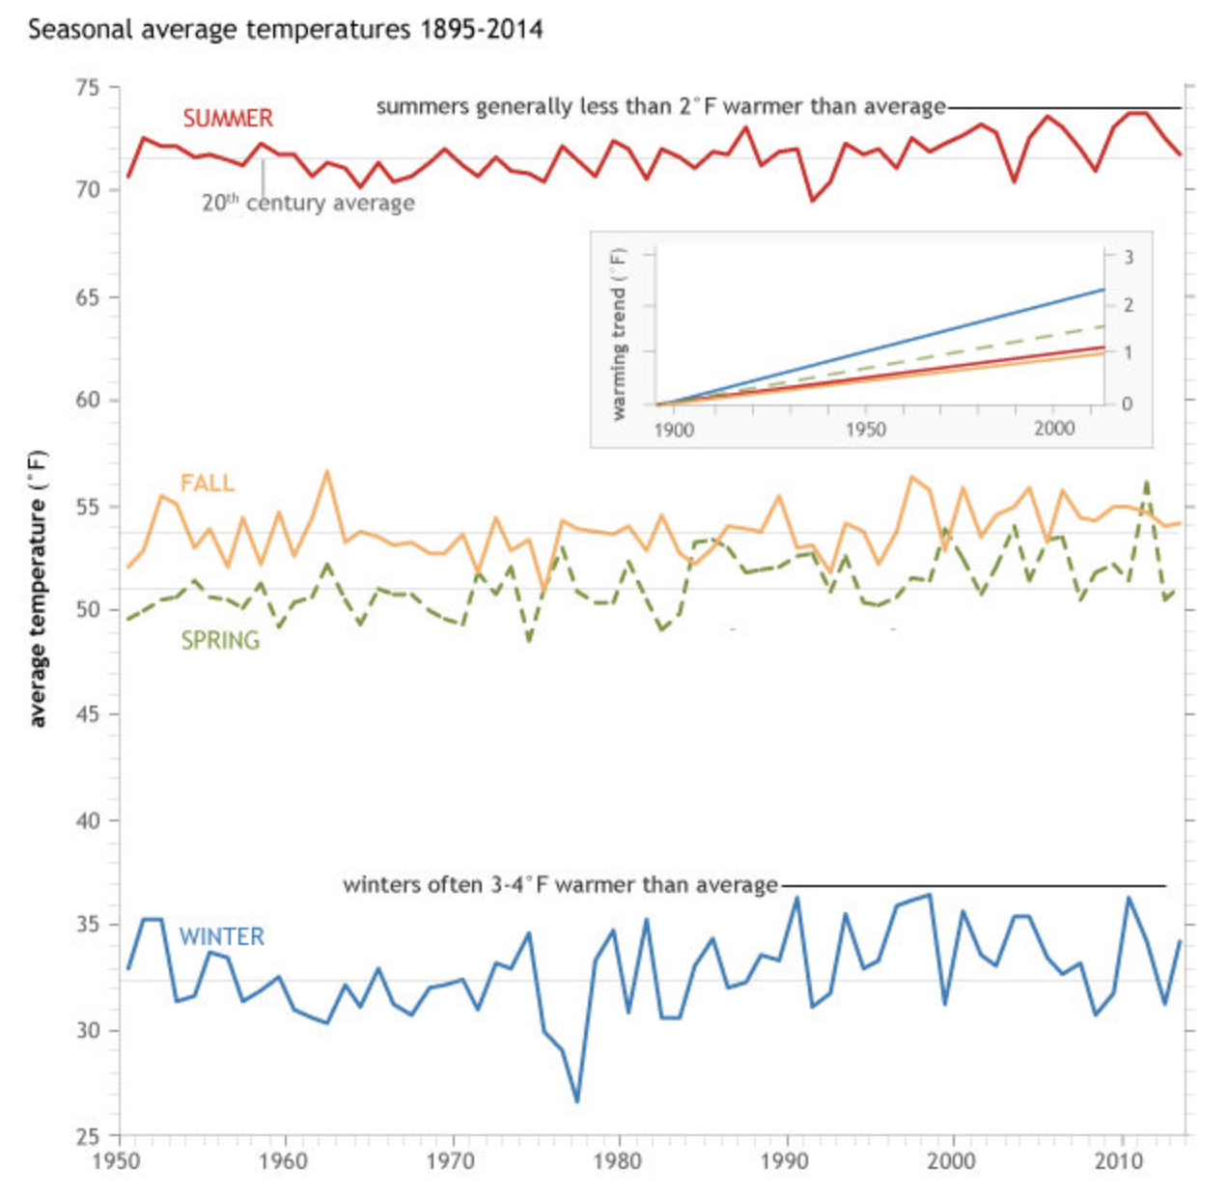
……………
Warming occurs more in colder places, during colder seasons, and at colder times.
Undeniable
fact 3
Full effects of CO2 going forward (- and +) with precision
For this and other shareable resources, email resources@alexepstein.com

Slide 20
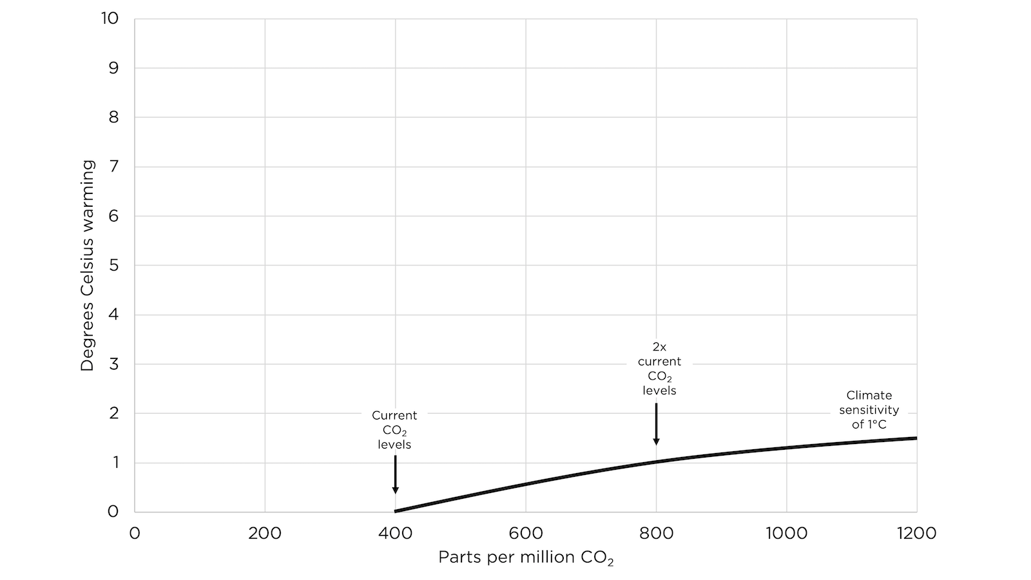
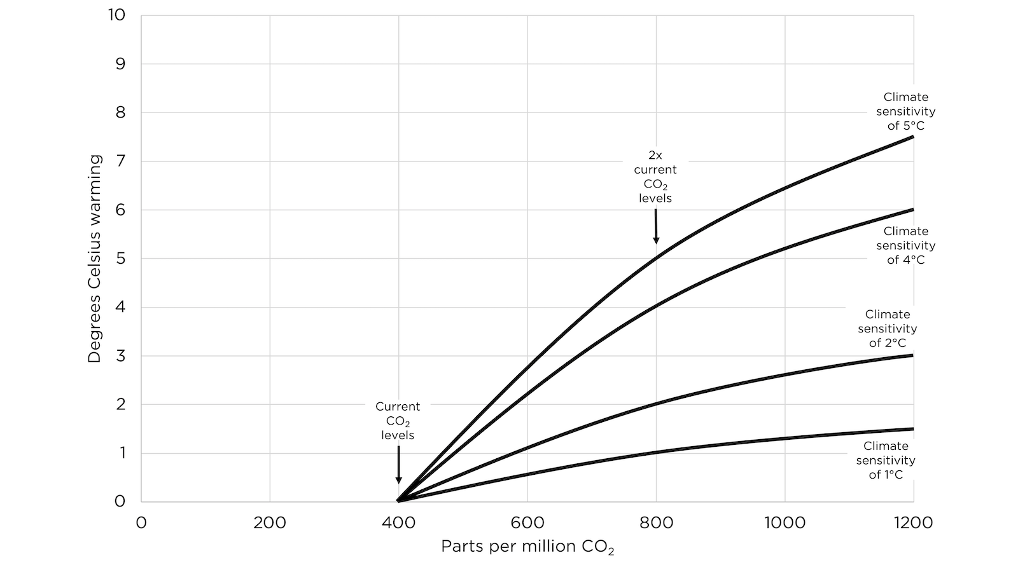
……………
The “greenhouse effect” of CO2 is a diminishing, logarithmic effect, which means that even in (highly unlikely) extreme projections warming will slow.
Undeniable
fact 4
Full effects of CO2 going forward (- and +) with precision
For this and other shareable resources, email resources@alexepstein.com

Slide 21
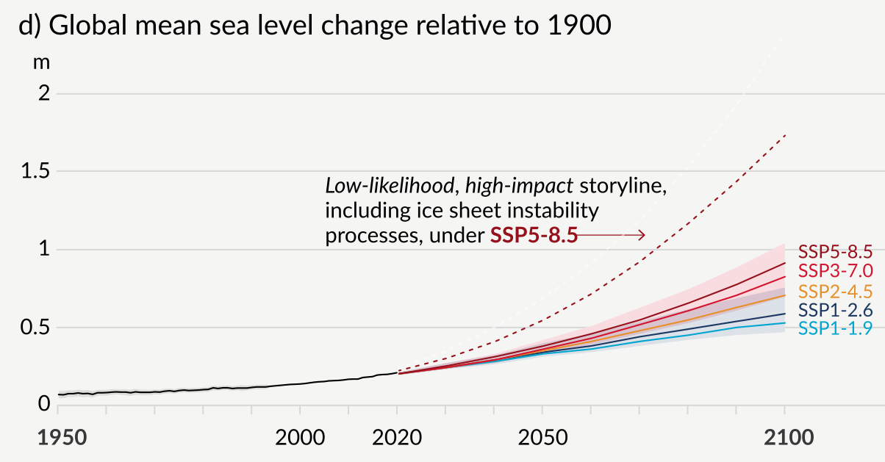
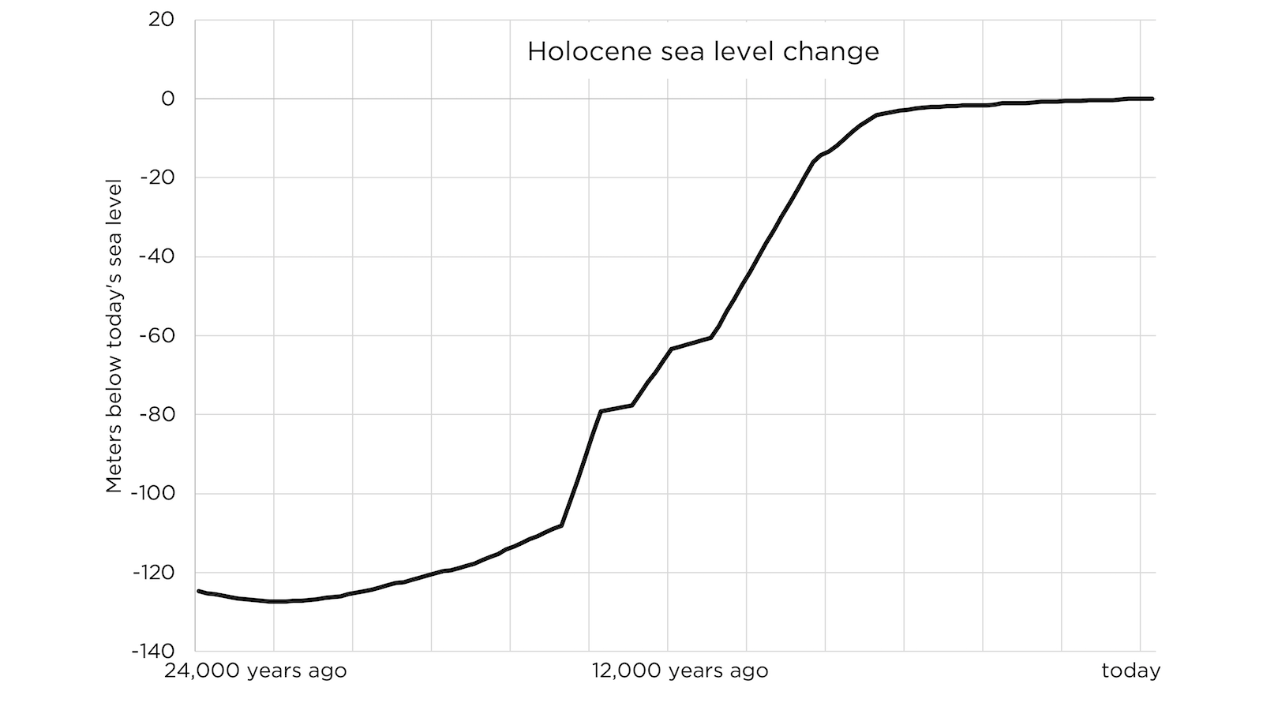
……………
IPCC projected changes in weather and sea level due to warming are all readily masterable by an empowered world.
Undeniable
fact 5
Full effects of CO2 going forward (- and +) with precision
E.g., mainstream projects of storms being 1-10% more intense, 25% less frequent
Extreme sea level projections of 3 feet in 100 years. Not in 10 years.
For this and other shareable resources, email resources@alexepstein.com

Slide 22
……………
If we are free to use fossil fuels, we will continue to have a warming and greening impact that we can master and flourish with.
If we rapidly eliminate fossil fuels, we will have a less-impacted impact (short-term) but a much less livable climate and world.
Conclusion
Full effects of CO2 going forward (- and +) with precision
The benefits of fossil fuel use going forward are incomparably greater than negative climate side-effects.
For this and other shareable resources, email resources@alexepstein.com

Slide 23
……………
Rapid elimination of fossil fuels is based on total failure to proper good thinking principles—ignores benefits of fossil fuels, “catastrophizes” negative side-effects, denies/distorts today’s reality.
The right policy: Energy freedom, including nuclear decriminalization
Create an abundant and safe world for 8 billion people, lower CO2 emissions (as well as pollution and danger) long-term.
Conclusion
For this and other shareable resources, email resources@alexepstein.com

Slide 24
……………
Why do our leaders think so irrationally about fossil fuels?
Feel free to ask in the Q&A (or read Chapter 3 of Fossil Future).
The root is anti-human philosophy (often disguised as pro-human).
Why?
For this and other shareable resources, email resources@alexepstein.com

Slide 25
Today’s unprecedented energy education opportunity
For this and other shareable resources, email resources@alexepstein.com

Slide 26
Resource:
Fossil Future (FossilFuture.com)
For this and other shareable resources, email resources@alexepstein.com

Slide 27
Resource:
EnergyTalkingPoints.com
For this and other shareable resources, email resources@alexepstein.com

Slide 28
……………
resources@alexepstein.com
speaking@alexepstein.com
alex@alexepstein.com
Next steps
For this and other shareable resources, email resources@alexepstein.com

