Slide 1
Nuclear Energy – A Key Component for Our Clean Energy Future
Gale Hauck
Senior Advisor to Assistant Secretary for Nuclear Energy
February 2, 2023

Slide 2
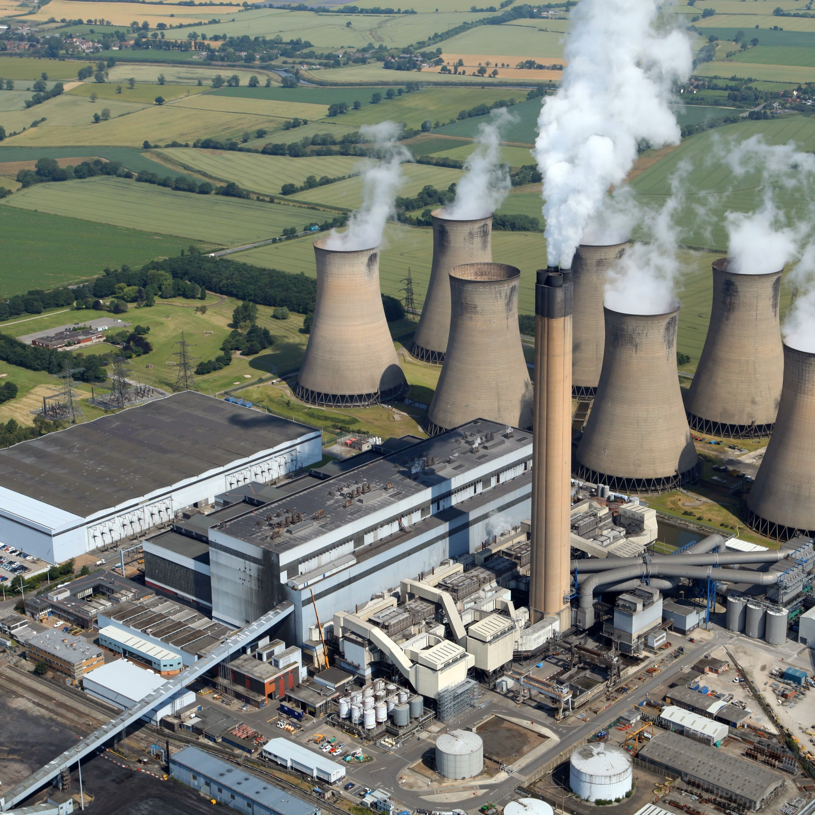
Our Clean Energy Imperative
Fossil fuels are plentiful and cheap but contribute to climate change
Increased access to energy improves quality of life; especially important in developing nations
Rapidly deploying carbon free energy is essential, especially in developing economies that are heavily reliant on cheap energy from coal
Current renewable energy and battery technologies are insufficient to meet the demand
Nuclear energy is the only currently available, carbon-free, rapidly deployable energy source that can produce power day and night
Thus, deployment of nuclear energy, especially in locations with high reliance on coal, is urgently needed
Nuclear energy is an important component to addressing environmental concerns and quality of life worldwide

Slide 3
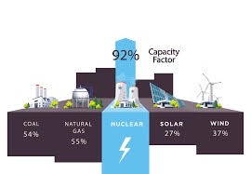
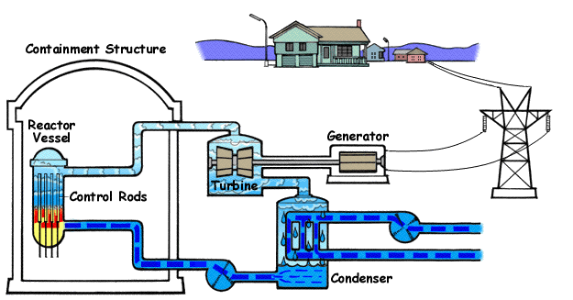
Nuclear Energy is Unique
Nuclear power plants are unique because they
    Can be located nearly anywhere
    Provide energy nearly 100% of the time
    Have broad applications beyond electricity
    Can be used to decarbonize the industrial sector
  Nuclear power plants make electricity by
    Generating heat in the reactor core
    Using that heat to boil water and produce steam
    Use the steam to turn a turbine
    The turbine is connected to an electrical generator and spins to generate electricity
Notes:
Among the carbon free energy sources, nuclear energy is unique in that it can be located anywhere (technically – politically is a different matter) and can provide energy nearly 100% of the time (versus intermittently).
Nuclear energy also has broad applications that can be used to decarbonize industries beyond electricity.
Traditional, light water reactor nuclear power plants work by generating heat in the reactor core (similar to a thermal plant), using that heat to boil water and make steam to turn a turbine connected to an electrical generator to generate electricity.
Source: https://energyeducation.ca/encyclopedia/Nuclear_power_plant

Slide 4
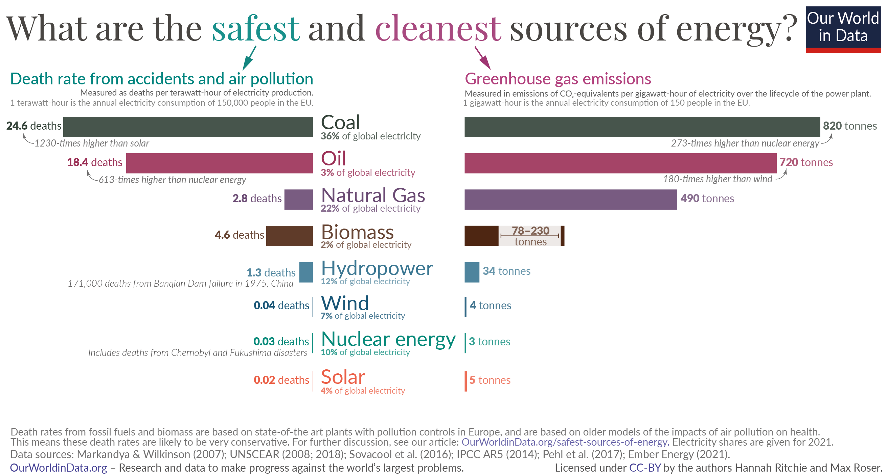
Nuclear Has the Lowest Lifecycle Carbon Emissions

Slide 5
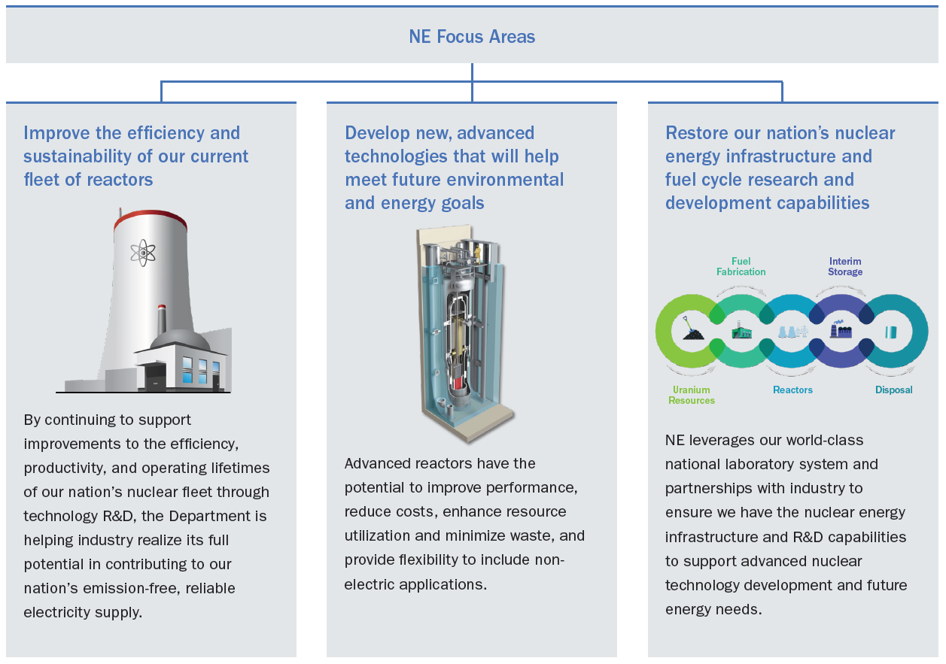
DOE NE Mission and Priorities
Mission: to advance nuclear energy science and technology to meet U.S. energy, environmental, and economic needs.

Slide 6
NE-20
NE-1/2
Chief Operating Officer
Dennis Miotla
Assistant Secretary for Nuclear Energy
Dr. Kathryn Huff, Assistant Secretary
Mike Goff, Principal Deputy Assistant Secretary
Stakeholder Advisory Groups
Office of Human Capital & Business Services
Deborah Sharpe
Office of Budget & Planning
Patrick Edgerton
Senior Advisor Staff
Office of Communications and Engagement
Alisa Trunzo
NE-3
NE-4
NE-5
NE-6
NE-8
Deputy Assistant Secretary for Nuclear Infrastructure Programs
Tracey Bishop
Deputy Assistant Secretary for Nuclear Fuel Cycle and Supply Chain
Jon Carmack
Deputy Assistant Secretary for Reactor Fleet and Advanced Reactor Deployment
Alice Caponiti
DAS for International Nuclear Energy Policy and Cooperation
Aleshia Duncan
Manager, Idaho Operations Office
Lance LaCroix
Deputy Assistant Secretary for Spent Fuel & Waste Disposition
Vacant
Office of Nuclear Facilities Management
Vacant
Office of Advanced Fuels Technologies
Bill McCaughey
Office of Nuclear Energy Technologies
Suibel Schuppner
Office of Bilateral, Multilateral and Commercial Cooperation
Vacant
Office of Spent Fuel and Waste Science and Technology
William Boyle
Office of Nuclear Materials Production, Management & Protection
Vacant
Office of Materials and Chemical Technologies
Stephen Kung
Office of Nuclear Reactor Deployment
Alison Hahn
Office of International Nuclear Safety
Vacant
Office of Integrated Waste Management
Erica Bickford, Acting

Slide 7

Nuclear Energy Investments Through Department of Energy
Annual
Appropriations
Bipartisan Infrastructure Law
Inflation Reduction Act
FY 2023 Enacted $1.773B*
FY 2022 Enacted $1.682B
FY 2021 Enacted $1.535B
FY 2020 Enacted $1.493B
Advanced Reactor Demonstrations
$2.5B
Civil Nuclear Credits
$6B
Regional Hydrogen Hubs
(at least 1/4 nuclear)
$8B
HALEU
Availability
$700M
Production Tax Credit
$15/MWh
Investment Tax Credit
30% of capital cost in tax credit in year 1 of operations
Lab Infrastructure
$150M

Slide 8
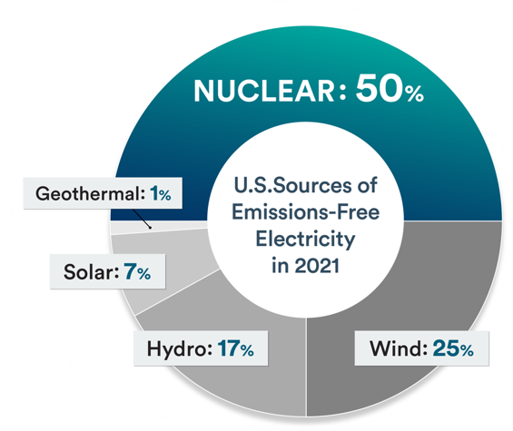
Bipartisan Infrastructure Law – Civil Nuclear Credit (CNC) Program
Program Goal: To prevent premature retirements of existing commercial nuclear reactors due to economic factors.
Credits will be allocated to reactors meeting specific criteria to ensure continued operation in support of decarbonizing the U.S. electricity sector by 2035 and achieving net-zero emissions economy-wide by 2050.
Bipartisan Infrastructure Law (BIL) appropriates $1.2 billion in each of five Fiscal Years (2022-2026) for the CNC program ($6 billion total).

Slide 9
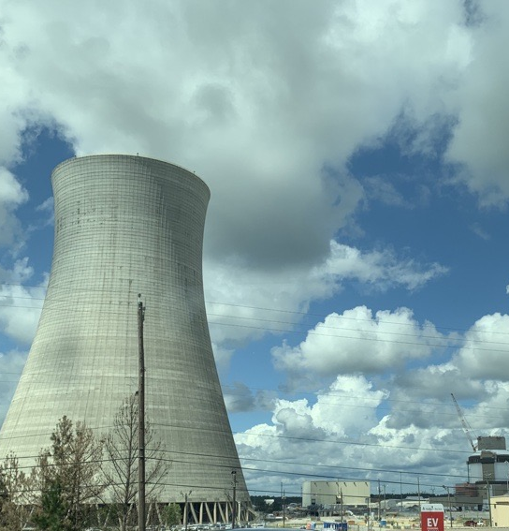
Inflation Reduction Act – for existing nuclear
Production tax credit for existing nuclear power plants:
For those nuclear plants in service before 2024 (when the credit commences) through 2032, operators will be eligible for a credit of 1.5 cents/kWh if projects meet prevailing wage and apprenticeship requirements (0.3 cent/kWh if not), indexed to inflation using 2023 as a baseline.
If the power price received (including state/local subsidies “zero emission credit programs”) rises above $25/MWh, then the credit gradually phases down by 80% for each $1/MWh earned above $25/MWh and drops to zero at $43.75/MWh.
9
Notes:
Pres Biden signed the IRA on Aug 16, 2022
only after an impartial review
of the scientific and technical merit of the proposals

Slide 10
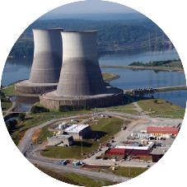
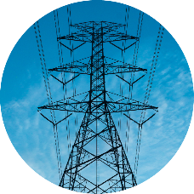






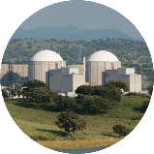
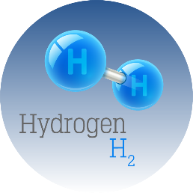
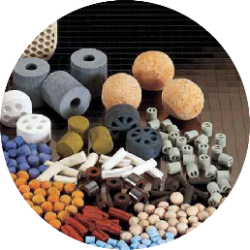

Flexible Business Models for the Future
NOW
Baseload Electricity Generation
Flexible Electricity
Generation
FUTURE
Large Light Water Reactors
Heat
Small Modular Reactors
e⁻
Industrial
Applications
Advanced Gen IV Reactors
Hydrogen Production
New Chemical Processes
Clean Water
Notes:
Walk through the current state – energy to the grid
Intermediate future state – (near term)
Rethinking how we use our current generators to do more than just put electrons on the grid
Transformative future state – (long term)
Designing new systems, both small and large, to use heat, electricity and radiation to drive many other processes
Adding degrees of freedom to the optimization problem - the integrated system.
Long story short, I think it’s important to discuss the holistic perspective rather than trying to prove piece-wise that it’s better than status quo.
Achieving this goal will require significant S&T advances in:
– Enabling technology for flexible operation of existing and future nuclear power plants in integrated, hybrid configurations
– Advanced industrial processes that utilize nuclear fission reactors as a primary energy source
– Revolutionary concepts in materials design that incorporating new understanding of processes that are initiated and propagated using radiation, heat, and electricity provided by nuclear energy (suggest editing this bullet slightly into: Revolutionary concepts in materials design that incorporate new understanding of processes and enable the comprehensive use of nuclear energy in the form of radiation, heat, and electricity)
Another way to look at it is that we’re talking about harvesting energy in whatever form that we’re going to see anyway. The waste heat from power conversion goes to atmosphere already; we’re not talking about generating any more MWt than we already are. We’re already using pumping power to maintain spent fuel temperature; what if we make some use of that ever-so-slight delta-T? The radiation fields around the reactor or spent fuel are facts of life; can we use those lemons to make radioactive lemonade?
The other part is that we’re trying to divorce ourselves from serving a single power consuming master. If the thermal market looks better than the electric market at any given moment, and it costs the same to run regardless of the customer, then we want to go thermal in that market, and vice versa. In some ways, it’s about moving the power market closer to a better approximation of a liberalized market by adding both consumers and producers and facilitating their interaction. In theory, that should allow more potential equilibrium states and smoother transitions between them.
This goes beyond nuclear, and extend to all forms of energy generation. This goes beyond Nuclear.....suggest "We will transform the current energy paradigm".

Slide 11
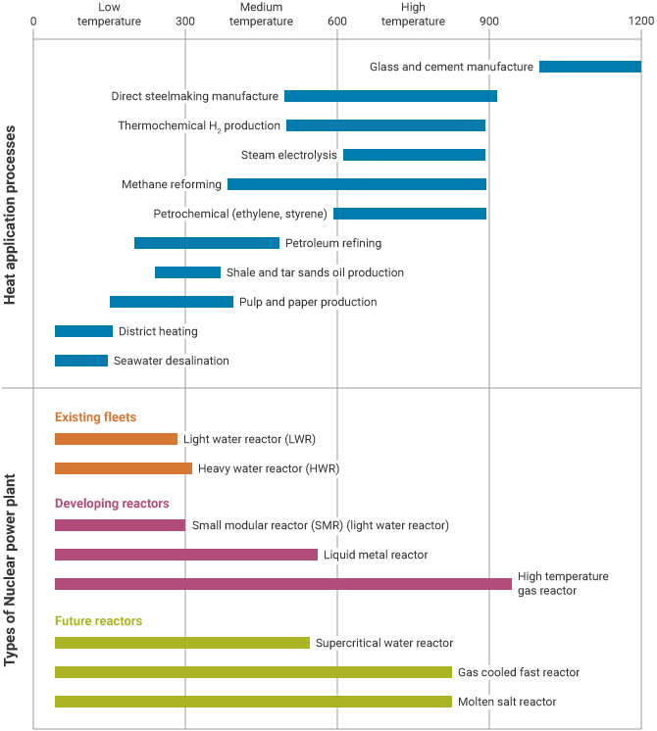
Industrial Applications of Nuclear Energy
Heat from nuclear reactions can be used for heating and/or industrial applications
Traditional, light water cooled nuclear plants can only reach temperatures up to approximately 300degC
Energy intensive industries such as steel manufacturing and the chemical industry often require much higher temperatures >600 degC
Advanced reactor types such as liquid metal or molten salt can support industrial process needs
Notes:
Heat from the nuclear reactors can be used directly (rather than being converted to electricity) for applications in industry (process heat) as well as district heating for commercial and residential applications
Traditional, light water cooled nuclear plants can only reach certain temperatures (500-600 degF). This is show in the orange bars in the figure.
Energy intensive industries such as steel manufacturing and the chemical industry often require much higher temperatures (>1000 degF). Industrial energy needs are shown in blue.
Advanced reactor types such as liquid metal or molten salt can support industrial process needs. Advanced reactor types are shown in pink – developing reactors that will be available in the near term – and in yellow – future reactors that will be available in the next decade.
Source: https://world-nuclear.org/information-library/non-power-nuclear-applications/industry/nuclear-process-heat-for-industry.aspx#:~:text=Nuclear%20energy%20is%20an%20excellent,in%20the%20future%3A%20hydrogen%20production.

Slide 12
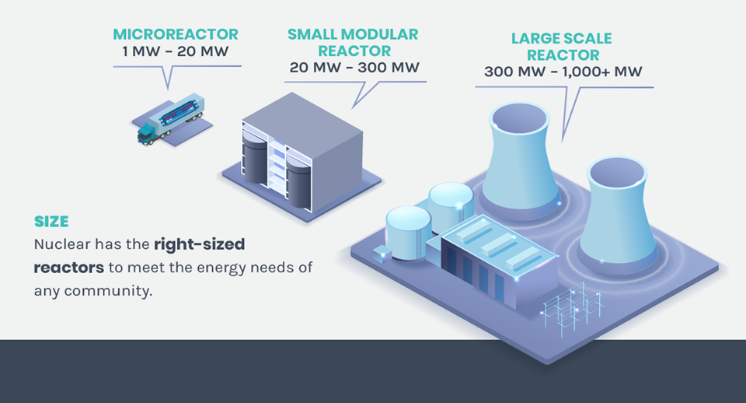
Advanced Reactor Applications

Slide 13
Reactor Designs, Old and New
Light Water Reactor
High Temperature Reactor
Liquid Metal Reactor
Molten Salt Reactor
Micro Reactor

Slide 14
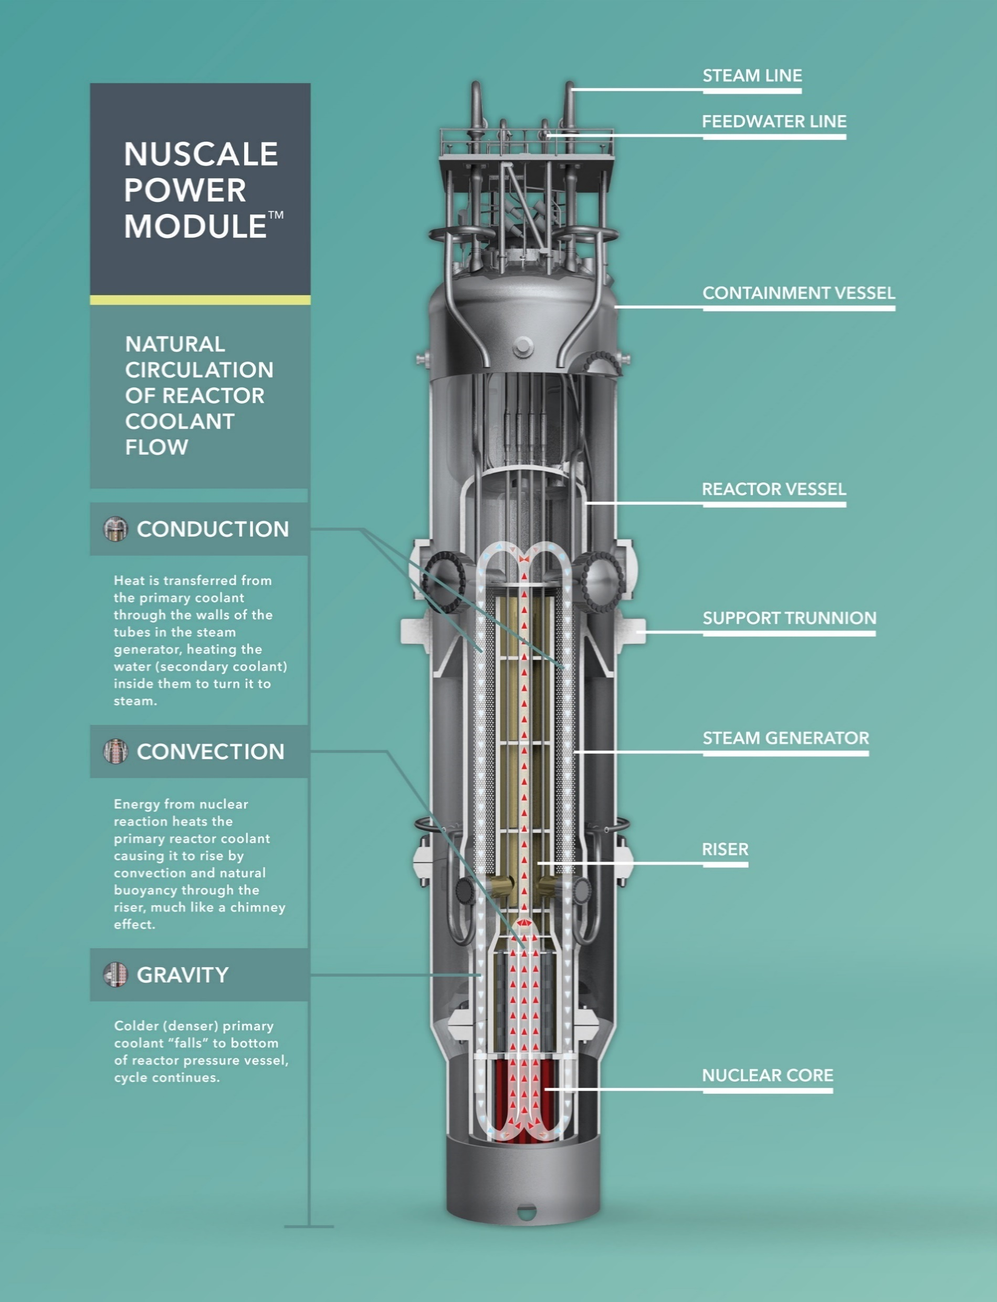
Light Water Reactor (LWR)
Light Water Reactor (LWR) Small Modular Reactor (SMR)
  Use water as the coolant and moderator
  Builds on existing LWR technology and extensive operating experience
  >80% of reactors worldwide are LWRs

Slide 15
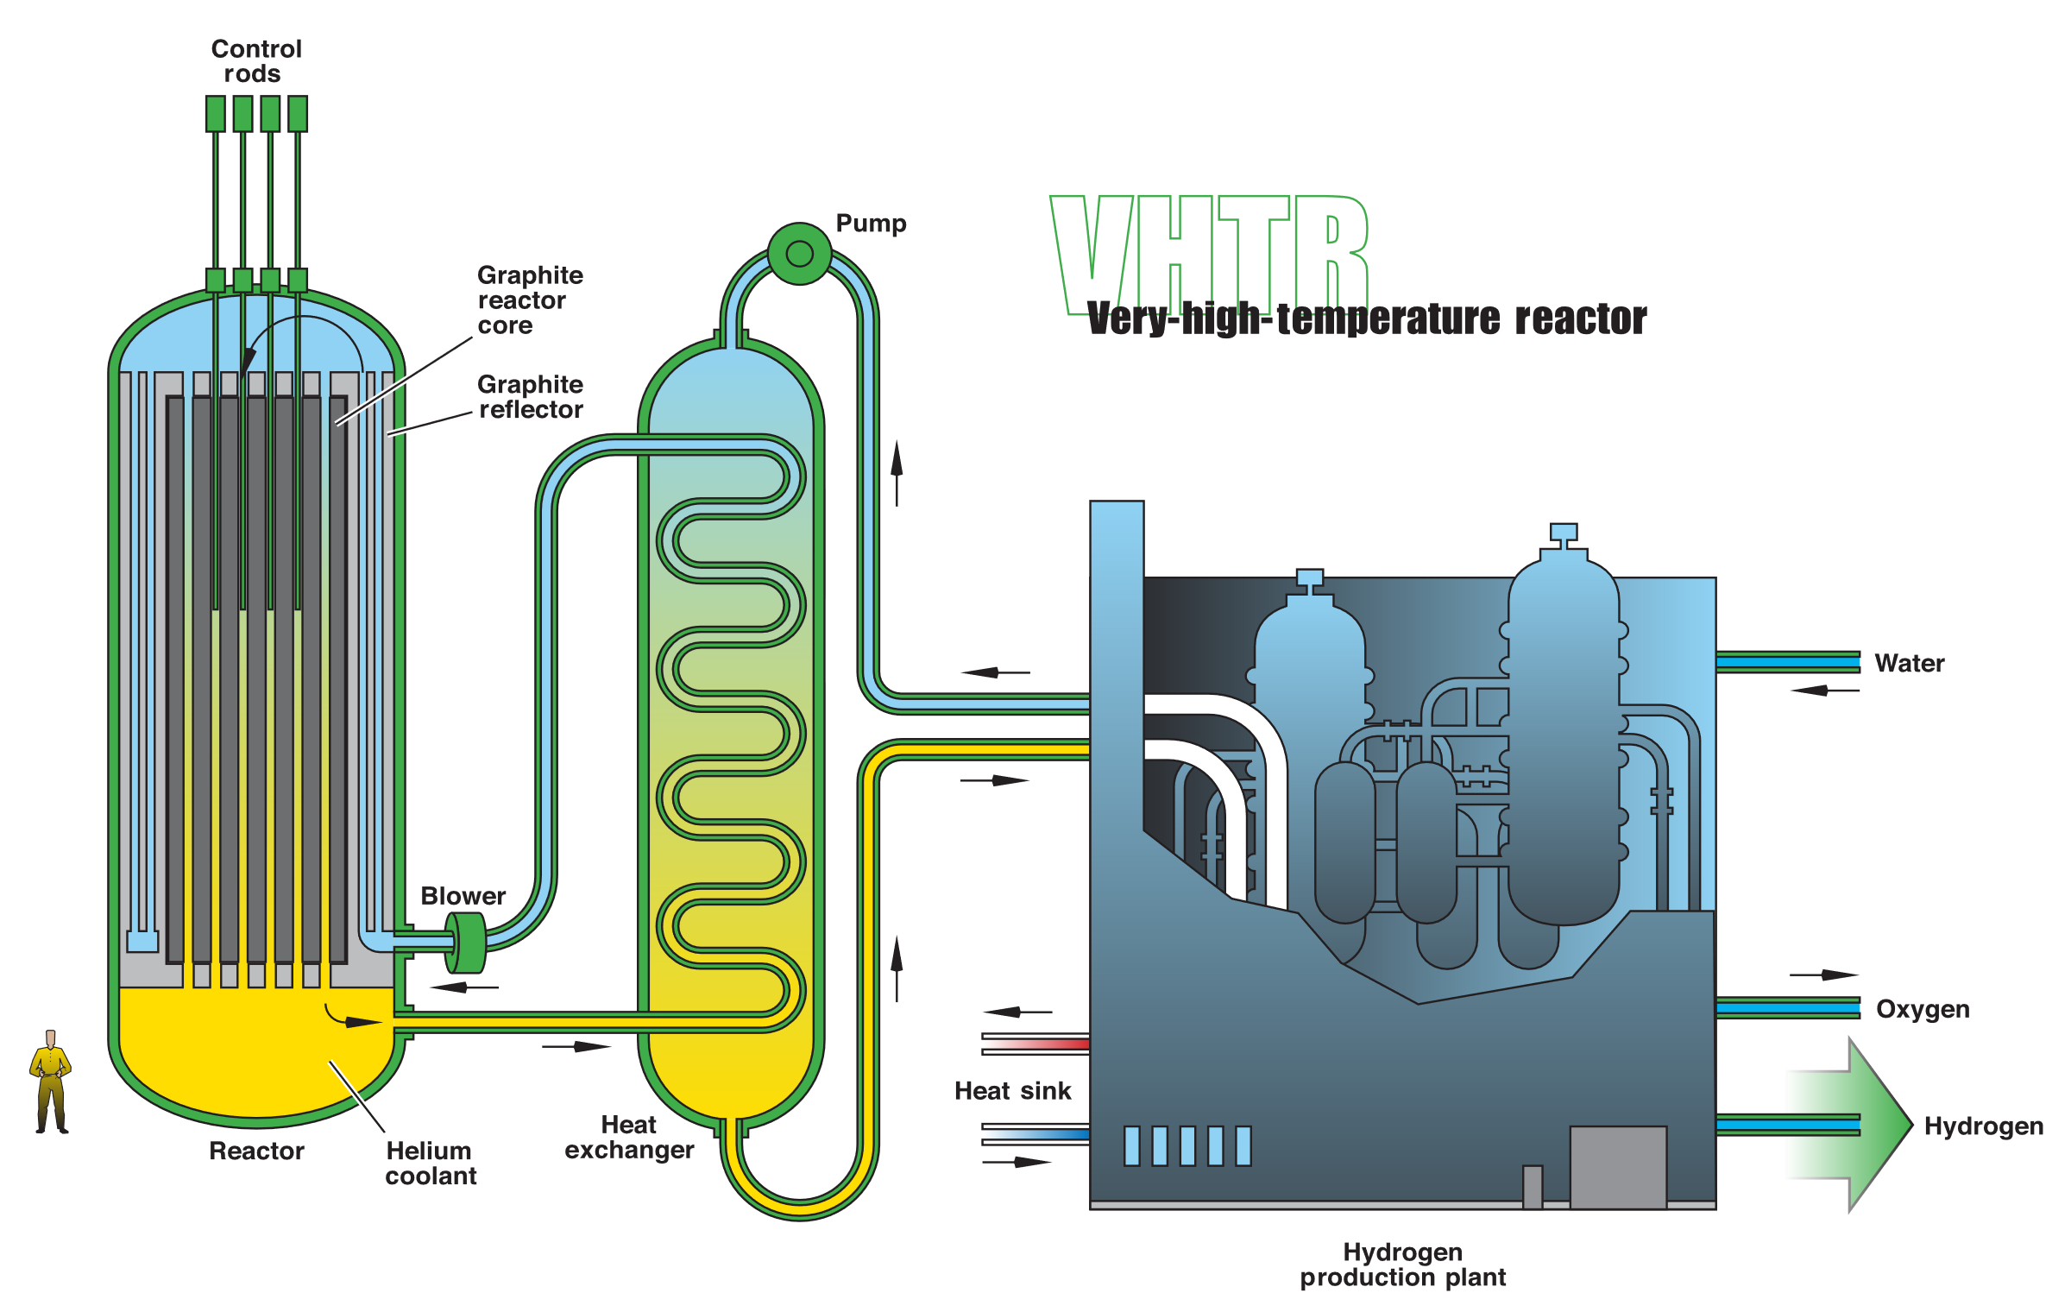
High Temperature Reactor (HTR)
High Temperature Reactor (HTR) SMR
  Use graphite as a moderator and gas (i.e. helium) as a coolant
  Long history of commercial operation in the United Kingdom
  Output temperatures can reach up to 750°C

Slide 16
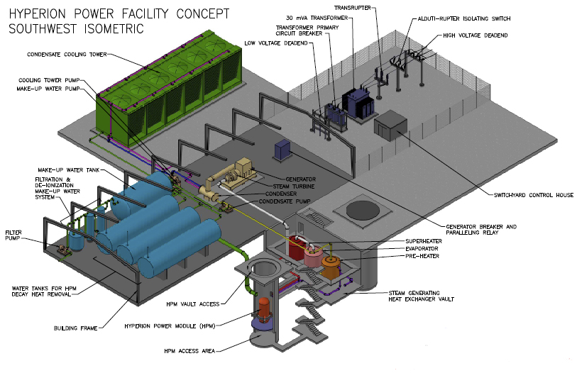
Liquid Metal Reactor
Liquid Metal (LM) SMR
  Use liquid metal (i.e. sodium) as a coolant with solid fuel
  Operate at or near atmospheric pressure
  Can be used as breeder reactors that produce more fissile material than they consume

Slide 17
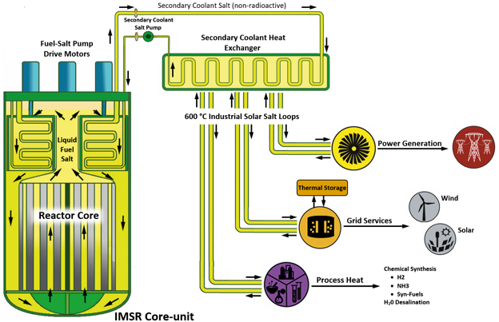
Molten Salt Reactor
Molten Salt SMR
  Use molten salt as a coolant with solid or dissolved fuel
  Operate at or near atmospheric pressure
  Dissolved fuel allows for online fueling / processing

Slide 18
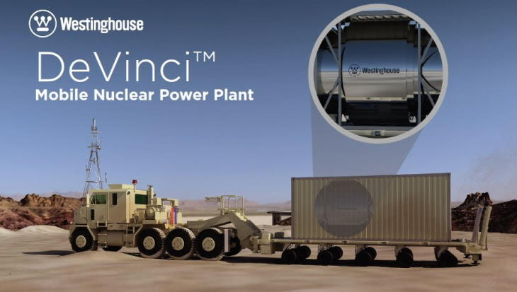
Micro Reactor
Micro Reactor
  Very small portable reactor in an integrated package
  Can be shipped to and deployed in remote locations
  Generate up to 20 megawatts of thermal energy

Slide 19
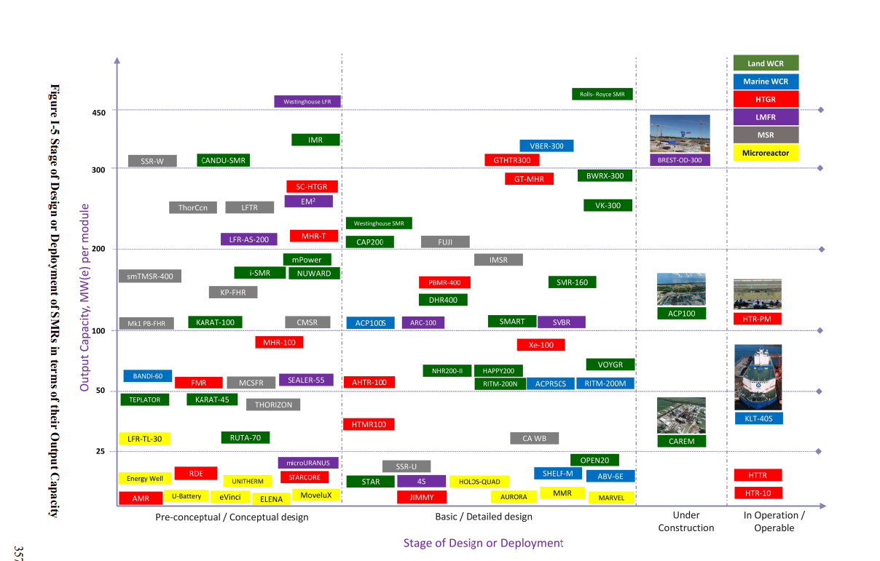
Notes:
INTERNATIONAL ATOMIC ENERGY AGENCY, Advances in Small Modular Reactor Technology Developments, A Supplement to: IAEA Advanced Reactors Information System (ARIA), IAEA, Vienna (2022)

Slide 20
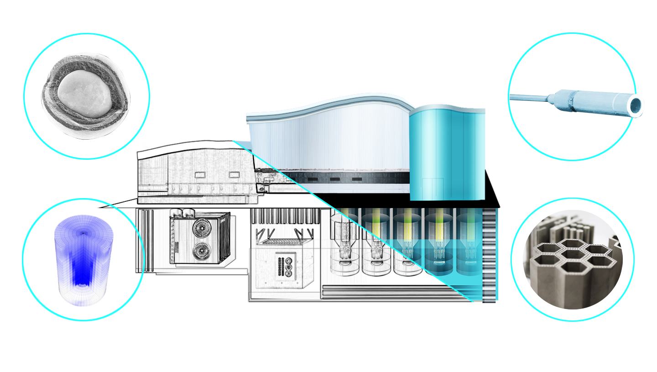

Advanced Reactor Development

Slide 21
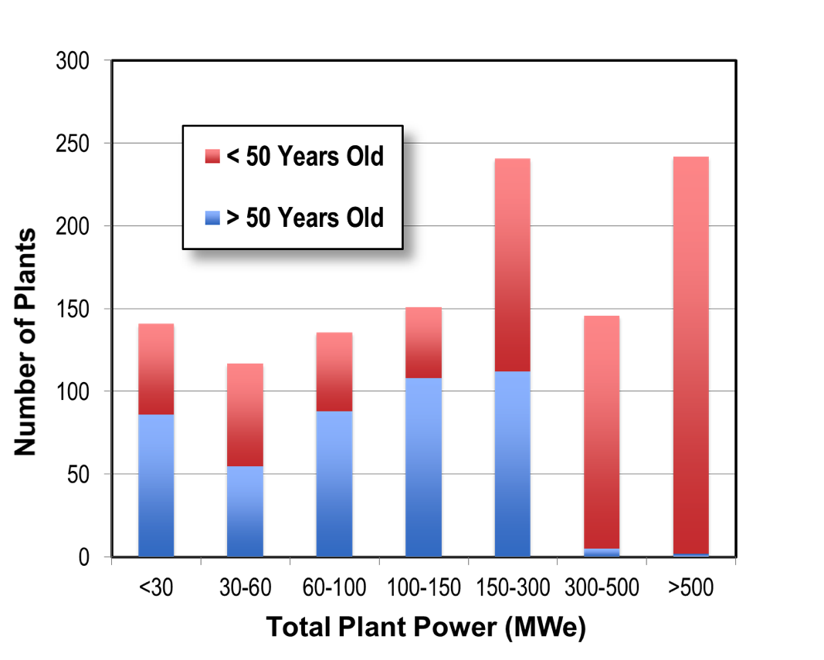
Electric Utility Interest in SMRs
Site selection
Lower land and water usage
Adaptable to broader seismic
conditions
Load demand
Better match to power needs
Replacement of older coal plants
Demand growth
Incremental capacity addition for
regions with low demand growth
Grid stability
Closer match to traditional power generators
Smaller fraction of total grid capacity
Potential to offset non-dispatchable unreliable sources (e.g. wind, solar)
U.S. Coal Plants
Plants >50 yr old have capacities below 300 MWe
Total capacity for 50+ yr old plants = 49 GWe

Slide 22
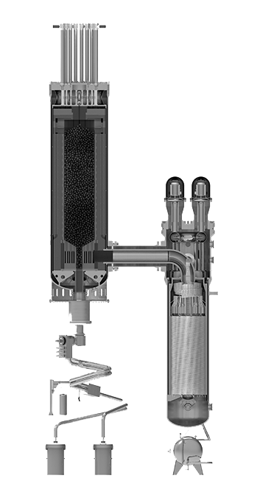
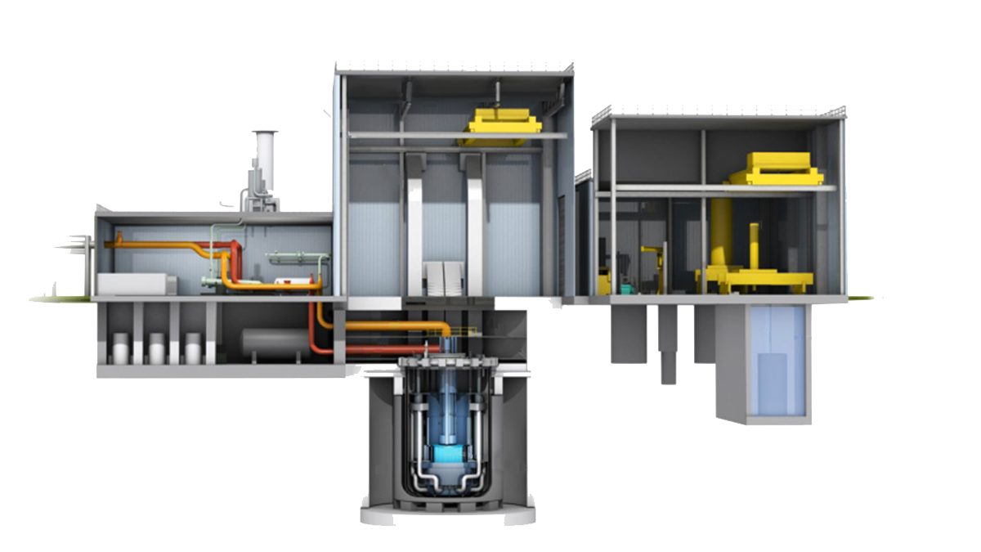
Bipartisan Infrastructure Law –
Advanced Reactor Demonstration Program - $2.5 Billion
Kemmerer, WY
Grant County, WA

Slide 23
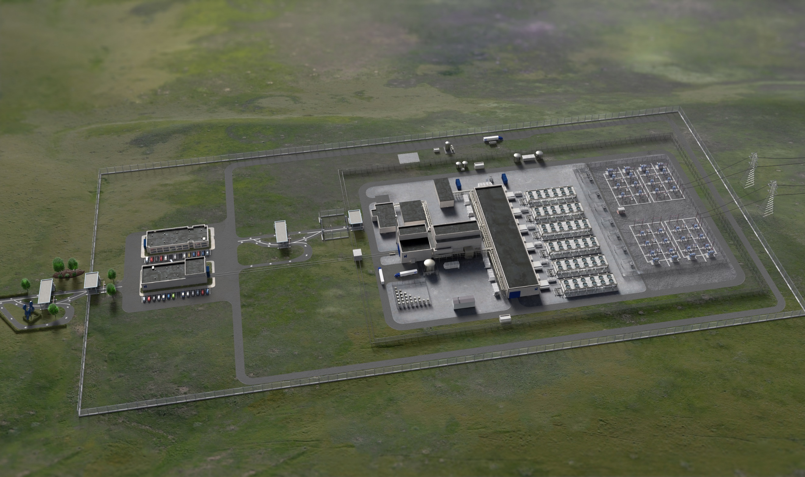
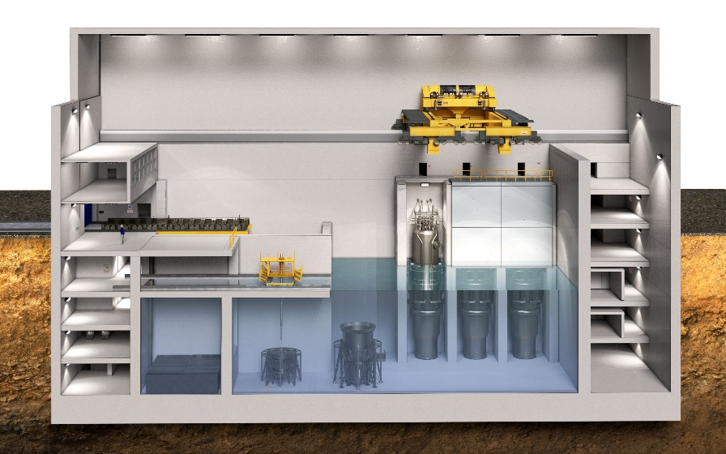
Carbon Free Power Project:
NuScale SMR Demonstration at Idaho National Laboratory
Turbine
Building
Reactor
Building
NuScale SMR Attributes - Six-module Plant Configuration
6 Nuclear Power Modules - 462MWe (77 Mwe per module)
Leverages proven and commercially-available LWR fuel
Air Cooled Condensers – substantially reduces water use
Initial site characterization work completed
First module operation planned for 2029

Slide 24
Inflation Reduction Act – for new nuclear (built 2024 or later)
New plants will have two options for tax assistance:
  The Investment Tax Credit – 30% credit for energy property constructed after January 1, 2025
      Bonuses and requirements:
        Applies a 10% bonus for meeting domestic manufacturing requirements for steel, iron, and manufactured components.
        Applies a 10% bonus for projects located in energy communities (defined as brownfield sites or fossil fuel communities).
        Credits are set to phase out the later of 2032 or when emission targets are achieved (i.e., the electric power sector emits 75% less carbon than 2022 levels)
  Tech Neutral Production Tax Credit - 1.5 cents/kWh, adjusted for inflation using 1992 as a baseline (1.5 cents in 1992 dollars; in 2023 equals 2.6 cents/kWh)
      Becomes available to facilities already in service in 2024 and ends after 2032
      Same bonuses and requirements as ITC apply
24
Notes:
Pres Biden signed the IRA on Aug 16, 2022
only after an impartial review
of the scientific and technical merit of the proposals

Slide 25
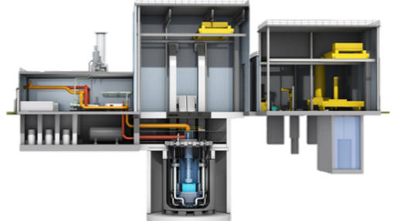
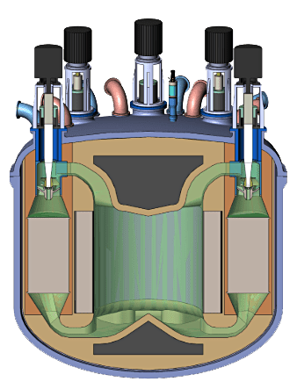
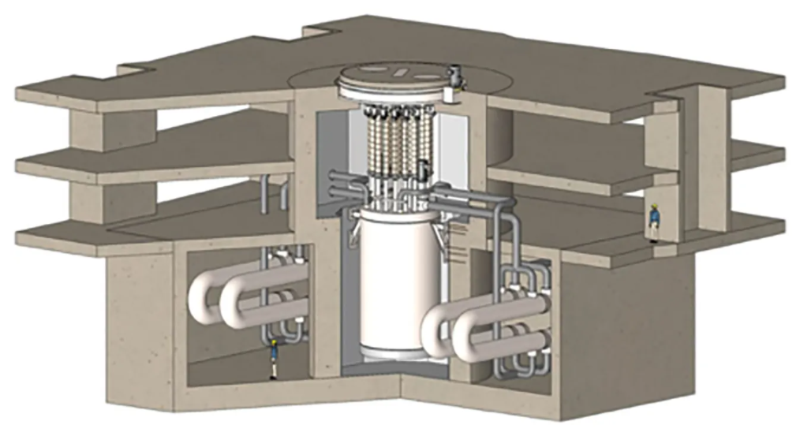


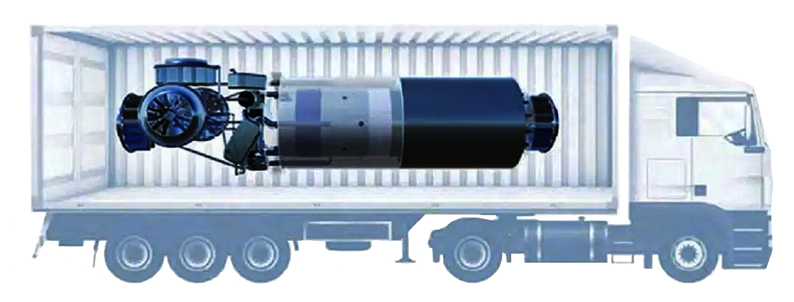
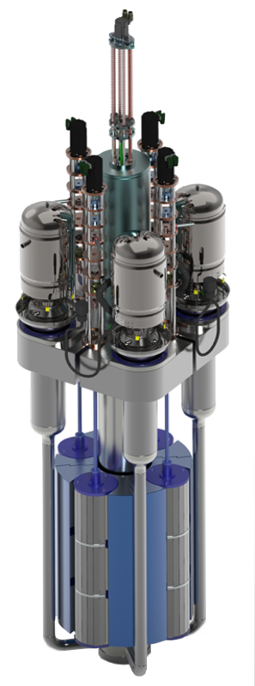






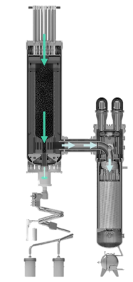

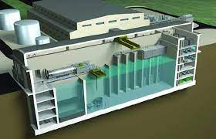
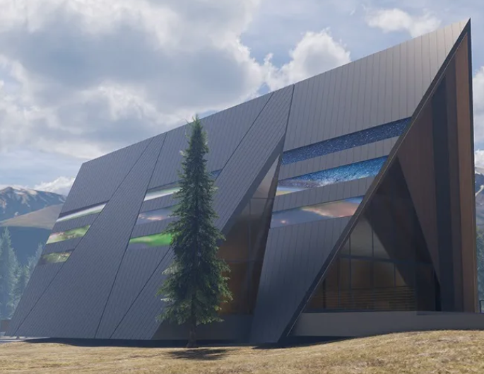
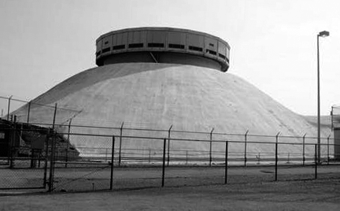
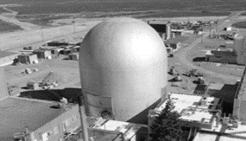

Current Advanced Reactor Projects
Natrium Reactor
TerraPower & General Electric
SMR
UAMPS &
NuScale
Hermes
Kairos
MCRE
Southern Co. & TerraPower
Xe-100
X-energy
Project Pele Microreactor
DoD
Aurora
Oklo Inc.
LOTUS Test Bed
NRIC
MARVEL
DOE
DOME Test Bed
NRIC
Notes:
The timeline for developing advanced reactors also corresponds nicely with the Earthshot goal for hydrogen (that is reaching $1/kg-H2 in one decade).
The Light Water Reactor Sustainability Program supports the development of the new paradigm for nuclear reactors.
By 2030, several advanced micro reactors and small modular reactors will be built and demonstrated. INL is work with most of the companies developing these reactors.
Some will be tested at the INL NRIC. Others will be built at sites around the U.S. For example, Natrium announced a project in Wyoming that will effectively replace a coal plant and use the power transmission infrastructure already in place.
INL’s response to the Earthshot RFI recommended an activity that would help INL become a zero-emissions campus with hydrogen produced using one or more advanced reactors. This hydrogen would then be used to fuel buses that run to the site each day. It can be blended with natural gas and even be converted to synthetic fuels and ammonia to support the regional agriculture community.
In this manner the RD&D effort of INL will not help INL become a zero-emissions Lab, but it will support the broader region, as well as provide a springboard for using nuclear energy across the country and throughout the world.
Common attributes
Inherent safety for prevention of severe accidents
Passive decay heat removal
Gas Reactor Technologies
High temperature operation
Extremely safe fuel form (TRISO)
High temperature heat enabling non-electrical products
Metal-Cooled Fast Reactor Technologies
High burnup fuel and long-lived cores
Fuel cycle flexibility
Low pressure and passive cooling options
Molten Salt Reactor Technologies
Low-pressure high-temperature operation
On-line fueling
Fast or thermal spectrum options
High temperature process heat

Slide 26
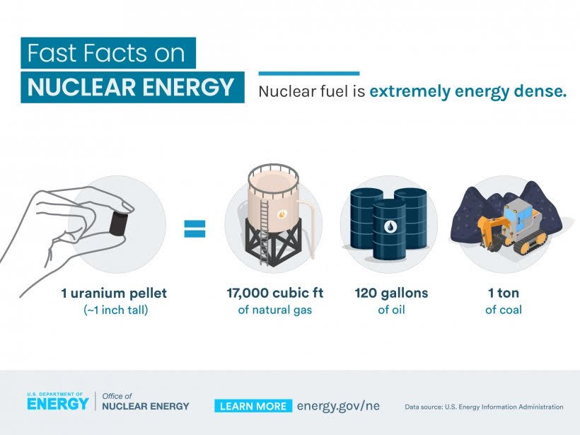

Slide 27
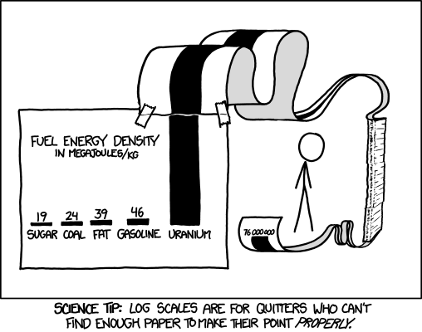
Nuclear is Energy Dense

Slide 28

Office of Nuclear Energy Priorities: Advance Environmental Justice
Advancing environmental justice and energy justice
Deeply integrate energy and environmental justice into used fuel management through consent-based siting of interim storage and community engagement
Embed justice in new and advanced reactor deployments at home and abroad to deliver benefits to disadvantaged, historically underserved, marginalized, or over-burdened communities, including transitioning fossil communities

Slide 29

Office of Nuclear Energy Priorities: Jobs and the American Workforce
Put policies, processes, and funding in place to facilitate, sustain, and create millions of good-paying, nuclear energy jobs with the option to join a union
Through initiatives that replace retiring fossil assets with new nuclear reactors, incorporate fossil communities and their workers into the clean energy transition

Slide 30
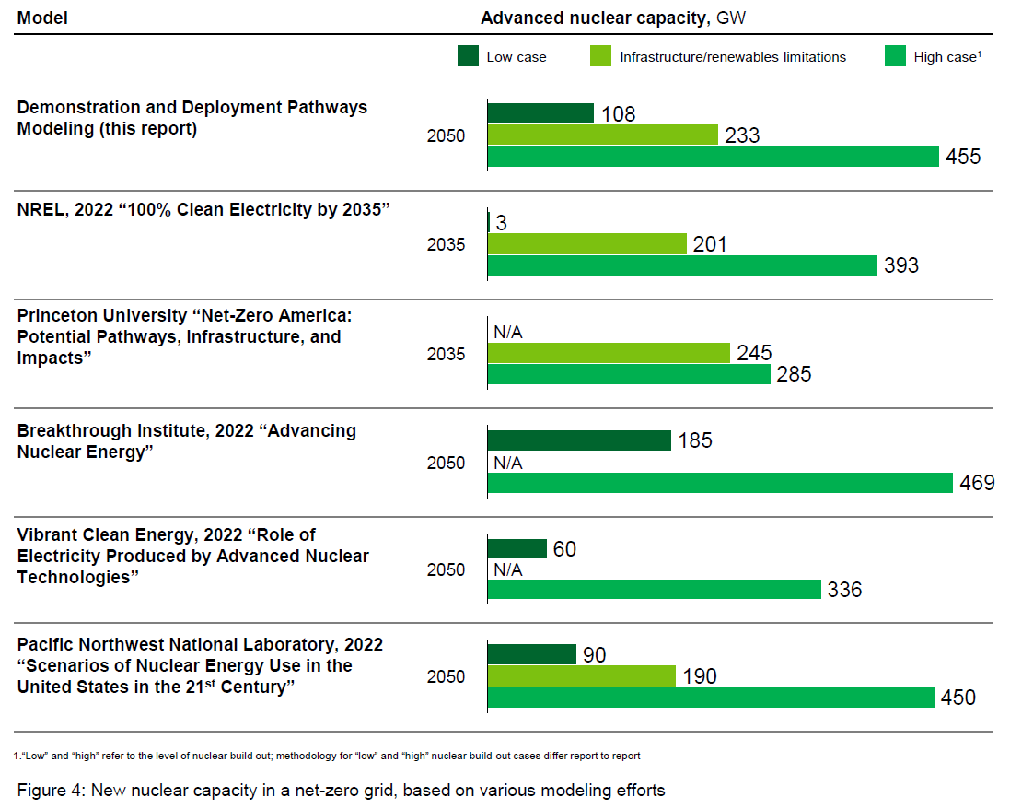

Pathways to Commercial Liftoff Report: Predictions

Slide 31
Thank you!
Gale Hauck
gale.hauck@nuclear.energy.gov

