Slide 1
Unleashing Energy Value Creation
Paul E. Roege, P.E.
Laufer Energy Symposium
St Louis, MO
March 2023
Information in this presentation does not represent any official positions of the U. S. Government.

Slide 2
New Risk/Value Paradigm
PERFORMANCE
ABSORB/
RESPOND
ACCELERATED
RECOVERY
LEARN/ADAPT
SENSE/ANTICIPATE
TIME
RESILIENCE
PROTECTION
The Resilience Advantage

Slide 3
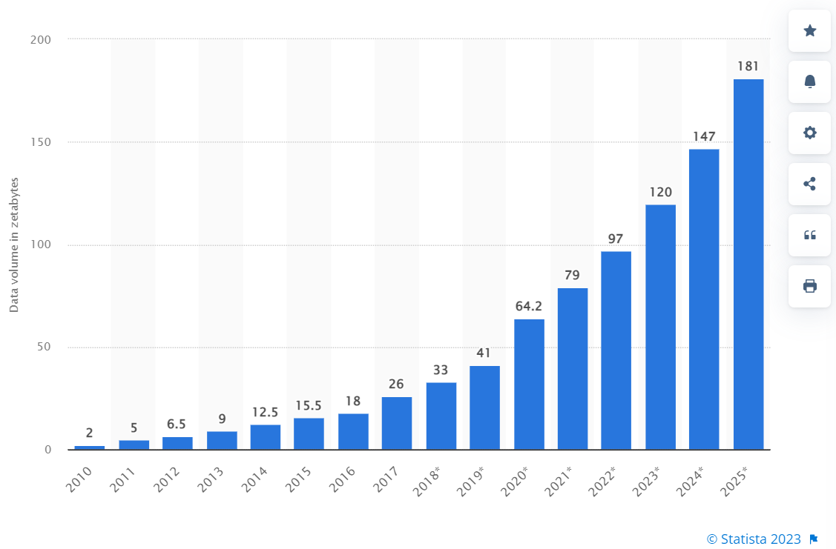
Runaway Data Growth
Taylor, P. (2022). Amount of data created, consumed, and stored 2010-2020, with forecasts to 2025. Statistia web site, https://www.statista.com/statistics/871513/worldwide-data-created/, accessed 28 Mar 2023

Slide 4
Adaptive System Architecture
DEV community website, https://dev.to/leehambley/the-pyramid-architecture-86m. Accessed 28 Mar 2023.

Slide 5
Policy or Paradigm
Resilience transforms the value/risk proposition
Accessibility can promote both productivity and resilience
Layered architecture facilitates accessibility and flexibility
The new energy paradigm calls for consensus communities and standards to unlock innovation and entrepreneurship

