Slide 1
Energy Policy – Impacting US Economics

Slide 2
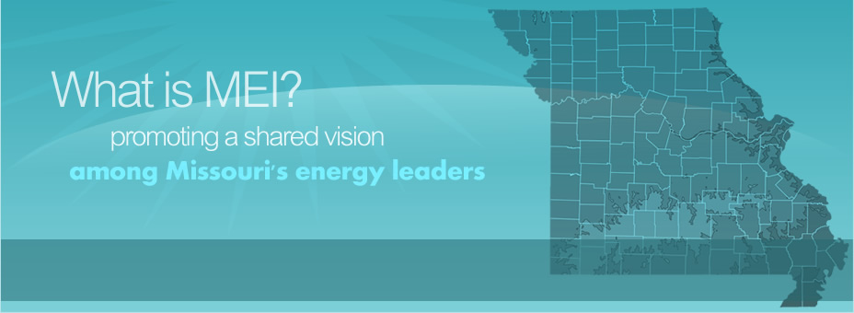
Our Mission is to work collaboratively to identify opportunities and solutions to meet Missouri’s energy needs through support and facilitation of energy economic development, education, research and pragmatic policies.
Our Vision is to be Missouri’s trusted source and forum for information and solutions on innovative, reliable and affordable energy for Missouri.

Slide 3
MEI Board of Directors
Chairman – Frank Caro - Chair, Polsinelli
Vice Chair – Open
Secretary – Glenda Abney - Director, EarthWays Center of Missouri Botanical Garden
Treasurer – Kimberly Winslow - Director, Evergy
Caleb Arthur – CEO, SunSolar
Derek Auer - V.P. Continental Cement Co.
Brandon Butler – Director of Communications, Roeslein Alternative Energy
Steve Flick - Founder, Show Me Energy Cooperative
Sheila Grant, Assoc. Vice Chancellor, Univ. of Missouri Columbia
Nate Hackney – Mgr., Liberty Utilities
Bob Holden - former Missouri Governor - Webster Univ. & Chairman Midwest US-China Association
James Hoyt – Director ADM
Fatih Dogan, Ph.D, Missouri Univ. of Science and Technology
Time Michels – Energy Resources Group
Holly Neill – Director, The Nature Conservancy
Whitney Hampton – USBank CDC
Brandon Renaud – Director, Columbia Water & Light
Kristin Riott – Ex. Dir., Bridging the Gap
Emily Romines – Director, Spire
Brett Leopold – Director, ITC
Cara Shaefer – Dir. City Utilities
Ron Wood, J.D. - former CEO, Black & Veatch Energy
Warren Wood -VP, Ameren

Slide 4
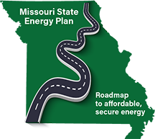
MEI Activities
Legislative & PSC
Tracking
White Papers
Connecting…
Creating Opportunities

Slide 5
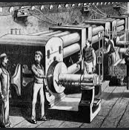
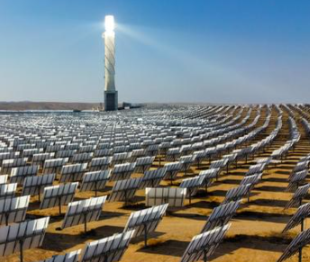
It Takes Time to Change
When Should We Begin?
Political consensus building |  | ~ 3 - 20+ years
Policy Implementation |  | ~ 2-7 years
Technical R&D |  | ~10+
Production model |  | ~ 4+
Financial |  | ~ 2++
Market penetration |  | ~10++
Capital stock turnover |  | ~ 10 - 100
Cars |  | ~ 15
Appliances |  | ~ 10-20
Industrial Equipment |  | ~ 10-30/40+
Power plants |  | ~ 40
Buildings |  | ~ 80
Urban form |  | ~100’s
Lifetime of Greenhouse Gases |  | ~100’s-1000’s
Reversal of Land Use Change |  | ~100’s
Reversal of Extinctions |  | Never

Slide 7
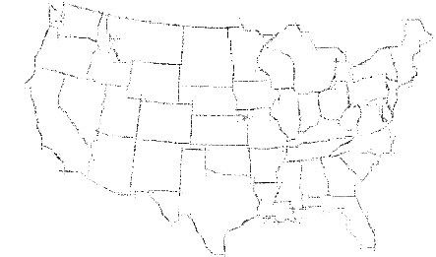
By the numbers
Securitization: 11
Deregulated Utility States: 26
States with RPS: 30
States with State Energy Plans: 38
States with Net Metering: 34
Commercial Energy Code: 41
Residential Energy Code: 40
Energy / Environmental Federal Legislation since 2010: 159
Energy / Environmental Federal Exec Order since 2010: 130

Slide 8
Federal Action Big Swings
Nov. 2021
Bipartisan Infrastructure Law (November 2021) makes the largest long-term investment in our nation’s infrastructure in nearly a century
July 2022
CHIPS and Science Act (July 2022) invests in cutting-edge science and innovation to boost American competitiveness, including for semiconductors, and to bring jobs and supply chains home
Aug. 2022
Inflation Reduction Act or IRA (August 2022) breathes life into our clean energy economy by incentivizing deployment of clean technologies and lowering energy costs for American families

Slide 9
BIL brings our foundational infrastructure into the future:
Transportation:
Devotes $42 billion to strengthen ports, airports, and rail
Appropriates $110 billion for roads and bridges
Invests more than $750 million in electric vehicle and sustainable transportation initiatives
Broadband:
Appropriates $42.45 billion for reliable high-speed internet across the country
Ensuring Resilience and Longevity of the Grid:
Invests $11 billion to enhance grid resilience
Backs a $3 billion expansion of the Smart Grid Investment Matching Grant Program
Provides $1 billion for modernizing electric generation facilities
Clean Energy Demonstrations:
$8 billion for clean hydrogen
More than $10 billion for carbon capture, direct air capture and industrial emission reduction
$2.5 billion for advanced nuclear
Manufacturing:
Invests more than $7 billion in the supply chain for batteries
Provides an additional $1.5 billion for clean hydrogen manufacturing and advancing recycling RD&D
Uses $750 million to support clean energy manufacturing and recycling
Offers $400 million to enhance efficiency and productivity at existing facilities

Slide 10
Inflation Reduction Act

Slide 11
Missouri State Energy Plan
Phase 1
Metals Minerals and Storage
Energy Efficiency – value tracking/proposition
Streamlining solar permitting
Evs
Energy Training and Installations in Schools
Phase 2
Biofuels
RNG and Hydrogen Hub
Commercial Building EE Education
CHP
Industrial Assessment Centers/Education/Awareness
Pay as You Save

Slide 12
Securitization Missouri, Kansas, Indiana, North Carolina, Michigan, New Mexico, Colorado, Idaho, Montana, Wisconsin & Louisiana
Transition support for current energy – mostly coal
The process of taking out low-interest bonds to pay off remaining coal investments
Immediate and long-term savings for ratepayers
Allowing utilities to retire their uneconomic coal plants and profit off of cheap clean energy instead
Ratepayer-backed
Examples
Missouri, Empire Electric District (Liberty/Algonquin) recently filed to securitize the remaining plant balance of its retired Asbury coal plant. 15 years ahead of schedule.
Securitize $199M re: to Uri, $81.2M re: to plant, $7.9M re: financing costs = $290M
Ratepayers receive $65.6M savings
RMI analysis shows savings of $25 million compared to traditional utility financing methods.
Indiana, CenterPoint to retire and securitize its Indiana A.B. Brown coal plant in 2023, estimating savings of $60 million once approved.
IRA has $9.7 B allocated for COOPs to do similar things (impacting 20GW)

Slide 13
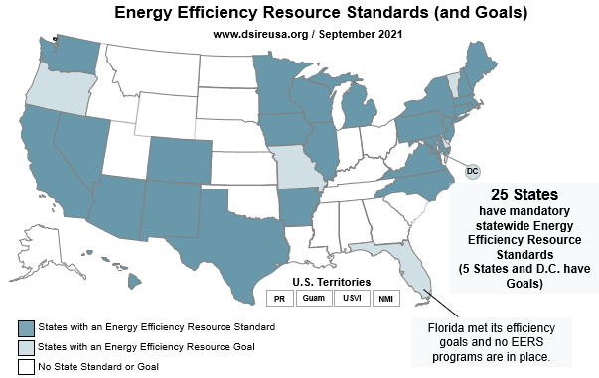

Slide 14
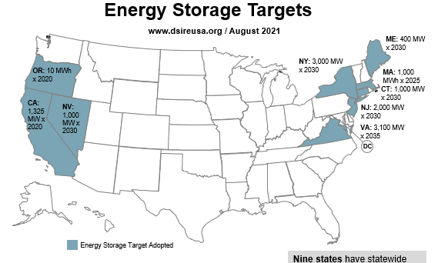

Slide 15
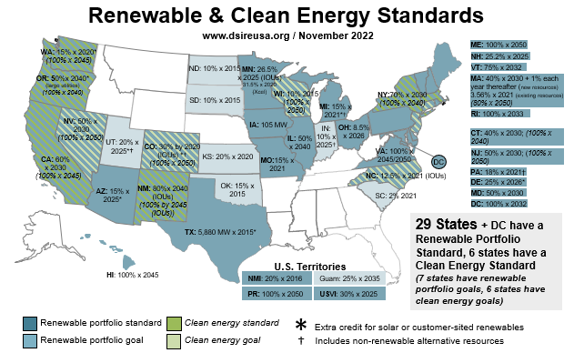

Slide 16
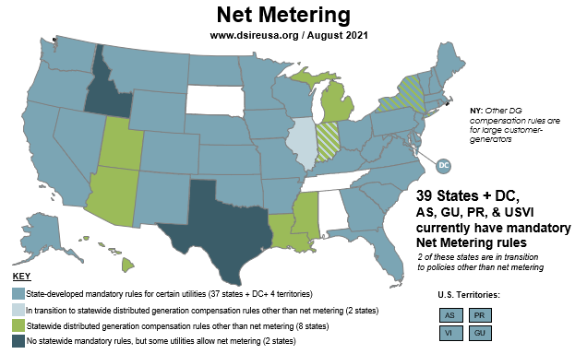

Slide 17
Example of Policy Creating Economic Drive
Growth of on-shore Storage Capacity
Doe Run Rule Making
Increased National Security
Incentives for Manufacturing
Incentives for Processing
Local Storage Supply Chain Development
Doe Run Incentives for Processing
Doe Run build hydrometallurgical process

Slide 18
Contact Us
Josh Campbell, J.D.
Executive Director
Missouri Energy Initiative
238 East High Street, 3rd Floor
Jefferson City, MO 65101
Ph: 573-616-1046
Cell: 314-651-0214
Web: www.Moenergy.org
Twitter: Moenergy1

