Slide 1

Campus and Community-Scale Climate Change Solutions
Fatih Dogan
Professor, Department of Materials Science and Engineering
Interim Director, Center for Research in Energy and Environment
Missouri University of Science and Technology
2023 Laufer Energy Symposium
April 1, 2023

Slide 2

https://cree.mst.edu/

Slide 3
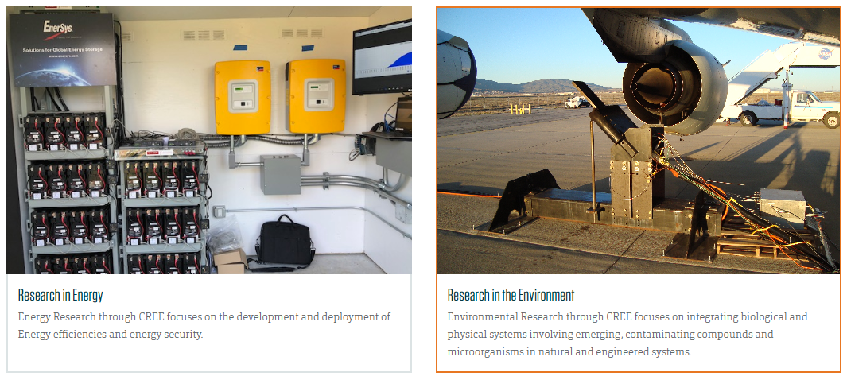

Slide 4
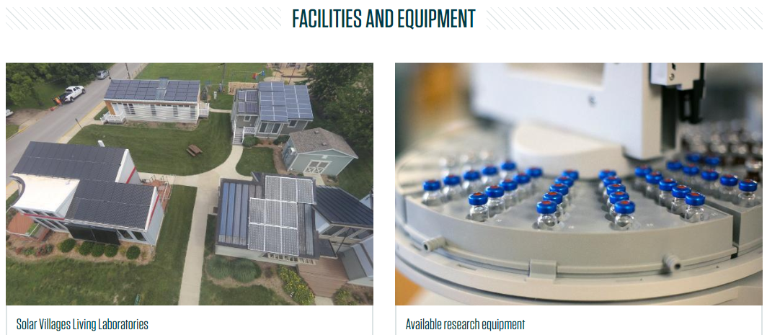

Slide 5
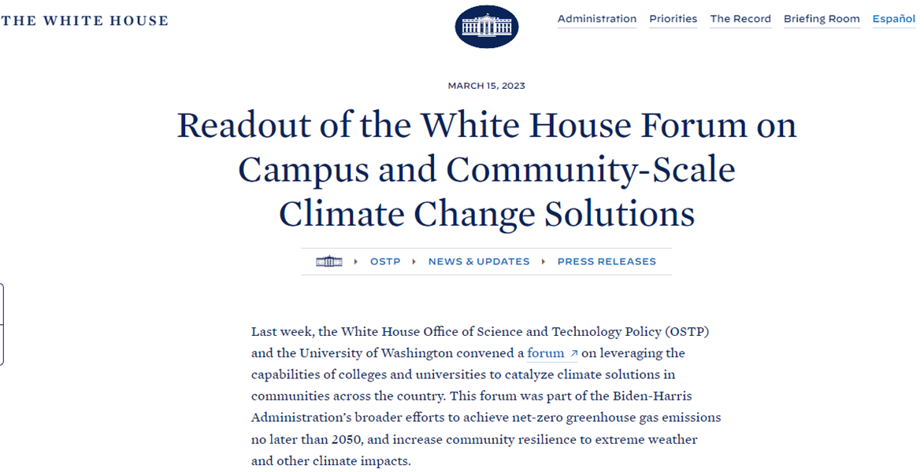
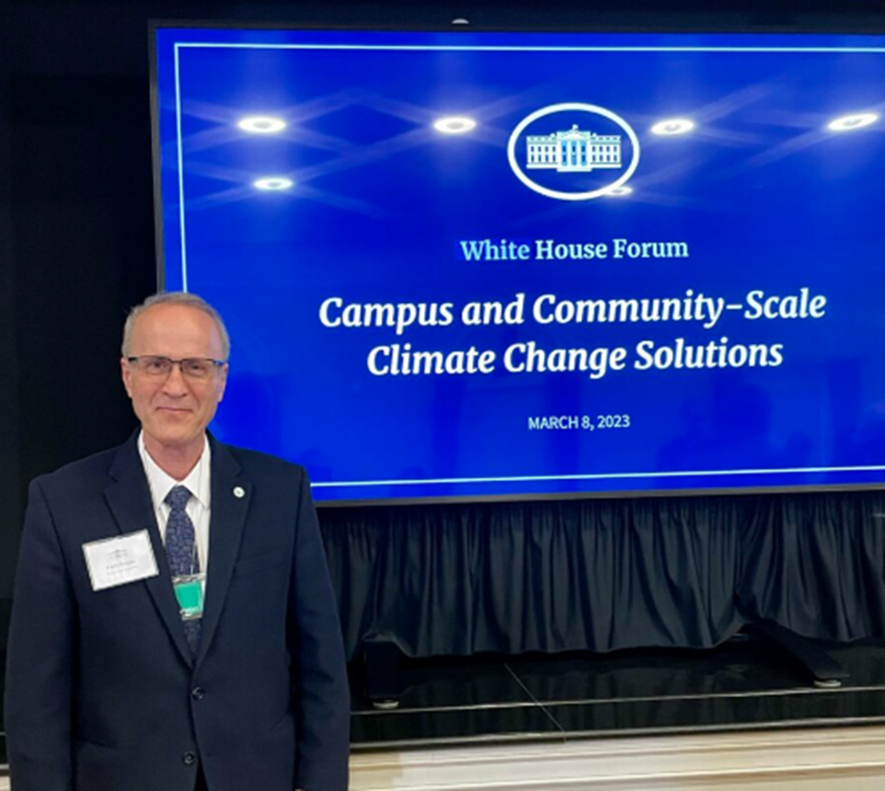


Slide 6
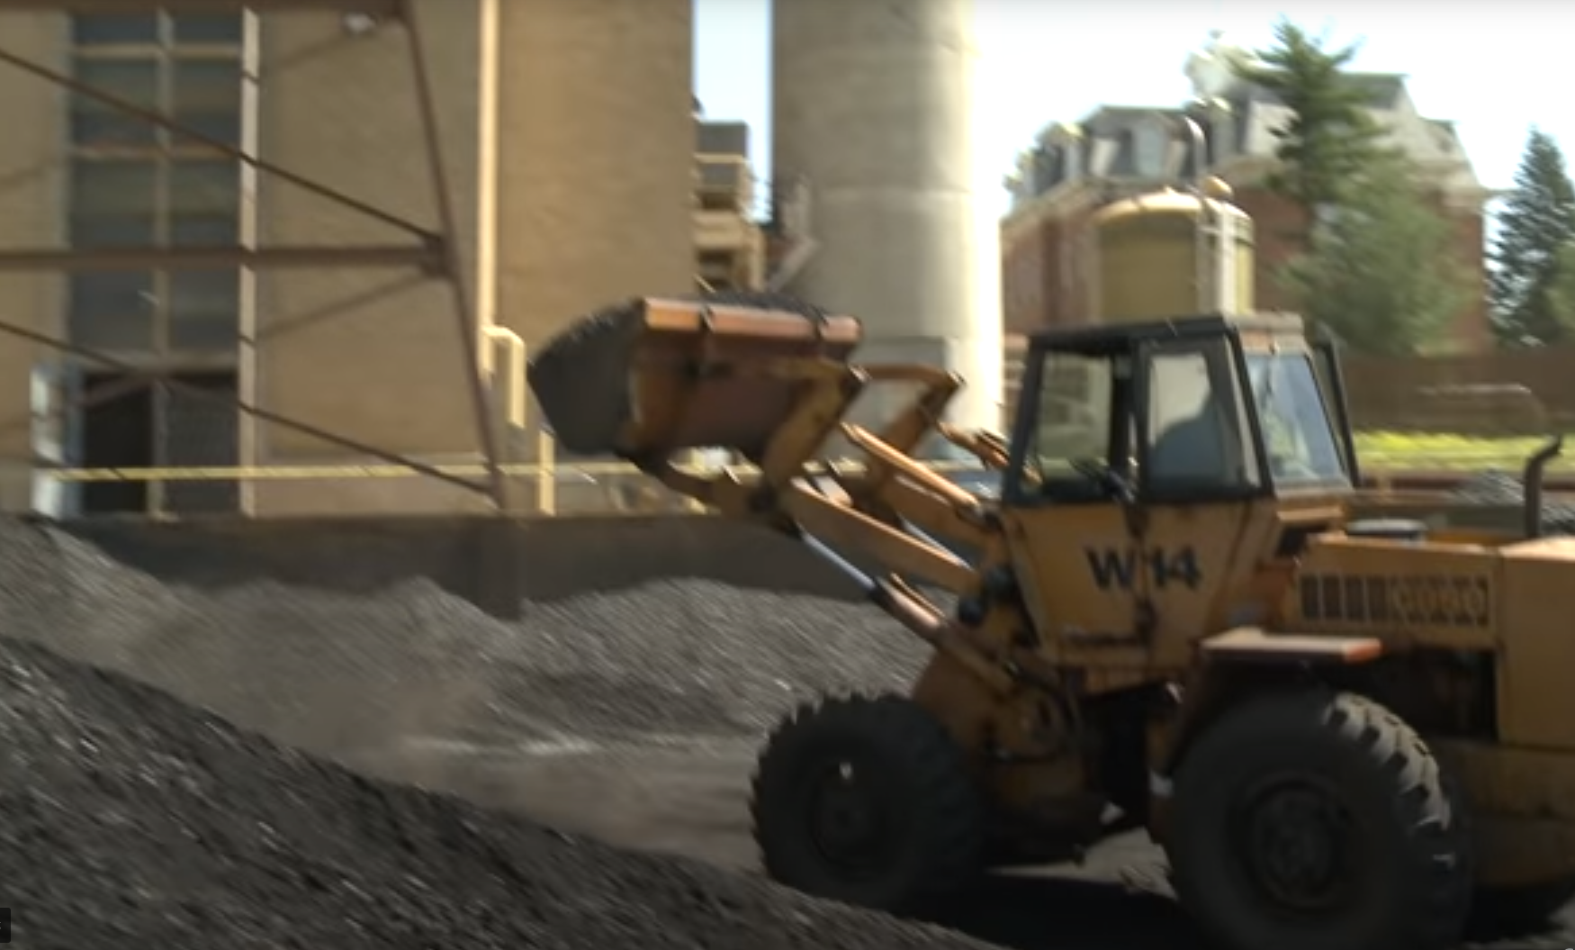
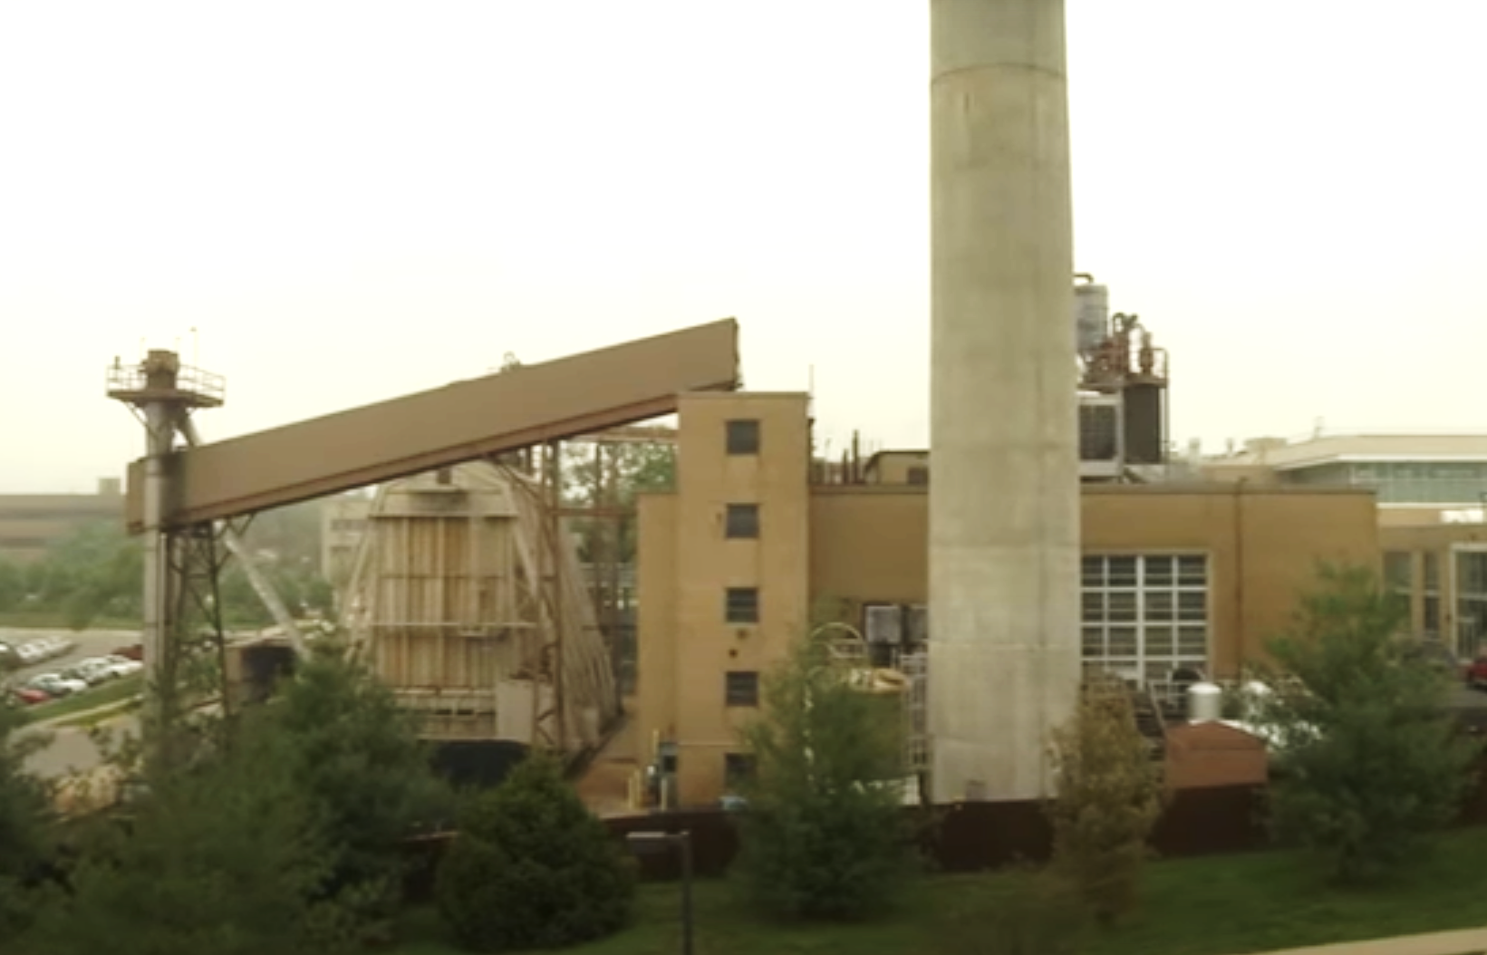
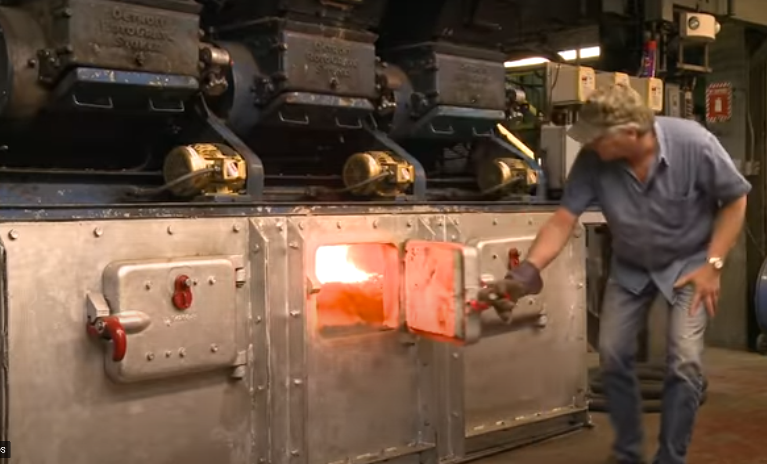
A World War II-era coal-fired power plant at Missouri S&T has served the campus for nearly seven decades.

Slide 7
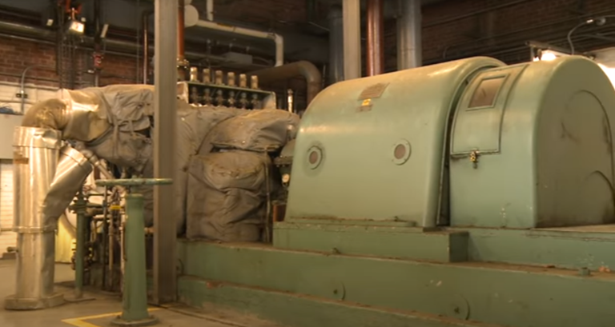
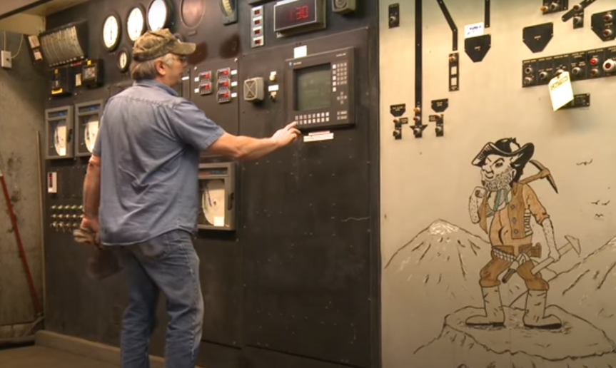

Slide 8
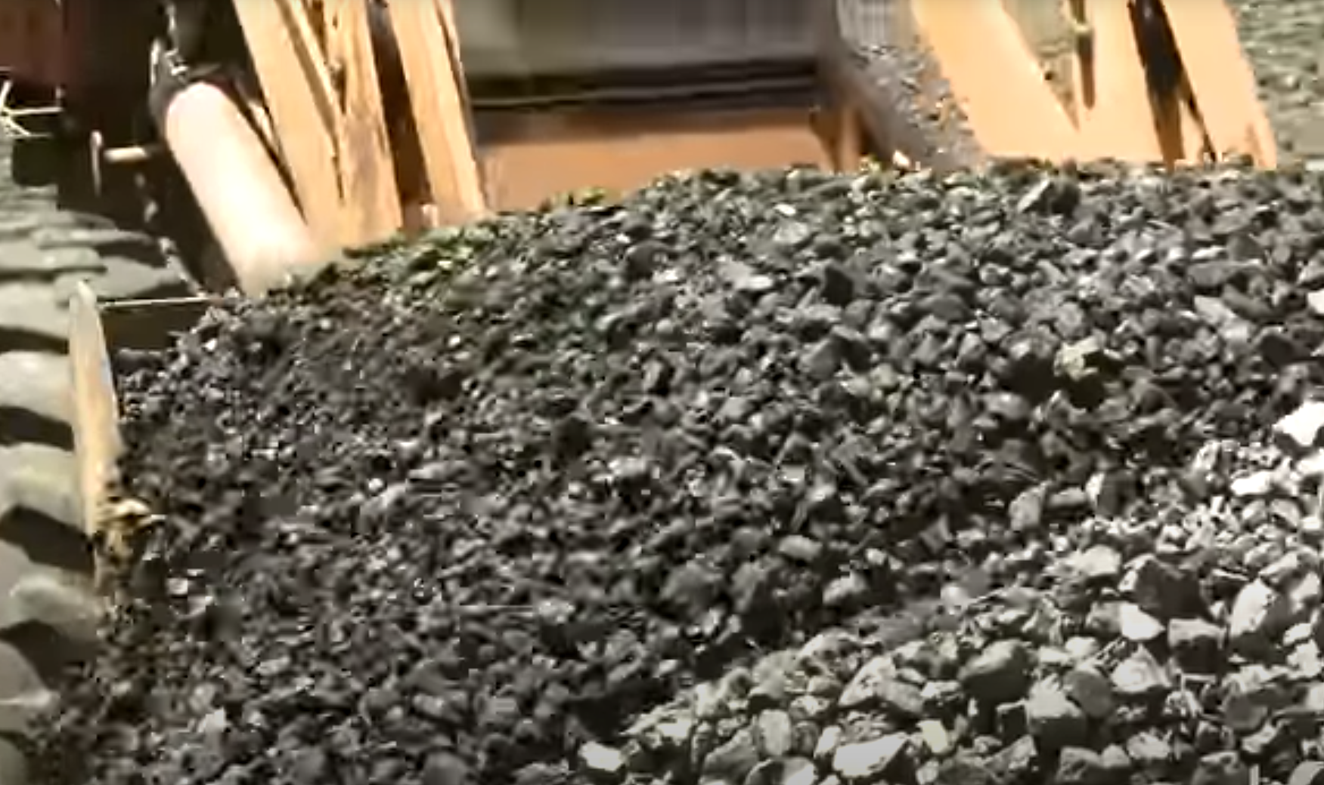
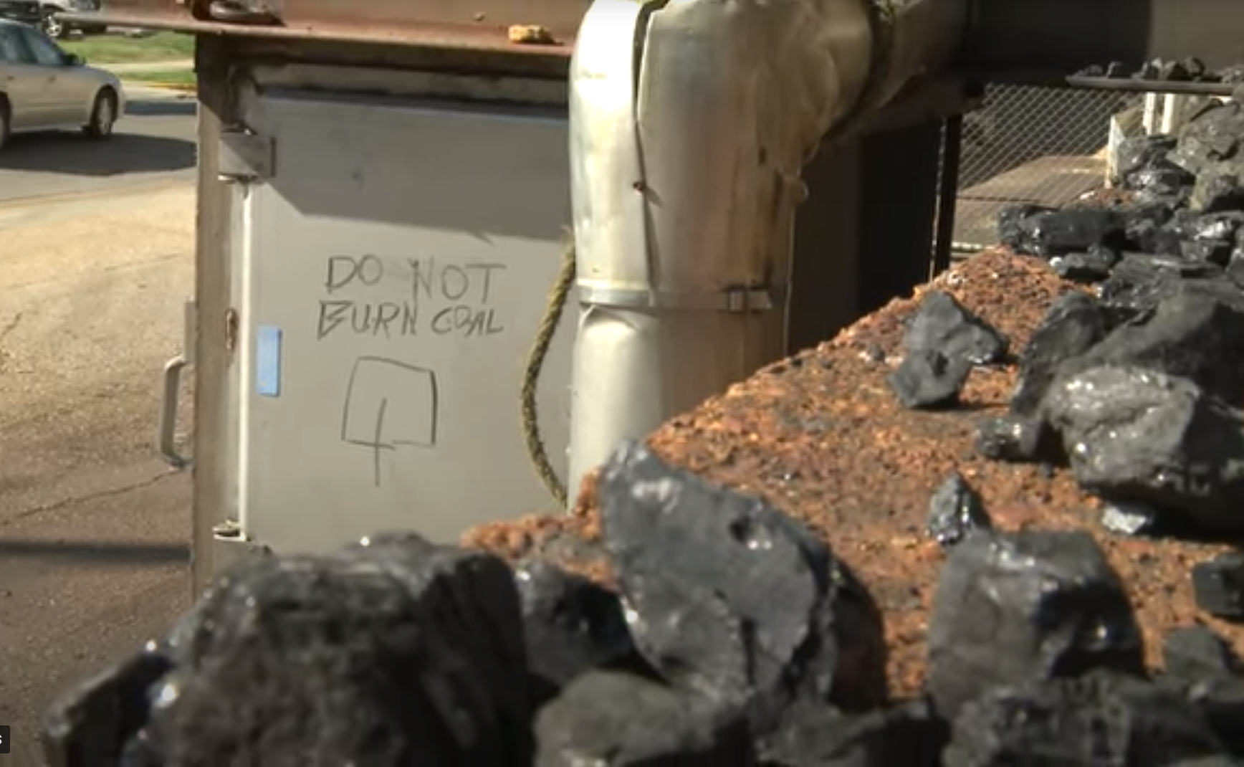

Slide 9
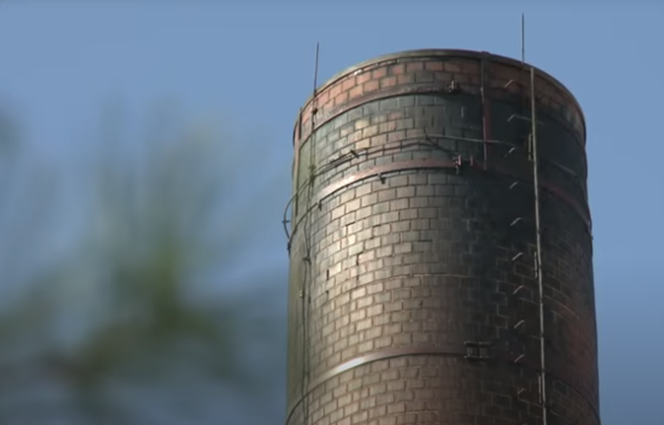
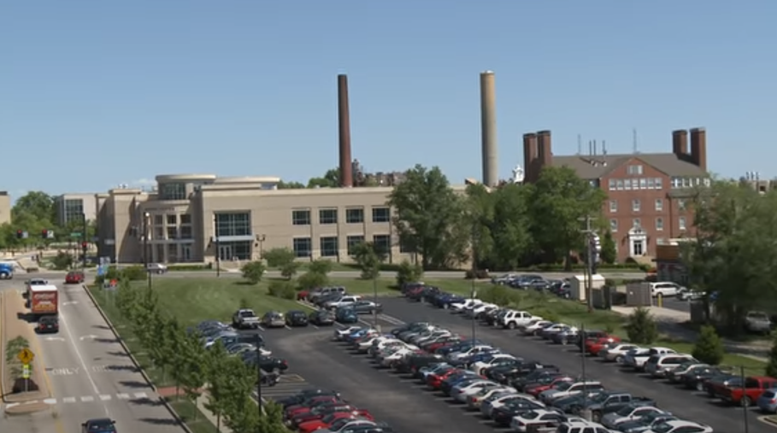

Slide 10
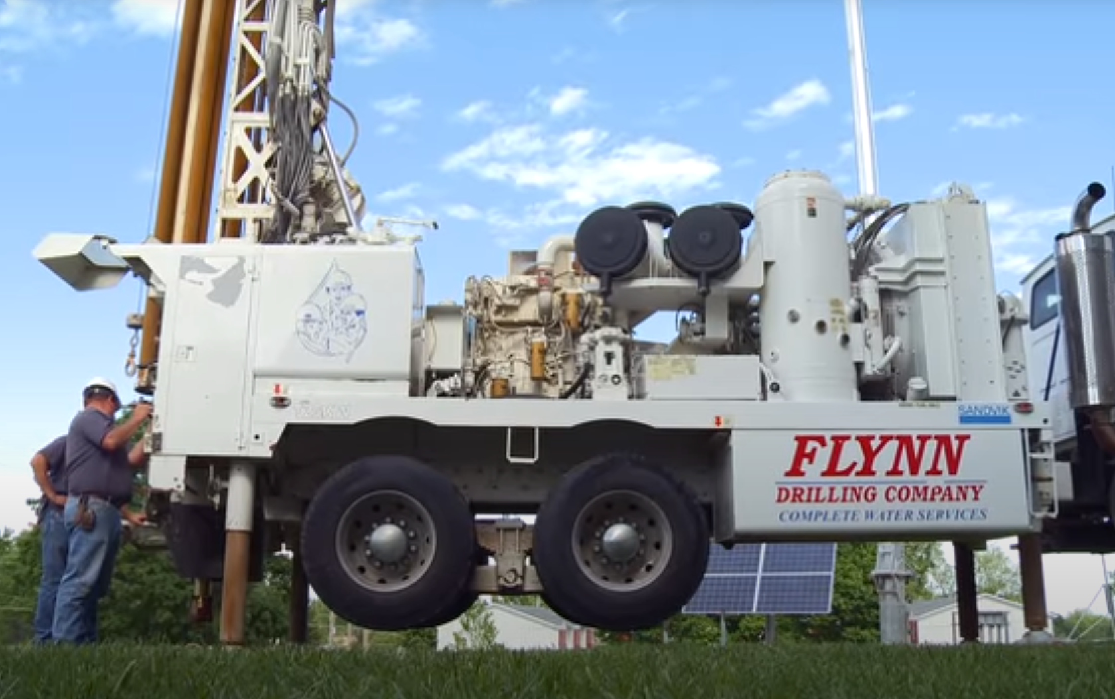
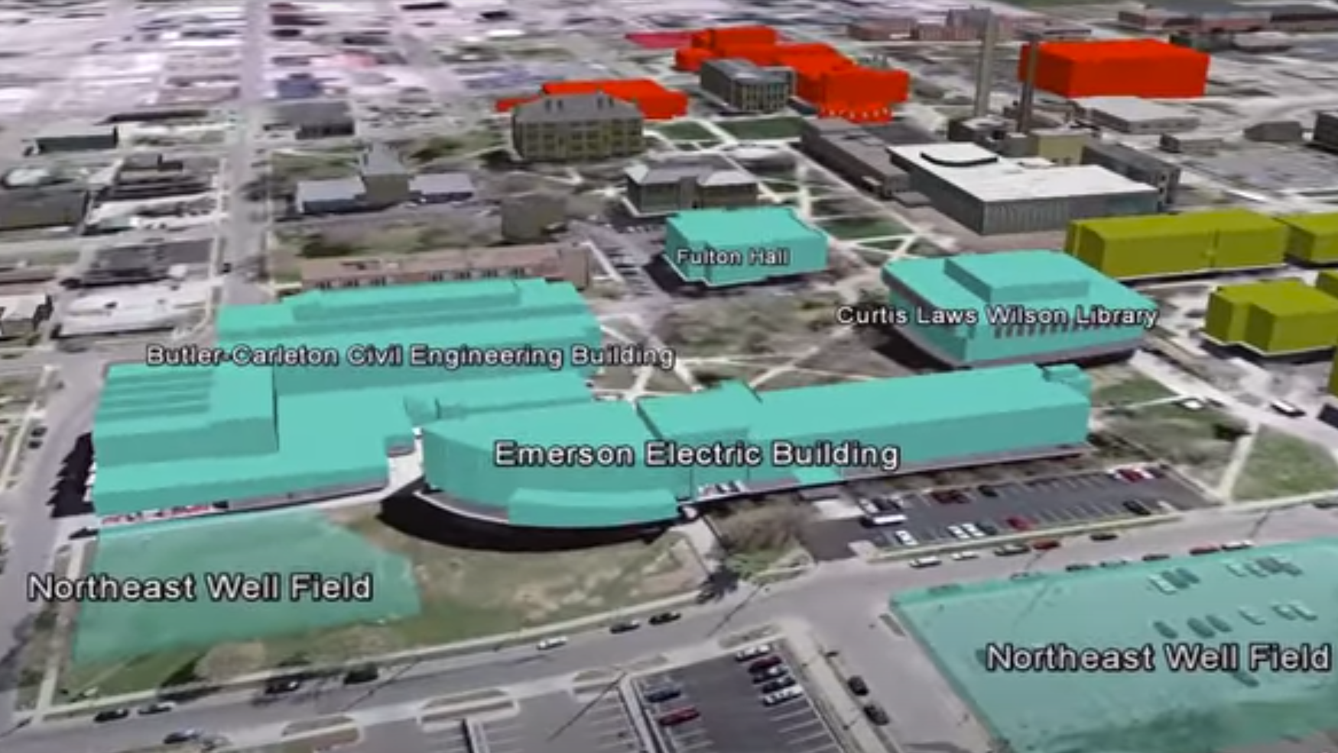
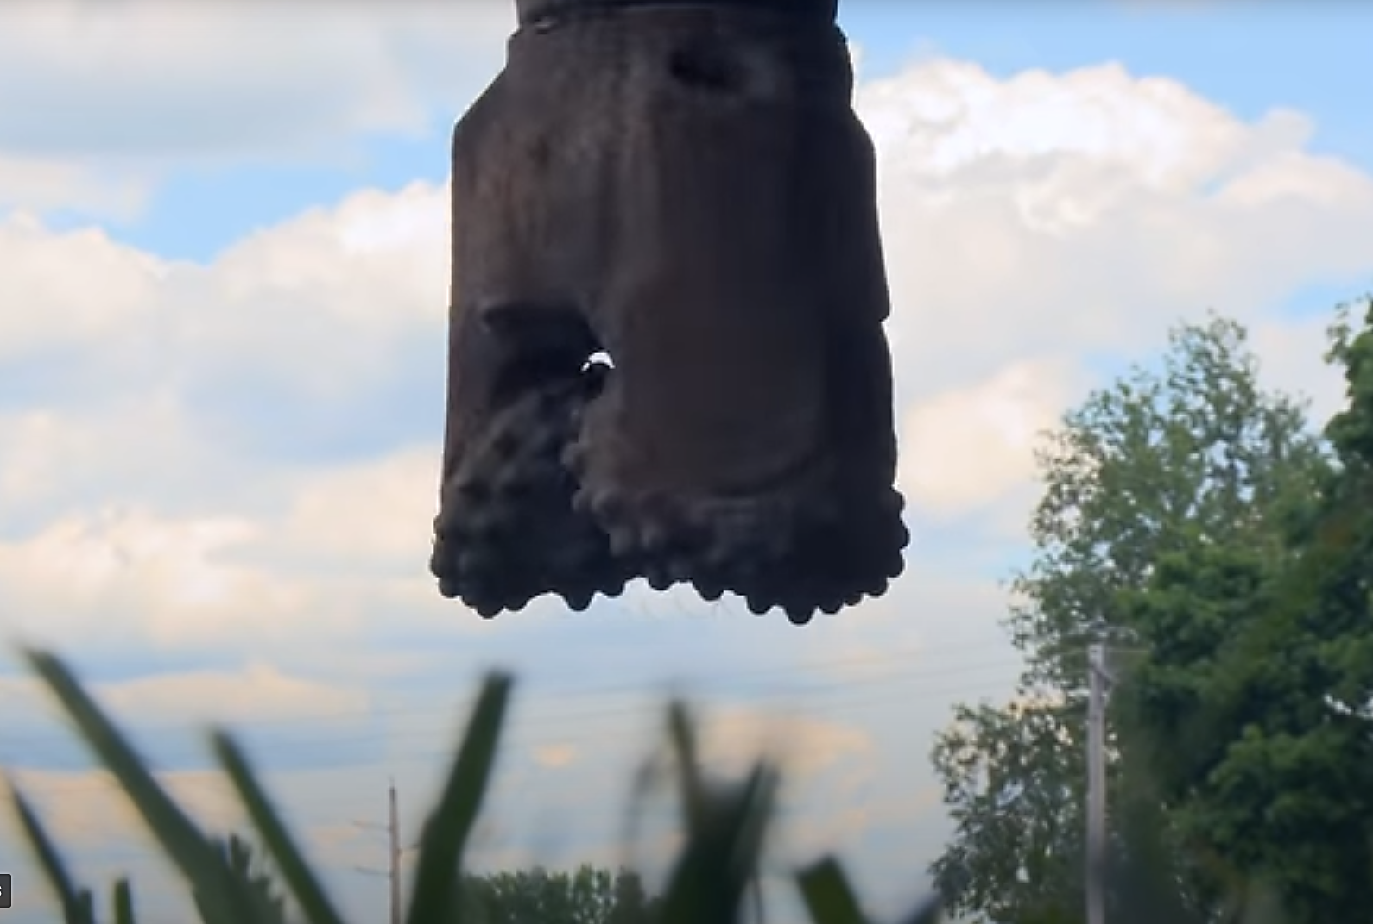
Geothermal drilling at S&T: ~800 wells

Slide 11
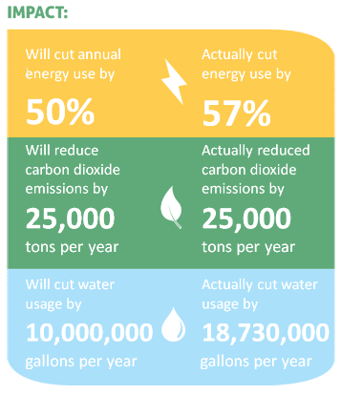
Missouri S&T GEOTHERMAL ENERGY SYSTEM
savings ~$2.8 million annually

Slide 12
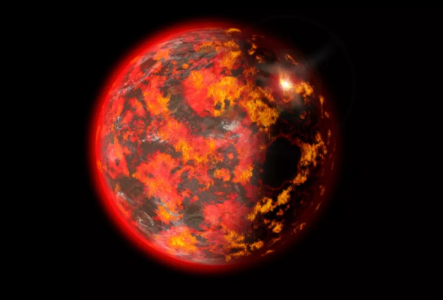
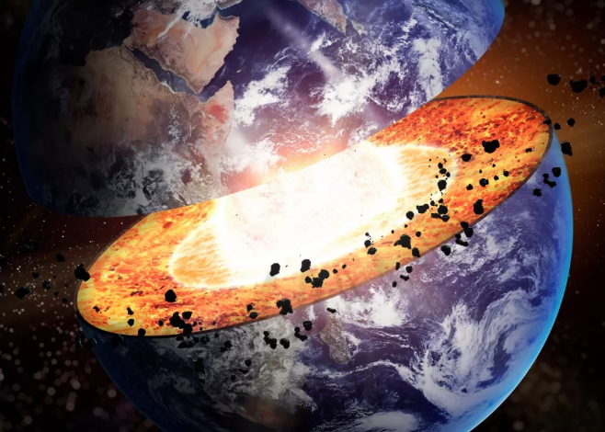
Earth was a fire ball

Slide 13
Superconductivity

Slide 14
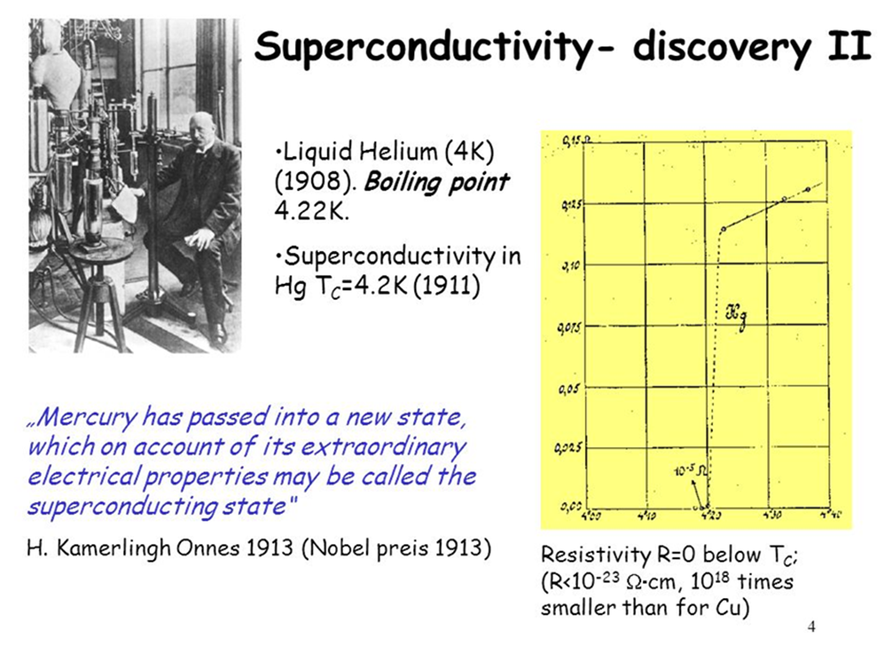

Slide 15
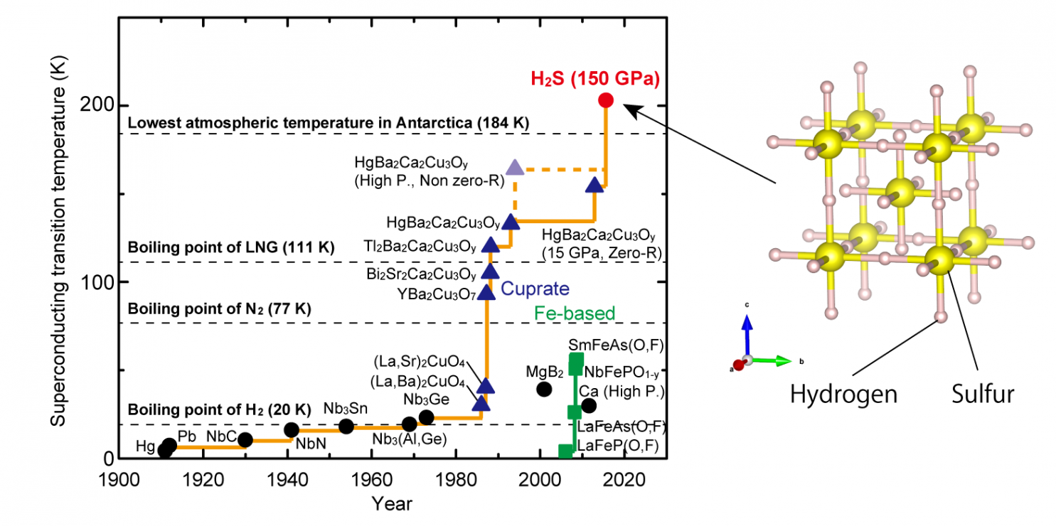
Superconducting Materials

Slide 16
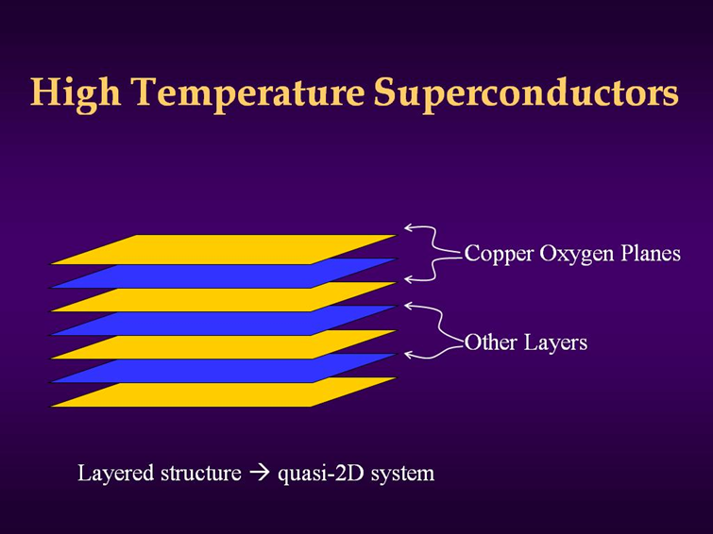
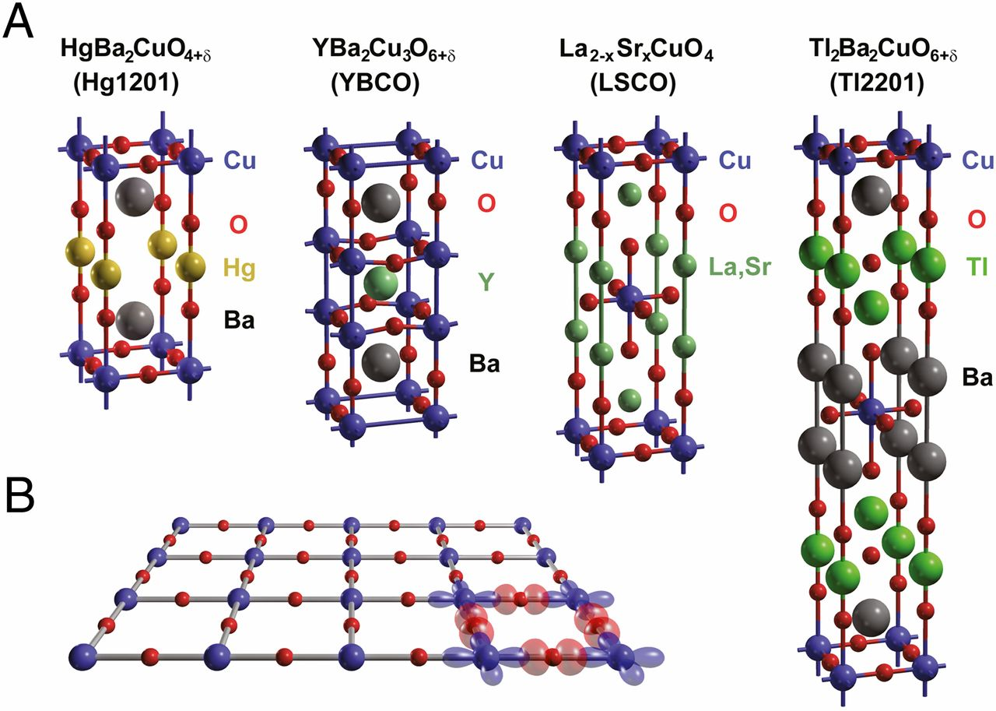
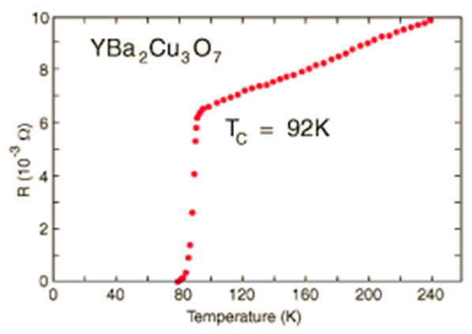
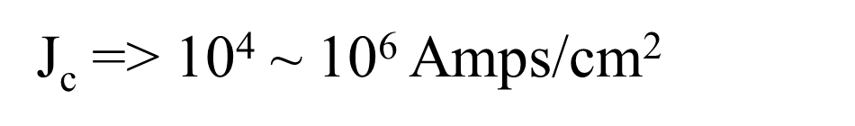
Critical Current

Slide 17
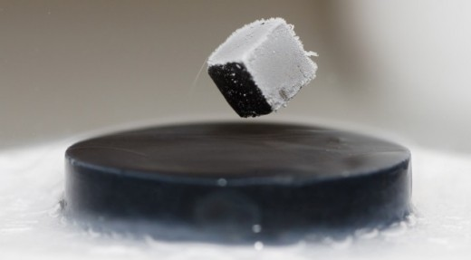
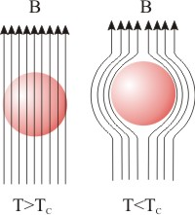
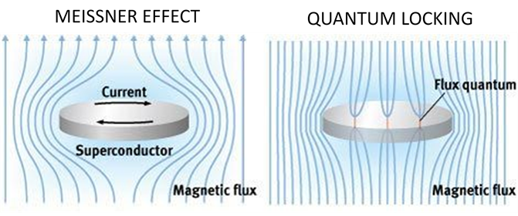
Meissner Effect

Slide 18
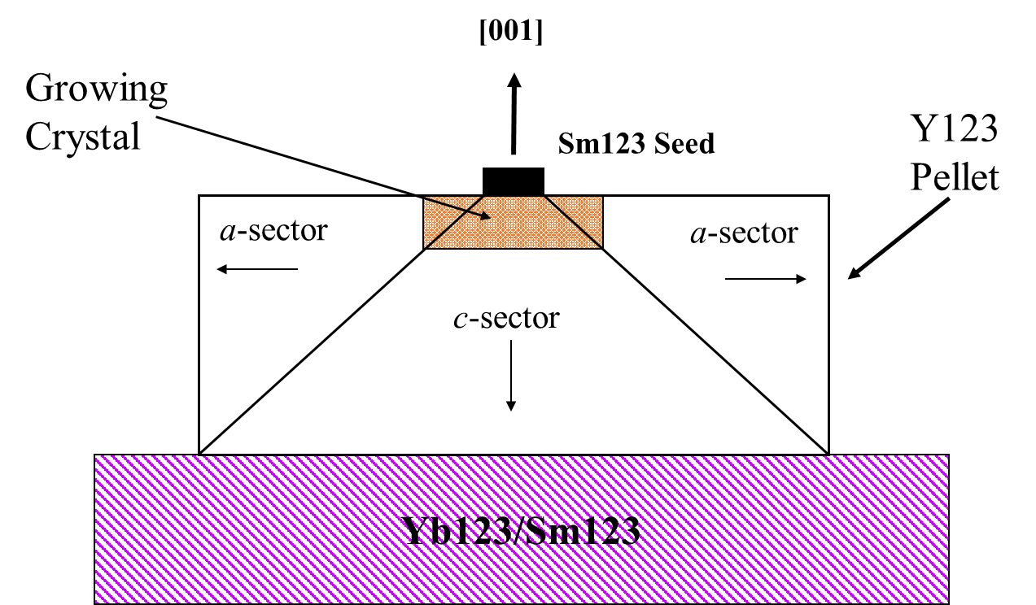
Single Crystal Growth of Superconducting YBa₂Cu₃O_{6.5} (123)
Peritectic Melting (semisolid melt)
2YBa₂Cu₃O_{6.5} (solid) → Y₂BaCuO₅ (solid) +[3BaCuO₂ + CuO] (liquid)

Slide 19
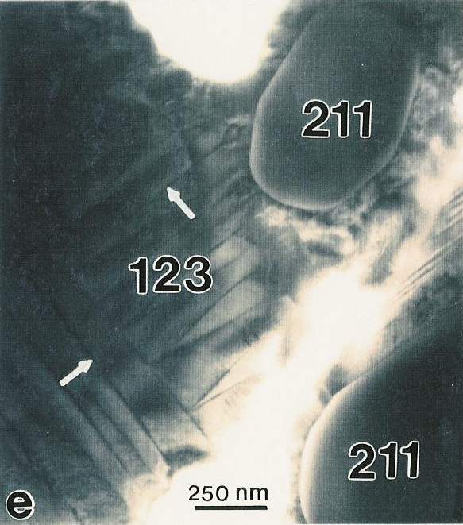
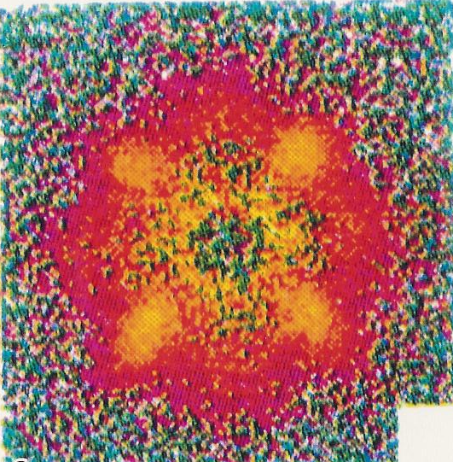
Twin Boundaries & Flux Pinning in Superconducting YBa₂Cu₃O_{6.5}
TEM Bright Field Image of
{110} Transformation Twins
Science ‘93, ‘99
Nature ‘98, ‘99, 2000
Neutron scattering, four-fold organization of peaks; flux pinning at twin boundaries

Slide 20
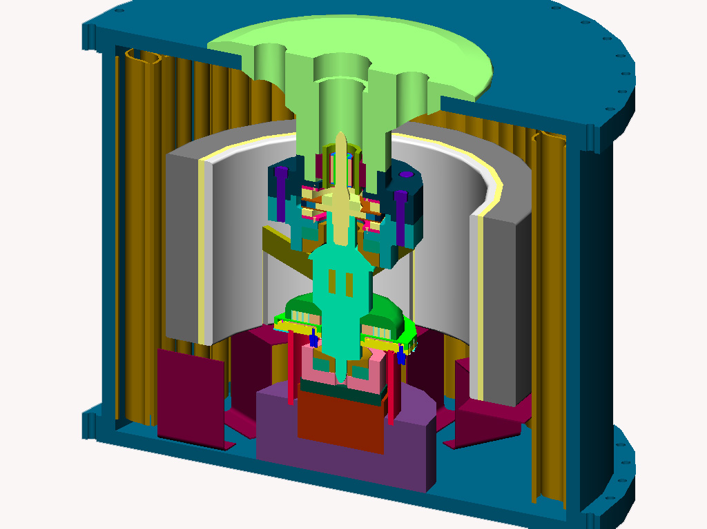
10 kWh Superconducting Flywheel Energy Storage System
Motor/Generator
Steel Vacuum Vessel
Energy-Absorbing
Containment Liner
Lift Bearing
Steel Hub
Spokes
Graphite Composite Rotor
Stability HTS Bearing
Touchdown Bearing
Surfaces and
Roller Bearings
Assembly Support
Brackets
Air Cylinder Actuator

Slide 21
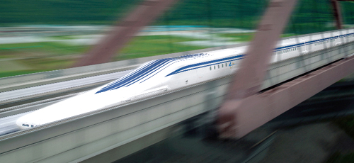
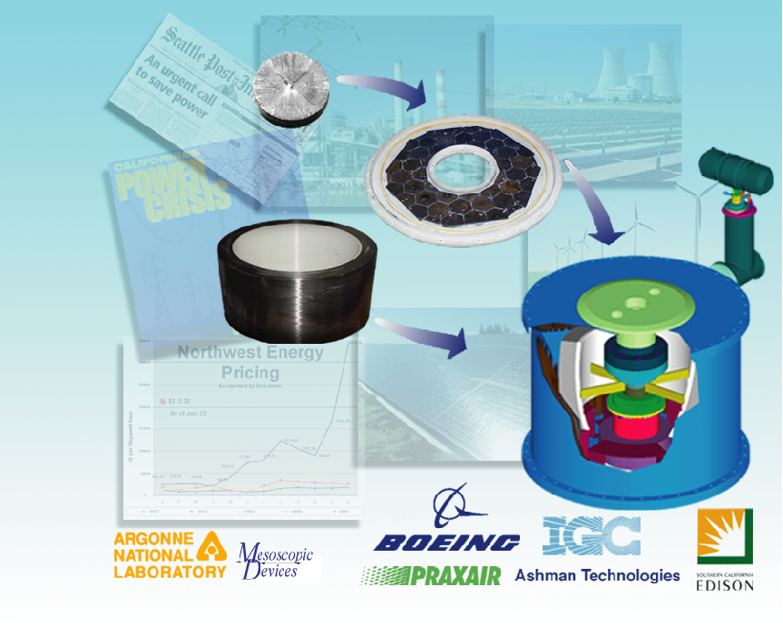
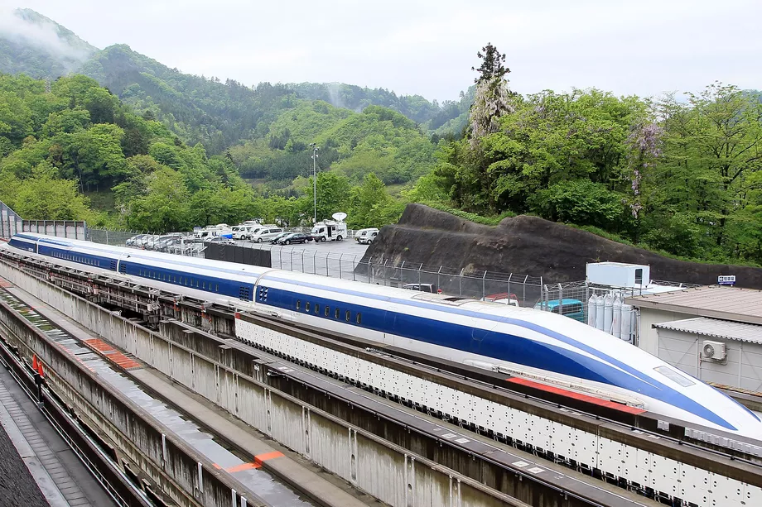
Flywheel Electricity Systems with Superconducting Bearings for Utility Applications
A Japanese maglev train set a new speed record of 603 kilometers per hour or 374 miles per hour

Slide 22
High Energy Density Capacitors

Slide 23
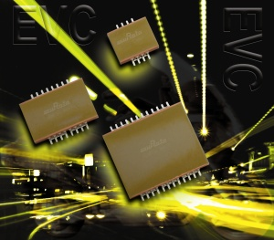
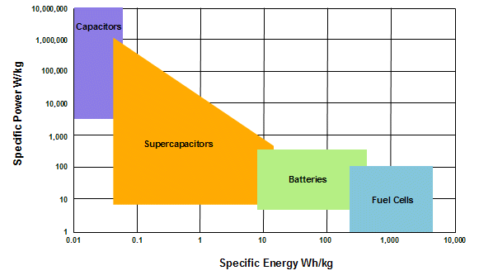
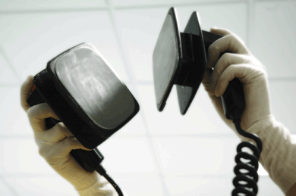
High Energy Density Capacitor
Energy Density: Energy stored per unit volume or mass, J/m³ or J/kg
MLCC for Power Electronics
High Power Microwave Source
Defibrillator Systems

Slide 24
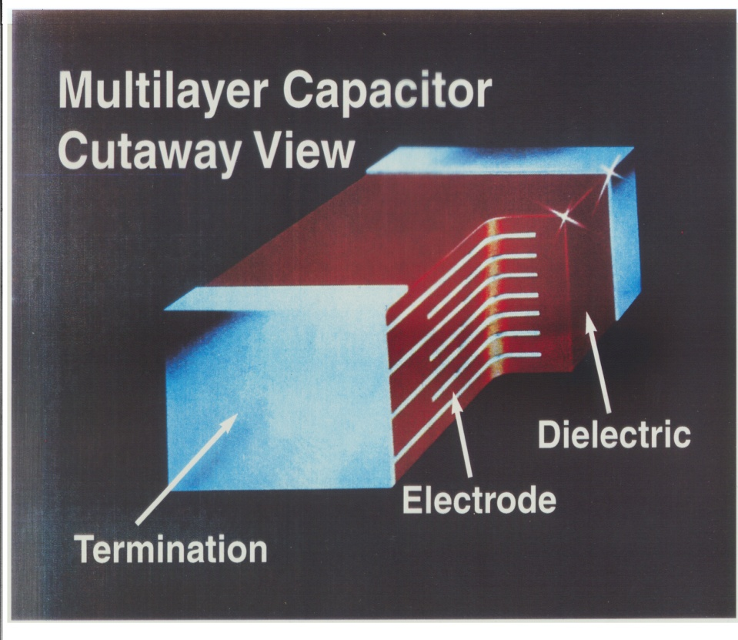
DARPA/AFRL
Integrated High Energy Density Capacitors
Nano-Grain TiO₂ Dielectric
  - Linear
  - Low specific gravity (ca. 4.0)
  - Sintering temperature ≤ 900 °C
ca. 70 layers of Dielectric
- Dielectric layer thickness 10 μm
- 5 μF capacitance
10 Capacitors Stacked Together

Slide 25
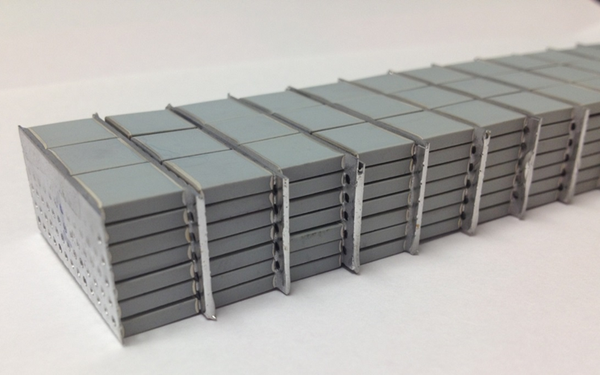
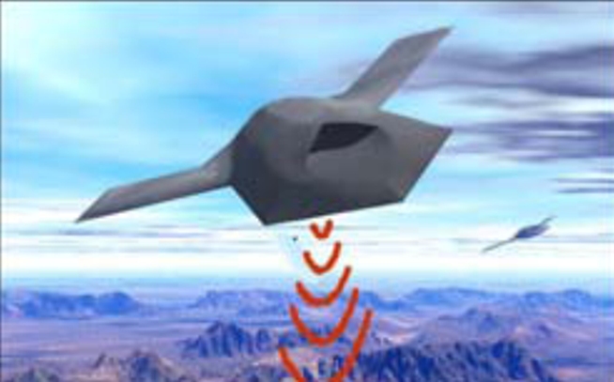
Stacked BNT Capacitors Bank Assembled in Parallel and Series
High Power Microwave Source
Test voltage = 10 kV (Each segment was tested at 700 V before final assembly).
Rise time: 2 µsec
Fall time: 1 µsec
Cycles repeated 100 times
Dimensions = 6.0"L x 1.25"W x .64"T
Volume = 78.65 cm³
Capacitance = .25 µF
Total energy = 12 J

Slide 26


Slide 27
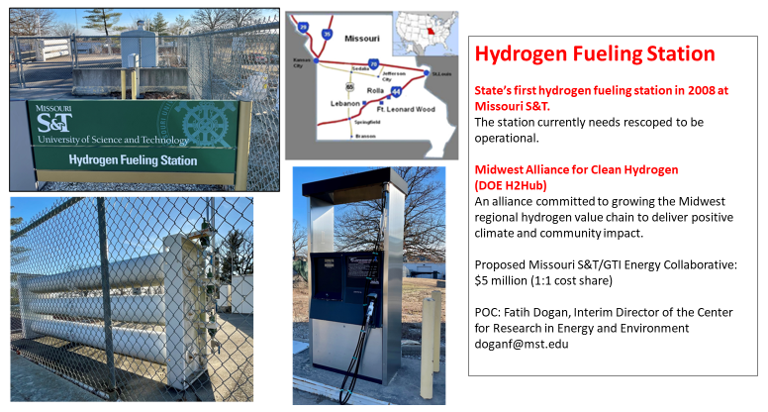

Slide 28


