Slide 1
Towards more rapid deployment of alloys for nuclear
Joseph W. Newkirk April 1, 2023

Slide 2
Outline
The need for “Advanced Metals and Alloys”
New alloy development
High-throughput development
Conclusions

Slide 3
Recent priority project calls
Specific request
Specific request
Specific request
Specific request
Specific request
Specific request
Specific request
Specific request
Specific request
Advanced materials

Slide 4
Recent priority project calls
Specific request
Specific request
Specific request
Specific request
Specific request
Specific request
Specific request
Specific request
Specific request
Advanced materials
NASA
DOE
ARL
AFOSR
Etc.

Slide 5
Alchemy
For millennia metallurgy was an art
Mix different ingredients and test
Art was learned and passed down
Often superior metallurgy was state secret
Until microscopes little understanding of science

Slide 6
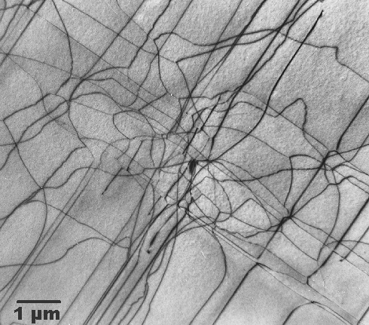
Materials Science
Transition metals have large, nearly spherical electron shells
Lowest energy state is maximize nearest neighbors
Results in high densities of metals
Non-directional atomic bonding allows movement
Defects (dislocations) allow deformation without cracking at lowered strengths
Dislocations can lower strength of metal >100x

Slide 7
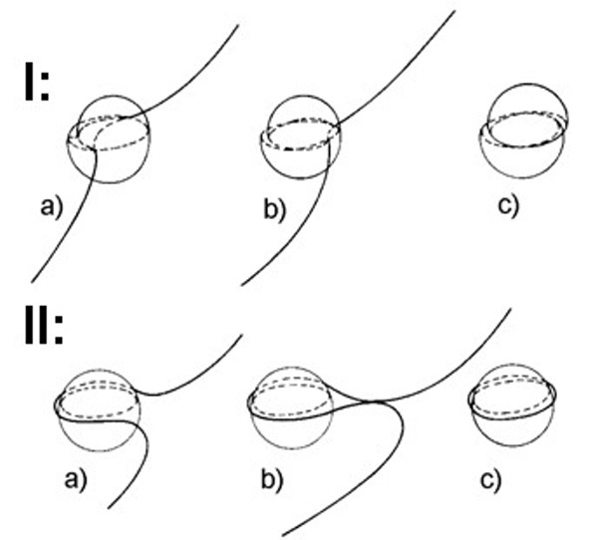
Materials Engineering
Stopping dislocations makes metal brittle
Hindering dislocation strengthens metal and retains some ductility
Metallurgists add 2nd phases to hinder dislocations
Removing phases allows fabrication
Restoring phases after fabrication locks strength into component

Slide 8
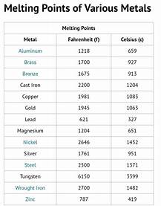
Materials for Extreme Environments
Higher temperatures
Harsher environments
Metal behavior at high temperature?
What is high?
~50% of T_{m}, homologous Temp
193
27
590
549
1563

Slide 9
Materials for Extreme Environments
Higher temperatures
Harsher environments
Metal behavior at high temperature?
What is high?
50% of T_{m}, homologous Temp
Now creep matters, not strength doesn’t
Nickel alloys have high temperature use
Refractory metals highest
193
27
590
549
1563

Slide 10
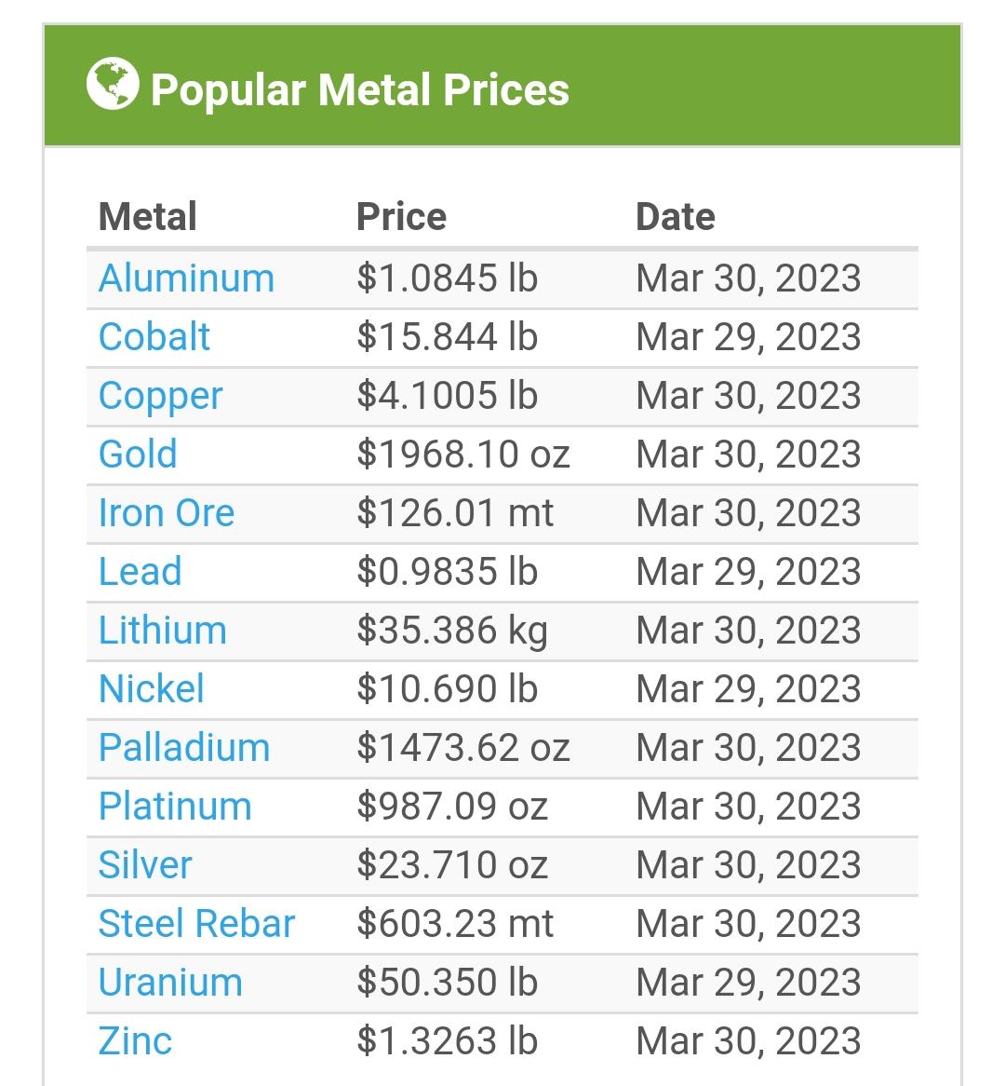
Materials for Extreme Environments
Cost soars for hi T alloys
Compare Al to Co
Look at steel vs nickel
Later will mention Ta
$170/lb

Slide 11
Materials for Extreme Environments
Cost includes several factors
Material
Fabrication
Heat treatment
Secondary treatments
Market forces

Slide 12
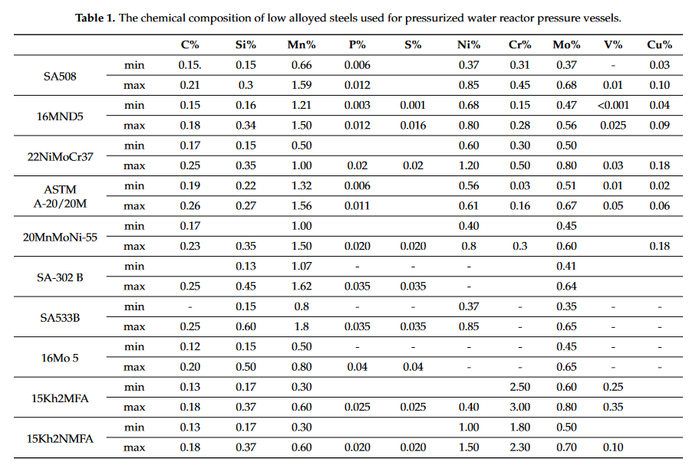
Reactor steels
Gillemot, F. Review on Steel Enhancement for Nuclear RPVs. Metals 2021, 11, 2008.

Slide 13
RPV structure
Low alloy steels form pressure vessel by forging
Inner surface clad with stainless steel by welding
Štefan, J. et al. Microstructure and Failure Processes of Reactor Pressure Vessel Austenitic Cladding. Metals 2021, 11, 1676.

Slide 14
Reactor steel degradation
Over time steel properties change
Increased hardness is usually accompanied by lower fracture toughness
Ulbricht, A., et al. Effect of Neutron Flux on an Irradiation-Induced Microstructure and Hardening of Reactor Pressure Vessel Steels. Metals 2022, 12, 369

Slide 15
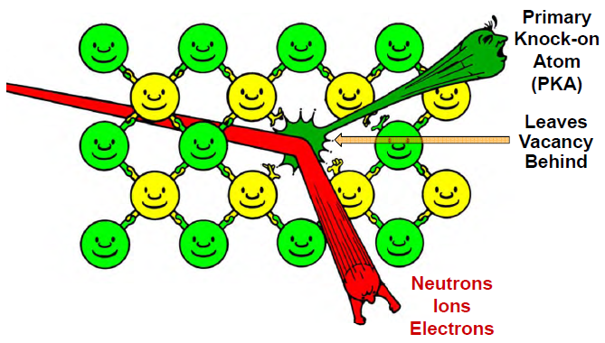
Irradiation damage process
Fast neutrons and heavy ions produce cascade displacements
Electron irradiations create single Frenkel defects (point defects of interstitials and vacancies)
Low energy protons and light ions create similar defects as electrons
Diffusion of transmutation products Helium & Hydrogen (embrittlement)

Slide 16
Irradiation damage process

Slide 17
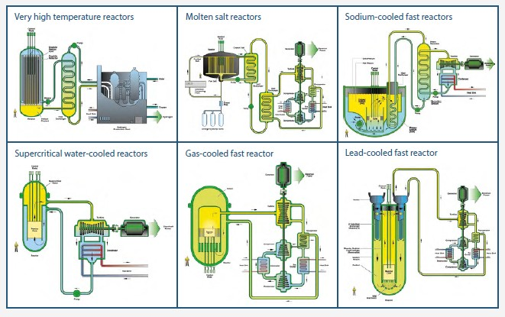
Advanced reactor concepts
High temperatures
High neutron fluences
Corrosive cooling fluids
High pressure
Long lifetimes
Operating temperature = 300 – 1000 ºC
Neutron energy < 1 – 3 MeV
Dose range = ~ 30 – 200dpa
Time of operation – 10s of years

Slide 18
Reactor pressure vessel alloy
Normal development cycle
Conceive
Experimental testing
Irradiation testing*
Optimize
Transition to full scale production*
Certify
Cycle is optimistically 20 years

Slide 19
Reactor pressure vessel alloy
Normal development cycle
Conceive
Experimental testing
Irradiation testing*
Optimize
Transition to full scale production*
Certify
Cycle is optimistically 20 years

Slide 20
Radiation resistant materials
Have radiation stable microstructure with reasonable density of small defect clusters and/or precipitates contributing to hardening
Enhanced point defect recombination = reducing large clustering and extended defects = reducing radiation induced changes and radiation effects
Typical radiation resistant materials have a softer matrix with hard phases dispersed in them – dispersion strengthening.
Hard dispersoids strengthen material, reduce creep and are sinks for defects.
Ductile matrix with significant amount of dispersed phases should be the TARGET !

Slide 21
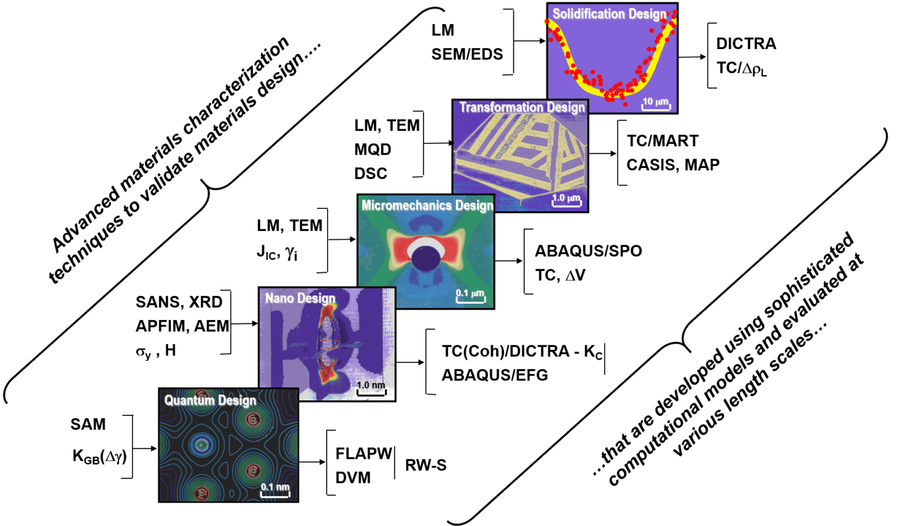
Strategy to accelerate development

Slide 22
Ductility
Strength
Heat treatment & stress relief
High temperature embrittlement
Comparatively in lower amounts
GB cavities & Inter-granular bubbles
Size & distribution
Ductile Matrix
Grain structure
Transmutation
If high irradiation
Swelling & growth
GB ; chemistry & pinning
Additive manufacturing
Voids & precipitates
LONGER LIFE - SUCCESS
Inclusions, voids & porosity
Radiation hardening & embrittlement
hard dispersed phase
If low irradiation
Displacement cascade
Solidification structure
Micro segregation
Dislocation climb, network evolution, segregation
Creep & stress corrosion
Powder atomization
Toughness
Corrosion resistance
PROCESS
STRUCTURE
PROPERTY
RADIATION DAMAGE PROCESS

Slide 23
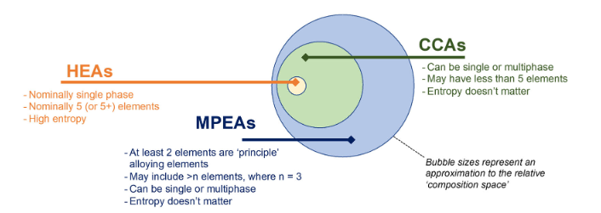
New material (classifications)
Concept
High entropy alloys already have high degree of disorder
Many have good high temperature properties
Attractive for possible RPV materials
N. Birbilis, et al., npj Materials Degradation (2021) 5:14; https://doi.org/10.1038/s41529-021-00163-8

Slide 24
MPE strategy
MPEs (Multi Principal Element alloys), when full solid solution are weak and unsuitable.
Matrix – ductile - contributes to the ductility of the alloy.
Dispersed phase – ductile/brittle - contributes to the strengthening of the alloy.
Matrix & dispersed phase – radiation and creep resistance
Operating temperature range in advanced nuclear reactors – 300 - 1000ºC

Slide 25
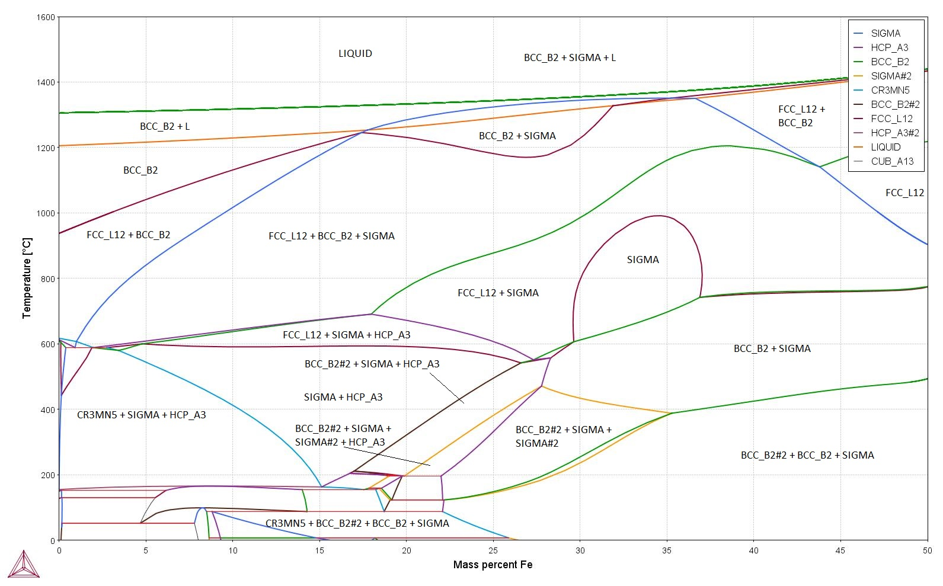
PHASE DIAGRAM of B16 – Fe 25.19 Cr 23.45 Mn 24.78 Co 26.58 (advanced reactor operation range)
Liquidus temp -- 1345 ºC
Solidus temp -- 1289ºC
Delta T -- 56 ºC
Temp ranges | Major Phase | Secondary Phases and (amount in mol)
200 - 320 ºC | SIGMA(0.73-0.8) | BCC_B2#2 (0.21-0.15)+ SIGMA#2 (0.05-.04)
320 - 380 ºC | SIGMA(0.8-0.83) | BCC_B2#2 (0.15-0.1)+ SIGMA#2 (0.04 - 0) + HCP_A3 (0-0.06)
380 - 500 ºC | SIGMA#2 (0.83 - 0.9) | BCC_B2#2 (0.1- 0) + HCP_A3 (0.06 - 0.1)
500 - 570 ºC | SIGMA#2 (0.9) | HCP_A3 (0.1)
570 - 610 ºC | SIGMA#2 (0.9 - 0.89) | HCP_A3 (0.1 - 0) + FCC_L12 (0 - 0.11)
610 - 880 ºC | SIGMA#2 (0.89 - 0.8) | FCC_L12 (0.11 - 0.2)
880 - 1180 ºC | SIGMA#2 (0.8-0.5) | BCC_B2#2 (0-0.5) + FCC_L12 (0.2-0)
1180 - 1290 ºC | BCC_B2 (0.5-0.72) | SIGMA (0.5-0.28)
1290 - 1323 ºC | BCC_B2 (0.72-0.27) | SIGMA(0.28-0) + LIQ (0-0.73)
1323 - 1341 ºC | LIQ (0.73-1) | BCC_B2(0.27-0)
High probability to form
Lower probability to form
Least probability to form
ThermoCalc 2020a (TCHEA4 database)

Slide 26
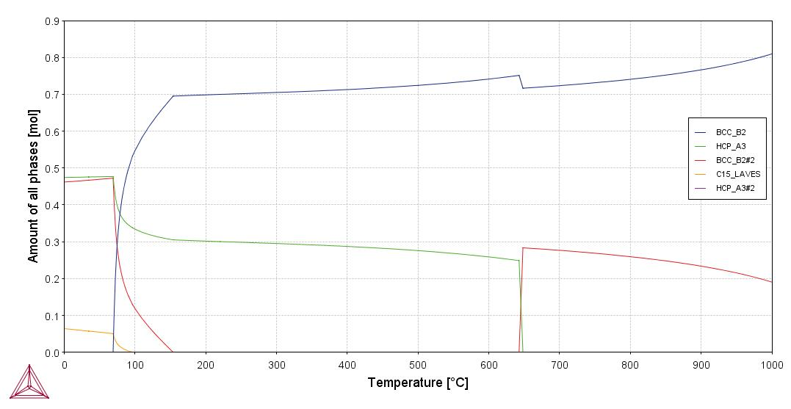
D23 – Ti14.60Zr27.82Mo29.26Nb28.33
RHEA
Operational range

Slide 27
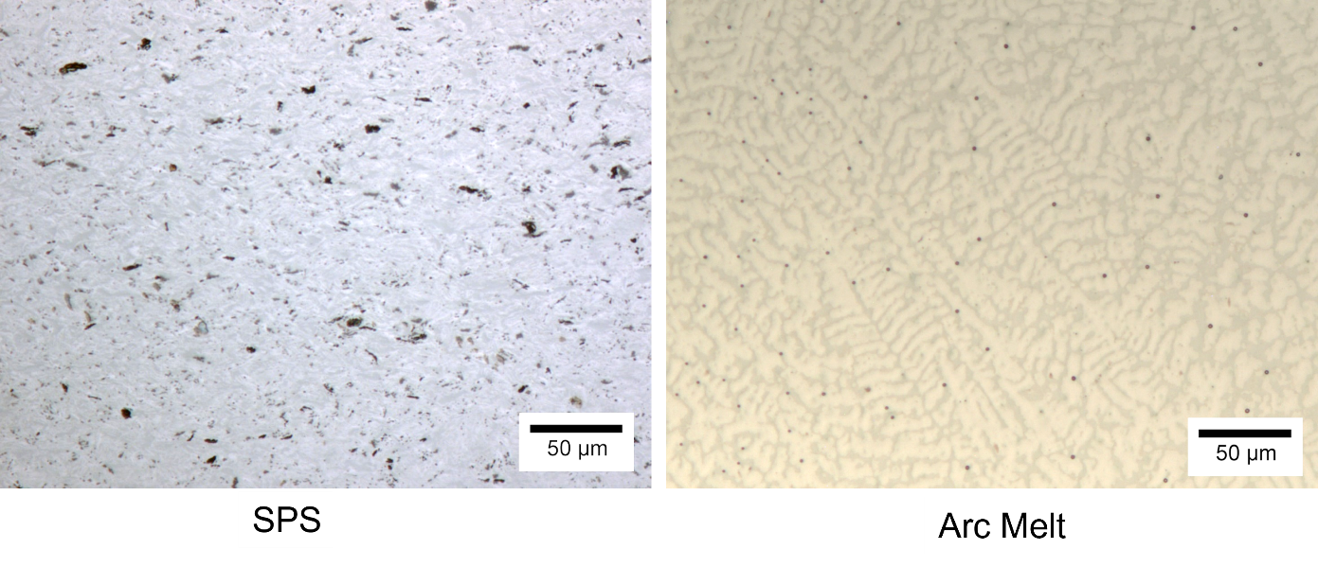
D23 microstructure
Predicted: majority of softer BCC phase
Smaller quantity of hard phase
Should have cracking resistance
Can be heat treated to disperse 2nd phase

Slide 28
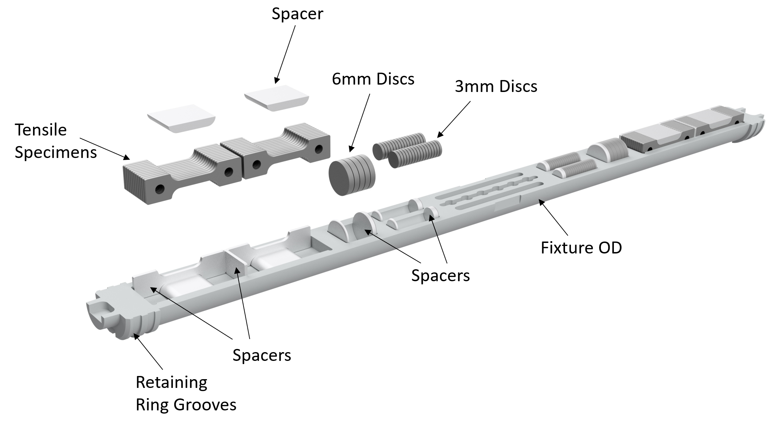
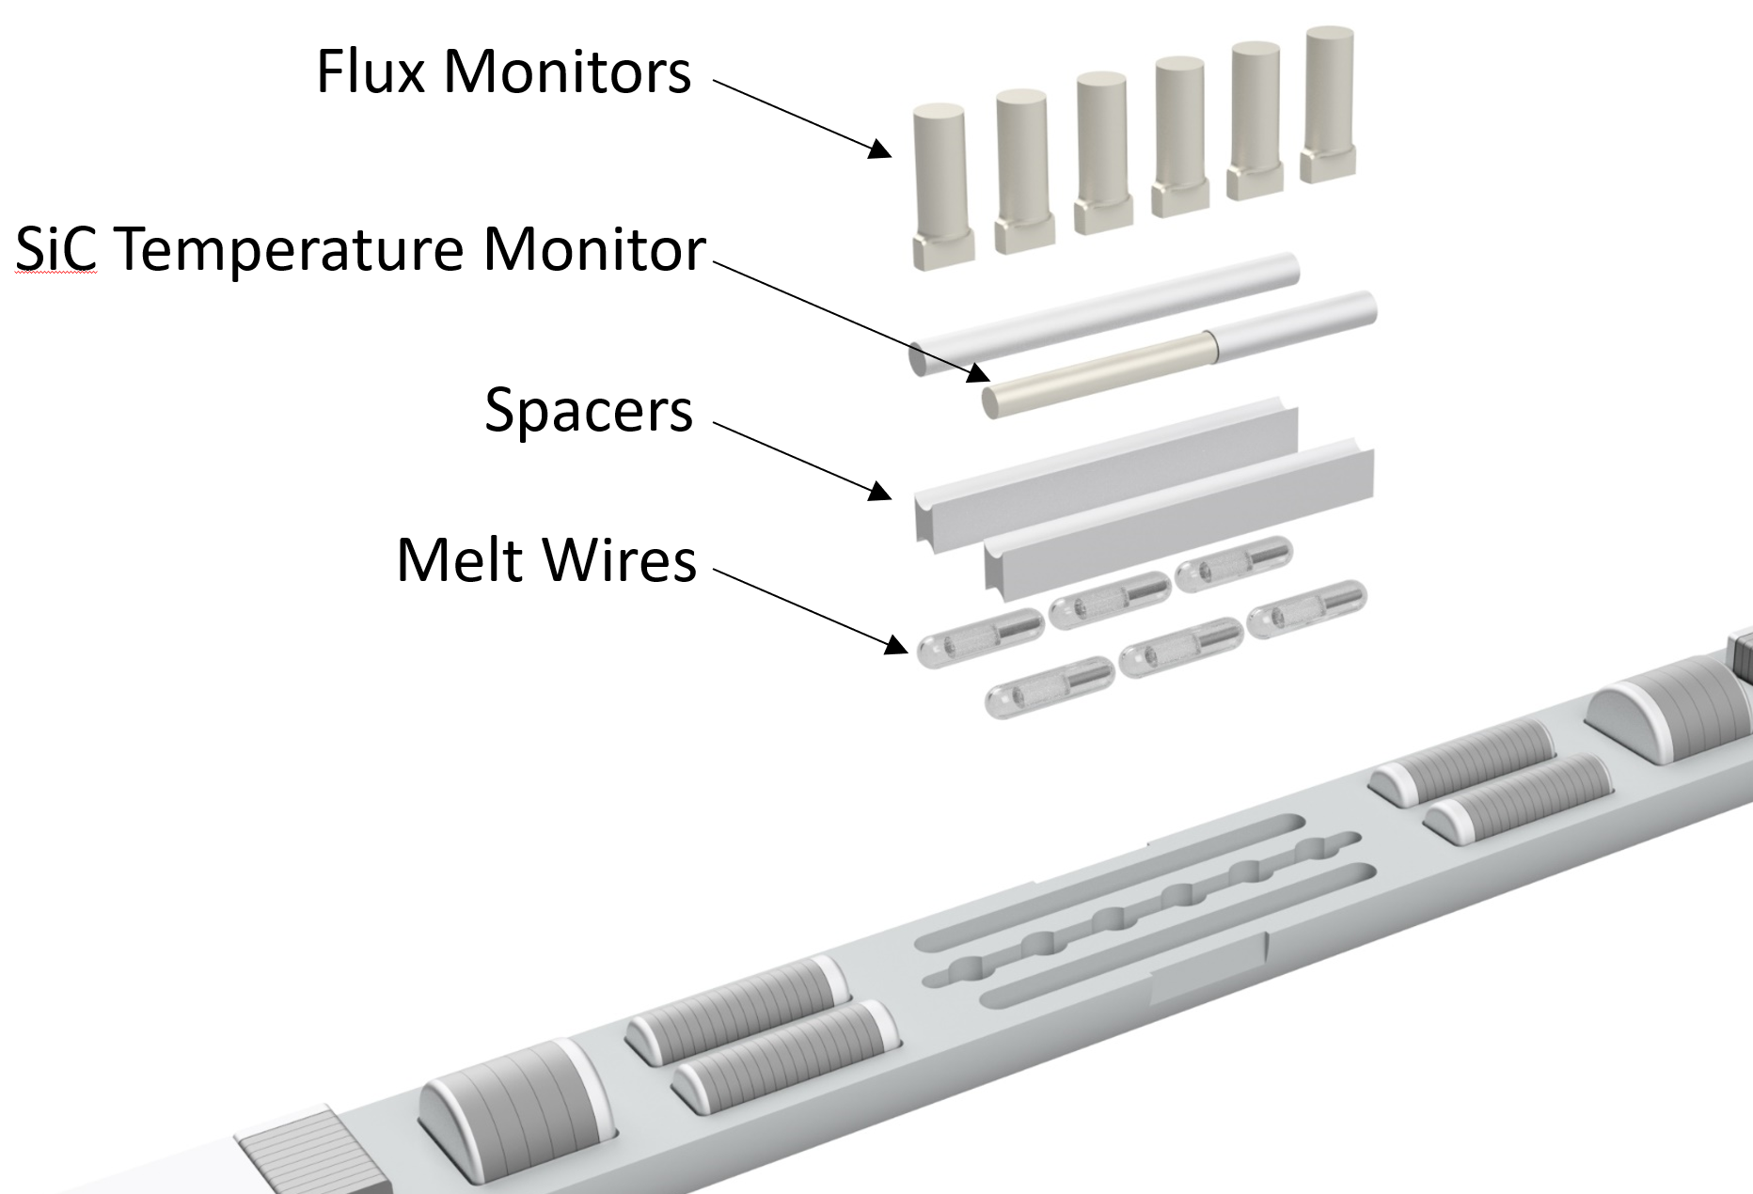
High packing density for ATR
SSJ design

Slide 29
Miniature tensile specimen (MT2)
Material characterization
Chemistry variation
Spatial variation
Process variation
Benchmarking
DIC analysis
All dimensions are in mm

Slide 30
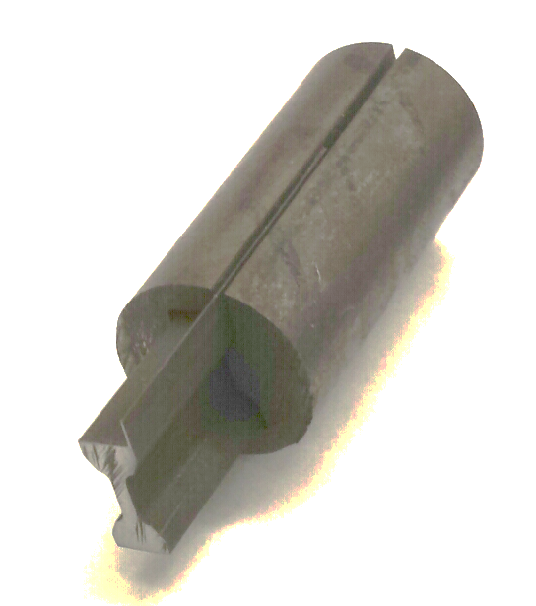
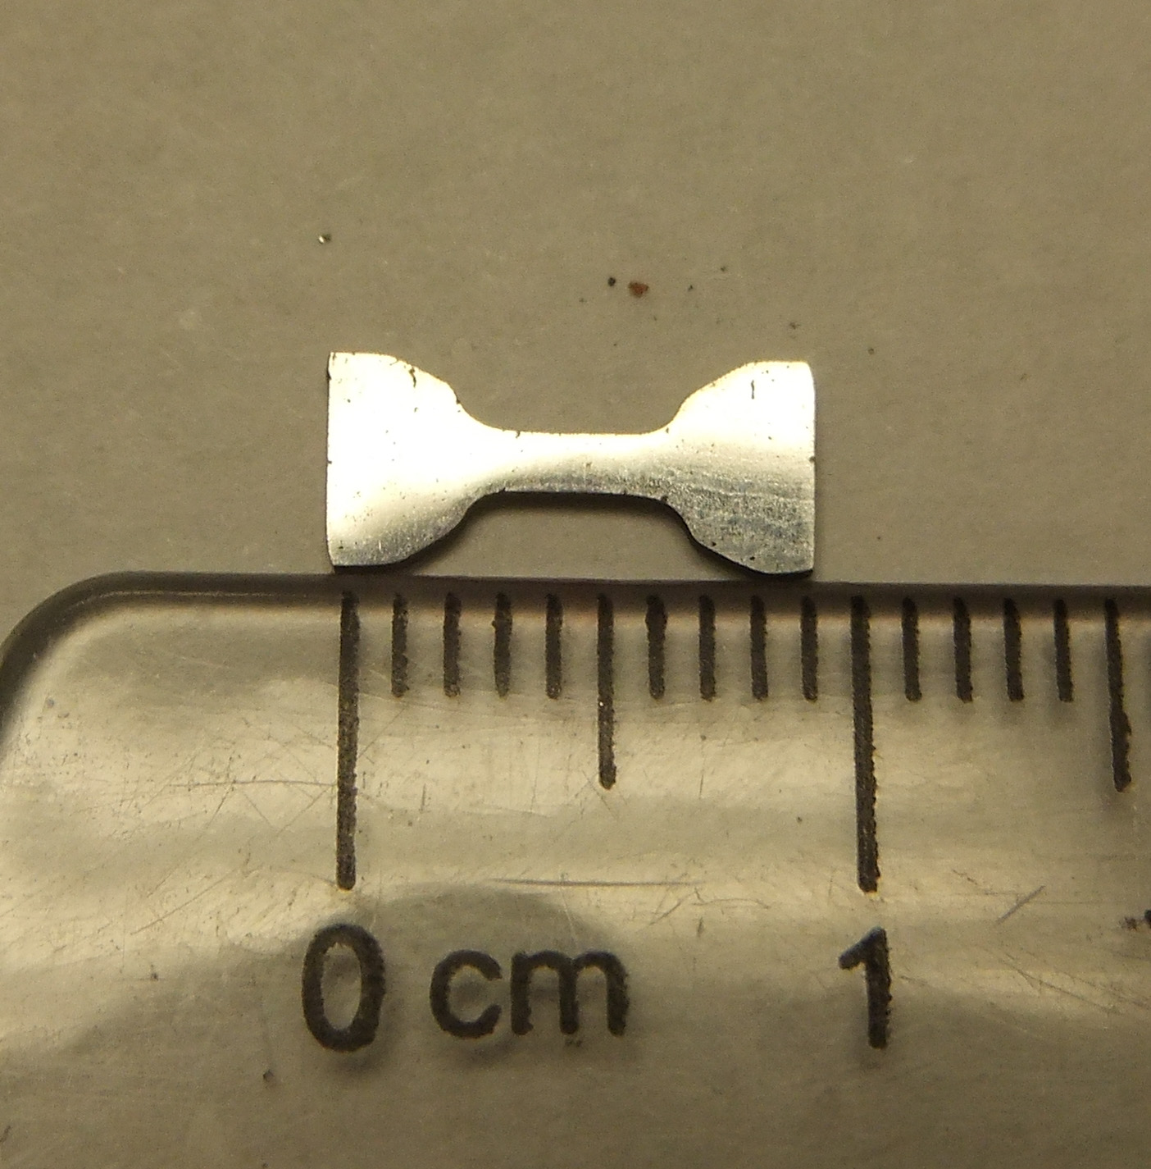
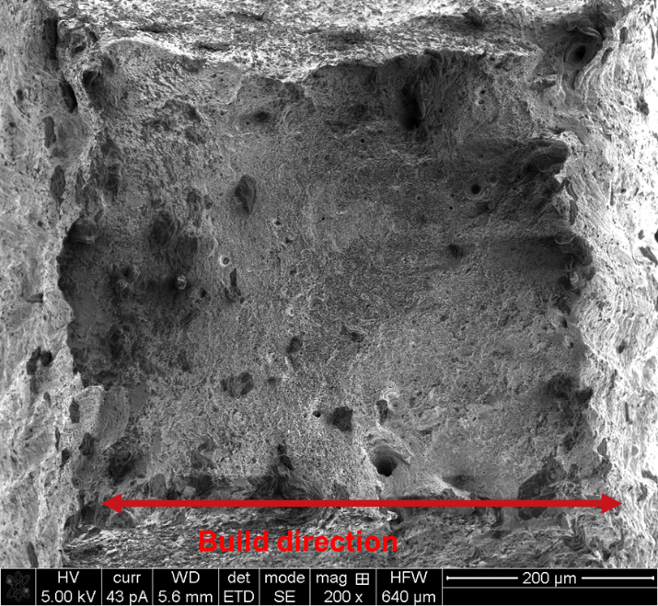
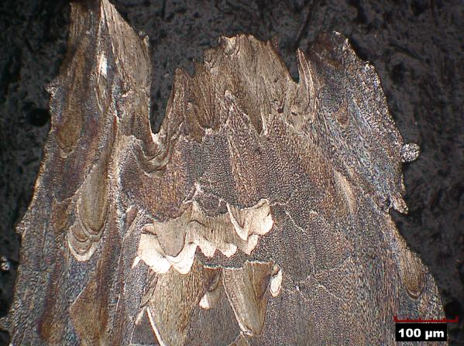
Smaller sample - higher packing density
Enabling local property measurements
Component level testing
High temperature testing
High throughput tester commercialized by PINE, LLC
EDM shape prior to slicing
Polished unbroken sample
Top down view
Side view
J.W. Newkirk and J. Wang, Advances in Powder Metallurgy & Particulate Materials-2014, 11-16 – 11-22.

Slide 31
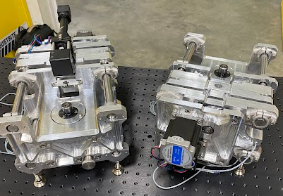
High-throughput tester
PINE, LLC commissioned through small business grant
Build and deliver tester
Carousels for SSJ and MT2
Fully automated
Radiation hardened

Slide 32
Conclusions
New designs interact with new materials
Development of new materials accelerated by:
Computational modeling
New verification methods
More densely packed test reactor samples
Development of new materials hampered by:
Limitations of modeling
Time for irradiation results
Time for creep testing
Time for environmental testing
Regulations?

Slide 33
Questions?

Slide 34
Experiment presented to INL
16 MPEs fabricated by arc melting compared to SPS
Compositions studied using CALPHAD approach
Experimental verification of models
Compare to “ideal” microstructures
Add capability in atomistic models
Use CALPHAD to vary compositions

Slide 35
Radiation damage
Absorbed at sinks leading to void formation, gas trapping & growth → embrittlement & swelling
In-Cascade clustering (Dislocation loops and networks)
Vacancies
Interstitials
Cause 2nd phase formation (impurities)
Most Frenkel pairs (vacancy & interstitial) recombine during cascade annealing.
Those which do not, either stay isolated or diffuse to form clusters forming visible extended defects
Movement of dislocations determine plasticity
Defects (voids, gas filled bubbles, dislocation loops, secondary phase precipitates) act as obstacles to dislocation motion (glide) → Radiation-induced hardening
When material is stressed, dislocation climb occurs → irradiation creep
Precipitation of new phases with different microstructure than that of matrix
Absorbed at sinks which gets enriched/ depleted in certain elements leading to solute segregation and eventually precipitation

Slide 36
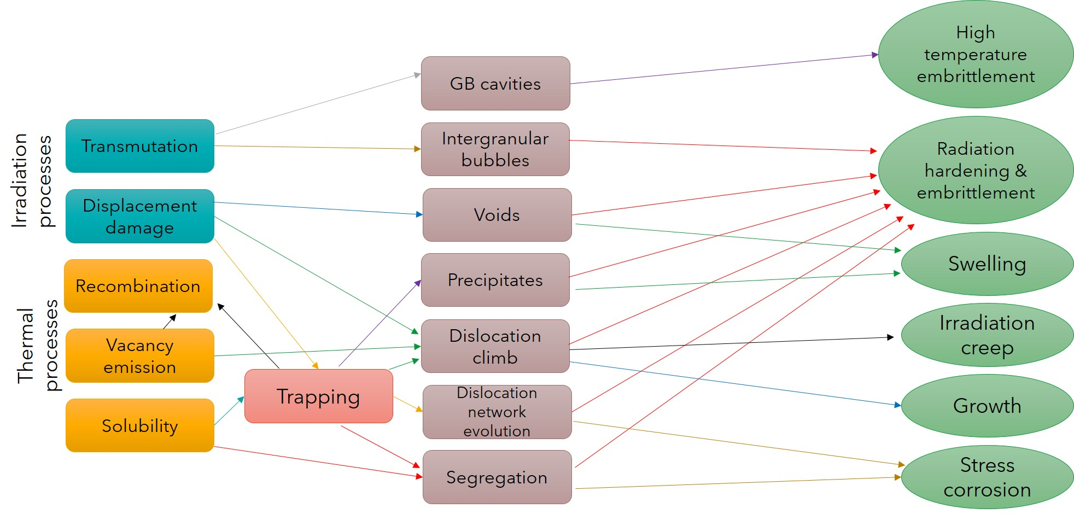
RADIATION DAMAGE PROCESS

Slide 37
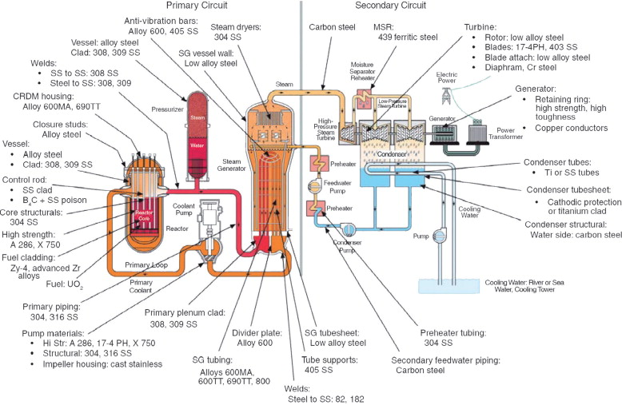
Reactor materials

Slide 38
COMPUTATIONAL MODELS & METHODS contd
Defect formation and migration energies can be calculated; hence properties of defects.
Electronic structure features and ground state properties. Obtained from electronic densities calculated.
Amount and diffusion of defects or impurities are calculated from atom jump simulations (segregation & precipitation)
Defect-dislocation, defect-dislocation loop interactions can be calculated; mechanical properties of materials
Inputs are defects and defect jump rates simulated by MD or BCA
DFT
(Density Function Theory)
Properties of point defects
KMC
(Kinetic Monte Carlo)
Defect transport & clustering
RE/RT
(Rate Equations or Rate theory)
Defect densities & microstructure
DDD
(Discreet Dislocation Dynamics)
Motion of dislocations
Forces on each dislocation is determined taking into account all possible interactions
Done by calculating elastic strain energy
prolonged irradiation, damage by dislocations → final mechanical property
Models microstructure evolution especially swelling
Gives the average defect concentration
Spans from defect production in cascade to changes in macroscopic properties
Inputs are MD data

Slide 39
Classification of bulk forming processes
Forging
Closed-die forging with flash
Closed-die forging w/o flash
Coining
Electro-upsetting
Forward extrusion forging
Backward extrusion forging
Hobbing
Isothermal forging
Nosing
Open-die forging
Rotary (orbital) forging
Precision forging
Metal powder forging
Radial forging
Upsetting
Incremental forging
Rolling
Sheet rolling
Shape rolling
Tube rolling
Ring rolling
Rotary tube piercing
Gear rolling
Roll forging
Cross rolling
Surface rolling
Shear forming
Tube reducing
Radial roll forming
Extrusion
Nonlubricated hot extrusion
Lubricated direct hot extr,
Hydrostatic extrusion
Co-extrusion
Equal channel angular extr.
Drawing
Drawing
Drawing with rolls
Ironing
Tube sinking
Co-drawing

Slide 40
Classification of sheet forming processes
Bending and straight flanging
Brake bending
Roll bending
Surface contouring of sheet
Contour stretch forming (stretch forming)
Androforming
Age forming
Creep forming
Die-quench forming
Bulging
Vacuum forming
Linear contouring
Linear stretch forming (stretch forming)
Linear roll forming (roll forming)
Deep recessing and flanging
Spinning (and roller flanging)
Deep drawing
Rubber-pad forming
Marform process
Rubber-diaphragm hydroforming (fluid cell forming or fluid forming)
Shallow recessing
Dimpling
Drop hammer forming
Electromagnetic forming
Explosive forming
Joggling

Slide 41
Useful Conditions for Metal Additive Manufacturing
Single unique item or small number of copies needed
Suitable materials and small in size (12” by 12” by 12”)
Shape is too complex to be generated in any other way

Slide 42
Materials Genome Initiative
Vision:
Advanced materials are essential to economic security and human well-being and have applications in multiple industries, including those aimed at addressing challenges in clean energy, national security, and human welfare. To meet these challenges, the Materials Genome Initiative will enable discovery, development, manufacturing, and deployment of advanced materials at least twice as fast as possible today, at a fraction of the cost.
Materials Genome Initiative – Strategic Plan, 2014

