Slide 1


Process Electrification in a Context of Sustainability: New Examples of Introduction of Microwave in Future Processes
PROF. JAMAL CHAOUKI
Eng., PhD., MACG.
Total Industrial Chair
Chemical Eng. Dept.
Polytechnique Montréal
Prof. affilié à l’UM6P, BenGuérir
2023 Laufer Energy Symposium

Slide 2
Change in total final energy use and CO2 emissions from electrification estimated in this study (in US)

Slide 3
New (smart) uses in industry:
The electric sources concerned
As Mechanical Energy
As Energy:
  Electromagnetic irradiation
    Inductive heating
    Microwave heating.
  Plasma;
  Ultrasound.

Slide 4
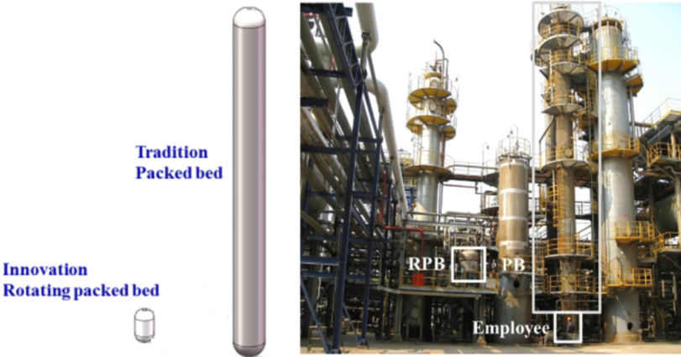
ROTATING PACKED BEDS
Gas-liquid contactor type | Advantages | Disadvantages
Packed Bed | - Low gas-side pressure drop - Can handle foaling liquids | - Sensitive to solid impurities
Rotating packed bed | - Maximize the gas-liquid contact area - Higher mass transfer rates | - Complicated structure - High pressure drop and high-power consumption
Tray | - Can accommodate heat exchangers on trays | - Not appropriate for foaming and corrosive liquids - High gas-side pressure drop - High operating cost
Bubble column | - Simple construction - Low capital and maintenance costs | - High gas-side pressure drop
Spray | - Low gas phase pressure drop Can handle gases with solid particles | - High energy consumption for spraying the liquid phase
Gas-liquid contactor type | Gas-phase mass transfer coefficient | Interfacial area (m²/m³)
Packed Bed | 0.5–2.0 | 100–300
Rotating packed bed | 1.0-8 | 200-1000
Tray | 0.5–1.0 | 100–400
Bubble | 0.4–1.0 | 10–30
Spray | 0.1–0.8 | 20–80

Slide 5
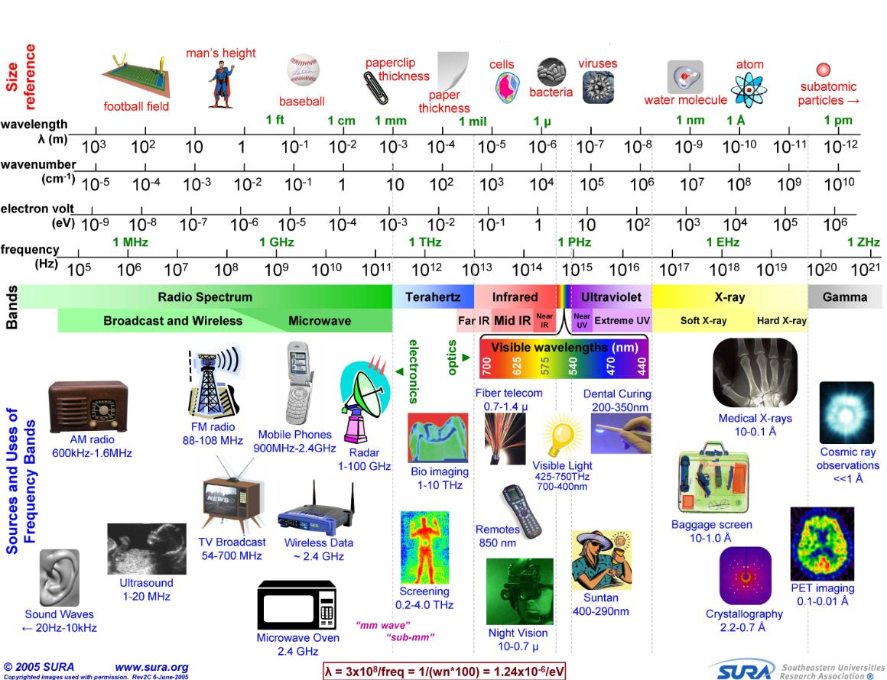
Microwave fundamentals
What is Microwaves?
Frequency range: 0.3to 300GHz,
Wave length:10⁻³ to 1m.
In North America, the frequencies designated for industrial applications are 0.915, 2.45, 5.8, and 22 GHz.
The frequency used in domestic microwave ovens and laboratory reactions is 2.45GHz (12.2 cm)
Notes:
Electromagnetic spectrum has a wide range of applications, each has a specific range of frequency and corresponding wavelength.

Slide 6
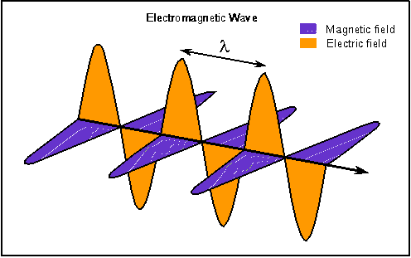
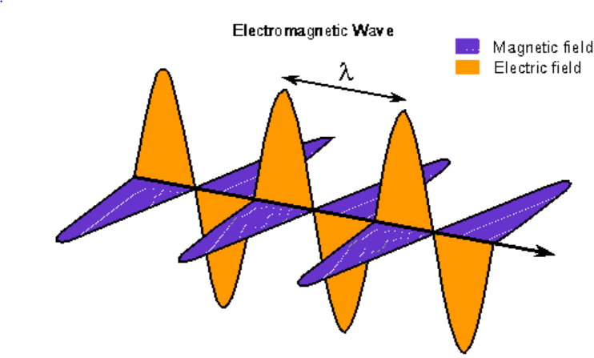
Microwave fundamentals
-
+
-
+
-
+
-
+
-
+
-
+
-
+
In presence of an oscillating electromagnetic field, molecular-dipoles reorient themselves in order to be in phase with the alternating field.
Notes:
The specific heating effect of a beam of high-power microwaves was discovered accidentally in 1945.
Microwaves consisted of an electric and a magnetic field perpendicular to each other.
The fundamental mechanism of MWH involves agitation of polar molecules or ions that oscillate under the effect of an oscillating electric field of electromagnetic waves. In the presence of an oscillating field, molecules try to reorient themselves in order to be in phase with the alternating electric field.
Since the motion of these molecules is restricted by resisting forces (molecular interaction and its resistance), this oscillation increases the kinetic energy of all molecules in the system. Therefore heat energy will be produced, which results increases of system temperature.

Slide 7
Microwave fundamentals
The main parameters describe the level of heat-generation inside a heated material are:
Dielectric constant (ε/):
      represents the amount of electric energy that can be stored within the heated material.
          Loss Factor (ε//):
                represents the ability of the heated material to dissipate microwave energy.
                Penetration depth (D_{P} ):
                the depth where the magnitude of the electric field drops
                by a factor 1/e with respect to the surface value.
                loss tangent (tanδ):
                the ratio between ε// and ε/.

Slide 8
Microwave fundamentals
Dielectric constant, dielectric loss, and loss tangent of different materials.
Material |  |  |  | Temperature | Frequency GHz
Vacuum | 1.00 | 0 | 0 | 25C | ND
Air | 1.0006 | 0 | 0 | 25C | ND
Glass | 4.82 | 0.026 | 0.0054 | 25C | 3
Alumina | 8.9 | 0.009 | 0.00010 | 800C | (3.89-3.61)
Fused quartz | 3.8 | 0.0001 | 0.00003 | 25C | 2.45
Pyrex | 4 | 0.005 | 0.0013 | 25C | 2.45
Water | 80.4 | 9.89 | 0.123 | 25C | 2.45
Salty Water (0.5mol) | 79.2 | 2500 | 33.56 | 25C | 2.45
Methanol | 32.6 | 21.48 | 0.659 | 25C | 2.45
Ethanol | 24.3 | 22.86 | 0.94 | 25C | 2.45
Silicon carbide | 105 | 110 | 1.048 | 200C | 2.45
-D. C. F. D.E. Clark, "What is microwave processing," presented at the Microwave Solutions for Ceramic Engineers, Westerville, OH 2005. -E. W. W. L. Manoj Gupta, Wai Leong Wong, Microwaves and metals: John Wiley & sons (Asia) Pte Ltd 2007.

Slide 9

Heat up a pizza in MicroWave (MW)

Slide 10
Turn problems into opportunities

Slide 11
Examples of applications
T_{M}
T_{p}
T_{M}
T_{F}
Particle Temperature DIFFERENT from Fluid Temperature: T_{F}
Fluid: Gas or Liquid: T_{P}
Molecular Temperature T_{M}

Slide 12
Example 1: Pyrowave technology
Polystyrene Styrene Ethylbenzene Others products
T_{p}
Polystyrene (T_{F})

Slide 13
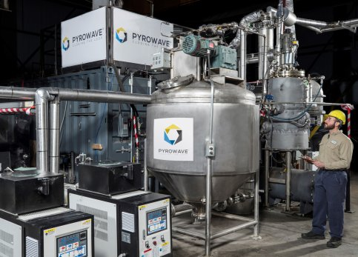
Microwave Pyrolyzer

Slide 14
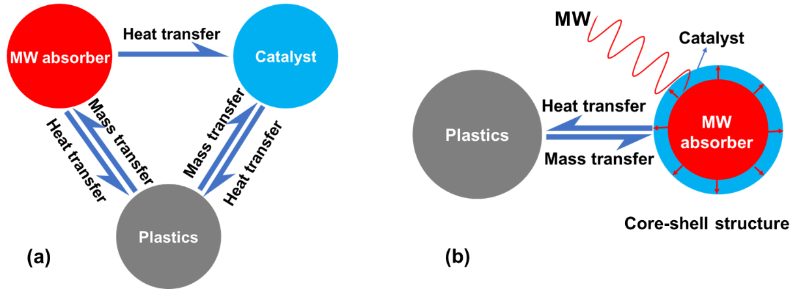
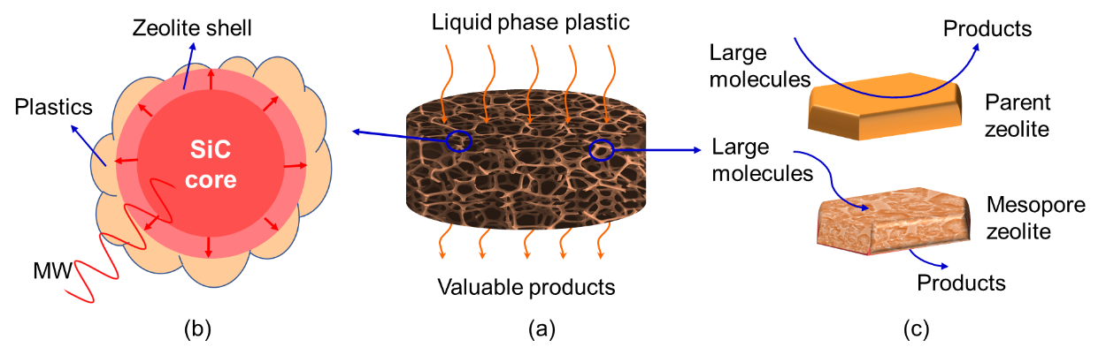
Example 2: Microwave-responsive SiC foam@zeolite core-shell structured catalyst for catalytic pyrolysis of plastics

Slide 15
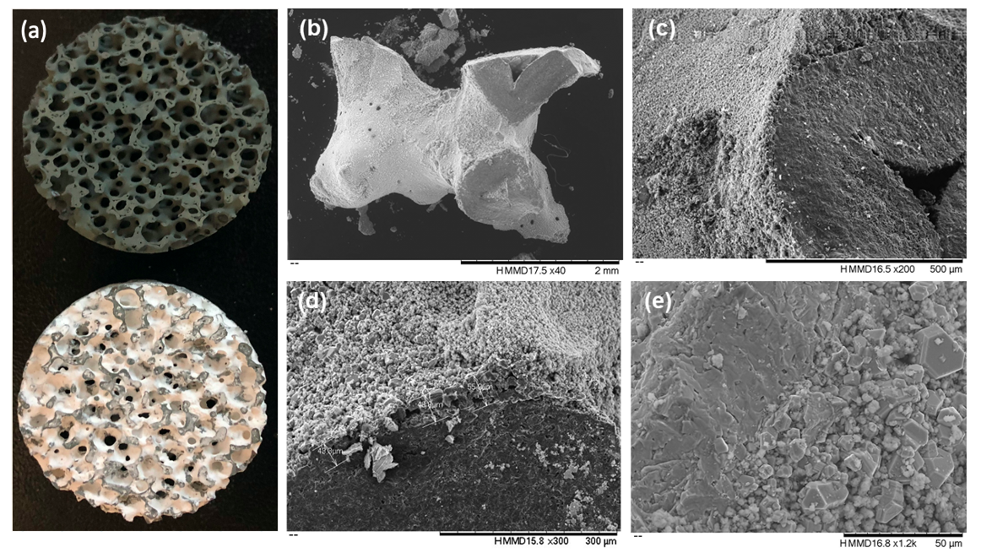
core-shell structured catalyst for catalytic pyrolysis of plastics
(a) SiC foam before and after the coating, (b), (c) SEM image of coated SiC, and (d), (e) Coated layer of HZSM-5 on the SiC foam’s surface.

Slide 16
Gas-particles system: example 3
𝐶𝐻₄ + 𝐶𝑂₂ → 2𝐶𝑂 + 2𝐻₂
ΔH = +247 𝑘𝐽 𝑚𝑜𝑙
GAS: Methane, CO2, CO, H2: No Interaction with MW
Catalyst: High Interaction with MW

Slide 18
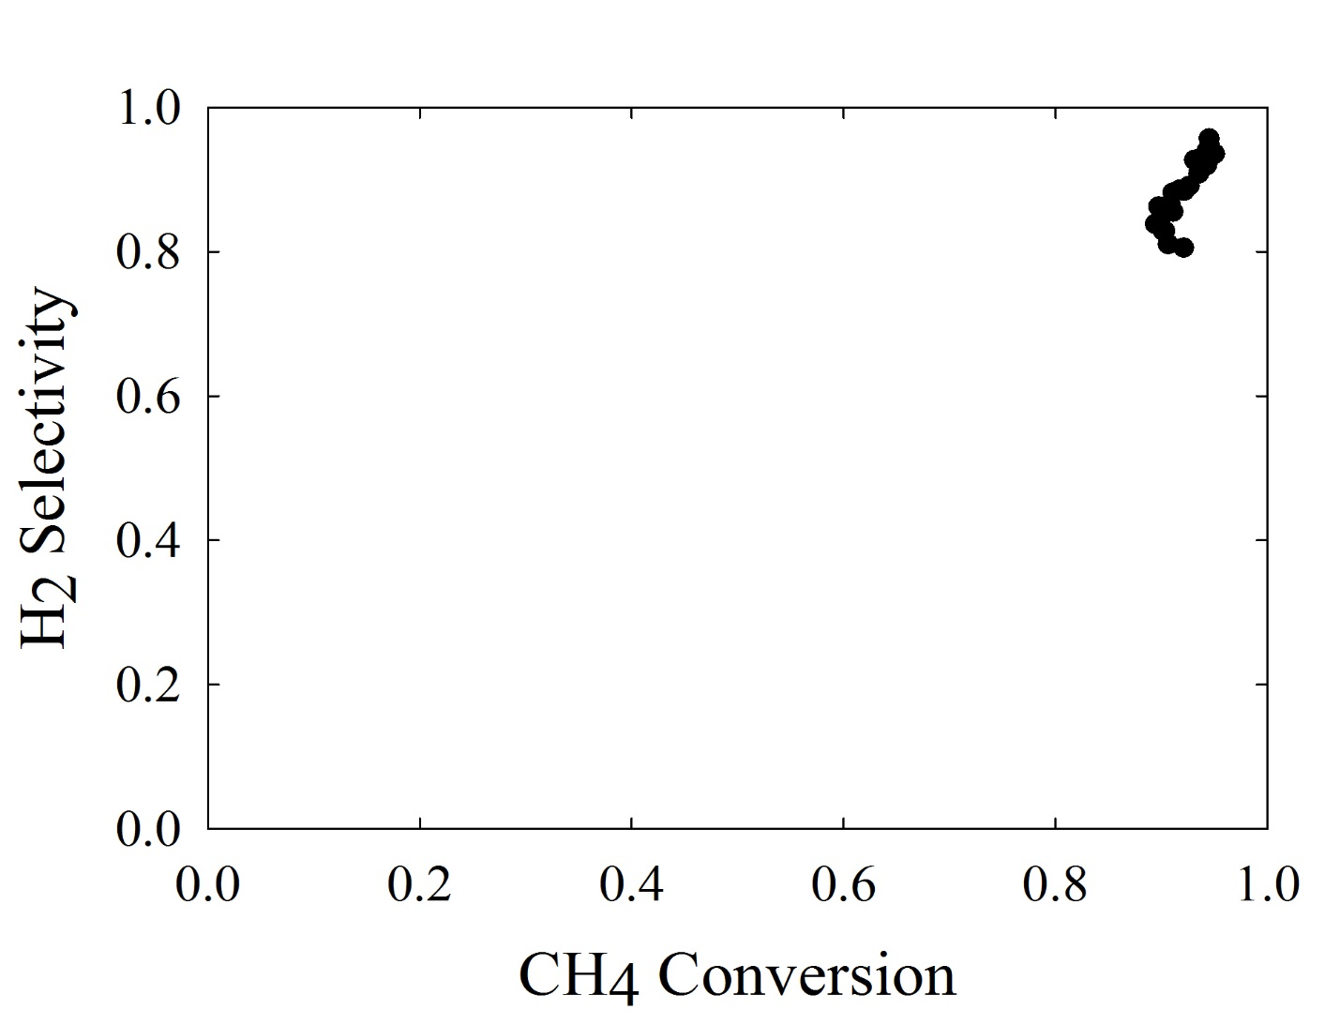
Selectivity and Conversion Distribution: proof of concept

Slide 19
Conclusion: Take home messages and new ideas
Decarbonize industry & find new applications. Process Electrification: new opportunities
Main Microwave Heating Characteristics:
    3D Heating;
    Different Temperatures in the System
New Applications: Imagination/Innovation

