Slide 1






Disruptive technologies for promoting energy efficiency. Can the use of fossil fuels be environmentally sustainable?
Youssef Belmabkhout
Laufer Energy Symposium
April 1st , 2023
Applied Chemsitry and Engineering Research Centre of Excellence (ACER CoE)
Notes:
Thank you so much Dr Alodan, good morning ladies and gentlemen's. I will try in the time allocated to me to share with you some of our thoughts, from academic research perspectives on how we can promote the sustainable use of energy by implementing new technologies and the challenges to achieve this goal.

Slide 2
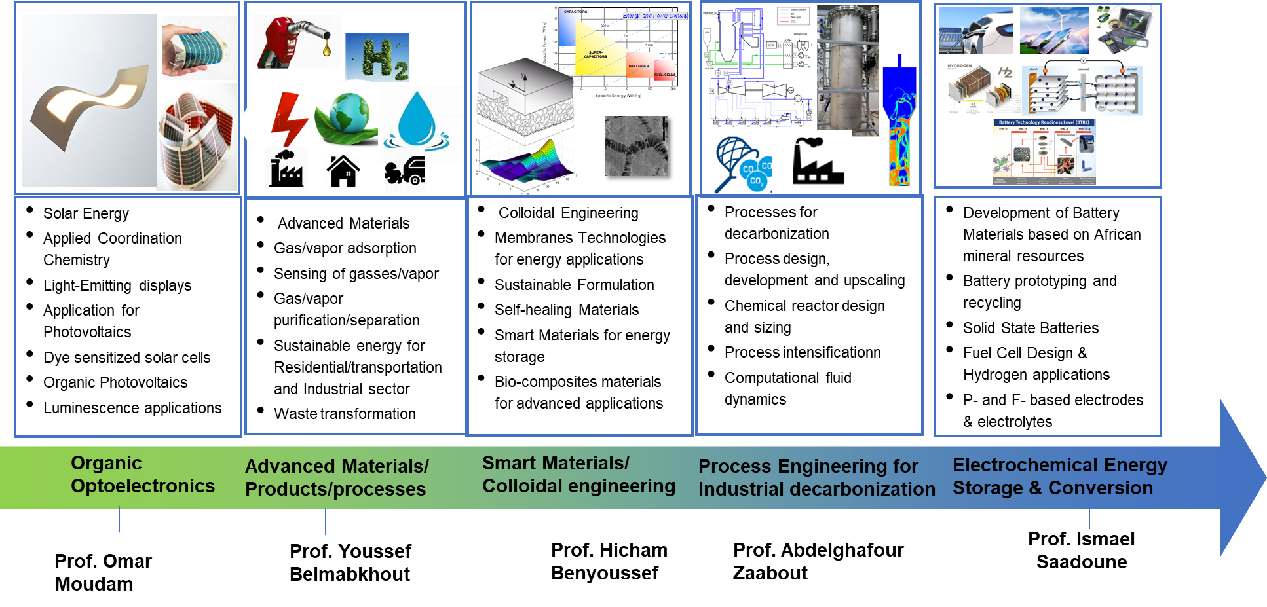
Applied Chemistry and Engineering Research Centre of Excellence (ACER CoE)
Current Research Activities @ ACER

Slide 3
Energy in purification/separation industry
Power generation
Chemicals
Oil and gas
Purification & separation to produce commodities are energy intensive (~15% of 2011 global energy use)
Global demands for commodities (water, fuel, chemicals) will grow ~3X by 2050, so “business as usual” would require an equivalent to 45% of total 2011 energy usage for separations alone in 2050

Slide 4
Pathways for sustainability
1- Renewable Energies (solar, wind, geothermal, etc, “nuclear”
and “hydropower” ?)
2- Carbon management (CO₂ capture and utilization)
3- Reduce/recycle waste and emissions (Flaring, toxic gases)
4- Cleaner Fuels (methane (CH₄), hydrogen (H₂))
5- Energy saving (Industry, residential and transportation sectors)
6- Technology maturation
Notes:
For most of the public, clean energy means always renewable energy like solar, winds geothermal, …Nuclear energy is controversial topic because some people they consider it as a renewable other no. This is a subject of international debate.
By talking about Renewable energies I want to make quickly two points.
With all the effort made in the last years implementing renewable energies, all renewable energies together will definitely not be able to cover all the growing needs of energy in our society

Slide 5




Total world ELECTRICITY PRODUCTION
TREMENDOUS INCREASE IN THE SHARE OF RENEWABLE ENERGY PRODUCTION
≈1300%
≈234%
≈1400%
≈17000%
5

Slide 6
Total world electricity generation
≈400%
Source: IEA, World Energy Balances, 2021.
6

Slide 7



Total world Fossil fuel production
≈146%
≈227%
≈43%
7
Source: IEA, World Energy Balances, 2021.

Slide 8
Total world Energy production
by source: Detailed split
87% to 81%
94% to 77.8%
Source: IEA, World Energy Balances, 2021.
8
Notes:
3 times increase in developing countries (33% increase for OECD and 138 for developing countries in 40 years
Same distribution with a surge in the share of NG and Nuclear and renewable for Both OECD and developing countries

Slide 9
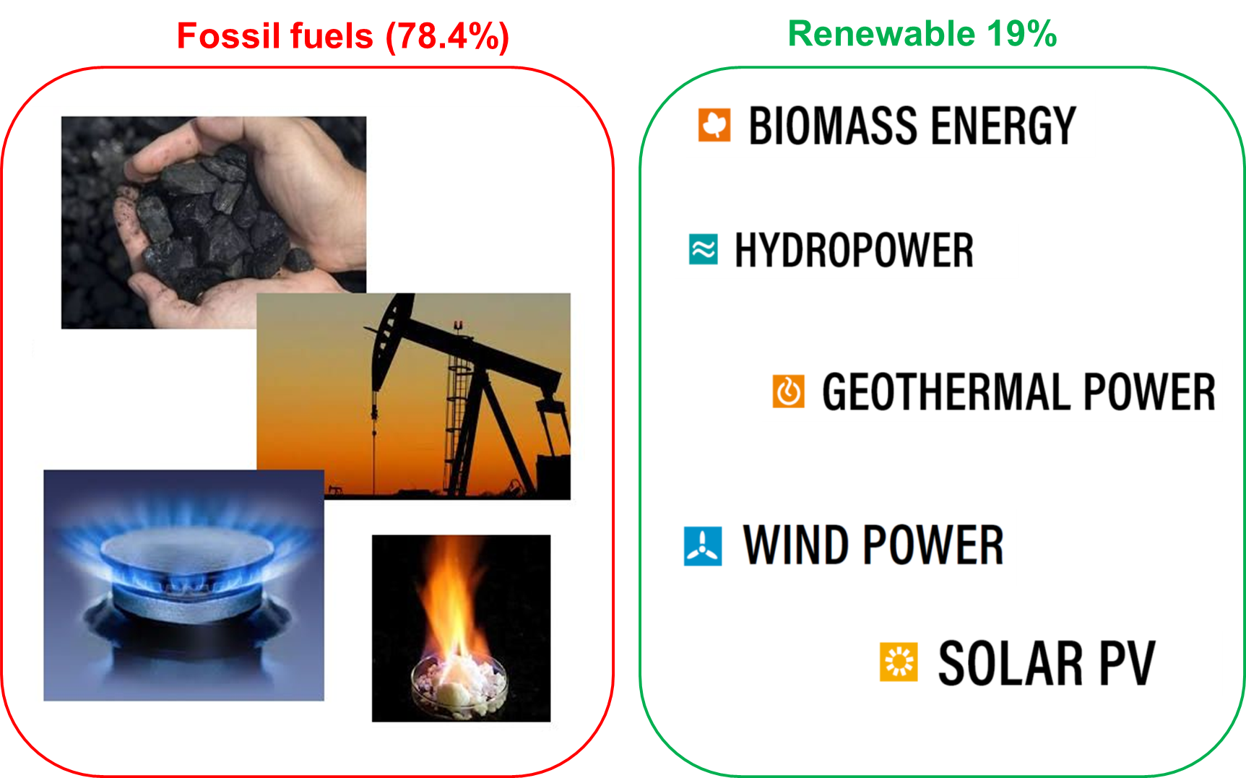
Renewables vs. conventionnal
1- Renewable Energies (solar, wind, geothermal, etc, “nuclear”
and “hydropower” ?) General perception: clean energy → Renewable energies?!
. Renewable energies (19%) # Fossil fuels (81%)
. Renewable energies use is growing # Fossil fuels use is “not declining” too
Notes:
For most of the public, clean energy means always renewable energy like solar, winds geothermal, …Nuclear energy is controversial topic because some people they consider it as a renewable other no. This is a subject of international debate.
By talking about Renewable energies I want to make quickly two points.
With all the effort made in the last years implementing renewable energies, all renewable energies together will definitely not be able to cover all the growing needs of energy in our society

Slide 10

Fossil fuels-free world ! For When?
We won’t be off fossil fuels by 2050
Some misconceptions about Fossil Fuels and renewable energies
Decarbonisation does not mean thinking about energy only in terms of electricity. it is also the least of the big consumer on energy. The big challenges is in transportation sector, especially for long-distance haulage and trans-ocean shipping. The best alternative could come up with LNG (liquefied natural gas)
01
02
Food industry & Agriculture: How large urban population will be by 2050 and how can be fed without using the amount of fertilizers we produce using fossil fuel.
Important carbon based materials: Where are you going to get plastics in sufficient quantities to meet demand without fossil fuels? The same applies to materials we need for renewable-energy essentials like lightweight carbon-fibre wind-turbine blades, and thin-film photovoltaics. Nobody has a serious alternative to this – the list goes on
03
04
Energy for industry: Energy to be spent in Industry to produce important commodities for our life will triple by 2050 and renewable energy alone can not cover all of it
05
Fossil fuels dependence: with our life style and the stress on permanent economy growth we are more realistically heading towards a world in 2100 where we depend more heavily on fossil fuels
10
Notes:
Talk about research center

Slide 11
Fossil fuels-free world ! For When?
We won’t be off fossil fuels by 2050
When looking at sustainable electricity resources, we commonly identify four: solar, wind, hydro and biomass. Each of them is renewable, but that doesn’t necessarily make them sustainable. Sustainability is determined by three different parameters:
Environmental sustainability: Environmental sustainability means that it doesn’t do harm to the environment
01
02
Social sustainability
03
Economic sustainability
Can be Fossil fuels sustainable?
11
Notes:
Talk about research center

Slide 12
Examples
2- Carbon management (CO₂ capture and utilization)
3- Reduce/recycle waste and emissions (Flaring, toxic gases)
4- Cleaner Fuels (methane (CH₄), hydrogen (H₂))
5- Energy saving (Industry, residential and transportation sectors)
Notes:
For most of the public, clean energy means always renewable energy like solar, winds geothermal, …Nuclear energy is controversial topic because some people they consider it as a renewable other no. This is a subject of international debate.
By talking about Renewable energies I want to make quickly two points.
With all the effort made in the last years implementing renewable energies, all renewable energies together will definitely not be able to cover all the growing needs of energy in our society

Slide 13
Separative concept promoting
energy efficiency
New adsorptive mechanism lead to new efficient separation concepts
Adsorbents
Kinetic based
Equilibrium (Thermodynamic) based
Combination of both
Full Molecular sieving
A
uptake
uptake
B
Pressure
time
Favorable Kinetics
A
Favorable thermodynamics
B
Nature (2013) 495 (7439), 80; US Patent App. 15/119,870

Slide 14
Separative concept promoting
energy efficiency
New co-adsorption mechanisms lead to new efficient separation concepts:
CO₂ capture as a case study
Adsorbents
Kinetic based
Equilibrium (Thermodynamic) based
Combination of both
Full Molecular sieving
100 kJ/mol
35-55 kJ/mol
Energy required for regeneration
CO₂ kJ/mol CO₂
20-25 kJ/mol
Uptake
Chemical Engineering Journal, 2016, 296, 386-397

Slide 15
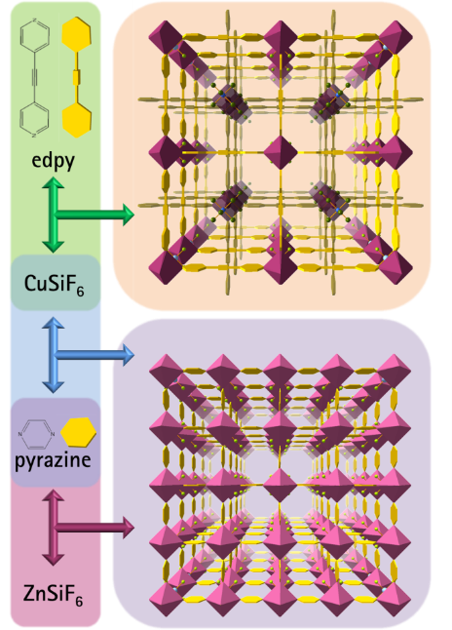
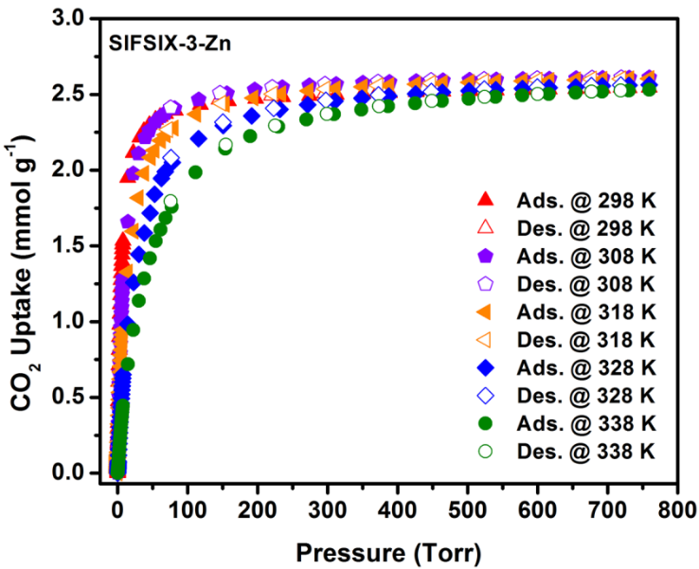
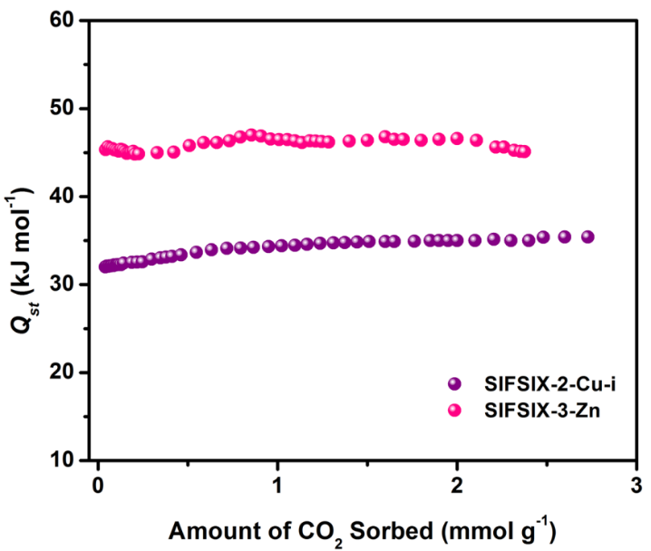
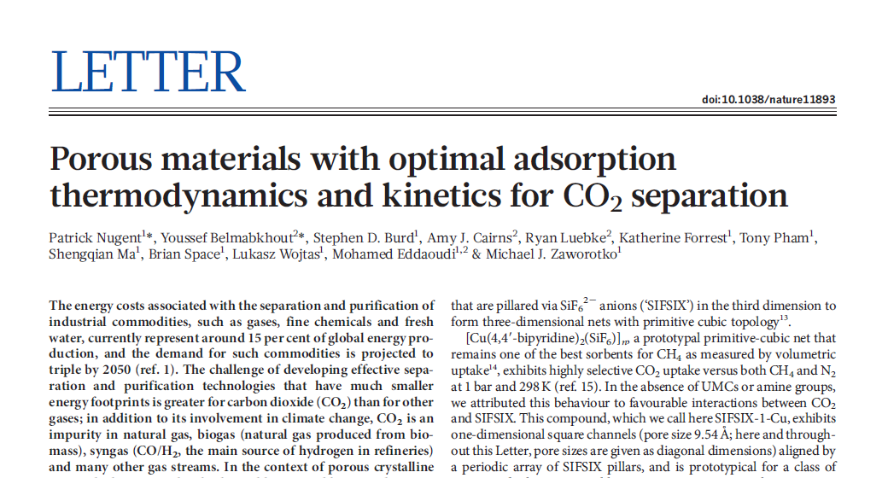
Energy efficient CO₂/air Capture
15

Slide 16
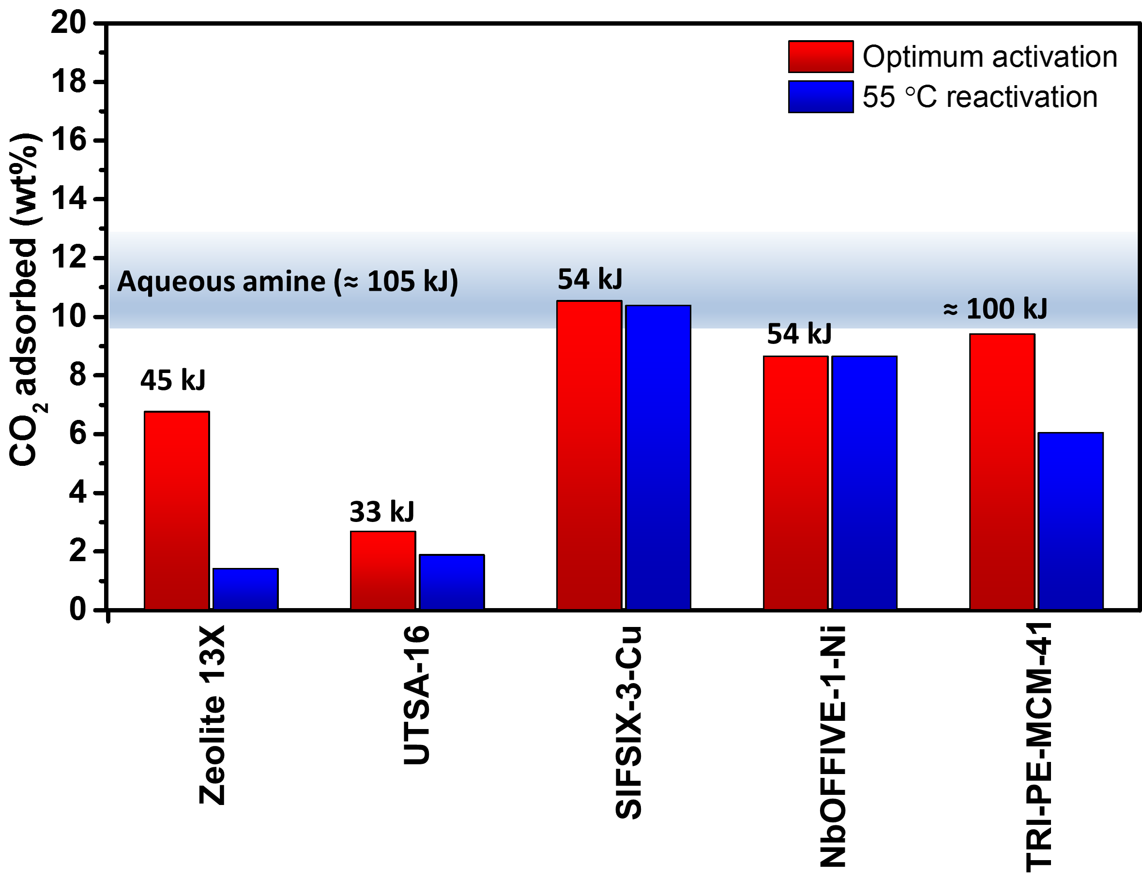
Best Materials for CO₂ capture from different
sources
Advanced Materials 29 (39)

Slide 17
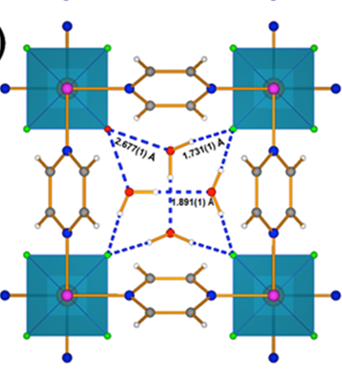
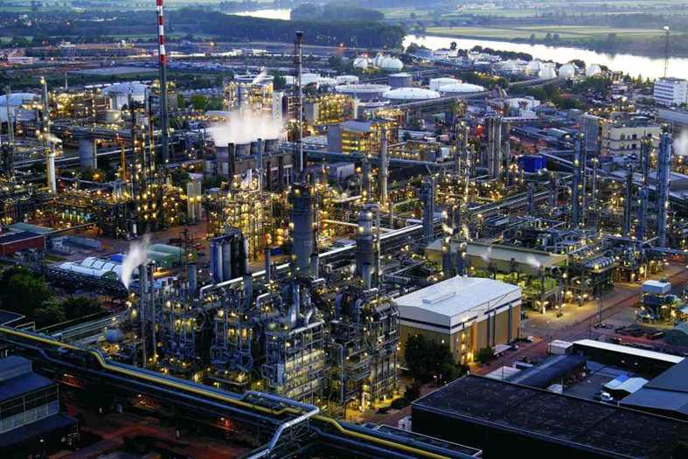
Clean fuel and efficient upgrading of NG
Efficient dehydration of NG &
CO₂ and H₂S removal from NG
Science, 2017, 353, 6295, 137-140, Patent pending
Nature Energy, 1, 2018

Slide 18
Reducing flaring and emission of CO₂/SO_{X}
Methane/NG storage
-US Patent App. 17/131,385
- JACS, 137 (41), 13308-13318
Flaring
18

Slide 19

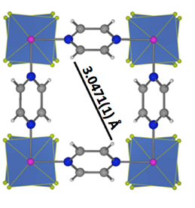
Energy efficiency for Industrial sector
New generation of molecular sieves for:
- Olefin/ Paraffin separation
-Science 356 (6339), 731-735
50%

Slide 20

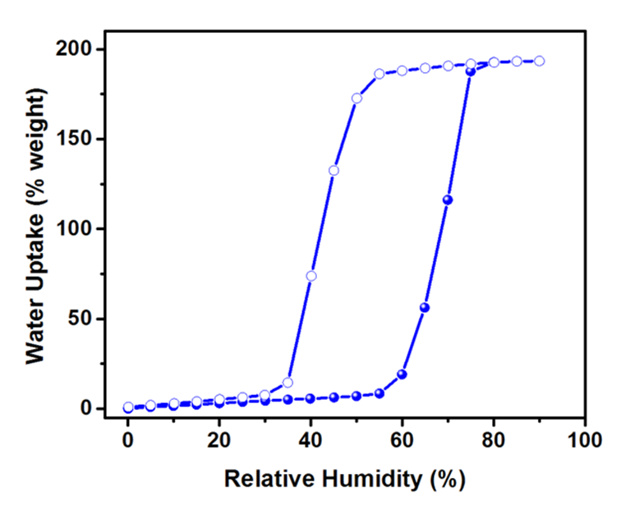
R&D on Energy efficiency for residential sectors
Air conditioning aided by Humidity Control
Humidity Control agent
Energy for air conditioning
-US Patent App. 17/131,385
- Chem 4 (1), 94-105

Slide 21
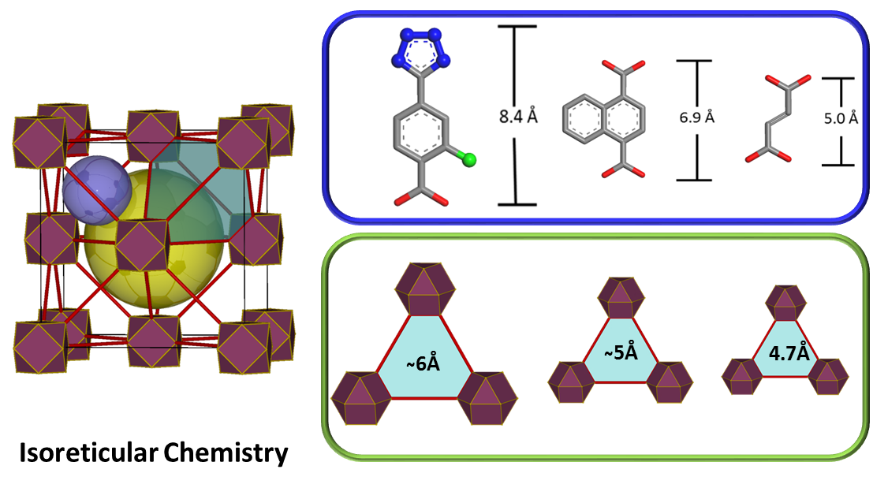
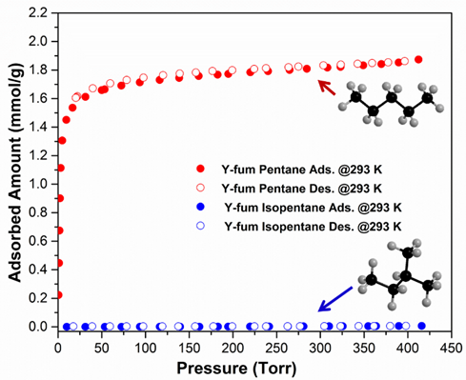
R&D on clean fuel and energy saving in transportation
sector
US Patent App. 15/509,764, US Patent App. 14/919,238

Slide 22
Need of technology maturation force
Industry
TRL 8
TechCell
TRL 7
TRL 6
TRL 5
Labs
Researchers

Slide 23


Thank you
youssef.belmabkhout@um6p.ma
23

