Slide 1
Nuclear Fusion Status Overview
Opportunities-Challenges
Rusi P. Taleyarkhan, Professor
School of Nuclear Engineering
Purdue University, West Lafayette, IN, USA
Laufer Symposium, St. Louis, MO
3/30 – 4/1/2023
Thanks to Profs. M. Al-Dahann, H. Al-Rubaye, J. Smith, A. Gillman and Org. Team
Declarations:
Views are my own – Presentation Not Prepared for Publication
Data/Excerpts from numerous cited published sources

Slide 2
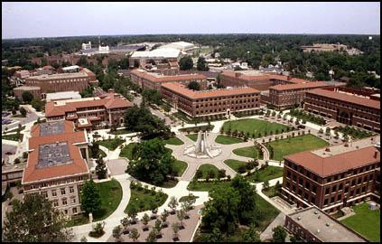
Greetings from Purdue University – The Boilermakers
Inventors of the “Barn” Unit

Slide 3
Purdue University – Fact Sheet
Established (1869) – 39 enrolled
Enrollment (Current) > 118,000 (6 campuses)
Degrees Awarded (1874-Present) - ~602,778
Alumni (Living) - 375,000+
Budget ~ $2.6B
Ranking(Grad. Engr.) - #4 (USA)
Academic Staff ~ 8,733
Physical Plant - ~18,000 acres
President (#1 USA-WSJ) - M.Daniels (M.Chiang)

Slide 4
Grand Challenges -21st Century
United States National Academy
2008 report
Make Energy from Fusion
Make Solar (Fusion) Economical
Prevent Nuclear Terrorism
Access to Clean Water
Manage the Nitrogen Cycle
Carbon Sequestration
Reverse Engineer the Brain
Engineer Tools of Scientific Discovery
Secure Cyberspace
Engineer Better Medicines

Slide 5
Lecture Topics (Top Level)
Fission vs Fusion – Background
Lure & Challenges of Nuclear Fusion re: Power Systems
Fusion History Timeline - Hot & Cold
Reality Check re: Break-Even Definitions
Recent NIF (8/21) Press Euphoria – What/To Whom is the Real Message?
Current Status & thrusts re: Thermonuclear Fusion Energy Generation
- Public Sector (ITER/NIF/Z-P/IEC)
- Race from Private Sector (SPARC-MIT, FL, GF,..)
Caution-Views of Skeptics
Fundamental Challenges to be Overcome
Successful/Proposed Fusion-Fission Spinoff Applications

Slide 6
Nuclear Technology Evolution Primer
~500BC “Atom”; Smallest indivisible object →Stable
1890s “Radioactivity” → Not all atoms are stable
Concept of Nucleus/Nucleons (~10⁻¹⁵ m scales)
1934 Nuclear Fusion → x10⁶ Combustion
1930s “Artificial Radioactivity”; Controlled Fission
→ Create New Elements-Isotopes at Will
1940s → WMDs; “Unlimited” Energy/Destruction Potl.
1950s+ Recognitions: → Radiation alters (mutates) cells
Un-Controlled:→ Cancer/Stop Division→Death
Controlled: → Desirable Outcomes
→ Energy “too cheap to meter”
Present: Technological Expansion in All Walks of Life ($2T)

Slide 7

Energy Equivalence
1000 MWe
Nuclear Power Plant
1 km²
1000 Windmills
100 km²
Solar Cells
5000 km²

Slide 8


HISTORY OF KEY NUCLEAR FISSION-FUSION DEVELOPMENTS
1920 -- Concept of H fusion (A. Eddington) Power in Stars
1934 – M. Oliphant (MAUD) discovers nuclear (accelerator) fusion (Q << 1)
1939-45 – Nuclear Fission discovery, WMD (Pulsed), Reactors (Continuous)
1951-52 – Thermonuclear WMDs (Pulsed-Explosive Fusion Energy)→Success
1955-56 – Muon-Catalyzed Fusion (L. Alvarez) – “Cold Fusion” NYT (Q << 1 --$$)
Focus Shifts → “Thermonuclear” Fusion
1959.. – First controlled thermonuclear fusion (LANL)
1985 – US/USSR/.. Joint collaboration→ ITER (2013 - ?)
1995 – PPL Tokamak (Record 510M ºC Plasma)
1996 – Comprehensive Nuclear Test Ban Treaty (CPBT) → Motivates NIF
1997 – NIF (Q=1.5; 12/2021) First & Only Scientific Break-Even with D-T fusion
2002 –Acoustic Inertial Confinement Bubble Nuclear Fusion
(Science, 3/2002 --2017; ORNL,RPI,SK,RAS)
2000s - Significant New Public-Private Sector Starts
Fusion-Fission Hybrid Systems (Medical,…)

Slide 9
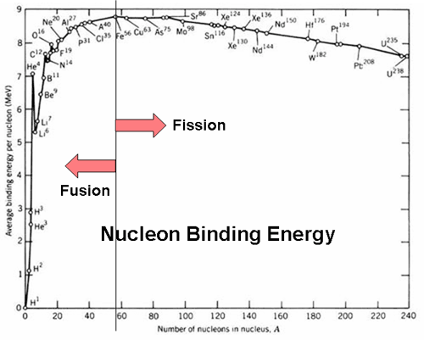
Fission is Trivial – Occurs Naturally / Needs Very Little Stimulus
Fusion on Earth Must Find Way to Overcome Electrostatic Repulsion
Fusion
→ + + repulsion
- 10-100 keV
- 10⁸⁻⁹ K/10⁶ bar
Fission (Sun-like)
Spontaneous
(~10¹² fiss./g/s Cf-252)
n capture (En)
Notes:
https://www.bing.com/images/search?view=detailV2&ccid=F%2fzZ1Lq8&id=6185B8BFA40F00AA49EDD8DD801FB168F3B94140&thid=OIP.F_zZ1Lq8d33iGTGmTmDKygHaF8&mediaurl=https%3a%2f%2fi.stack.imgur.com%2fPG3WB.gif&cdnurl=https%3a%2f%2fth.bing.com%2fth%2fid%2fR.17fcd9d4babc777de21931a64e60caca%3frik%3dQEG582ixH4Dd2A%26pid%3dImgRaw%26r%3d0%26sres%3d1%26sresct%3d1%26srh%3d799%26srw%3d997&exph=401&expw=500&q=binding+energy+of+nucleus&simid=608041149080213091&FORM=IRPRST&ck=4623038BB0C1372C909D77C0880AD918&selectedIndex=0&idpp=overlayview&ajaxhist=0&ajaxserp=0

Slide 10
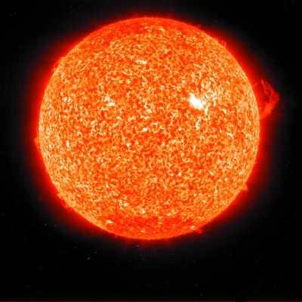
SUN ~2x10³⁰ kg (4*10²⁶ W ) – NATURAL GRAVITY DRIVEN INERTIAL CONFINED FUSION POWER – Spontaneous Fusion
865,000 miles
~ 17x10⁶ K; 2.5x10¹¹bar
~ 1% volume
~ 10⁵ kg/m³(10xPb)
~5,000 K
ENORMOUS (DIVINE) SIZE PERMITS GRAVITY DRIVEN SUPERCOMPRESSION FUSION
SL-26
10/19/05

Slide 11
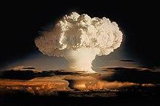
THERMO-NUCLEAR FUSION ENERGY PARADOX
Q >>> 1 – We Know How
If Explosive - Uncontrolled
-Enormous Damage Potential
Living on Edge of Catastrophe
Everyone’s Obligation
11/1/1952 Ivy Mike
(Atm.--Marshall Islands)
10.4MT TNT
Multi-$T Global Market if Continuous/Economic

Slide 12
TOWARDS CONTINUOUS/PULSED FUSION
3 Practical Reactions (< 10⁹K – 100 keV Plasma)
Aneutronic (Vastly Reduced Material Impact) but ..

Slide 13
Primary Fusion Fuel (D) is Virtually Infinite (1:5,000) Worldwide
10’
Lake Michigan
10’ = 15,000 y (Energy)
Secondary Fusion Fuels (³H & ³He) are Extremely Scarce
Current world supply of ³H < 20 kg; $1-3/Ci; 10,000 Ci/g → ~$20M/kg
1000 MWe Fission Reactor Produces: ~ 2-3 kg/y
1000 Mwe Fusion Reactor Requires: 100-200 kg/y → Must Self-Sustain Economically
Fortunately:
Known Technology; n + Li Reactions → Blanket Tech. Demo. Needed
³He Fuel for Aneutronic Fusion is Currently Impractical
Currently From: ³H → ³He + β +ν
Plentiful on Moon

Slide 14
KINETICS OF FUSION ARE CHALLENGING
(Need High Temp/Confinement – To Overcome Coulombic Repulsion)
D
-
T
1
0
-
2
4
D
-
D
Lawson’s Criterion
nτ > 2x10²⁰ s/m³ (D-T)
5x10²² s/m³ (D-D)
1
0
-
2
7
1
0
-
3
0
1
0
-
3
3
1
0
-
3
6
1
0
6
1
0
7
1
0
8
1
0
9
1
1
0
0
T
,
K
D-T is easiest: 100x D-D; 1000x D-He
Τ(D-He) / Τ(D-T) → ~ 10³
T_{D-He} → 10⁹ K vs 10⁸ K (T_{D-D})

Slide 15
Nuclear Fusion – Breakeven Definitions
Gain Factor (Q): = E_{f,t} / E_{i,t}
Scientific BE: Q = 1 **Attained Only by NIF 12/2021 **
Extrapolated BE: DD fusion gain x 100 = DT fusion gain
(for systems that work with D-D plasma)
Ignition: Q → Infinity (Sustained self-heating; NIF)
Engr. BE: Q for Self-Powered Electricity Gen. System
(Must take into account “All” input energy)
Commerce BE: Q when Operating Costs = Electric Revenue

Slide 16
MAIN APPROACHES TO THERMONUCLEAR FUSION POWER
Magnetic Plasma Confinement - Tokamak
Laser Inertial Confinement
Plasma Pinch
Hybrid Magnetized Target
Field Reversed Configuration
Stellarator
Bubble Implosion-Supercompression
Target Impact
Inertial Electrostatic Confinement

Slide 17
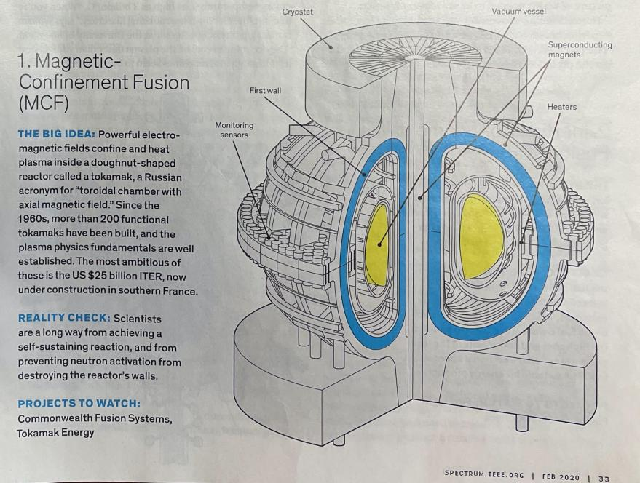
Magnetic Confinement Fusion – Tokamaks → ITER
Source: IEEE Spectrum, 2/2020
2022 (D-T Plasma): Record at JET
Q = 0.33; ~11+ MWt, for 5s →59 MJ

Slide 18
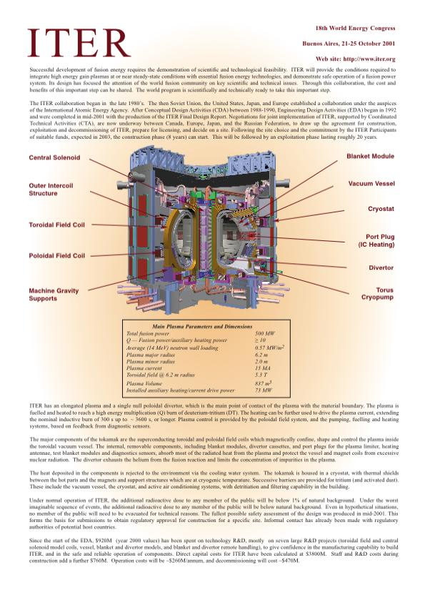
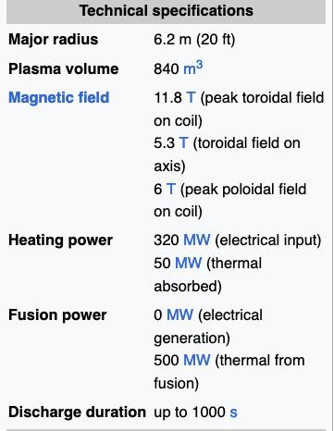
International Project – since 1985
Goal: Q = 10x Sci. break even
= 500MWt (Fusion)
------------------------
50 MWt (Absorbed)
However,
Qin = 320 MWe
Qout,t = 500 MWt
Assume 30% conv. efficiency:
Qe (ITER) ~ 0.3*(500 – 320)
→ 54 MWe to Grid
~35x (PWR)

Slide 19
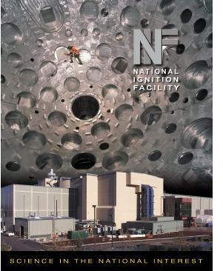
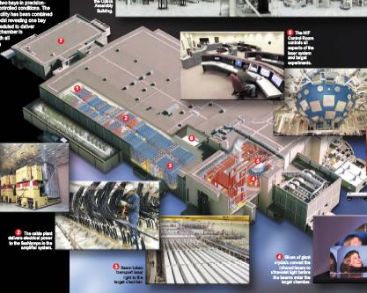
Inertial Confinement (Laser) Fusion - NIF
192 Laser Beams
~2 MJ/beam; Over 10⁻⁹s
> 5x10¹⁴ W (instantaneous)
On a mm scale pellet (< 1mg ³H)
→T ~2e8K; p > 10¹¹ bar
Fusion Yield (12/21) ~3.15MJ
Q of System → How Stated
E_{f}/E_{lb} = 1.5
E_{f}/E_{e,in} = 0.015

Slide 20
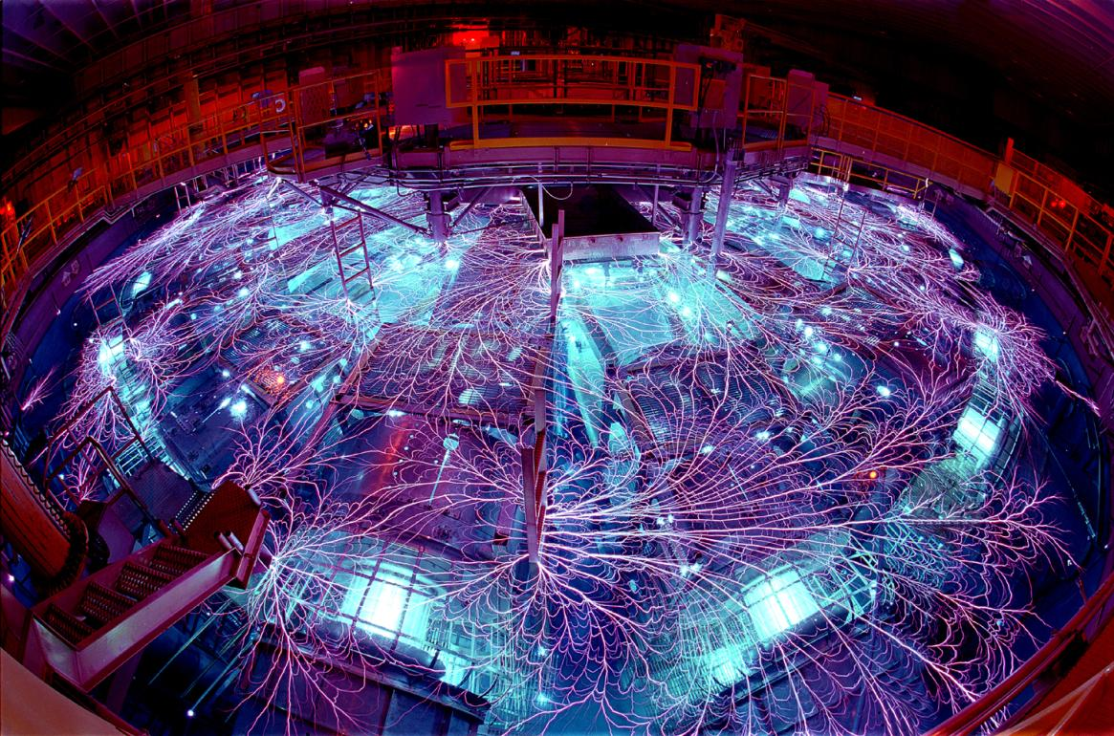
Z-Pinch (Pulsed Plasma Pinch Approach) - SNL
ZAP Fusion Energy

Slide 21
Real Goal: NTBT → Are we confident in our simulations
of legacy & new thermo-nuclear warheads?
→ Design a target to predict and then test it under fusion
“ignition” - extremes in p & T → nuke detonation
Attained “ignition” and confirmed simulations
→ Real audience? Our Adversaries, NOT Fusion Energy.

Slide 22
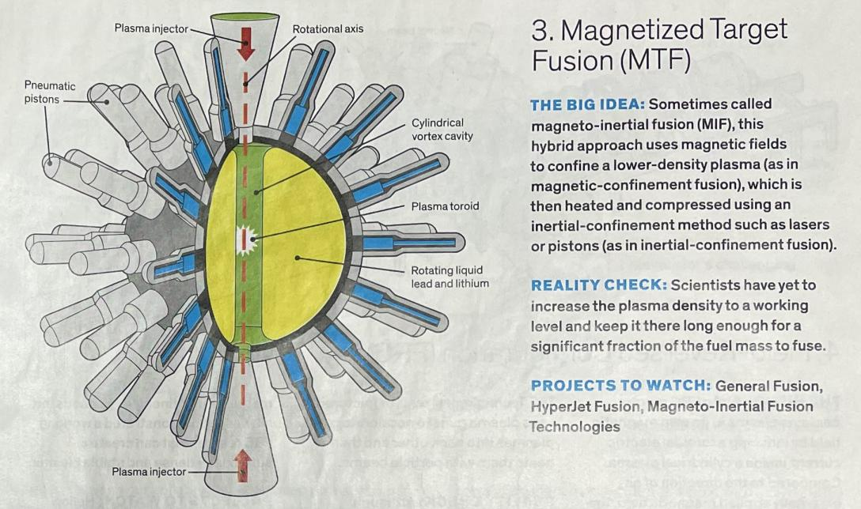
MTF - Hybrid Magneto + Piston / Shock Fusion
Source: IEEE Spectrum, 2/2020

Slide 23
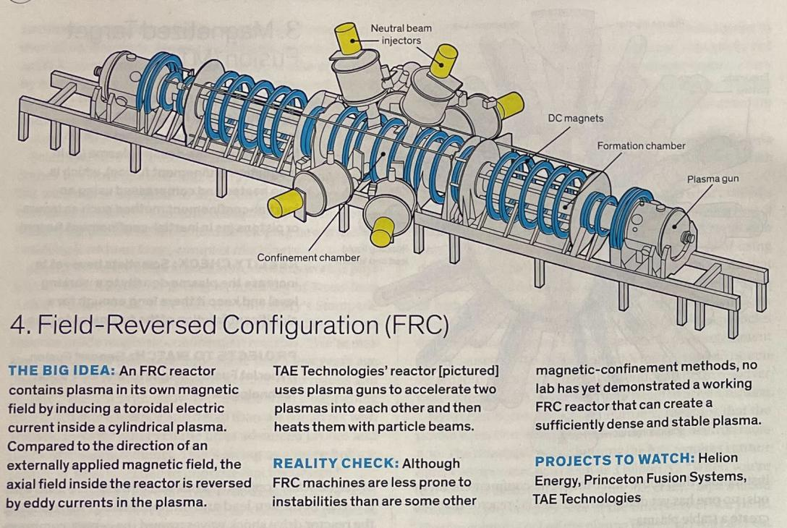
Field Reversed Config.: Toroidal Current → Mag.Field
Less instability prone
Source: IEEE Spectrum, 2/2020

Slide 24
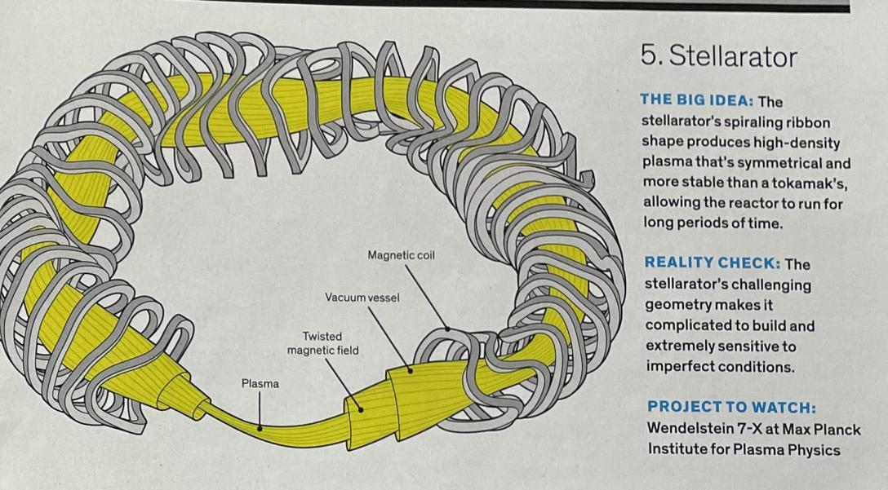
Stellarator – Spiral Tokamak → More Stable → Time

Slide 25
IEC – Inertial “Electrostatic” Confinement Fusion
In Wire Cages (DOE Labs; U.Wisc.; UIUC;…)
15 kV → Directly accelerate (D-T ions) to 15 keV (2x10⁸ K)
Source: U.Wisc.
Wikipedia
Key Physics / R&D Issues:
Core density high enough?
Heat flux on grids – matl. issues?
Direct fusion energy to electricity?
Scientific/Engr. Breakeven?
Potential for D-He aneutronic fusion potential?

Slide 26
Acoustically Driven
Imploding Bubble Supercompression
“Bubble Nuclear Fusion”

Slide 27
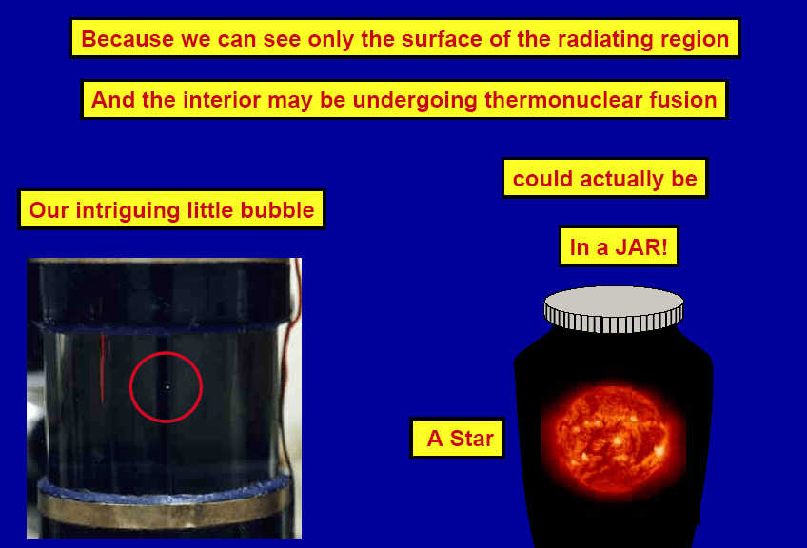
Sonoluminescence (~10⁶ K Plasma States Confirmed)

Slide 28

HOLLYWOOD TURNS TO SONOLUMINESCENCE POWER (1996)
TURNING FICTION TO REALITY ?

Slide 29
THE RACE BEGINS - 1999
– DARPA/DSO Director Larry Dubois in 1999-2000
Initiates Effort to Assess for SL-based Inertial Fusion
Group A (UCLA/UIUC/UW/..)
Group B (ORNL, RPI, RAS, ORISE)
Group C (Yale,… - R. Apfel – ORNL supporter/soon after demise)

Slide 30
And Then

Slide 31
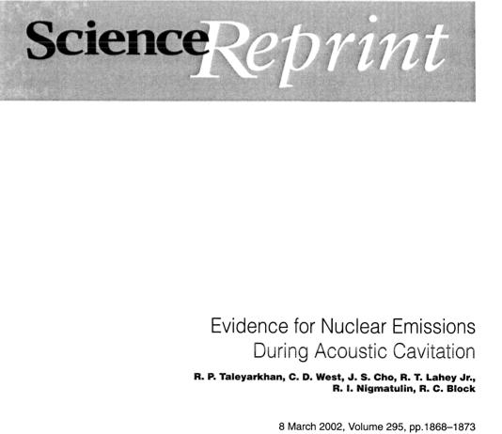
~5x10⁵ n/s; 2.45 MeV
~Time Correlated with SL Flash
~ 5x10⁵ Tritons/s
Continuous 8+h
P ~10¹¹ bar; T ~10⁹ K

Slide 32
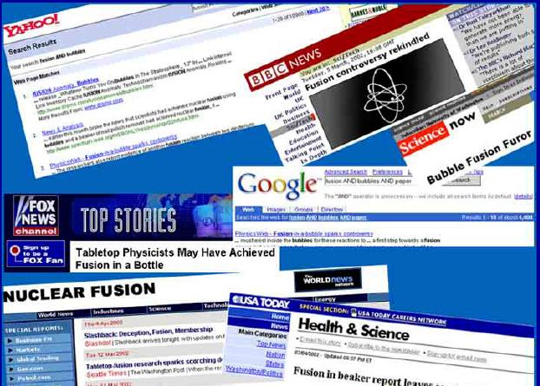
“ .. The Most Important Development Since the Dawn of the
Nuclear Age…” - London Times (3/2002)

Slide 33
SINCE circa 2000
FLURRY OF NEW (PRIVATE SECTOR) VENTURES
(~$6B+ - est.)

Slide 34
$2.6B

Slide 35
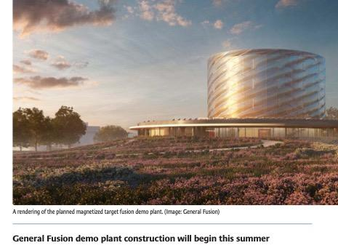
Nuclear News (March, 2023)
– General Fusion’s MTF Demo. Plant (2023 start) In U.K
Goals:
Build scaled system ~ 70% of commercial power plant
Sustained fusion operations at 10⁸ K
Demonstrate “feasibility” for viable electric power plant

Slide 36
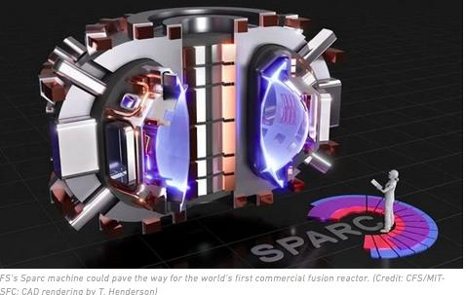
SPARC ($1.8B+) – Commonwealth Fusion Systems (MIT)
High Temp. Superconductors; 1/40 size of ITER → 12 Tesla
”Makes All the Difference – Economics/Timeline”-Sparc
Goal: First 50 MWt (Q=2) Tokamak Fusion Plant by ~2030

Slide 37
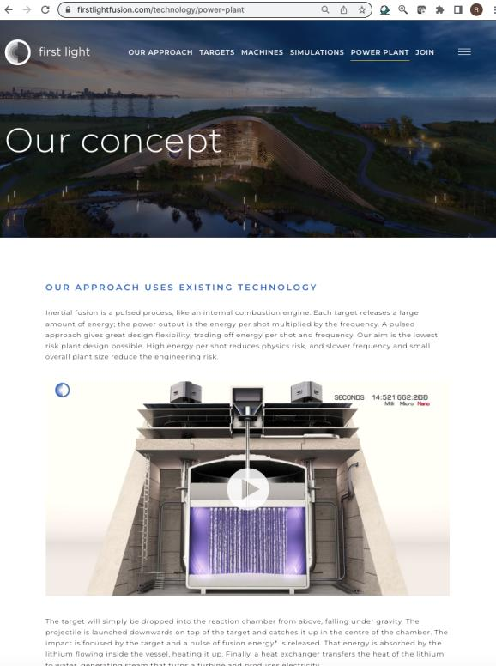
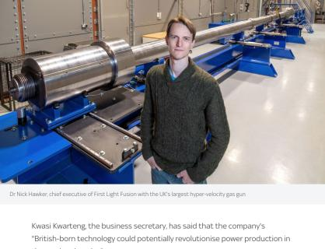
First Light (UK) – 70 km/s Capsule Impact, f =2 Hz
(Q>1 by 2027; 150 MWe)

Slide 38
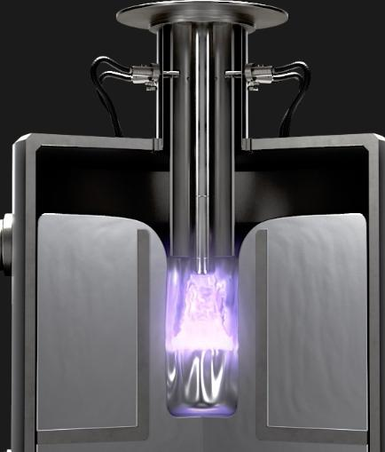
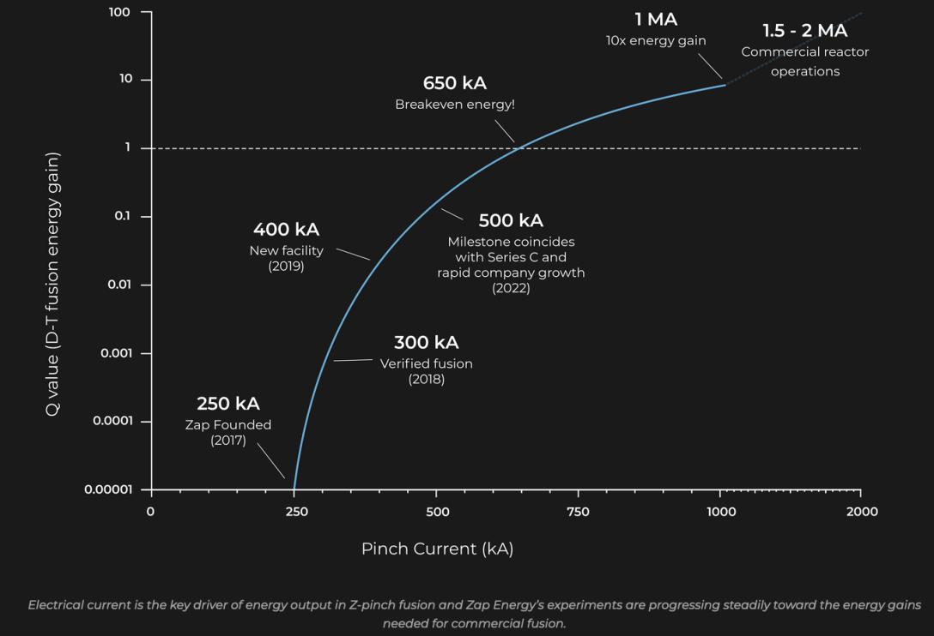
ZAP FUSION STARTUP (Sheared Flow Stabilized)

Slide 39
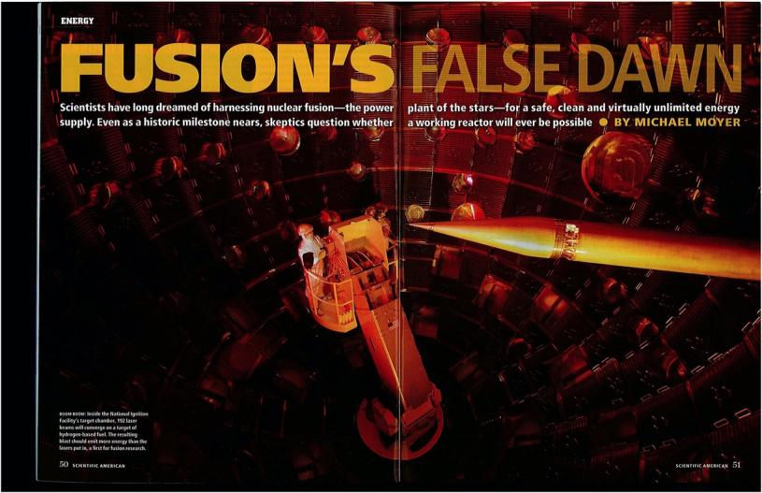
HERE COME THE SKEPTIC CHALLENGES
Scientific American, 2010

Slide 41
Fusion Power Reactors ??
Immediate Challenges
Only Thereafter:
(Q)_{engr} >> 1 ?
Competitive ($)?
NRC Regulations?
Siting/Licensing ?
Waste Handling?
Public Acceptance
First Wall Materials
→ Heat from 10⁸K Plasma
for 20-30 y
Neutron Embrittlement
Tritium Breeding
Reliability
Lasers (10⁵/d vs 5/d)
Plasma (Cont. vs 10 s)
Sci.Amer., 2010

Slide 42
Successful Fusion-Fission Hybrid System
Mo-99 Medical Isotope Production
SPECT IMAGING
50,000 / day (USA) - $15B/y
SHINE
(Subcritical Hybrid Intense Neutron Emitter)
4x10¹³ n/s (100 W, D-T Fusion Power)
n → Uranium Fission → Mo-99 Production

Slide 43
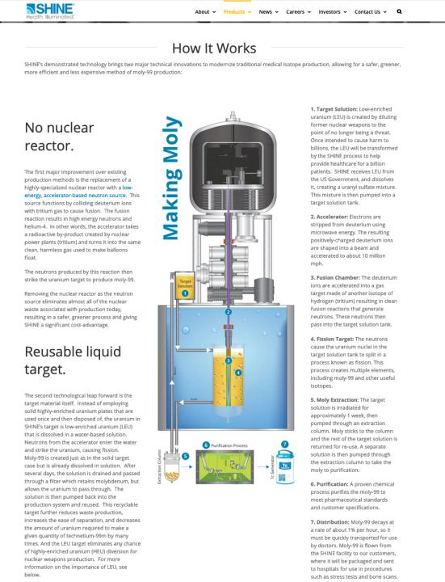
SHINE – Medical Isotopes
https://shinemed.com/products/

Slide 44
LIFE (Laser Inertial Fusion Engine) (Sci.Am - 2010)
Major Negative re: Fission Power
→ LWRs: Burn < 5% of U + Generate Long-Lived FPs/Pu/..
Major Opportunity
→ Hybrid (Fusion-Fission-Transmutation) Power System:
→ NIF neutrons Fission SNF → Power + Shortened Life FPs
“We can be competitive or cheaper than all other energy sources” –2010, Moses, NIF Director, LLNL
Challenged by Skeptics (Sci. American, 2010)
Single NIF (D-T) Capsule → $1M (Current) – each needs ~1 mg (³H).
Need to operate at 600 rpm → 90,000 targets/day → Precision Dropped
Cost Reduction Needed: From $1M to ~ $0.05
Tritium From Where?: → 50-100 kg/y (Not Addressed)

Slide 45
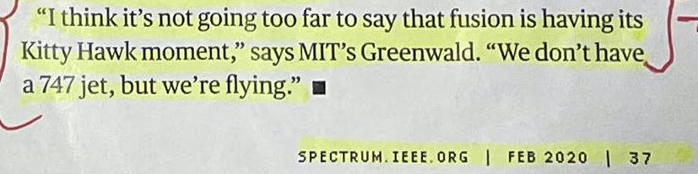
INTRIGUING CLAIM?
We Shall See
Thank You

Slide 46
IN SIMPLE TERMS – Improved Slingshot
BREAKTHROUGH TO ULTRA-Supercompression:
Rm/Ro ~ 100,000 (Earth to Sun) vs 10 (Earth to Moon)
Implode with 10¹² [= (10⁵/10)³ ]times greater energy in the bank
Earth
Sun

Slide 47
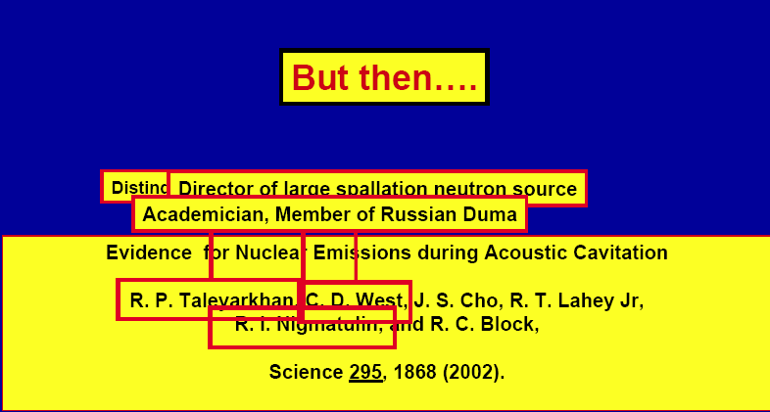
And

Slide 48
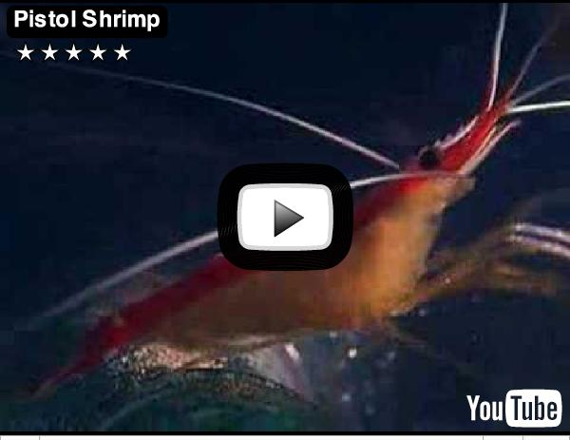
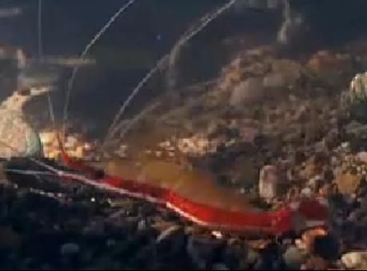
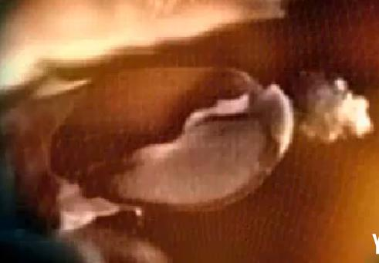

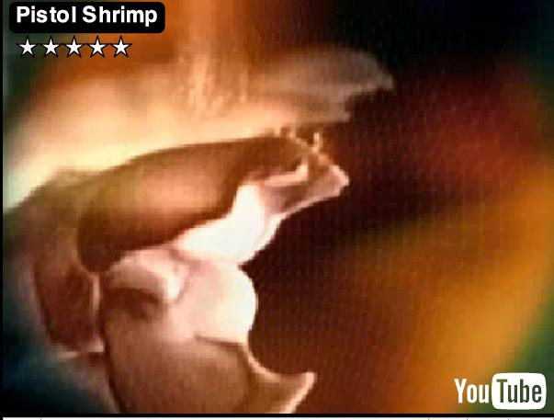

HUNTING UNDERWATER WITH BUBBLE (SUN) POWER
LUNCH

