Slide 1

Resilient Energy to Meet Growing Demand in Developing Countries
Dr. Joseph D. Smith, Professor
Missouri University of Science and Technology, USA, smithjose@mst.edu
1 April 2023
Notes:
Feel free to add your organization/company logo or use a briefing template

Slide 2
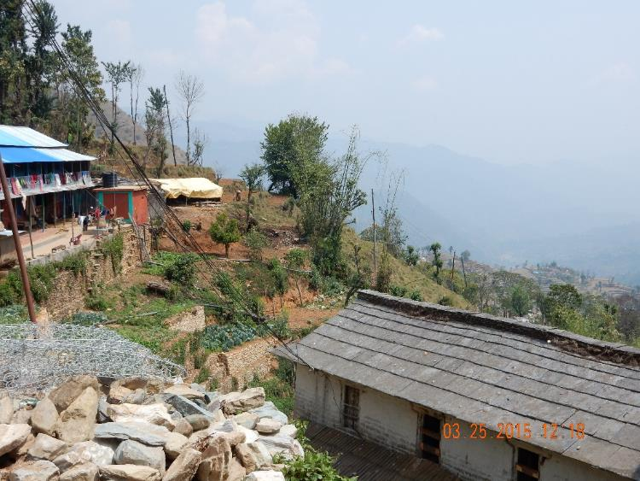
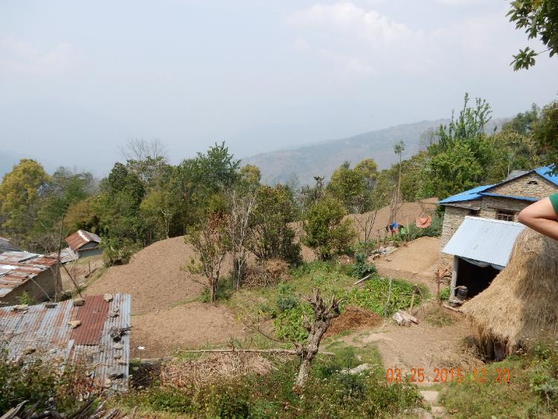
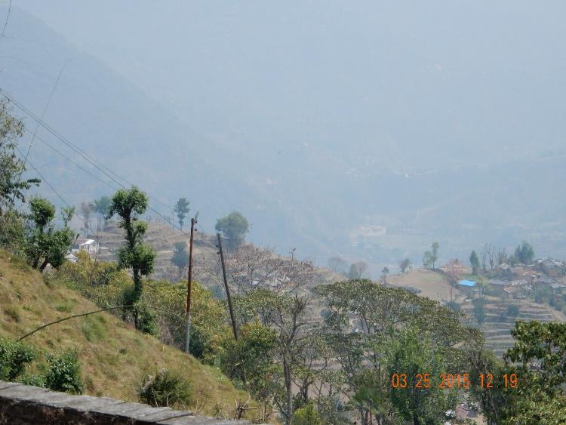
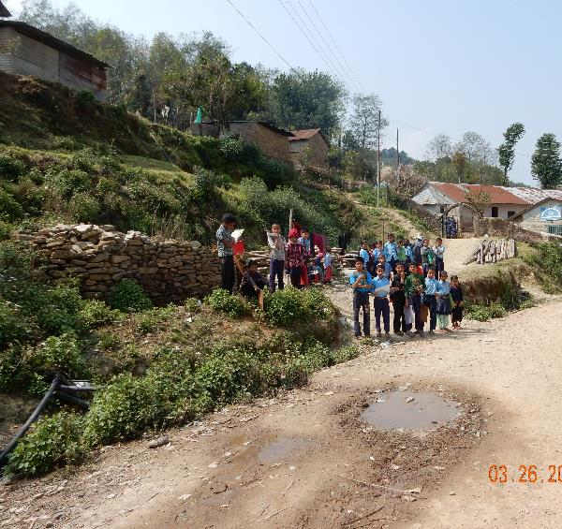

Over 1.5 Billion people don’t have access to electricity
Kakinada, Nepal

Slide 3
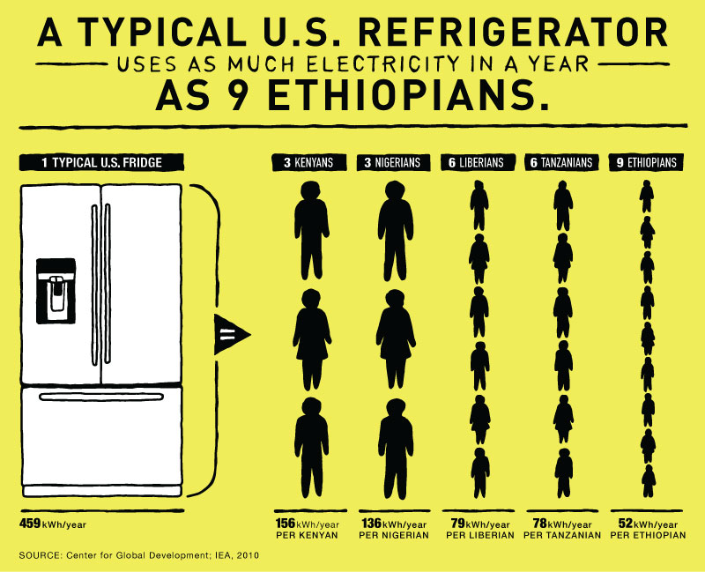
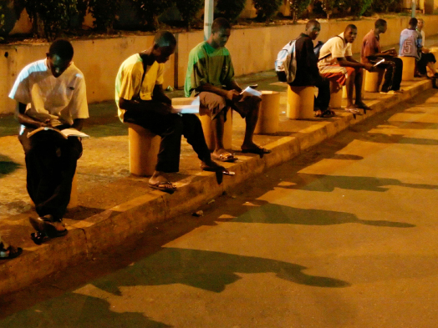
Energy Equity
1.3 billion people lack access to electricity (85% in rural areas)
Rich countries use much more electric power for computers, refrigerators, and energy-hungry health care than developing countries!
World’s energy demand increase <50% by 2040
As more energy produced; more CO2 is released by dirty fuels burned in low efficient systems
Economic development of poorest countries restricted by polices made by richest countries!
New energy for developing countries must be affordable and clean!
Rich countries must provide clean efficient energy systems to developing countries–can’t deny access to services only rich countries enjoy!
Lack of electricity means no refrigeration for pharmaceuticals and increased food born illness
Lack of electricity means students must study under streetlights

Slide 4
Access to Clean Cooking Fuel:
~2.8 billion people rely on traditional biomass for cooking
Air pollution from inefficient stoves cause more deaths/day
than malaria + tuberculosis + HIV/AIDS
Access to clean cooking energy impacts Women 2x more
than men (UN, 2010)
UN Sustainable Goal 7: Universal access to modern fuels by 2030, both to mitigate the household health effects of ‘dirty’ fuel use (wood, charcoal, dung, kerosene) from household air pollution (HAP) and to enable them to develop productive, educational and self-fulfilling opportunities for women and girls foregone due to the labor required to obtain and use such fuels
Source: Tanaka, N., Kjorven, O., Yumkella, K.K., “Energy Poverty; How to make modern energy access universal?”
Special early excerpt of the Energy Outlook 2010 for UN General Assembly on Millennium Development Goals, September (2010).

Slide 5
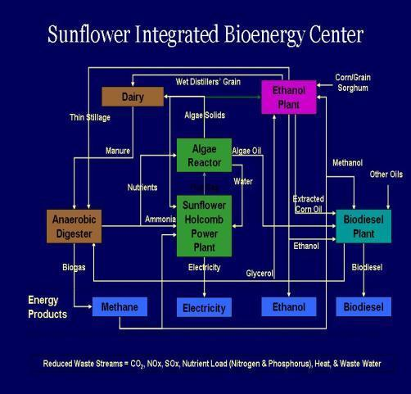
Hybrid Energy with distributed generation in local
Hybrid Systems combine local sources of Fossil + Renewable energy sources
U.S. Example: Integrated Energy Center
  Sunflower, Kansas
  Uses multiple energy sources
  Generates multiple energy products
  Overall efficiency increased
  Creates local jobs in rural areas
  Manufacturing “value-added” products
Energy focus on:
  Integrated wind/solar with fossil
  Dynamic System optimization
Notes:
In this Hybrid Energy System (currently operating in Kansas by Sunflower energy), the concept is easier to illustrate.
Consider “Methane Production”:
Produced in digester (could be generated via bio-gasifier or molten salt gasifier)
Can burn it to generate electricity,
Can use it to produce Methanol, or
Can use it to produce ethanol.
This process can be studied and optimized to reduce cost and increase efficiency and uses regional energy resources to produce multiple products.

Slide 6
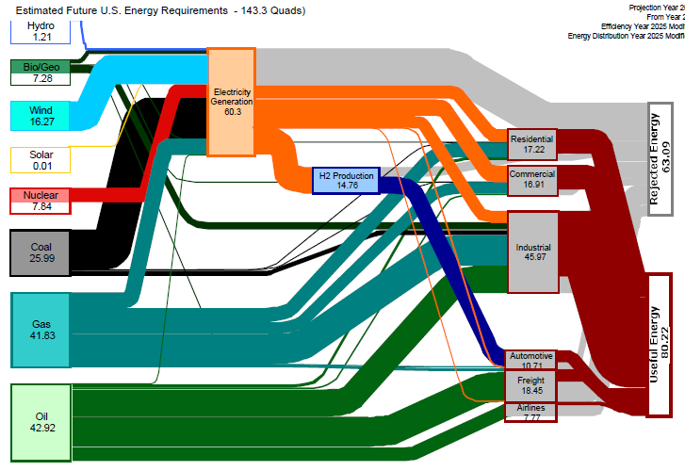
US Energy Use – 2050 (Est. 143.3 Quads)
Largest increased energy demand from developing countries!
Hydro
Geothermal
Energy Efficiency: 80.22/143.3 = 55.98%
+ Biomass
Wind
63.1 Quads
Lost Work
Solar
Nuclear
How will transportation be powered?
Energy Efficiency: ?
Coal
Fossil energy will remain our largest source of energy – what can we do to reduce impact on the climate?
Natural Gas
80.22 Quads
Useful Work
Petroleum
Can we become independent of crude oil?
Leighty, B., “Energy Storage with Anhydrous Ammonia: Comparison with other Energy Storage,” Ammonia: The Key to US Energy Independence, 29 – 30 September, Minneapolis, MN (2008)

Slide 7
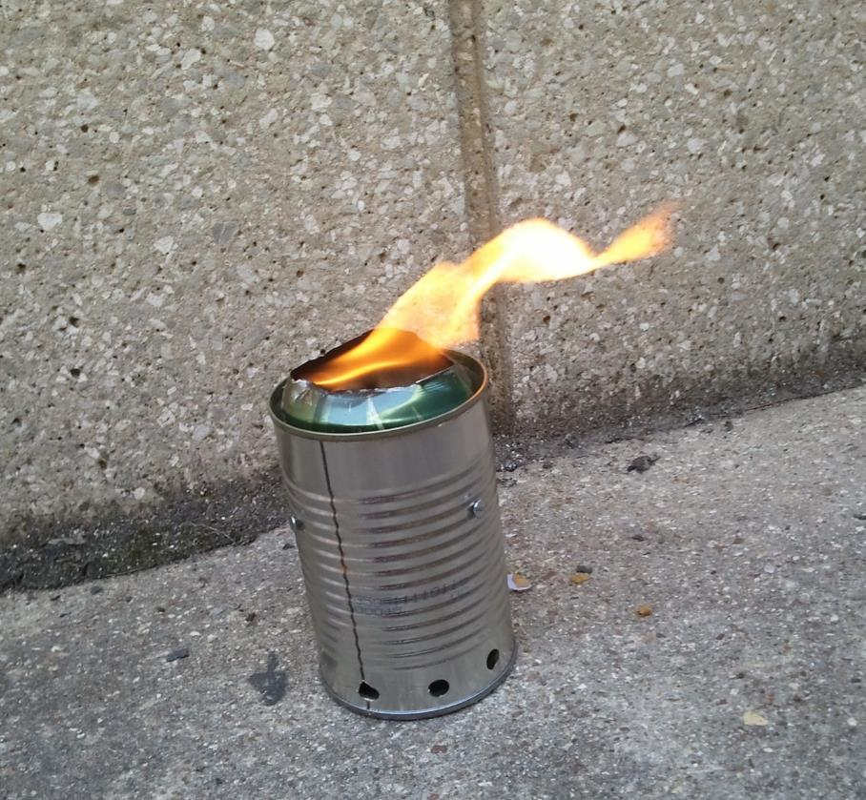
Welcome
See demonstration at: http://www.youtube.com/watch?v=XCsswquQ6H8&feature=related
Notes:
You have 30 minutes for your presentation including questions – please stay on schedule – we have many speakers scheduled for the day.
Thank You!

