Slide 1


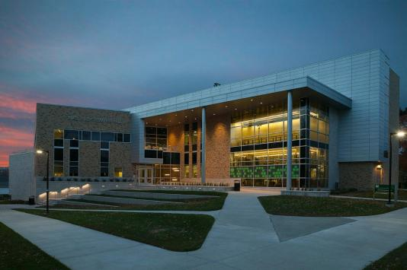
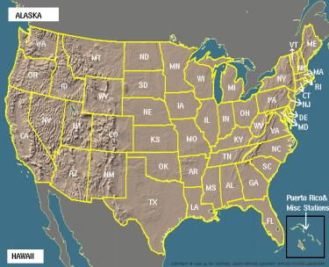
Multiphase Flows & Reactors Engineering & Education Laboratory (mFReel)
Alternative, Conventional, & Renewable Energy
Selected Recent Advances
MISSOURI
S&T
University of
Science & Technology
Dr. Muthanna H. Al-Dahhan
Wayne and Gayle Endowed Chair in Energy
Curators’ Distinguished Professor of Chemical & Biochemical Engineering and of Nuclear Engineering
College of Engineering and Computing Distinguished Professor
Affiliated Professor, Mohammed VI Poly Technic Univ. (UM6P)
Former Department chair (Jan. 2009 – June 2019)
AIChE Fellow
Missouri S&T
Laufer Energy Symposium
March 30 – April 1, 2023
Rolla
Bertelsmeyer Hall
Linda and Bipin Doshi Department of Chemical and Biochemical Engineering
Notes:
1

Slide 2
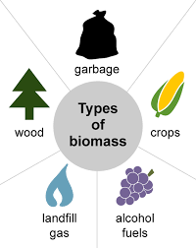
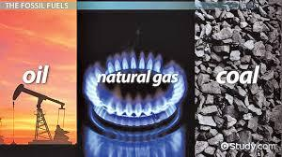
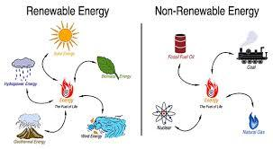
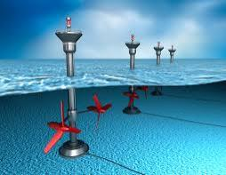
It was a Swedish scientist named Svante Arrhenius who was the first to state that the use of fossil fuel could contribute to global warming, way back in 1896.
Different Sources of Alternative Energy
Advantages
Lower emissions, fuel prices??? and the reduction of pollution
Selected Examples of Alternative Energy Sources
Hydrogen gas
Tidal Energy
(4) Biomass Energy
Wind Energy
Geothermal Power
(2) Natural Gas
(3) Biofuels
Wave Energy
Hydroelectric Energy
(1) Nuclear Power
Solar Power
(5) Fossil - Conventional Energy
We Have Studied
Fossil Energy

Slide 3
Multiphase Reactors
& Multiphase Flows Systems
Multi-scale in Length and Time
Energy
Biomass, Coal, Gas Petroleum, Solar,
Fuel Cells, Hydrogen,
Nuclear
G
Synthesis & Natural Gas Conversion
,and
Petrochemical Processing
HDS, HDN, HDM, Dewaxing Fuels, Aromatics, Olefins,..
L
MeOh, DME, MTBE, Parafins, Olefins, Higher alcohols,….
S
S
G
Polymerization,
Polymer
Processing
Bulk
Chemicals
G
G
L
Aldehydes, Alcohols, Amines, Acids, Esters, LAB’s, Inorg Acids, …
Polycarbonates, PPO, Polyolefins, Special plastics,…
S
G
L
L
Fine Chemicals, Pharmaceuticals, Materials
Wastes Treatment,
Environmental
Remediation
G
Biomass
Conversion,
Biorefinery,
Bioprocessing
S
G
Ag Chem, Dyes, Fragrances, Flavors, Nutraceuticals,….
De-Nox, De-Sox, HCFC’s, DPA, “Green” Processes,…..
Syngas, Methanol, Ethanol, Oils, High Value Added Products,…
G
L+S
Automotive Industry
CREL
Notes:
S4. Multiphase reactors are important in all process and energy industries, as clearly indicated on the slide. The wide spread importance and the fact that CREL made experimental advances that enabled it to better understand these reactors determined the focus of CREL research the past 10-15 years. It was reactor scale quantification of phenomena in various multiphase reactors.

Slide 4
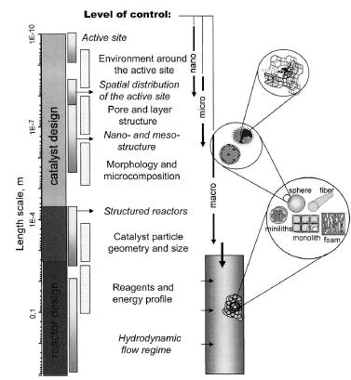
Temporal and Length Scales
1 h
Column
Dynamics
and Perturbations
1 min
Tray
and
packed
column
hydrodynamics
Intraparticle
Diffusion
Time scale
1 s
Film Diffusion
Gel diffusion
1 ms
1 nm
1 mm
1 mm
1 m
Length scale
Centi,G., Catal.Today, 79-80, (2003)
Dudukovic, 2008

Slide 5
Advancing the Knowledge and Understanding of the Interplay Phenomena of Multi-scale and Multiphase Flow, Reactors and Processes
Education & Training
Cleaner Processes
Processes Development & Advancement
Outreaching to Industry and R&D Institutions
Integrated Studies
Implemented Synergistic Approach
Transport
(Fluid Mechanics, Heat, Mass)
Kinetics/Catalyst Development
Sophisticated Measurement Techniques
Experimental/Labs
Facilities
Modeling/Computing
CFD
The Outcomes:
i) Advancing the knowledge, understanding, quantifying internal effects, and applications
ii) Enabling proper modeling, design, scale-up, operation and performance
iii) Enabling process intensification and modularization
iv) Reliably benchmarking and validating models and CFD
v) Minimizing/Eliminating the wastes at the source due the achieved advancement
vi) Well trained students, engineers and future leaders

Slide 6
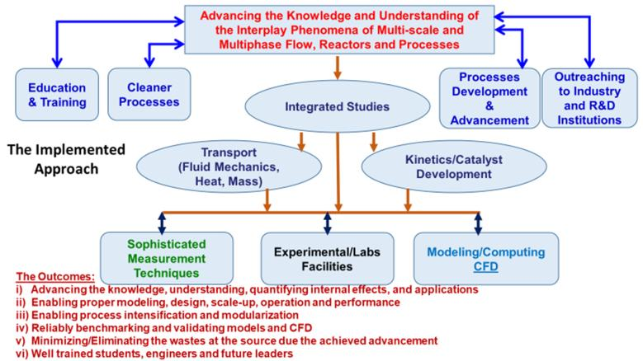
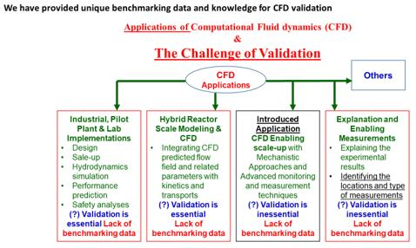
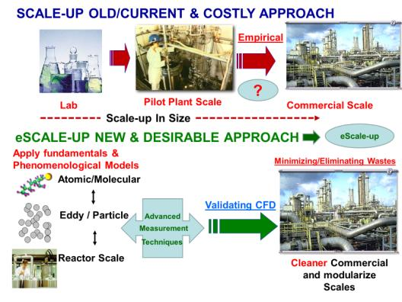
Our Approach Of Studies
Ref. Jamal Chaouki – ePilot Plant

Slide 7
Multiphase
&
Multi-scale Flows, Reactors
&
Processes
Multiphase Flows & Reactors Engineering & Education Laboratory (mFReel)
Sustainable Energy, Water, Products & Environment
Professor M. Al-Dahhan
Development & Implementation of Advanced Techniques and Facilities
Radioisotopes & Non-Radioisotope Techniques & Facilities
MRPT, RPT, DSCT, CT, NGD, ECT, Optical Probes, Mass Transfer, Heat Transfer, Gas Dynamics & RTD, Particle/liquid RTD, Conductivity probes, Hot Wire, Room conditions multiphase flow facilities, High pressure and temperature multiphase flow facilities, Kinetics measurement facilities, Mini-Micro reactors, Online measurements, Analytical equipment, etc.
Multi-Scale Modeling & Quantification of Kinetic-transport Interactions
Mechanistic Reactor Scale Models, Apparent and Intrinsic Kinetic Models, ANN, CFD and Closures Evaluation and Validation, Integration of Mechanistic models and CFD, etc.
Green & Sustainable Processes
Multiphase Flow systems
BUBBLE COLUMN (GAS-LIQUID INTERACTION)
SLURRY BUBBLE COLUMN (GAS-LIQUID-FINE SOLIDS INTERACTION)
GAS-SOLID FLUIDIZATION & CIRCULATING FLUIDIZATION (GAS-SOLIDS INTERACTION)
LIQUID-SOLID RISER AND FLUIDIZATION (LIQUID-SOLIDS INTERACTION)
EBULLATED BED (GAS-LIQUID-CATALYST SOLIDS INTERACTION)
PACKED BEDS AND STRUCTURED PACKING/MONOLITH BEDS (GAS-SOLIDS, LIQUID-SOLIDS AND GAS-LIQUID-SOLIDS INTERACTIONS)
STIRRED TANKS (GAS-LIQUID, LIQUID-SOLIDS AND GAS-LIQUID-SOLIDS INTERACTIONS)
AIRLIFT COLUMNS (GAS-LIQUID AND GAS-LIUQID-SOLIDS INTERACTIONS)
BIOREACTORS, DIGESTERS
ETC.
Energy, Biomass,
Coal, Gas, Oil, Solar,
Nuclear, Fuel Cells
Syn gas, Natural &
Biogas Conversion
Petroleum Refining
And Petrochemical
Processing
Biofuel-Bioprocesses, Anaerobic Digestion,
Biotechnology
Bio-refinery and its integration
Bulk Chemicals
Polymerization,
Polymer
Processing
Sustainable Construction Materials
Fine Chemicals,
Pharmaceuticals
Water Wastewater Treatment,
Environmental
Remediation, Benign Processes
Biomass
Conversion
Notes:
7
S4. Multiphase reactors are important in all process and energy industries, as clearly indicated on the slide. The wide spread importance and the fact that CREL made experimental advances that enabled it to better understand these reactors determined the focus of CREL research the past 10-15 years. It was reactor scale quantification of phenomena in various multiphase reactors.

Slide 8
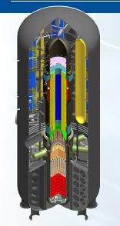
Multiphase Flows & Reactors Engineering & Education Laboratory (mFReel)
Sustainable Energy, Water, Products & Environment
Professor M. Al-Dahhan
Development & Implementation of Advanced Techniques and Facilities
MRPT, RPT, DSCT, CT, NGD, ECT, Optical Probes, Mass Transfer, Heat Transfer, Gas Dynamics & RTD, Particle/liquid RTD, Conductivity probes, multiphase flow facilities, High pressure and temperature multiphase flow facilities, Kinetics measurement facilities, Mini-Micro reactors, Online measurements, Analytical equipment, etc.
Multi-Scale Modeling & Quantification of transports and Kinetic Interactions
Mechanistic Reactor Scale Models, Apparent and Intrinsic Kinetic Models, ANN, CFD and Closures Evaluation and Validation, Integration of Mechanistic models and CFD, optimization, etc.
Nuclear Energy
Thermal-Hydraulic
4th Generation Nuclear Energy
Pebble beds
Prismatic Beds
TRISO Nuclear Fuels
Micronuclear Reactors
Other Nuclear Reactor Cores
Nuclear Energy
4th Generation Nuclear Energy
Solids Dynamics
Gas Dynamics and Dispersion
Bed Structure
Heat Transfer
Upset conditions
Small Modular Reactor (SMR)
SMR & 3th Generation Nuclear Energy - LWR
3D/2D Liquid Flow Field and Turbulence
Bubble Dynamics
Bed (Bubble/Gas I Liquid) Structure
3D/2D Phase Distribution
Heat Transfer
Interaction of bubbles and Heat Transfer
Upset conditions
3th Generation Nuclear Energy - LWR
PWR
LWR
Shielding quantification, adsorption, Graphite Oxidation
Notes:
S4. Multiphase reactors are important in all process and energy industries, as clearly indicated on the slide. The wide spread importance and the fact that CREL made experimental advances that enabled it to better understand these reactors determined the focus of CREL research the past 10-15 years. It was reactor scale quantification of phenomena in various multiphase reactors.

Slide 9
Nuclear Energy
High Temperature Gas Cooled Reactors – 4th generation Nuclear Energy
Pebble Beds (Vaibhav Khane, Abdulrahman Abdulmohsin, Fadha Ahmed, Muhana Al-Shimari, UG Students)
New Project – Pebble Bed Tagging (Oct. 1, 2020, for 3 years, $800,000)
Prismatic Blocks (Mahmoud Taha, Ibrahim Said, Sulaiman Al-Shahri, UG Students)
      New Project – Micronuclear Reactors (2 PhD students, UG Students
      Oct. 1, 2021, for 3 years, $800,000)
SMR & LWR (Saud Al-Dawood, UG Students)
TRISO Nuclear Fuel Particles Manufacturing (Shrekanta Aradhya, Neven Ali, Thaar Al-Juwayie, UG Students)
Total Funding - ($5.5M – DOE, Industry, Missouri S&T, International Governments)
Collaborators:
Oak Ridge National Laboratory
Idaho National Laboratory
University of Missouri – Columbia
North Carolina State University
University of Illinois – Urbana- Champaign
Oregon State University
Stony Brook University – New York
Industry (Areva, Framatom, X-Energy)

Slide 10
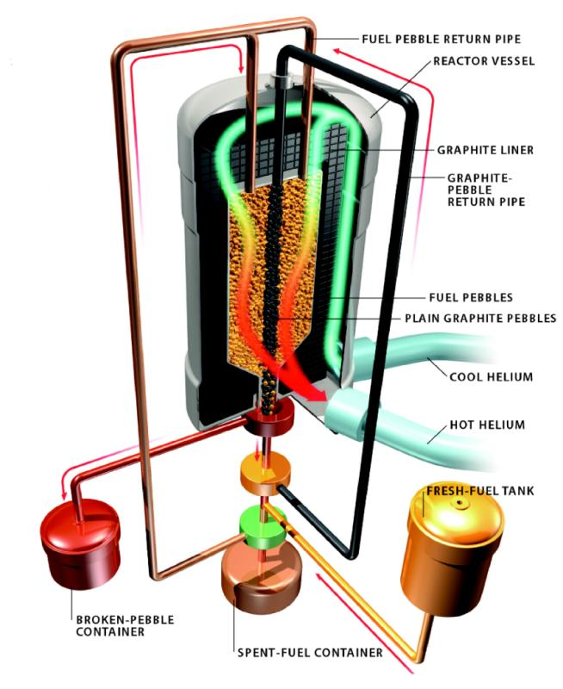
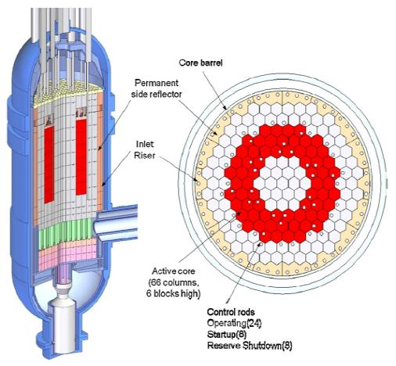
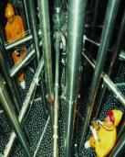
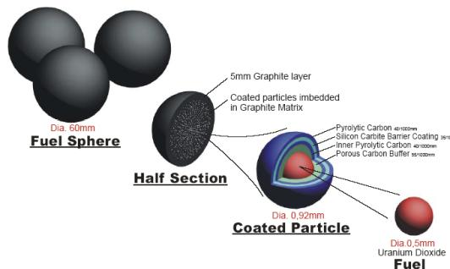
Pebble Bed Reactors (PBRs)
($5.2M – DOE)
Prismatic Modular Reactor (PMRs)
Upper plenum
GAS COOLED-He
Core
~ 7 MPa and 120 kg/s
(100% power)
Pebble Bed
Core
~ 450-500 ºC
Prismatic Block
Lower plenum
~ 900 ºC
TRISO Nuclear Fuel Particles
~ 0.9 mm diameter
~ 11,000 in every pebble
~10⁹ microspheres in core
TRISO acts as a pressure vessel

Slide 11
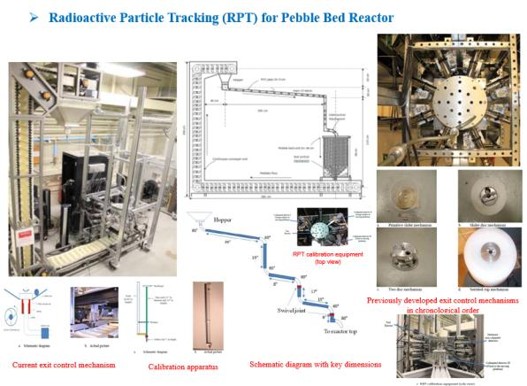
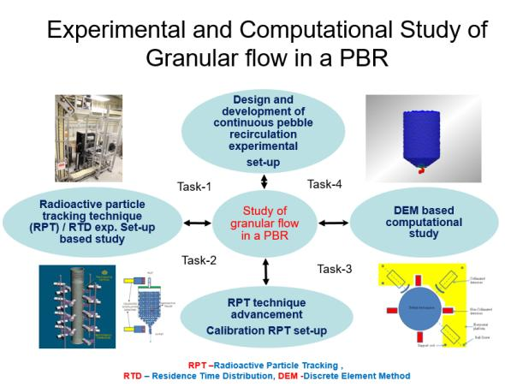

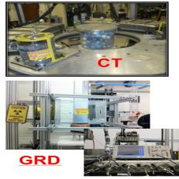
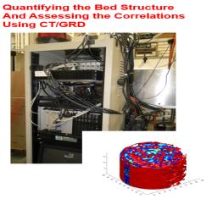
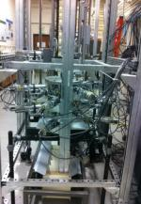
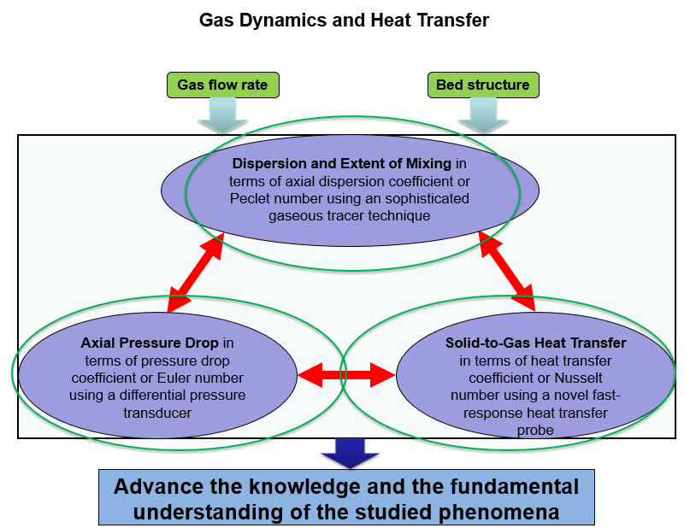
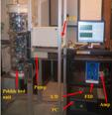
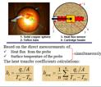
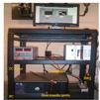
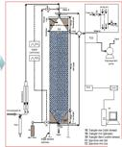
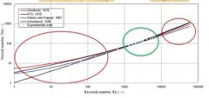
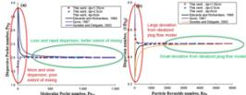
Pebble Bed Nuclear Reactors Advancement on Thermal Hydraulic
CT
Gas dynamic experimental setup

Slide 12
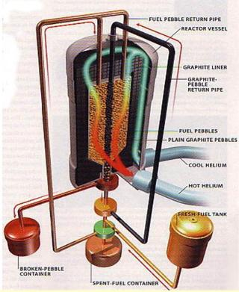
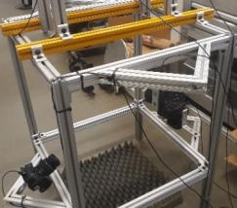
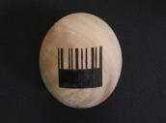
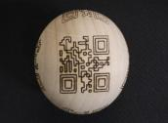


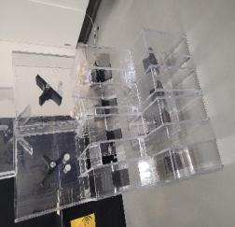
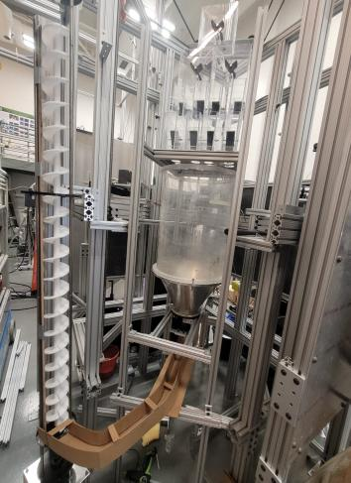
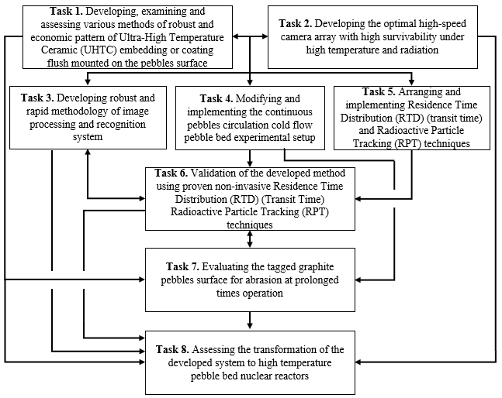
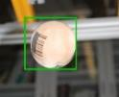
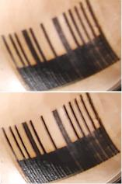
Robust Bullet-Time Tagging and Tracking System Based on Computer Vision for Individual Ex-Core TRISO-fueled pebble identification
(Started October 1, 2020 – 3 Years, $800,000)
New Project
Progress
Postnet barcode
QR barcode
Camera array
Random shapes
Random pattern
Tasks
Inlet column distributor
Barcode detection for falling pebble
(a)
(b)
Deblurring results: (a) original blurry patterns, (b) deblurred patterns
Experimental setup

Slide 13
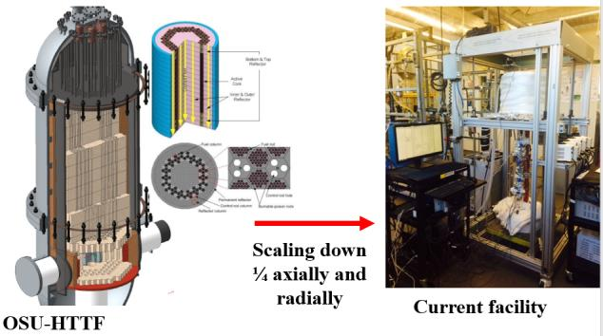
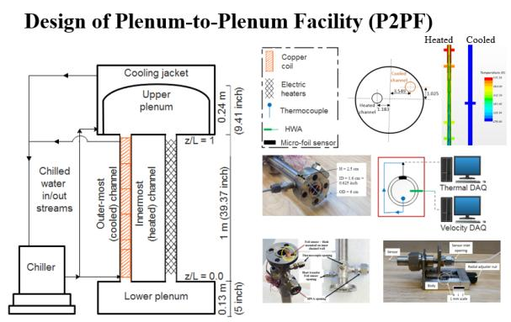
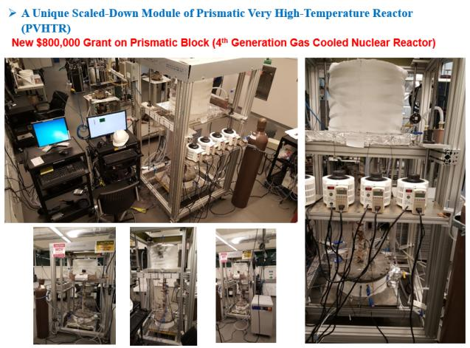
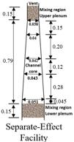
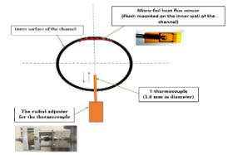
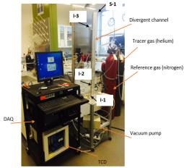
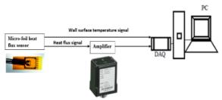
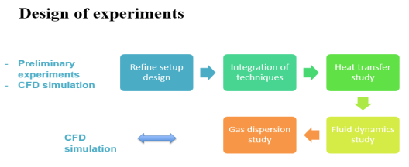
Prismatic Block Reactors Advancement on Thermal Hydraulic of natural convection
Under Upset Conditions
HWA

Slide 14
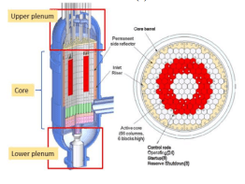
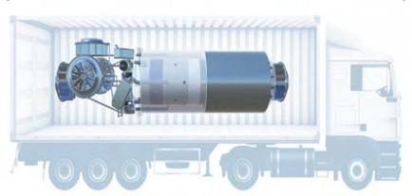
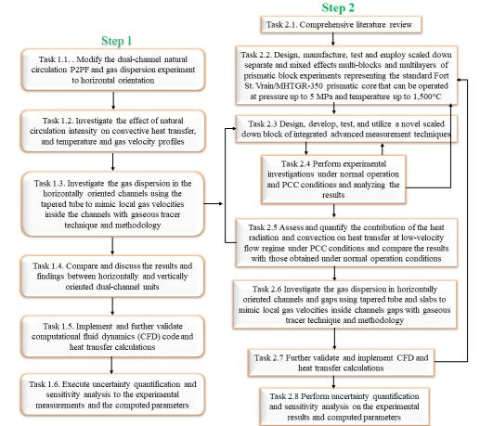
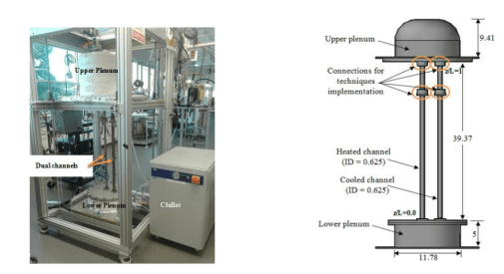
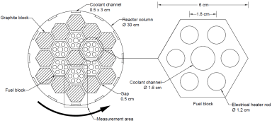
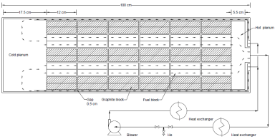
Thermal Hydraulics Investigation of Horizontally Orientated Layout Micro HTGRs Under Normal Operation and PCC Conditions Using Integrated Advanced Measurement Techniques
(October 1, 2021, for 3 Years, $800,000)
New Project
Figure 4 Schematic of scaled down micro prismatic reactor unit

Slide 15








Advancing TRISO Fuel Particles Manufacturing in Gas-Solid Spouted Beds
CT
Optical Probe
RPT

Slide 16


Small Modular Nuclear Reactors (SMRs) and Light Water Reactors (LWRs)
Proposed High Pressure and Temerature 5x5 Rod Assembly Experimental Set-up of the Core Representing SMR and LWR
Current 5x5 Rod Assembly Experimental Set-up of the Core in Our Laboratory

Slide 17
Natural Gas – To – Liquid Fuels & Chemicals (GTL) (Over $6M – DOE (US Government) & US and International Industry, Missouri S&T, International Governments) (Coal-to-Liquid (CTL), Biomass-To-Liquid (BTL)
Fisher-Tropsch (FT) – GTL (Nick Rados, Ashfaq Kheikh, Lu Han, Wu Chaentiang,, B.C. Ong, Puneet Gupta, Ahmed Youssef, Mohamed Ezat, Mohamed Al-Mesfer, Abbas Sultan, Laith Sabri, Ahmed Jasim, Hayder Al-Nasri, Omar Yahya, and others)
  Collaborators & Sponsors: DOE, Sasol (South Africa), Eni (Italy), Statoil (Norway), ConocoPhillips (Phillips 66) (USA), Johnson Matthew (UK), Air Products and Chemicals (USA), Exxon Mobile (USA), Chevron (USA)
Petroleum Hydrotreating (Industry, KISR, Kuwait, Chevron, Idemitsu)
Moving Bed (Vineet Alexander, Ali Toukan, Binbin Qi, Sebastian Uribe)
Trickle Bed (Khairul Salih, Fitri Abdulrahman, Mohamed Al-Ani, Binbin Qi, Sebastian Uribe
Upflow Packed Bed (Khalid Al-Jobori, Youssef Yatimi)
Biofuels (~ $1M – Department of Agriculture US Government, Almeria University, Spain, Missouri S&T, US and International Industry (Genencor, Center Ethanol, LLC, ADM, DSM), International Governments)
Microalgae (Huping Luo, Aastha Ojha, Laith Sabri, Abbas Sultan), Collaborators: Almeria University, Spain, DSM
Bioethanol (Bia Henriques), Collaborators: Eastren Reginol Research Center, Center Ethanol
Hydrogenation of Glycerin from Biodiesel (Consultations – Al-Dahhan), ADM
Biomass for Energy (Over $2.2M – DOE (US Government) & US Industry)
Anaerobic Digestion (Rebecca Hoffman, Mehul Vesvikar, Rajneesh Varma, Khursheed Karim), Collaborators: Oak Ridge National Laboratory, Iowa Energy Center
Fisher-Tropsch (FT) – BTL (See FT above)
Gasification (MS Student, Rahman Abdulmohsin), Collaborators: Mike Judd (Synsel)
Thermal Efficiency and Mass Transfer Enhancement Using Nanofluids
Thermal Efficiency and Desalination Enhancement Using Nanofluids (Nasser Zouli)
Thermal Efficiency quantified using CFD (Sebastian Uribe and Nasser Zouli)
Water- Energy Nexus: Wastewater & Water Treatment
Removing oil droplets from synthesis produced water using engineered membrane (Daches)
Rrecovering/Removing heavy metals and hydrocarbons from wastewater/water (Sawsan Mohamed, Qusay Al-obaidi, Faris Al-Ani, Amer Daham

Slide 18






Natural Gas, Biomass, Coal
Over $6M – DOE & Industry
Syngas
H₂/CO

Slide 19







GTL/CTL/BTL for Fuels and Chemicals
Bubble/Slurry Bubble Columns

Slide 20









FT & Hydrogenation of Glycerin – Biodiesel byproduct
Two Phase Flow Packed Bed For Wide Range in Industrial Applications
Selected Summary
@ Glance

Slide 21











Phase and Flow Distributions of Oil Hydrotreater Moving Bed Reactor (MBR) Using Advanced Measurement Techniques
KISR, Kuwait, Chevron, USA, Idemitsu Kosan Co.,Ltd., Japan (2012-2020), ~$1.25 Million
GAS/Liquid TRACER SYSTEMS
S
I-Injection Point
S-sampling Point
CT
I3
CT
Water
Pump
Gas and
Liquid
separator
S
Air
pump
A/D
amp
TCD
I2
I1
Probe dimension used in two-point optical probe experiment, the distance between two tips is 1mm

Slide 22









Studying Oil Hydrotreater Up-flow Packed Bed Reactor Using Advanced Measurement Techniques
Plenum design
Optical Fiber Probes
Gamma Ray Densitometry (GRD)
Chimney
Deflector design
Gamma-ray computed tomography (CT)
Upflow Packed Bed Reactor
Perforated Distributor

Slide 23
Concept of Integrated Bio-Refinery
Integrating Industrial and Environmental Biotechnology and Bioenergy
Sugar Feedstock
Sugar Platform
“Biochemical”
Residues
Multiple Biomass Feedstock
Fuels, Chemicals, Products, Food, & Feed
Anaerobic Digestion
Combined Heat & Power
Clean Gas
Syngas Platform
“Thermochemical”
Conditioned Gas
Integrated Bio refineries (IBRs) are the bio equivalent of petroleum refineries, petrochemical complexes and other chemical/biochemical industries
The IBR is an integration of processes and technologies that use multiple biomass feedstock from farm, public and ranch lands to produce marketable energy, fuels, products, and feed while achieving net zero CO2 emission

Slide 24















Advancing Microalgae Culturing
Selected Summary
@ Glance

Slide 25







$0.3M
Selected Summary
@ Glance
Significant decrease in natural gas usage during enzyme addition
Drier firing rate defined as % open of natural gas valve of drier. Statistically significant decrease in % opening of valve during enzyme addition

Slide 26






Anaerobic Digestion for Biogas & animal/Farm Waste Treatment
$2.1M - DOE

Slide 27








    Thermal Efficiency and Mass Transfer Enhancement using Nano-Fluids
Nanofluids (Nanoparticles and Fluid) For enhancing heat transfer and Thermal Conductivity for Process Energy Efficiency and Reducing Heating Volume
Selected Examples
Solar –Thermal Power (Heat Transfer Fluid) → Nanolfuids
Nanoparticles for Enhanced Culturing Microalgae
Heat Transfer Fluid
Solar – Evacuated Tubes (Heat Transfer Fluids) → Nanofluids

Slide 28






Water – Energy Nexus:
Wastewater and Water Treatment
Engineered Ceramic Membrane for Molecular Filtration
Used for oil droplets removal from produced water
Reuse Produced Water
Pellet Bed Reactor for Hardening Removal of Ground Water
Proposed Integration of Technologies
Enhanced Emulsion Liquid Membrane

Slide 29






Enhanced Emulsion Liquid Membrane by Nanoparticles and Ionic Liquid
Fe₂O₃ magnetics nanoparticles with about 1 nm - 20 nm combined with a [OMIM][PF6] ionic liquid used to extract lead (II) from water
Time (min) (W1+nano) + (O+ ionic liquid) + W2
1 77.20
2 86.23
3 99.89
W2
W1
O

Slide 30
Overview of the Research Laboratory
Multiphase Flows & Reactors Engineering, and Education Laboratory (mFReel)

Slide 31




Distinguished Visitors
Astronaut Dr. Sandra Magnus – Executive Director – American Institute of Aeronautics and Astronautics, Fall 2016
MISSOURI
S&T
University of
Science & Technology

Slide 32




Radioisotope Laboratory for Advancing Industrial Multiphase Processes
88
Notes:
Let us start from general idea for GTL technology

Slide 33





Multiphase Flow & Reactors Engineering, Applications & Education Laboratory (mFReael)
Radioisotope Laboratory for Advancing Industrial Multiphase Processes
RPT
RPT
CT
GRD
CT

Slide 34




Non-Radioisotope Laboratory for Advancing Industrial Multiphase Processes

Slide 35







Microalgae Laboratory
(Biochemical Lab)

Slide 36

High Temperature & Pressure Laboratory

Slide 37



















Other Selected Sophisticated Techniques at Glance
Heat Transfer Coefficients
Mass Transfer Probes
Gas/Liquid Dynamics – Tracer Techniques
Optical Probes in Packed bed
Sol-Gel
Light going to the probe tip (475 nm)
DC Power
Amplifier
DAQ
Overcoat
PC
Heat transfer probe
Gas-Solid optical probes
Rigs
Pressure
Transducers
Pebble bed unit
FID
PC
Am

Slide 38










Selected Rigs

Slide 39






Computational techniques and modeling methodologies
Modeling of reactor scale, kinetic rates, and integration of kinetics
and transport
Scale-up and design methodologies
Benchmarking Computational Fluid dynamics (CFD)
Benchmarking Discrete Element Method (DEM)
DEM-CFD
Time series analyses - statistical and chaotic approaches
Artificial neural network and mechanistic correlation for design, scale up and performance parameters

Slide 40
Wayne and Gayle Laufer Endowed Energy Chair
For Promoting Energy Related Research
&
Laufer Energy Symposium

Slide 41
Vision for the Wayne and Gayle Laufer Endowed Energy Chair
Performing, Expanding and Promoting Cutting-Edge Integrated Research, Advancing Knowledge, Developing Technologies, Educating and Training Graduate and Undergraduate Students, and Future Leaders, and Serving Industry Related to Clean, Alternative and Sustainable Energy & Environment.
Energy Sources:
  Alternative Energy – Non-Conventional Energy
    Nuclear Energy
    Bioenergy and Integrated Biorefinery (Biofuels, Biomass and Biogas)
    Thermal Efficiency and Mass Transfer Enhancement Using Nano-Fluids
    Fossil Energy - Conventional energy
      Oil – Petroleum refinery Processes and Produced Water Reuse
      Natural Gas – GTL (Gas-To-Liquid clean fuels and chemicals)
      Coal – Gasification and CTL (Coal-To-Liquid clean fuels and chemicals)
Past-Current-Future Topics
Nuclear energy (4th generation nuclear energy - pebble beds and prismatic blocks, small modular and current nuclear reactors, micronuclear reactors)
Clean alternative fuels from coal, natural gas/biogas, and biomass (Fischer – Tropsch (FT) process - synthesis gas (CO and H2) to Liquid Fuel)
Petroleum energy (refinery processes multiphase reactors and catalyst testing)
Integrated biorefinery
Bioenergy (microalgae culturing and nanoparticles enhancement, anaerobic digestion of animal wastes, bioethanol, biomass gasification)
Nano-fluids (nanoparticles and fluids) for enhancing Heat Transfer and thermal conductivity for process energy efficiency and reducing heating volume and emission
Nexus of Energy and Water (recycling produced water, removing hydrocarbons, oil drops and heavy metals from wastewater, intensifying thermal desalination process)

Slide 42

The Vision Is Enabled By:
Developing and implementing advanced and state-of-the-art non-invasive and invasive measurement techniques that are integrated in novel ways and can be utilized in harsh industrial conditions
Developing and Utilizing Multiscale Experimentation (experimental setups and separate effects experiments)
Developing Multiscale Models and Computing of Multiphase Reactors and Multiphase Flow that Integrate Hydrodynamics, Heat and Mass transfer and Reactions, and Validating Models and Computational Fluid Dynamics (CFD)
Involving Graduate and Undergraduate Students, Engineers and Research Fellows
Outreaching to Industry and Research Institutions Nationally and Internationally by Establishing Laufer Symposia, Consortium, consultations, research contracts, etc.

Slide 43
Plan to Promote Energy R&D and Laufer Endowment for Energy Chair
Continuing and expanding on attracting grants and research contracts
Hosting and organizing conference, symposium, or colloquium on assessing the fields of energy and their future and challenges
Working on establishing industry consortium for energy related cutting-edge research and development
Proposing to name my advanced research laboratories as Laufer Energy Laboratory where Laufer Endowment will help maintaining these laboratories and will continue expanding on the laboratory’s capabilities
Working on establishing Laufer undergraduate and graduate students’ fellowships including students from under representative schools to promote energy knowledge, education, and experiential learning in collaboration with other universities and with industry for matching sponsorships
Based on the availability of funding creating Laufer Research Assistant Professor to help on establishing the industrial-academia consortium and on expanding on research and funding
Submitting white paper in collaboration with government research center for plus up to be submitted through our university. Topics could be integrated biorefinery and/or integrated modules for water/wastewater treatment processes
Continuing and expanding on our cutting-edge integrated research and technologies development related to energy and its related processes, publications, presentations in conferences, plenary/keynote lectures and invited talks

Slide 44
Research and Development
(R&D)
Laufer Consortium on Advancing
Multiphase and Multi-scale Processes
(CAMMP)
Continuing Educational
Activities
Specialized and topical short courses
Thrust 1: Advancing multiphase flow systems, reactors, reactions engineering and transports applied on related industrial processes of interest to member companies; integrating kinetics and Transports (mass, heat, momentum – flow field)
Specialized Technical
Reports and Review
Laufer Energy Symposium
Organizing topical workshops
Thrust 2: Applying and developing advanced measurement and diagnostic techniques and sensors for process imagining and monitoring; non-invasive radioisotopes and non-radioisotopes-based techniques
Energy – alternative, renewable and Fossil, Carbon Management (CCS & U)
Participating in supervising students
Thrust 3: CFD simulation integrated with transport calculations and modeling validation for escale-up and industrial multiphase and multi-scale processes of interest to member companies
Transferring knowledge and technology related to R&D equipment and techniques
Chemical, petrochemical, agrochemical, biochemical, agriculture with renewable and non-renewable raw materials
Thrust 4: Advancing scale-up and design methodologies for multiphase flow systems, reactors, equipment and processes of interest to member companies which include evaluation, validation and implementation
Offering and exchanging seminars
Integrated Biorefinery
Facilitating graduate and undergraduate certificates
Thrust 5: Machine Learning and Deep Neural Network framework to advance evaluation, design, escale-up of multiphase flows and reactors systems and Processes
Environmental Applications
Thrust 6: Life cycle analyses, Techno-economical analysis and process safety engineering
Water and wastewater treatment
Thrust : Novel reactors, systems, equipment and processes, thermal and separation efficiency (Nanofluids)
Proposed
Laufer Consortium Structure

Slide 45











SELECTED AWARDS & HONORS

Slide 46
Special Thanks & Acknowledgment
Wayne and Gayle Laufer
Dr. Joseph Smith, Founding and First Laufer Endowed Chair in Energy
Laufer Energy Symposium
Sponsors
Dr. Joseph Smith
Amy Gillman
Dr. Haider Al-Rubaye
Tonya Lane
Speakers
Attendees

Slide 47
Future Laufer Energy Symposium
2-3 Years Cycle
Morocco – UM6P, 4th Laufer Energy Symposium
Middle East

Slide 48

















Laufer Endowed Chair in Energy
ACKNOWLEDGEMENTS – Funding
CRDF
IIE
Government: DOE, NERI
Missouri S&T & Alumni
Industry
International Universities & Government
US Department of State
US Embassy - Iraq
Graduated Graduate Students
Current Students
Colleagues and Collaborators
King Abdulaziz University – Jeddah Saudi Arabia
Energy and Environment Research Center
Thanks
SMR Consortium
Sustainable Construction Materials Center
Curators’ Distinguished Professor
CEC Distinguished Professor

